Slide 1
Model evaluation and metrics
Andreas Müller

Slide 2
training set
1.1 | 2.2
6.7 | 0.5
2.4 | 9.3
1.5 | 0.0
0.5 | 3.5
5.1 | 9.7
3.7 | 7.8
0
1
1
0
1
0
0
X =
y =
test set
Notes:
So far we’ve work with a split of the data into a training and a test set, build the model on the training set, and evaluated on the test set.
So now, lets say we want to adjust the parameter n_neigbhbors in k neighbors algorithm, how could we do this?
[split, try out different values of k, choose the best on test set]
What’s the problem with that?
- good for choosing k, overly optimistic for getting accuracy!

Slide 3
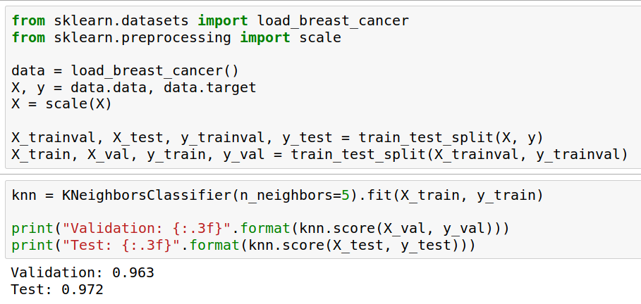
Overfitting the test set
Notes:
So I’ll try to illustrate this concept of overfitting the test set. Basically, the idea is that if you try out too many things on the test set, you will learn about noise in the test set, and this knowledge will not generalize to new data.
So here I give you an example with the breast cancer dataset that’s build into scikit-learn.
I split the data twice, now I have a training, a validation and a test set.
I build a nearest neighbors model on the training set, and apply it to the test set and the validation set.
The results are not the same, but they are pretty close. That they are different is a consequence of the small dataset and the noisy data.

Slide 4
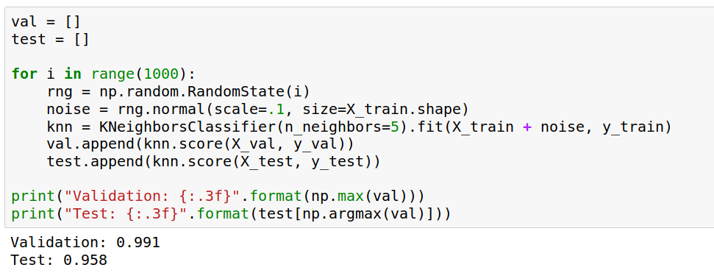
Overfitting the test set
Notes:
So now let me propose a silly way to tune my classifier.
I add random noise to my training set for fitting.
And I repeat that 1000 times, and I check which of these thousand runs has the best performance on the validation set. That particular run has 99.1% percent accuracy, much better than before.
If I test the same set on the test set, I get a much lower accuracy then before: the noise I added was good for the validation set, but not the test set.
If I try this often enough, I can find noise that will give me 100% on the validation set, but that doesn’t mean it will be good for any new data.
By selecting the best among many you introduce a bias, and the validation accuracy is not a good measure of generalization performance any more.

Slide 5

Three-fold split
pro: fast, simple
con: high variance, bad use of data.
Notes:
The simplest way to combat this overfitting to the test set is by using a three-fold split of the data, into a training, a validation and a test set.
We use the training set for model building, the validation set for parameter selection and the test set for a final evaluation of the model.
So how many models should you try out on the test set? Only one! Ideally use use the test-set exactly once, otherwise you make a multiple hypothesis testing error!
What are downsides of this? We lose a lot of data for evaluation, and the results depend on the particular sampling.

Slide 6

Notes:
Here is an implementation of the three-fold split for selecting the number of neighbors.
For each number of neighbors that we want to try, we build a model on the training set, and evaluate it on the validation set.
We then pick the best validation set score, here that’s 97.2%, achieved when using three neighbors.
We then retrain the model with this parameter, and evaluate on the test set.
Do you have any idea how to make this more robust?

Slide 7

Cross-validation
Pro: more stable, more data
con: slower
Notes:
The answer is of course cross-validation. In cross-validation, you split your data into multiple folds, usually 5 or 10, and built multiple models.
You start by using fold1 as the test data, and the remaining ones as the training data. You build your model on the training data, and evaluate it on the test fold.
For each of the splits of the data, you get a model evaluation and a score. In the end, you can aggregate the scores, for example by taking the mean.
What are the pros and cons of this?
Each data point is in the test-set exactly once!
Takes 5 or 10 times longer!
Better data use (larger training sets).
Does that solve all problems? No, it replaces only one of the splits, usually the inner one!

Slide 8

Cross-validation + test-set
Notes:
Here is how the workflow looks like when we are using five-fold cross-validation together with a test-set split for adjusting parameters.
We start out by splitting of the test data, and then we perform cross-validation on the training set.
Once we found the right setting of the parameters, we retrain on the whole training set and evaluate on the test set.

Slide 9
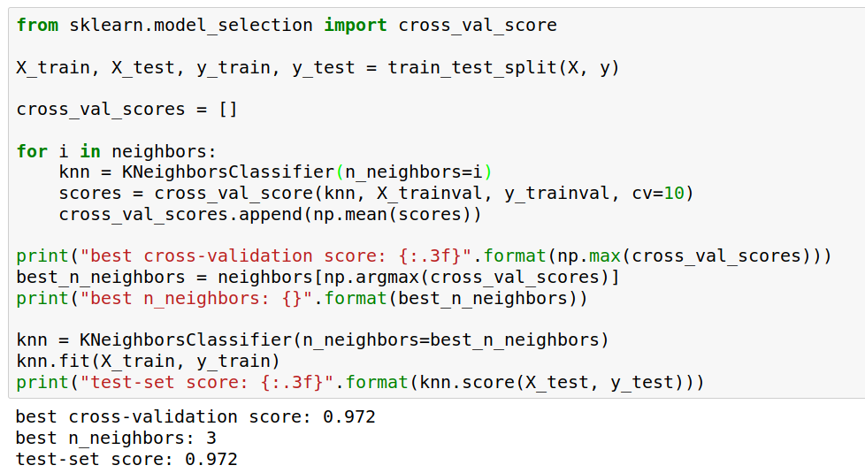
Notes:
Here is an implementation of this for k nearest neighbors.
We split the data, then we iterate over all parameters and for each of them we do cross-validation.
We had seven different values of n_neighbors, and we are running 10 fold cross-validation. How many models to we train in total?
10 * 7 + 1 = 71 (the one is the final model)

Slide 10

Notes:
Here is a conceptual overview of this way of tuning parameters, we start of with the dataset and a candidate set of parameters we want to try, labeled parameter grid, for example the number of neighbors.
We split the dataset in to training and test set. We use cross-validation and the parameter grid to find the best parameters.
We use the best parameters and the training set to build a model with the best parameters,
and finally evaluate it on the test set.

Slide 11
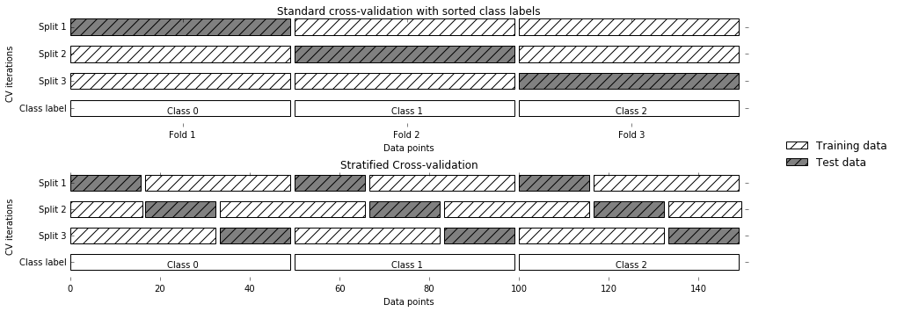
StratifiedKFold
Stratified:
Ensure relative class frequencies in each fold reflect relative class frequencies on the whole dataset.
Notes:
The idea behind stratified k-fold cross-validation is that you want the test set to be as representative of the dataset as possible.
StratifiedKFold preserves the class frequencies in each fold to be the same as of the overall dataset.
Here is and example of a dataset with three classes that are ordered. If you apply standard three-fold to this, the first third of the data would be in the first fold, the second in the second fold and the third in the third fold. Because this data is sorted, that would be particularly bad. If you use stratified cross-validation it would make sure that each fold has exactly 1/3 of the data from each class.
This is also helpful if your data is very imbalanced. If some of the classes are very rare, it could otherwise happen that a class is not present at all in a particular fold.

Slide 12
Notes:
Let’s come back to the general workflow for adjusting hyper-parameters, though.
So we start with hyper parameters we want to adjust and our dataset, we split it into training and test set, find the best parameters using cross-validation, retrain the model and then do a final evaluation on the test set.
Because this is such a common pattern, there is a helper class for this in scikit-learn, called GridSearch CV, which does most of these steps for you.

Slide 13
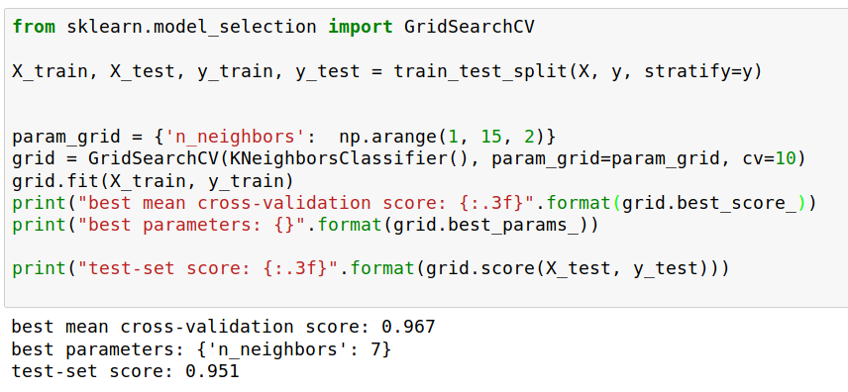
Grid-Search
Notes:
Here is an example.
We still need to split our data into training and test set.
We declare the parameters we want to search over as a dictionary. In this example the parameter is just n_neighbors and the values we want to try out are a range. The keys of the dictionary are the parameter names and the values are the parameter settings we want to try. If you specify multiple parameters, all possible combinations are tried. This is where the name grid-search comes from - it’s an exhaustive search over all possible parameter combinations that you specify.

Slide 14
Metrics for Binary Classification

Slide 15
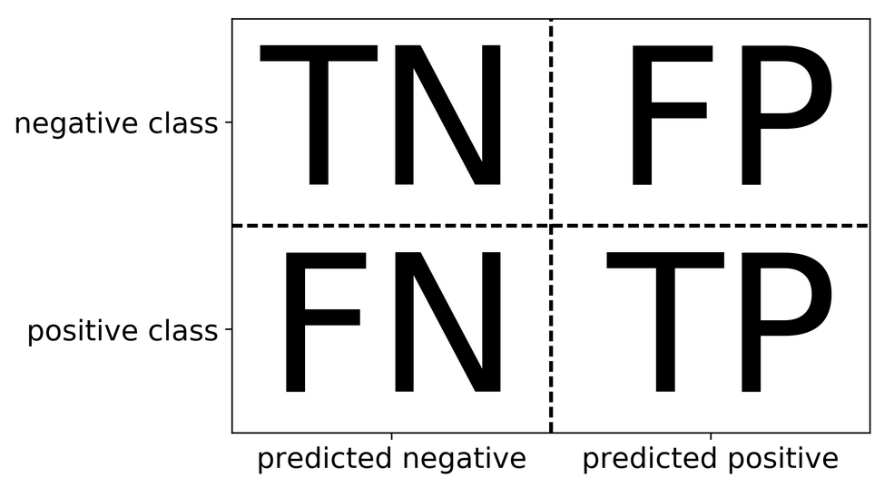
Review: confusion matrix
Diagonal divided by everything.

Slide 16
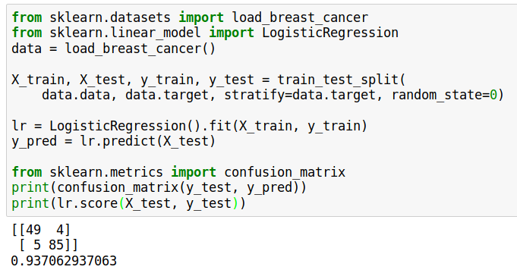

Slide 17
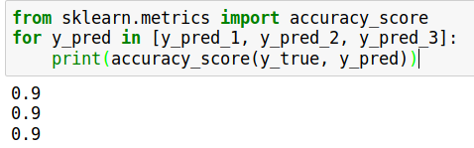
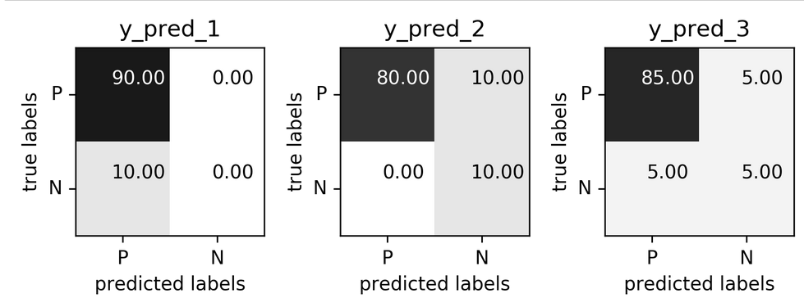
Problems with accuracy
Imbalanced classes lead to hard-to-interpret accuracy:
Data with 90% negatives

Slide 18
Precision, Recall, f-score
Positive Predicted Value (PPV)
Sensitivity, coverage, true positive rate.
All depend on definition of positive and negative!

Slide 19
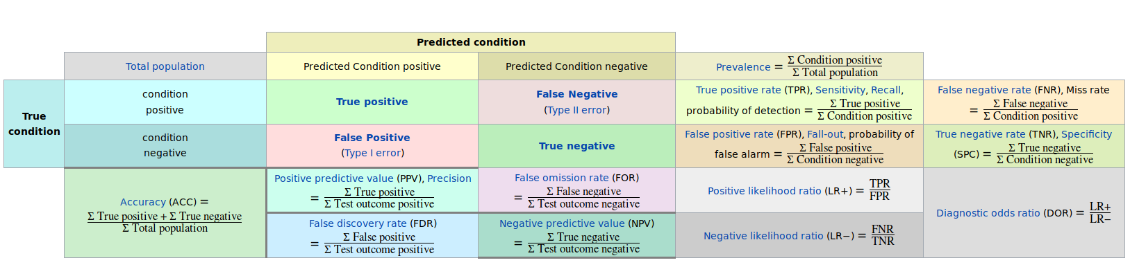
The zoo
https://en.wikipedia.org/wiki/Precision_and_recall

Slide 20
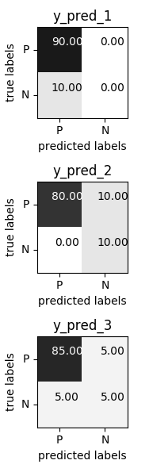
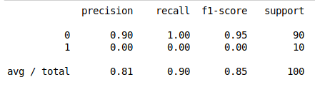
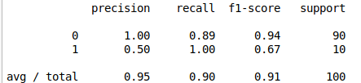
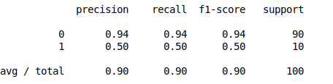

Slide 21
Goal setting!
What do I want? What do I care about?
(precision, recall, something else)
Can I assign costs to the confusion matrix?
(i.e. a false positive costs me $10, a false negative $100)
What guarantees do we want to give?

Slide 22
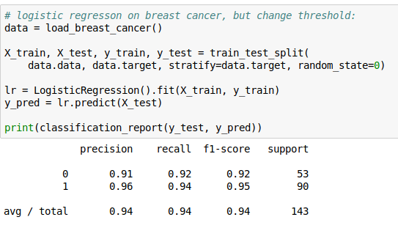
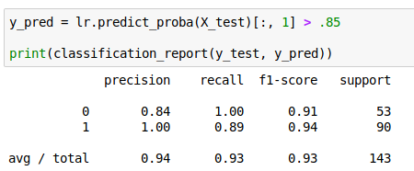
Changing Thresholds

Slide 23
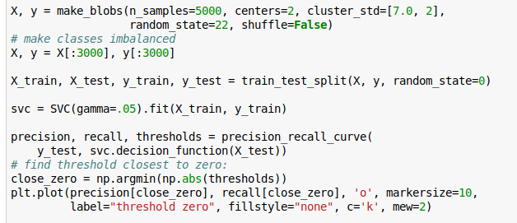
Precision-Recall Curve

Slide 24
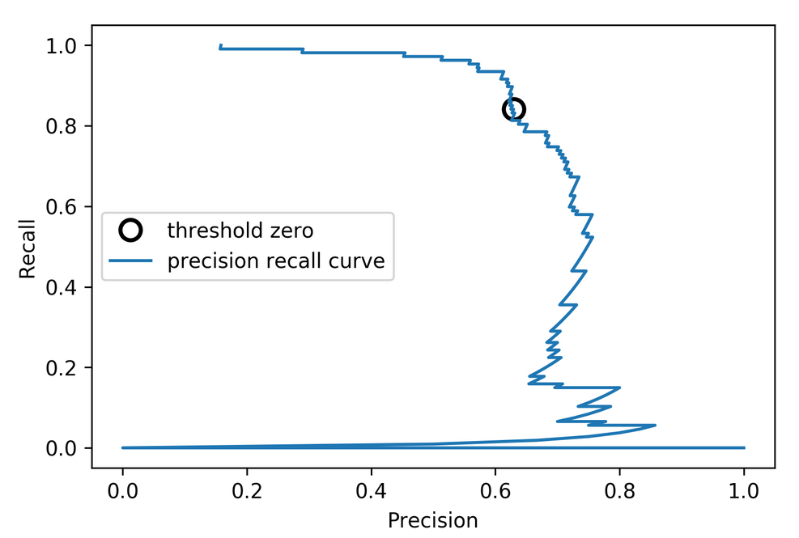
Precision-Recall Curve

Slide 25
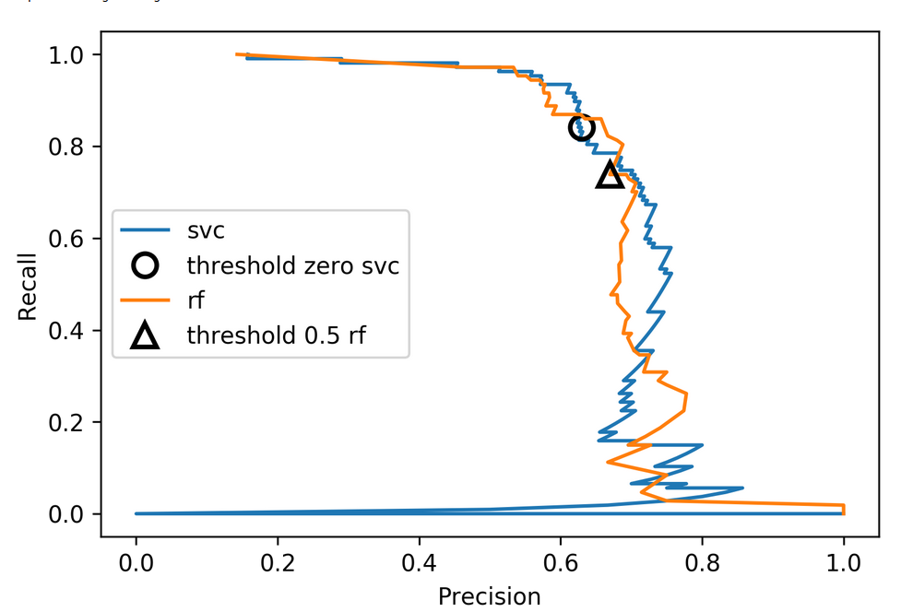
Comparing RF and SVC

Slide 26
Average Precision
Precision at threshold k
Change in recall
between k and k-1
Sum over data points, ranked by decision function
Same as area under the precision-recall curve
(depending on how you treat edge-cases)

Slide 27
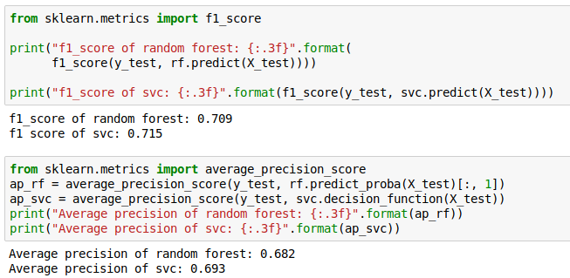
F1 vs average precision
AP only considers ranking!

Slide 28
ROC Curve
= recall

Slide 29
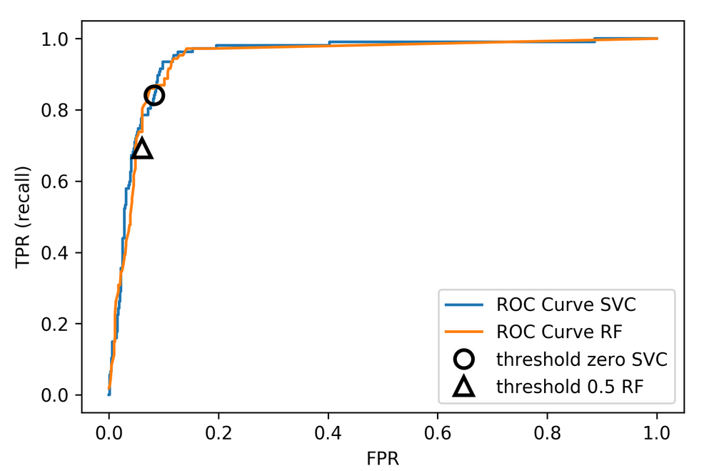

Slide 30
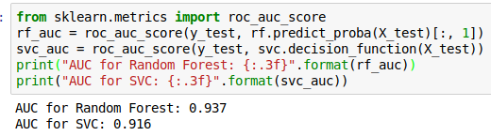
ROC AUC
Area under ROC Curve
Always .5 for random / constant prediction
The Relationship Between Precision-Recall and ROC Curves
https://www.biostat.wisc.edu/~page/rocpr.pdf

Slide 31
Multi-class classification

Slide 32
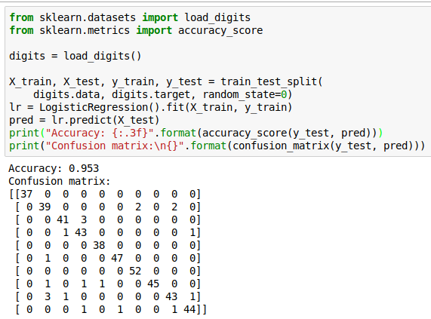
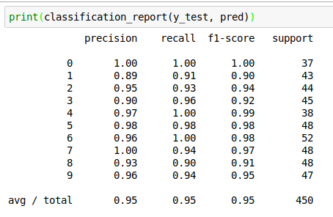
Confusion Matrix
Normalizing confusion matrix (by rows) can be helpful

Slide 33
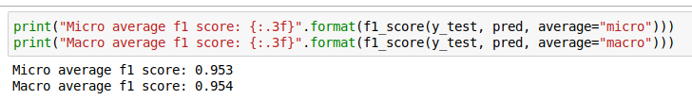
Micro and Macro F1
Macro-average f1: Average f1 scores over classes
Micro-average f1: Average binary confusion matrices, then compute recall, precision once
Macro: “all classes are equally important”
Micro: “all samples are equally important” - same for other metric averages

Slide 34
Picking metrics?
Accuracy rarely what you want
Problems are rarely balanced
Find the right criterion for the task
OR pick one arbitrarily, but at least think about it
Emphasis on recall or precision?
Which classes are the important ones?

Slide 35
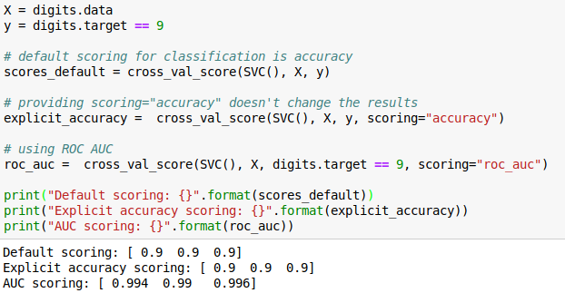
Using metrics in cross-validation
Same for GridSearchCV
Will make GridSearchCV.score use your metric!

Slide 36
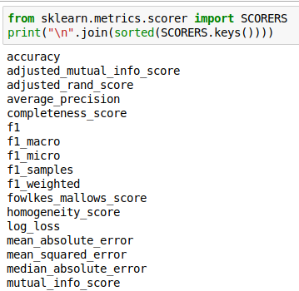
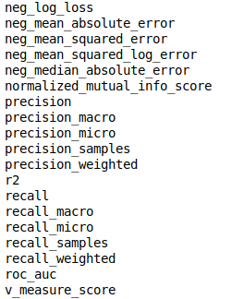
Built-in scoring
“scoring” can be string or callable.
Strings:

Slide 37
Metrics for regression models

Slide 38
Build-in standard metrics
R^2 : easy to understand scale
MSE : easy to relate to input
Mean absolute error, median absolute error:
more robust.
When using “scoring” use “neg_mean_squared_error” etc

Slide 39
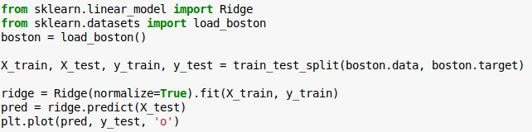
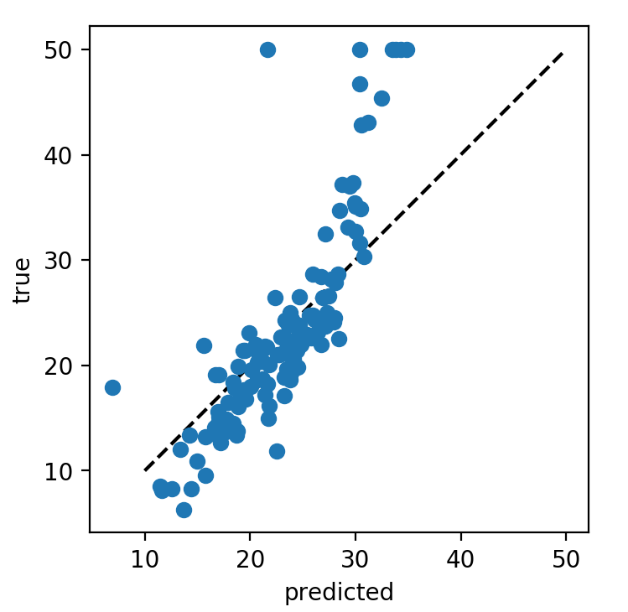
Prediction plots

Slide 40

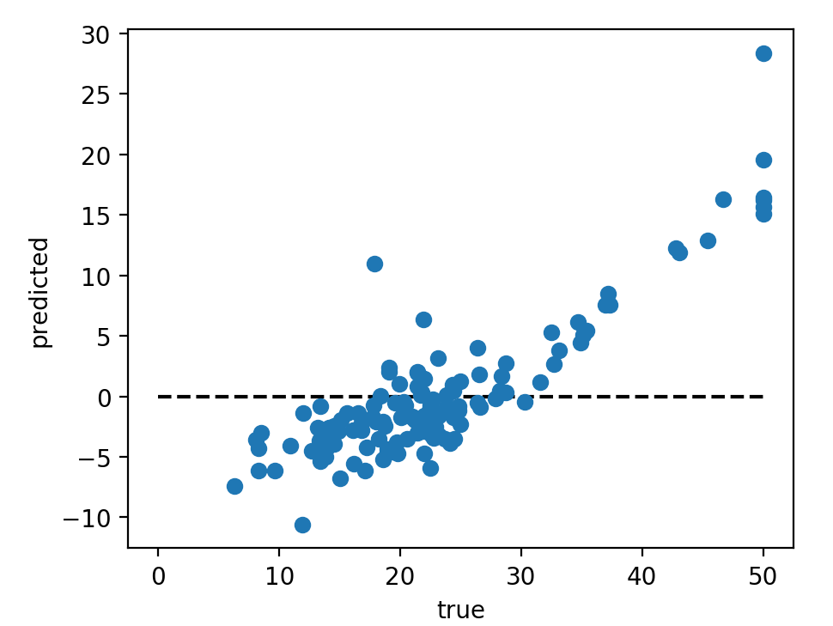
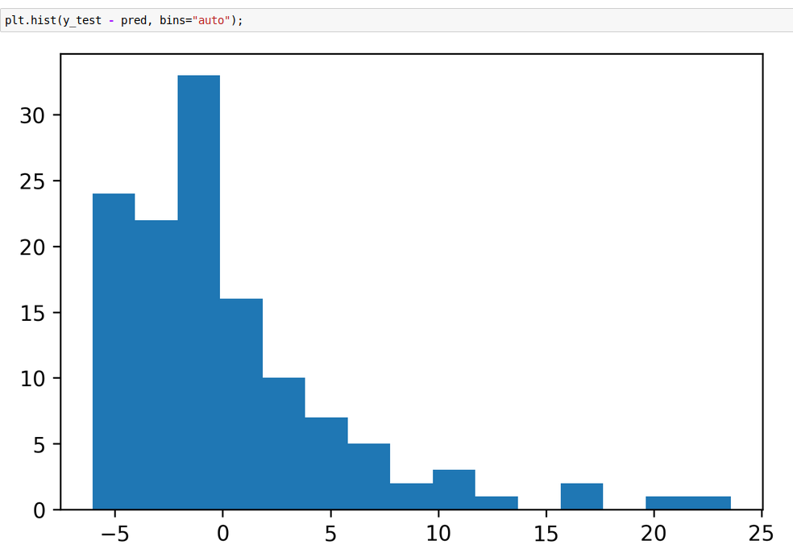
Residual Plots

Slide 41
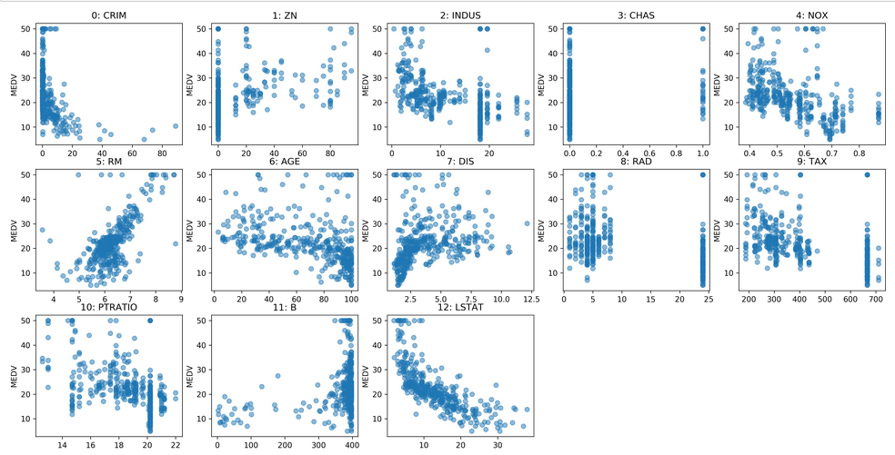
Target vs Feature

Slide 42
Absolute vs relative: MAPE

Slide 43
Over vs under
Overprediction and underprediction can have different cost.
Try to create cost-matrix: how much does overprediction and underprediction cost?
Is it linear?

