Slide 1
W4995 Applied Machine Learning
Linear Models for Classification
02/06/17
Andreas Müller

Slide 2
Linear models for binary classfiication

Slide 3


Slide 4
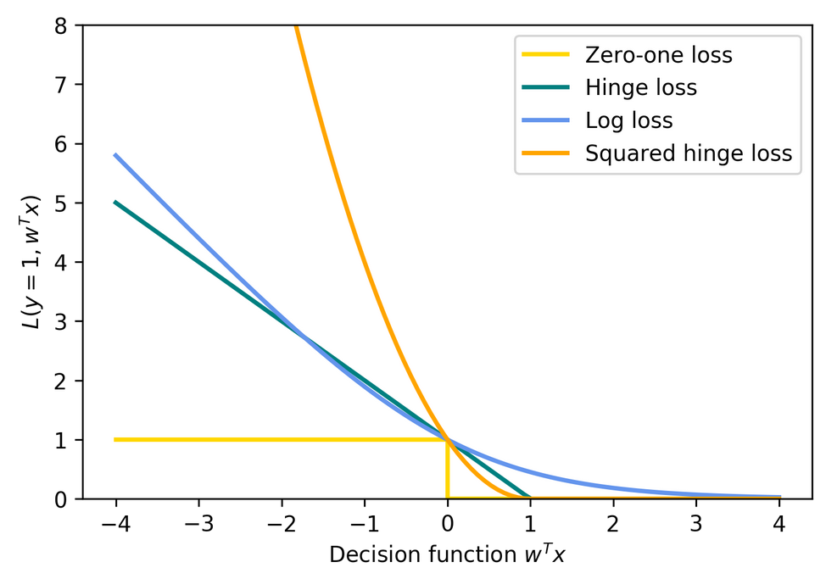
Picking a loss?
Obvious idea:
Minimize number of misclassifications aka 0-1 loss.
But: non-convex, not continuous => Relax

Slide 5

Logistic Regression

Slide 6
Penalized Logistic Regression
C is inverse to alpha (or alpha / n_samples)
Both versions strongly convex, l2 version smooth (differentiable).
All points contribute to w (dense solution to dual).

Slide 7
(soft margin) linear SVM
Both versions strongly convex, neither smooth.
Only some points contribute (the support vectors) to w (sparse solution to dual).

Slide 8
SVM or LogReg?
Do you need probability estimates?
ou
yes
It doesn’t matter
- try either / both
Logistic Regression
Need compact model or believe solution is sparse? Use L1.

Slide 9
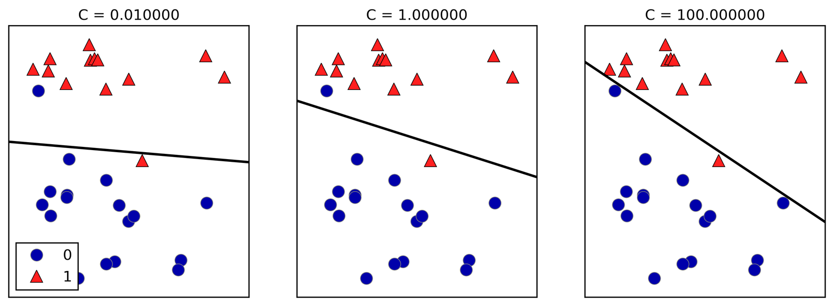
Effect of regularization
Small C (a lot of regularization) limits the influence of individual points!

Slide 10
Multiclass classification

Slide 11
Reduction to Binary classification
For 4 classes
One vs Rest
1v{2, 3, 4}, 2v{1, 3, 4}, 3v{1, 2, 4}, 4v{1, 2, 3}
n binary classifiers - each on all data
One vs One
1v2, 1v3, 1v4, 2v3, 2v4, 3v4
n * (n-1) / 2 binary classifiers - each on a fraction of the data
Standard

Slide 12
Prediction with One Vs Rest
“Class with highest score”
Unclear why it even works, but work well.

Slide 13
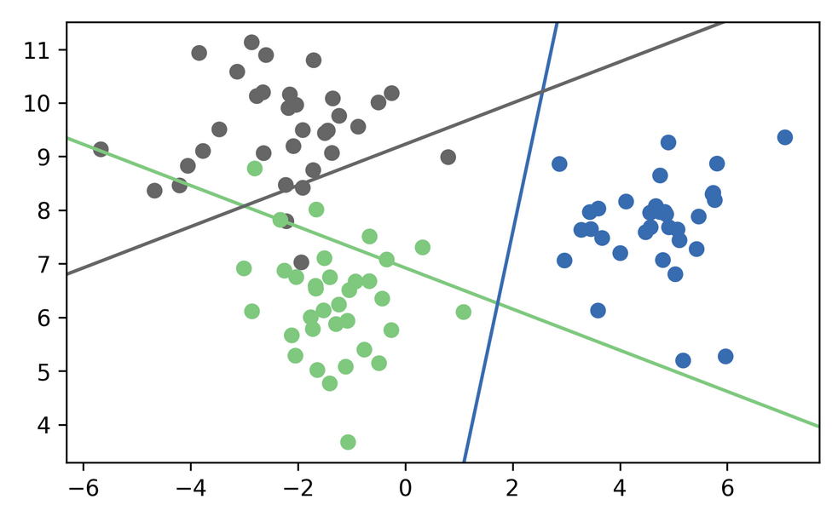
One vs Rest Prediction

Slide 14

One vs Rest Prediction

Slide 15
Prediction with One Vs One
“Vote for highest positives”
Classify by all classifiers.
Count how often each class was predicted.
Return most commonly predicted class.
Again – just a heuristic.

Slide 16
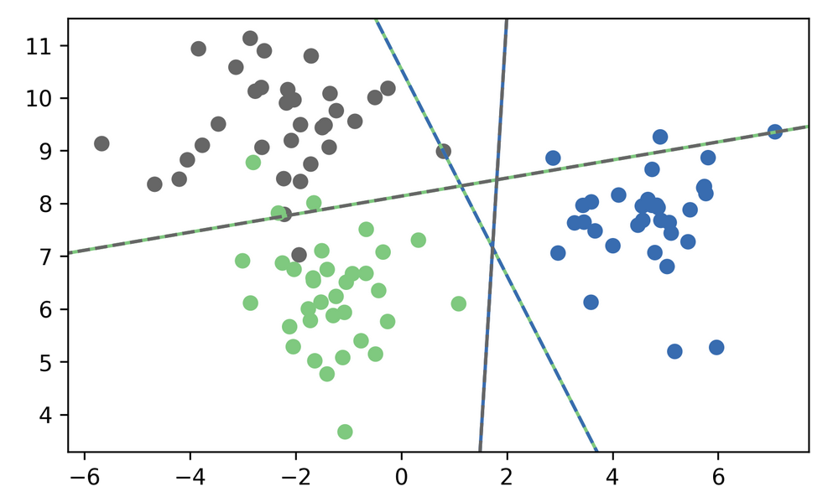
One vs One Prediction

Slide 17
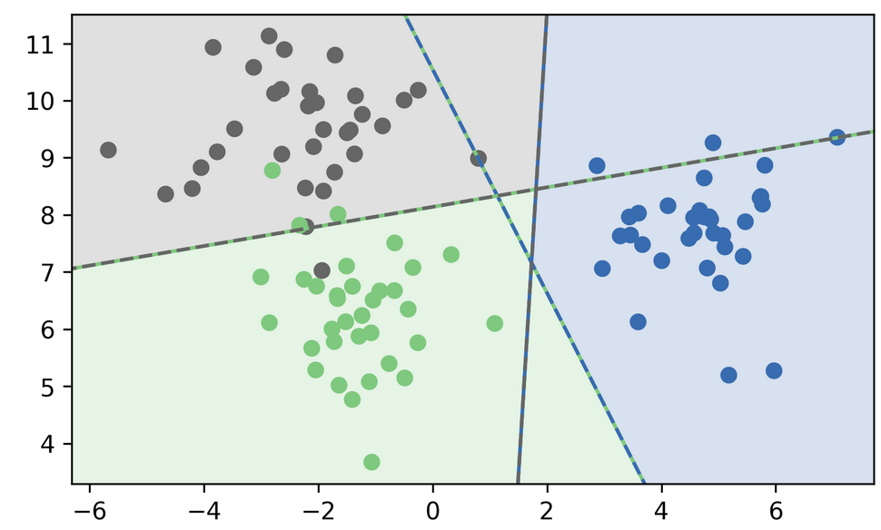

Slide 18
Multinomial Logistic Regression
Probabilistic multi-class model:
Same prediction rule as OvR!

Slide 19
In scikit-learn
OvO: only SVC
OvR: default for all linear models, even LogisticRegression
LogisticRegression(multinomial=True)
clf.decision_function = w^Tx
logreg.predict_proba
SVC(probability=True) not great

Slide 20
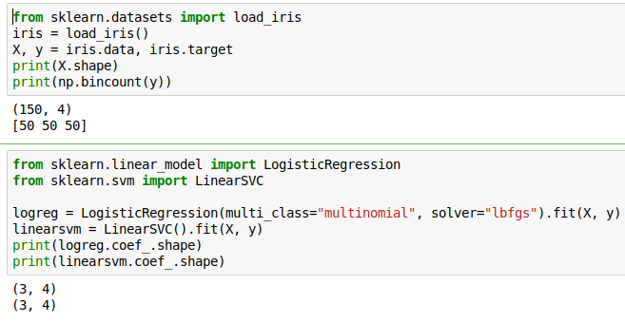
Multi-Class in Practice
OvR and multinomial LogReg produce one coef per class:
SVC would produce the same shape, but with different semantics!

Slide 21

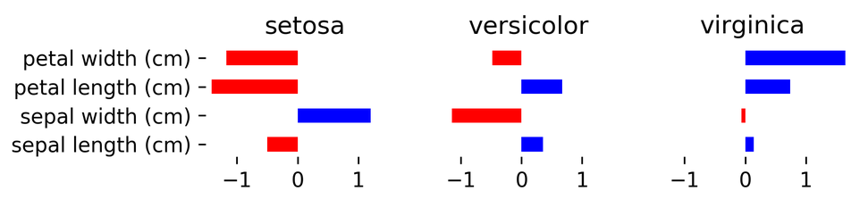
(after centering data, without intercept)

Slide 22
Computational Considerations
(for all linear models)

Slide 23
Solver choices
Don’t use SVC(kernel=’linear’), use LinearSVC
For n_features >> n_samples: Lars (or LassoLars) instead of Lasso.
For small n_samples (<10.000?), don’t worry.
LinearSVC, LogisticRegression: dual=False if n_samples >> n_features
LogisticRegression(solver=”sag”) for n_samples large.
Stochastic Gradient Descent for “n_samples really large”

Slide 24
Efficient Cross-validation

Slide 25
Models with build-in cross-validation
RidgeCV() - does GCV, approximation to LOO
LarsCV(), LassoLarsCV(), ElasticNetCV()
Use path-algorithms to compute the full solution path.
LogisticRegressionCV() uses warm-starts, doesn’t support all solvers.
All have reasonable build-in parameter grids.
For RidgeCV you can’t pick the “cv”!

Slide 26
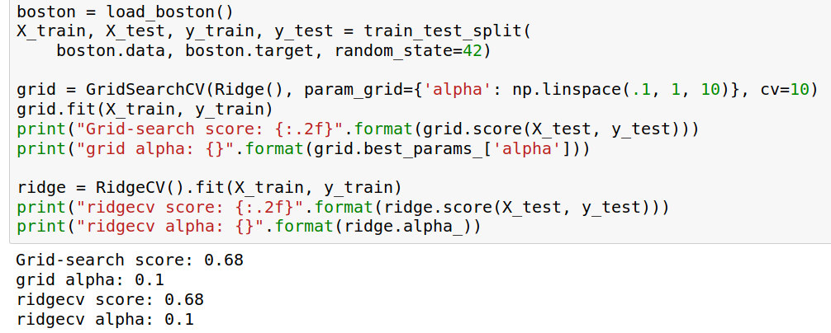
Using EstimatorCV

Slide 27
Stochastic Gradient Descent
(see http://leon.bottou.org/projects/sgd
and http://leon.bottou.org/papers/bottou-bousquet-2008
and http://scikit-learn.org/stable/modules/scaling_strategies.html)

Slide 28
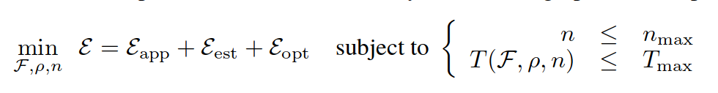
Decomposing Generalization Error
Error introduced by using the training set instead of “the true distribution”
Error of restricting f to family F
Error rho in finding the f that’s best on the training set.
Bottou et. al.

Slide 29
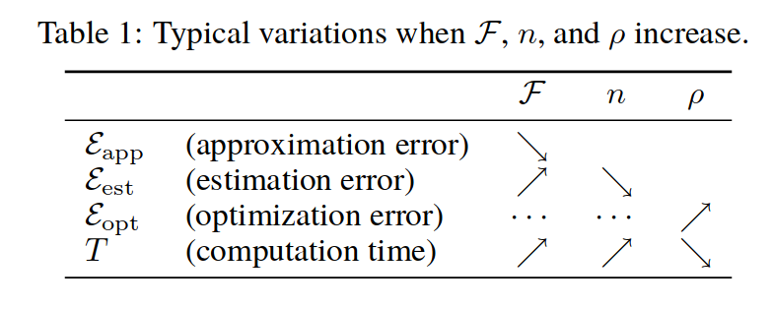

Slide 30
The Trade-off
If n_max large, we are constraint by T_max!
Making the optimization error small doesn’t matter if it means we can’t look at all training examples!
Trade optimization error for estimation error
use a worse algorithm but look at more data!

Slide 31
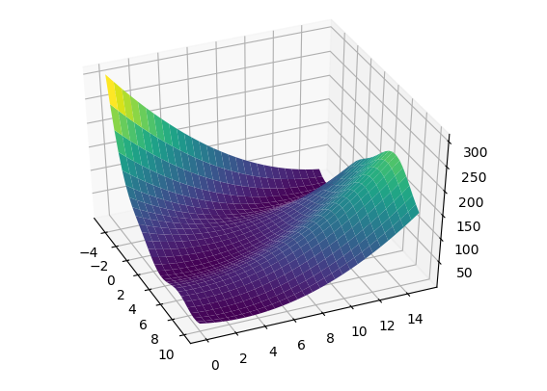
Reminder: Gradient Descent
Converges to local minimum

Slide 32
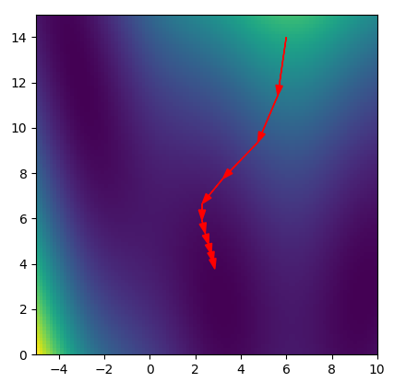
Reminder: Gradient Descent

Slide 33
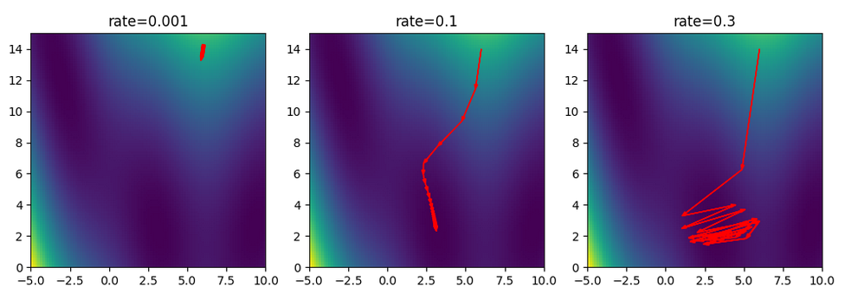
Picking a learning rate

Slide 34
Stochastic Gradient Descent
Logistic Regression:
Sum over data-points
Independent of data
Pick x_i randomly, then
Is a stochastic approximation of gradient of F with expectation the actual gradient.
In practice: just iterate over i.

Slide 35
SGD and partial_fit
SGDClassifier(), SGDRegressor() fast on very large datasets – have many different loss and regularization options.
Tuning learning rate and schedule can be tricky.
“optimal” learning rate only works with unit-variance data. Averaging can be helpful.
partial_fit allows working with out-of-memory data!

Slide 36
