Slide 1
W4995 Applied Machine Learning
Linear models for Regression
02/01/17
Andreas Müller

Slide 2

Linear Models for Regression

Slide 3
Linear Regression
Ordinary Least Squares
Unique solution if has full rank.

Slide 4
Ridge Regression
Always has a unique solution.
Has tuning parameter alpha

Slide 5
(regularized) Empirical Risk Minimization
Data fitting
Regularization
Notes:
This leads us to one of the core principles of machine learning, which I will only sketch here, but which is the essence of all the machine learning theory.
If we can find a model that fits the training data well, and that is “simple” then we are guaranteed that it will work well on new data.
The machine learning problem can then be formalized as minimizing the error on the training set, say the squared error, while constraining the model to be simple.
This is called “regularized empirical risk minimization” and that’s basically what all machine learning algorithms do, with different choices of the domain of f, and different choices of the regularizer R.

Slide 6

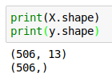
Boston Housing Dataset

Slide 7
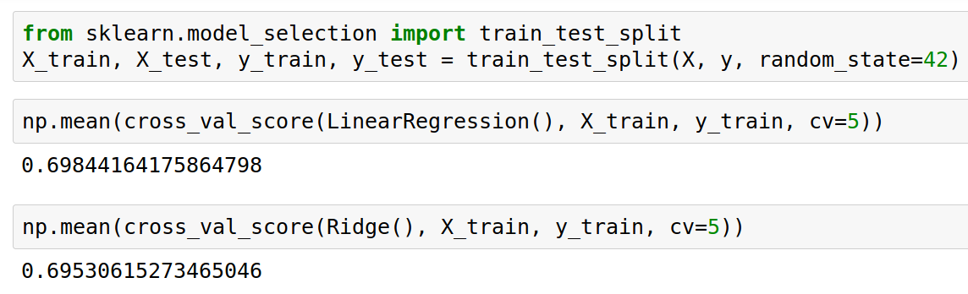
Score is always R^2 for regression!

Slide 8
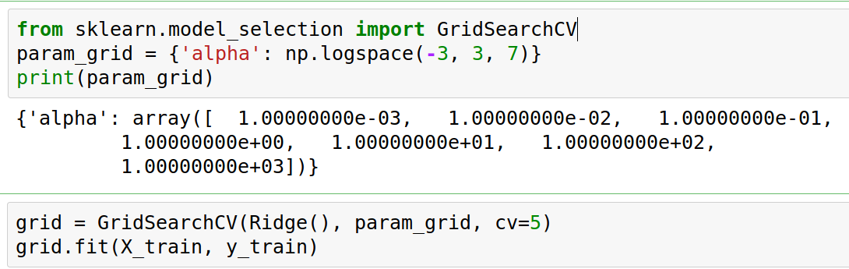
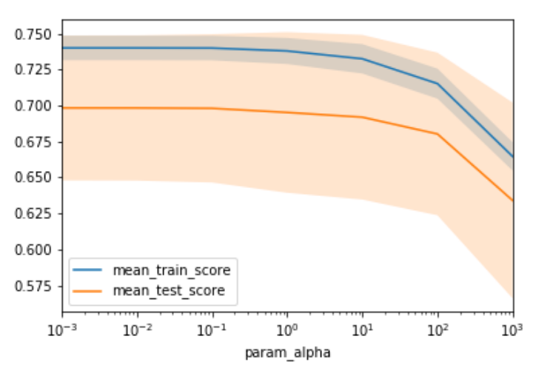

Slide 9
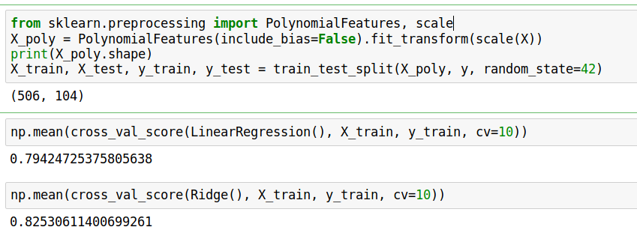
Adding features

Slide 10
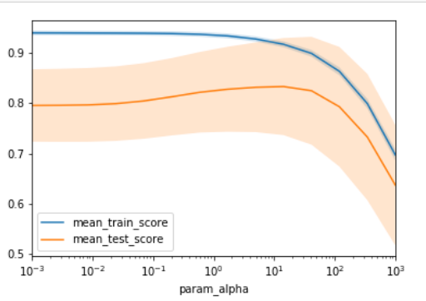
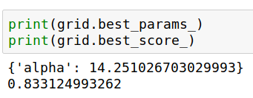

Slide 11
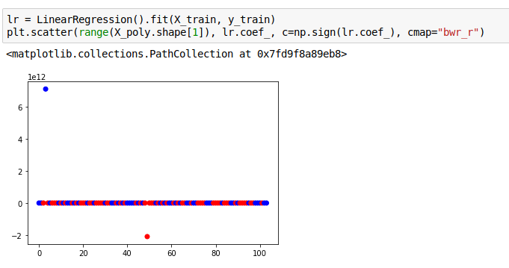
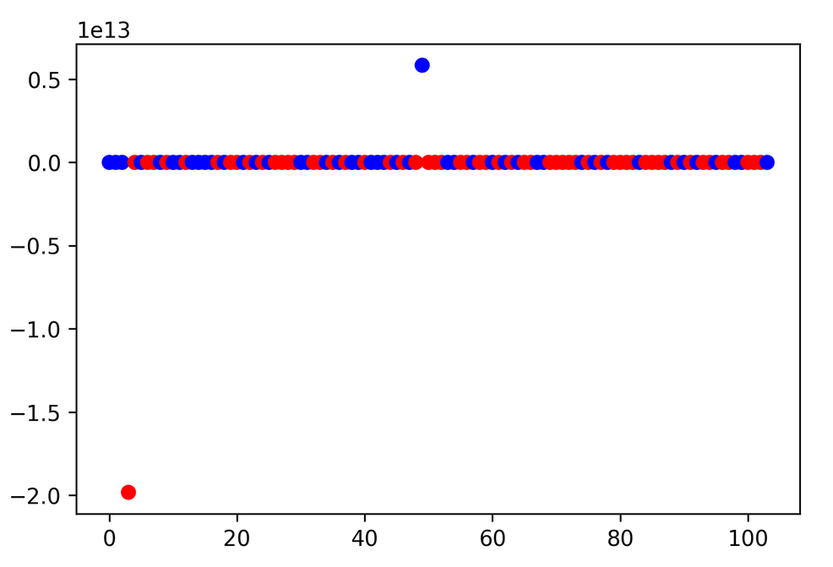
Plotting coefficient values (LR)

Slide 12
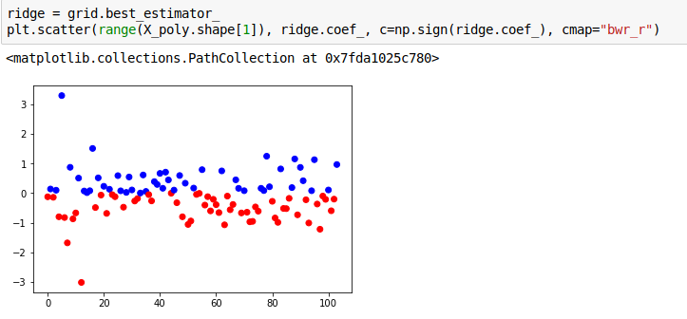
Ridge Coefficients

Slide 13
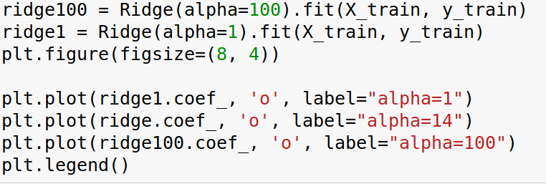
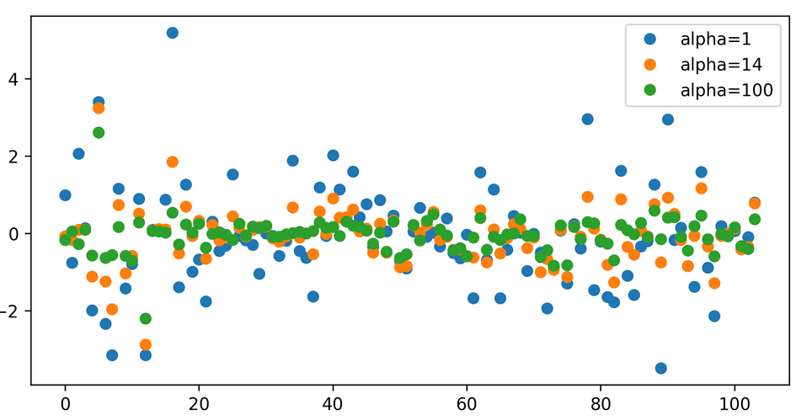

Slide 14
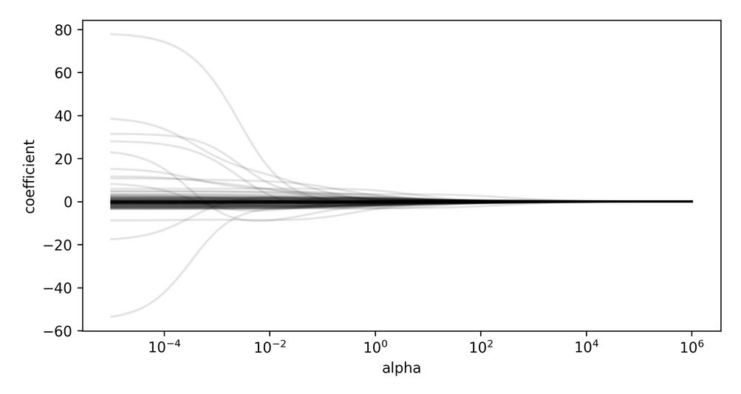
Coefficient Paths

Slide 15
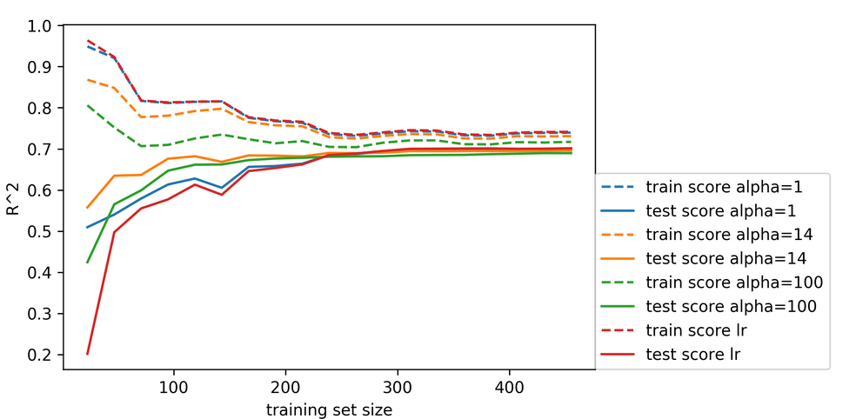
Learning Curve

Slide 16
Lasso Regression
Shrinks w towards zero like Ridge
Sets some w exactly to zero - automatic feature selection!

Slide 17
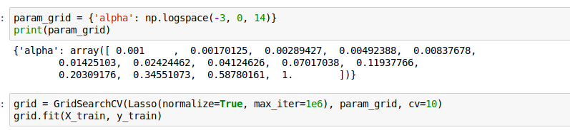
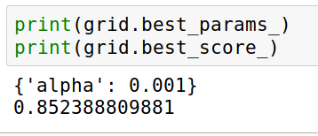
Grid-Search for Lasso

Slide 18
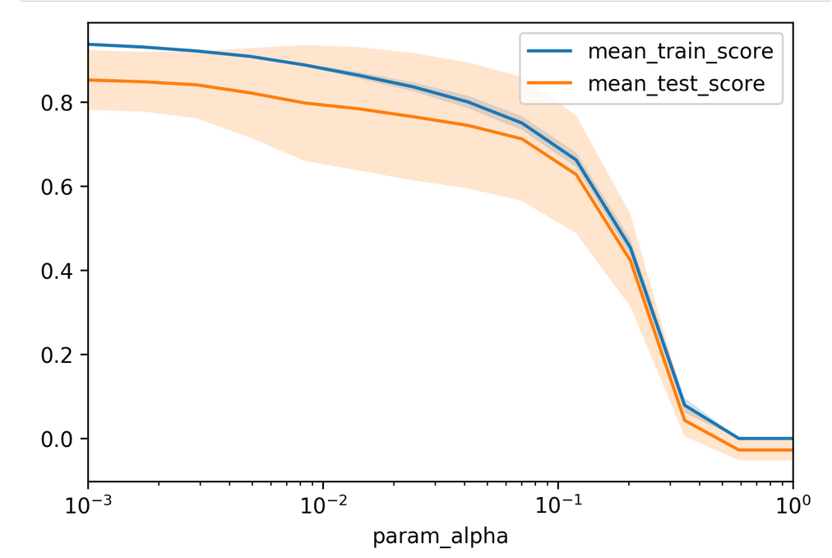

Slide 19
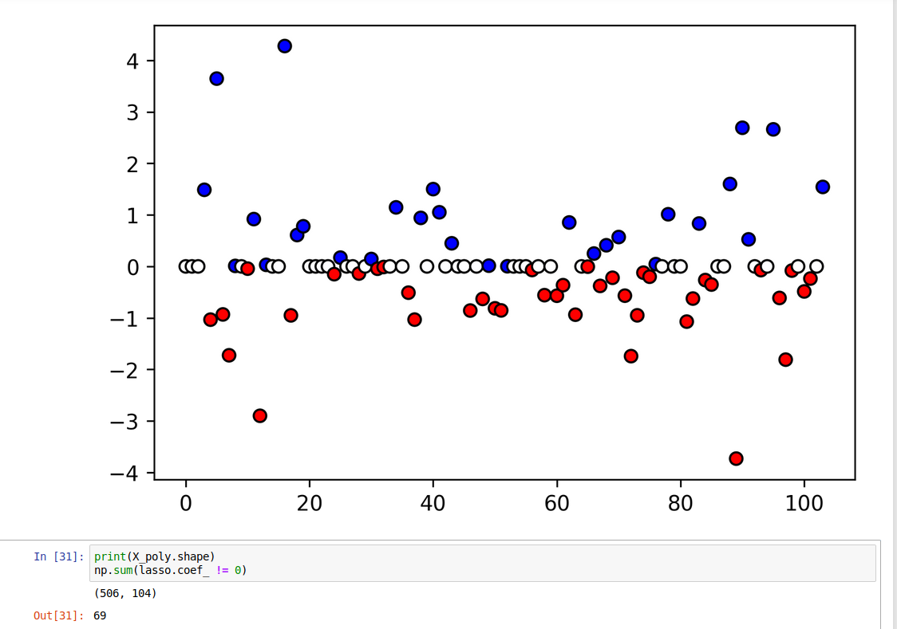

Slide 20
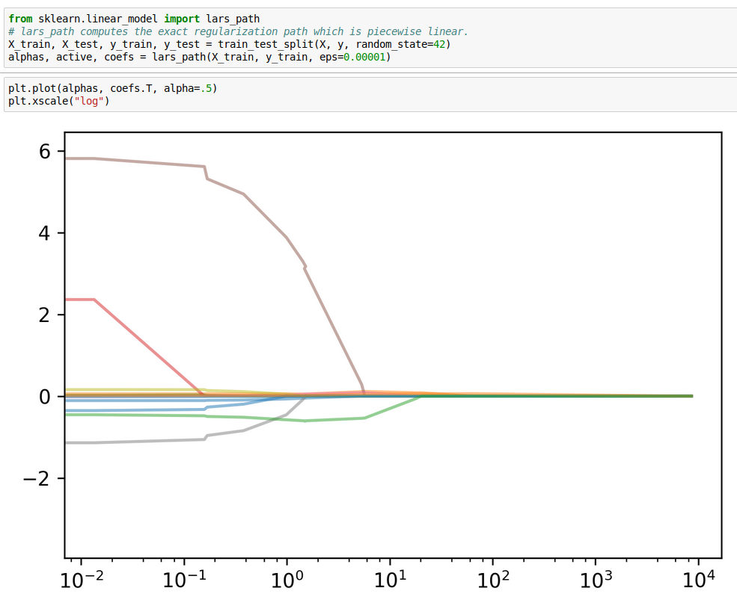

Slide 21
Elastic Net
Combines benefits of Ridge and Lasso
two parameters to tune.

Slide 22
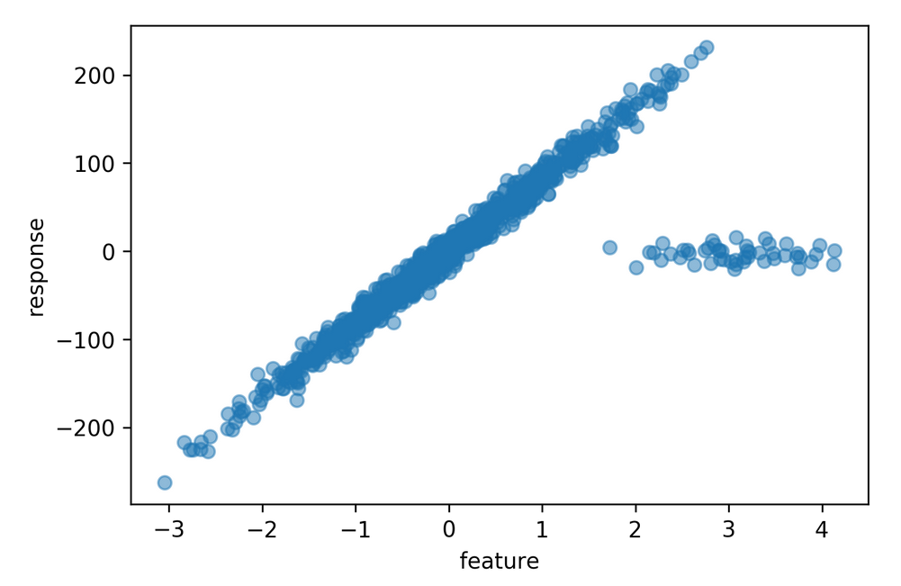
Robust Regression
RANSAC and Huber

Slide 23
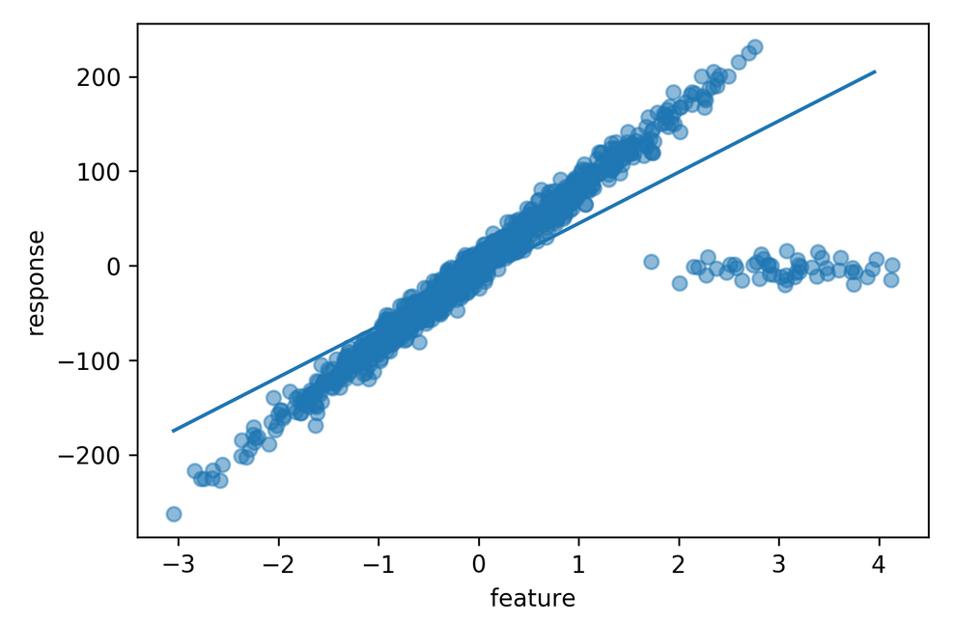
Least Squares Fit to Outlier Data

Slide 24
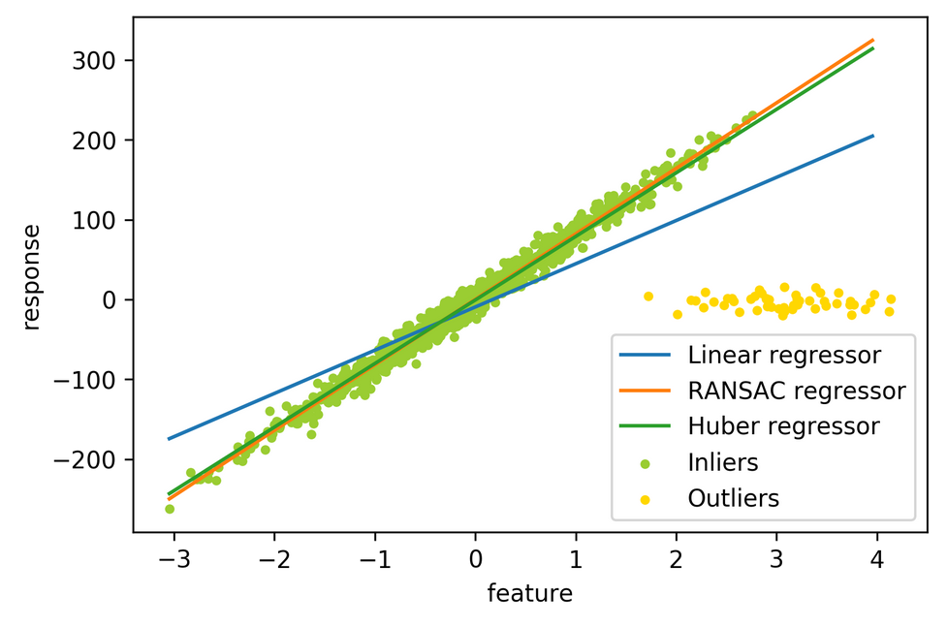
Robust Fit

Slide 25
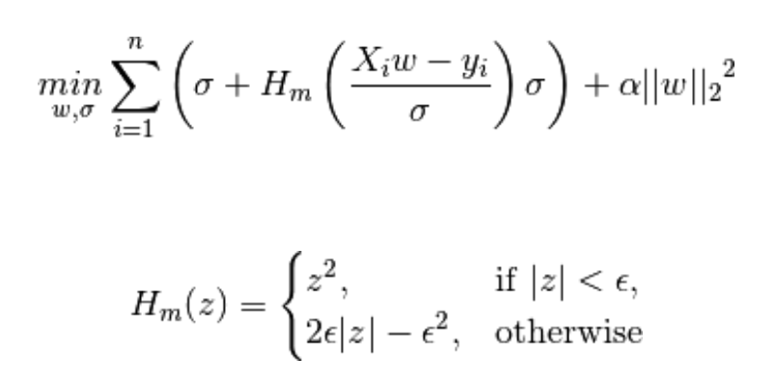
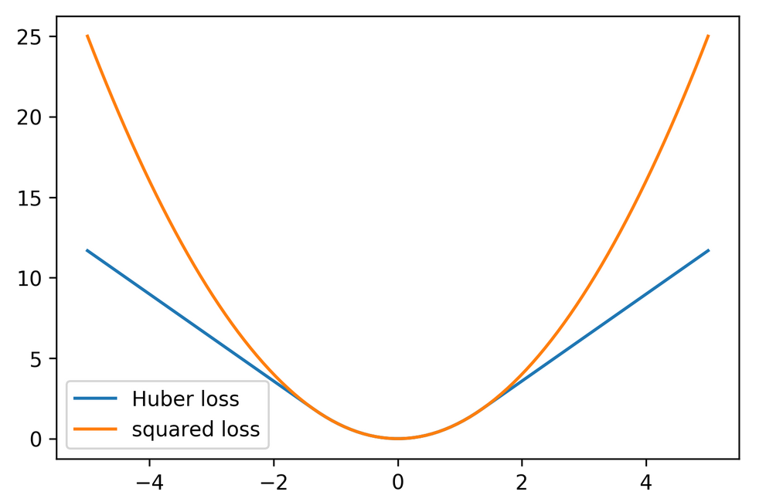
Huber Loss

Slide 26
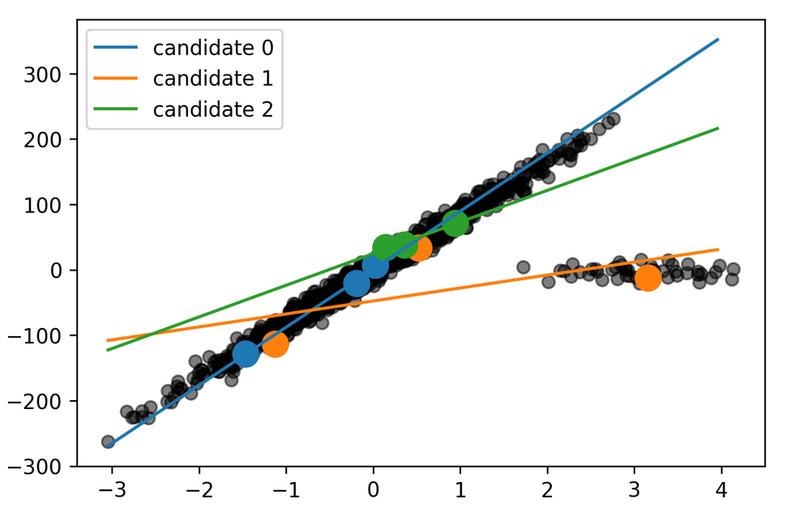
RANSAC

Slide 27
