Slide 1

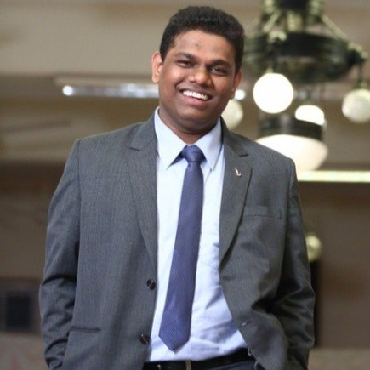
Ninad Chalke
Your contributions are highly valued. Thank you & best wishes for the next 10.

