Slide 1



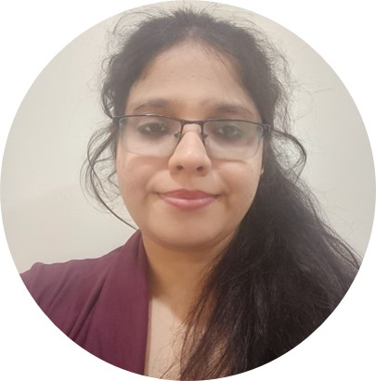
Congratulations
for marking
Years of
excelling
together
You make a difference!
We’re glad to have worked with you for all this while and look forward to doing even more amazing work in the future.
All the best!
Pavneet Kaur

