Slide 1




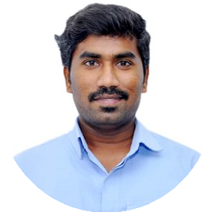
Congratulations
for marking
Years of
excelling
together
You make a difference!
We’re celebrating the countless achievements & successes that we’ve gained since the time you’ve joined us.
Thank you for being a part of the team.
All the best!
Manirathinam P

