Slide 1

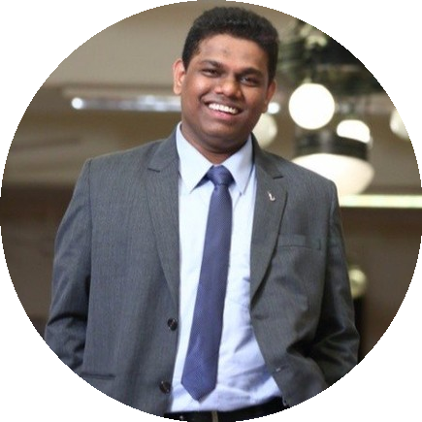
Celebrating
your day!
Ninad Chalke
Happy Birthday! You’ve been an amazing part of our team and we hope to continue seeing you healthy & happy ☺.

