Slide 1

Welcome To My Presentation
Department of Software Engineering

Slide 2
Title: Sentiment Analysis Through Evaluation of logistics support company Customer Reviews
Presented By
Md. MD RABIUL AWAL SHUVO
ID: 193-35-487
Department of SWE, DIU
Supervised By
Md Rittique Alam
Lecturer
Department of SWE, DIU

Slide 3
PRESENTATION OUTLINES
Introduction
Research Question
Motivation
Research Summery
Scope
Machine Learning Algorithm
Methodology
Data Pre-processing
Data Visualization
Result
Conclusion
Future Work
References
16/7/2023
3

Slide 4
INTRODUCTION
The logistics and freight industries in Bangladesh have been thriving for years in line with the steady growth of exports and imports, according to industry insiders. In Bangladesh, the industry came into being in 1991-92.
Logistics services, which are indispensable parts of online shopping, are directly related to customer satisfaction and influence purchase intentions. To focus on improving their own service level and attracting more consumers, many e-commerce enterprises usually outsource their logistics services to third-party enterprises because they are not core competitive.
4

Slide 5
Understanding the context of language for human is easy but teaching the same thing to machine is a complicated task.
Vast variety of languages and grammar usage of every language is different.
Usage of unstructured text like slangs, abbreviated form of text and grammar nuances make it more difficult to analyze.
5

Slide 6
Research Questions
Why Sentiment Analysis is Important?
How do Improve service quality?
Why we use sentiment analysis in Business purpose?
6

Slide 7
Motivation
Sentiment analysis provides ways to improve the service quality and it also helps the user to make a purchasing decision.
We conceive this study to deal with several aspects of sentiment analysis. The breadth of this study can lead to more general view and better understanding of sentiment analysis. We can reveal and overcome unexpected obstacles, create necessary evaluation datasets and even come up with new creative solutions to sentiment analysis tasks.
Thus the aim of that thesis is to study various aspects of sentiment analysis with the emphasis on the English language.
7
7

Slide 8
Research Summery
The analysis performed on product delivery for an online business involved four different algorithms: Random Forest, SNN, LSTM, and RNN. The data was divided into training (80%) and testing (20%) sets to evaluate the accuracy of each algorithm. the results suggest that combining the evaluations of the delivered products from these different algorithms can enhance the accuracy of predicting product delivery for the online business.
8

Slide 9
Scope
The main aim is to provide a different technique than mostly used machine learning algorithms. Providing a new dataset and new guide paper for Sentiment Analysis projects are also following aims.
We are using this algorithm for suggest any product and Service center.
Company’s are benefitted from this thesis for improving their service
Peoples are know which service are best for their transportation
In this thesis company are understand what are their lagging, and what they need to upgrade.
9

Slide 10
Machine Learning Algorithm
Simple Neural Networks
Long Short-Term Memory (LSTM)
Convocational Neural Networks (CNN)
RANDOM FOREST
10

Slide 11
Methodology
collecting raw data
import library
Preprocessing data
extracting Features
Labeling data
Split Data
Simple Neural Networks
Long Short-Term Memory (LSTM)
Convocational Neural Networks (CNN)
RANDOM FOREST
Evaluating model
Predicting
Accuracy
Visualizing results
11

Slide 12
Data preprocessing
Some common steps in data preprocessing include:
Data cleaning
Process Missing data
Data integration
Data transformation
Data reduction
12

Slide 13
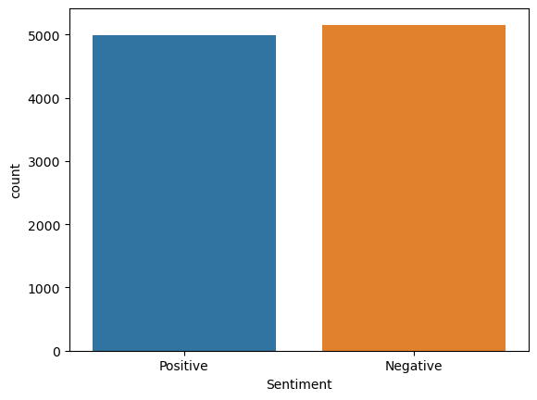
Data Visualization
13

Slide 14
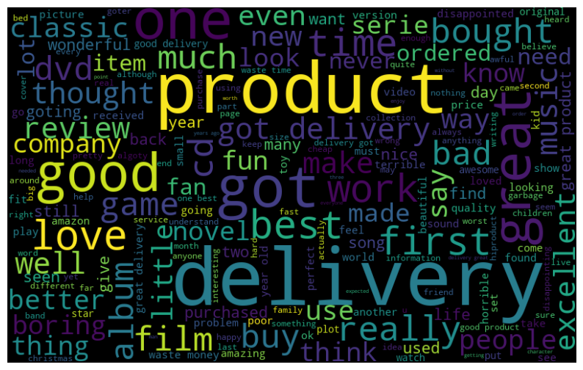
Data Visualization
14

Slide 15

Data Visualization
15

Slide 16
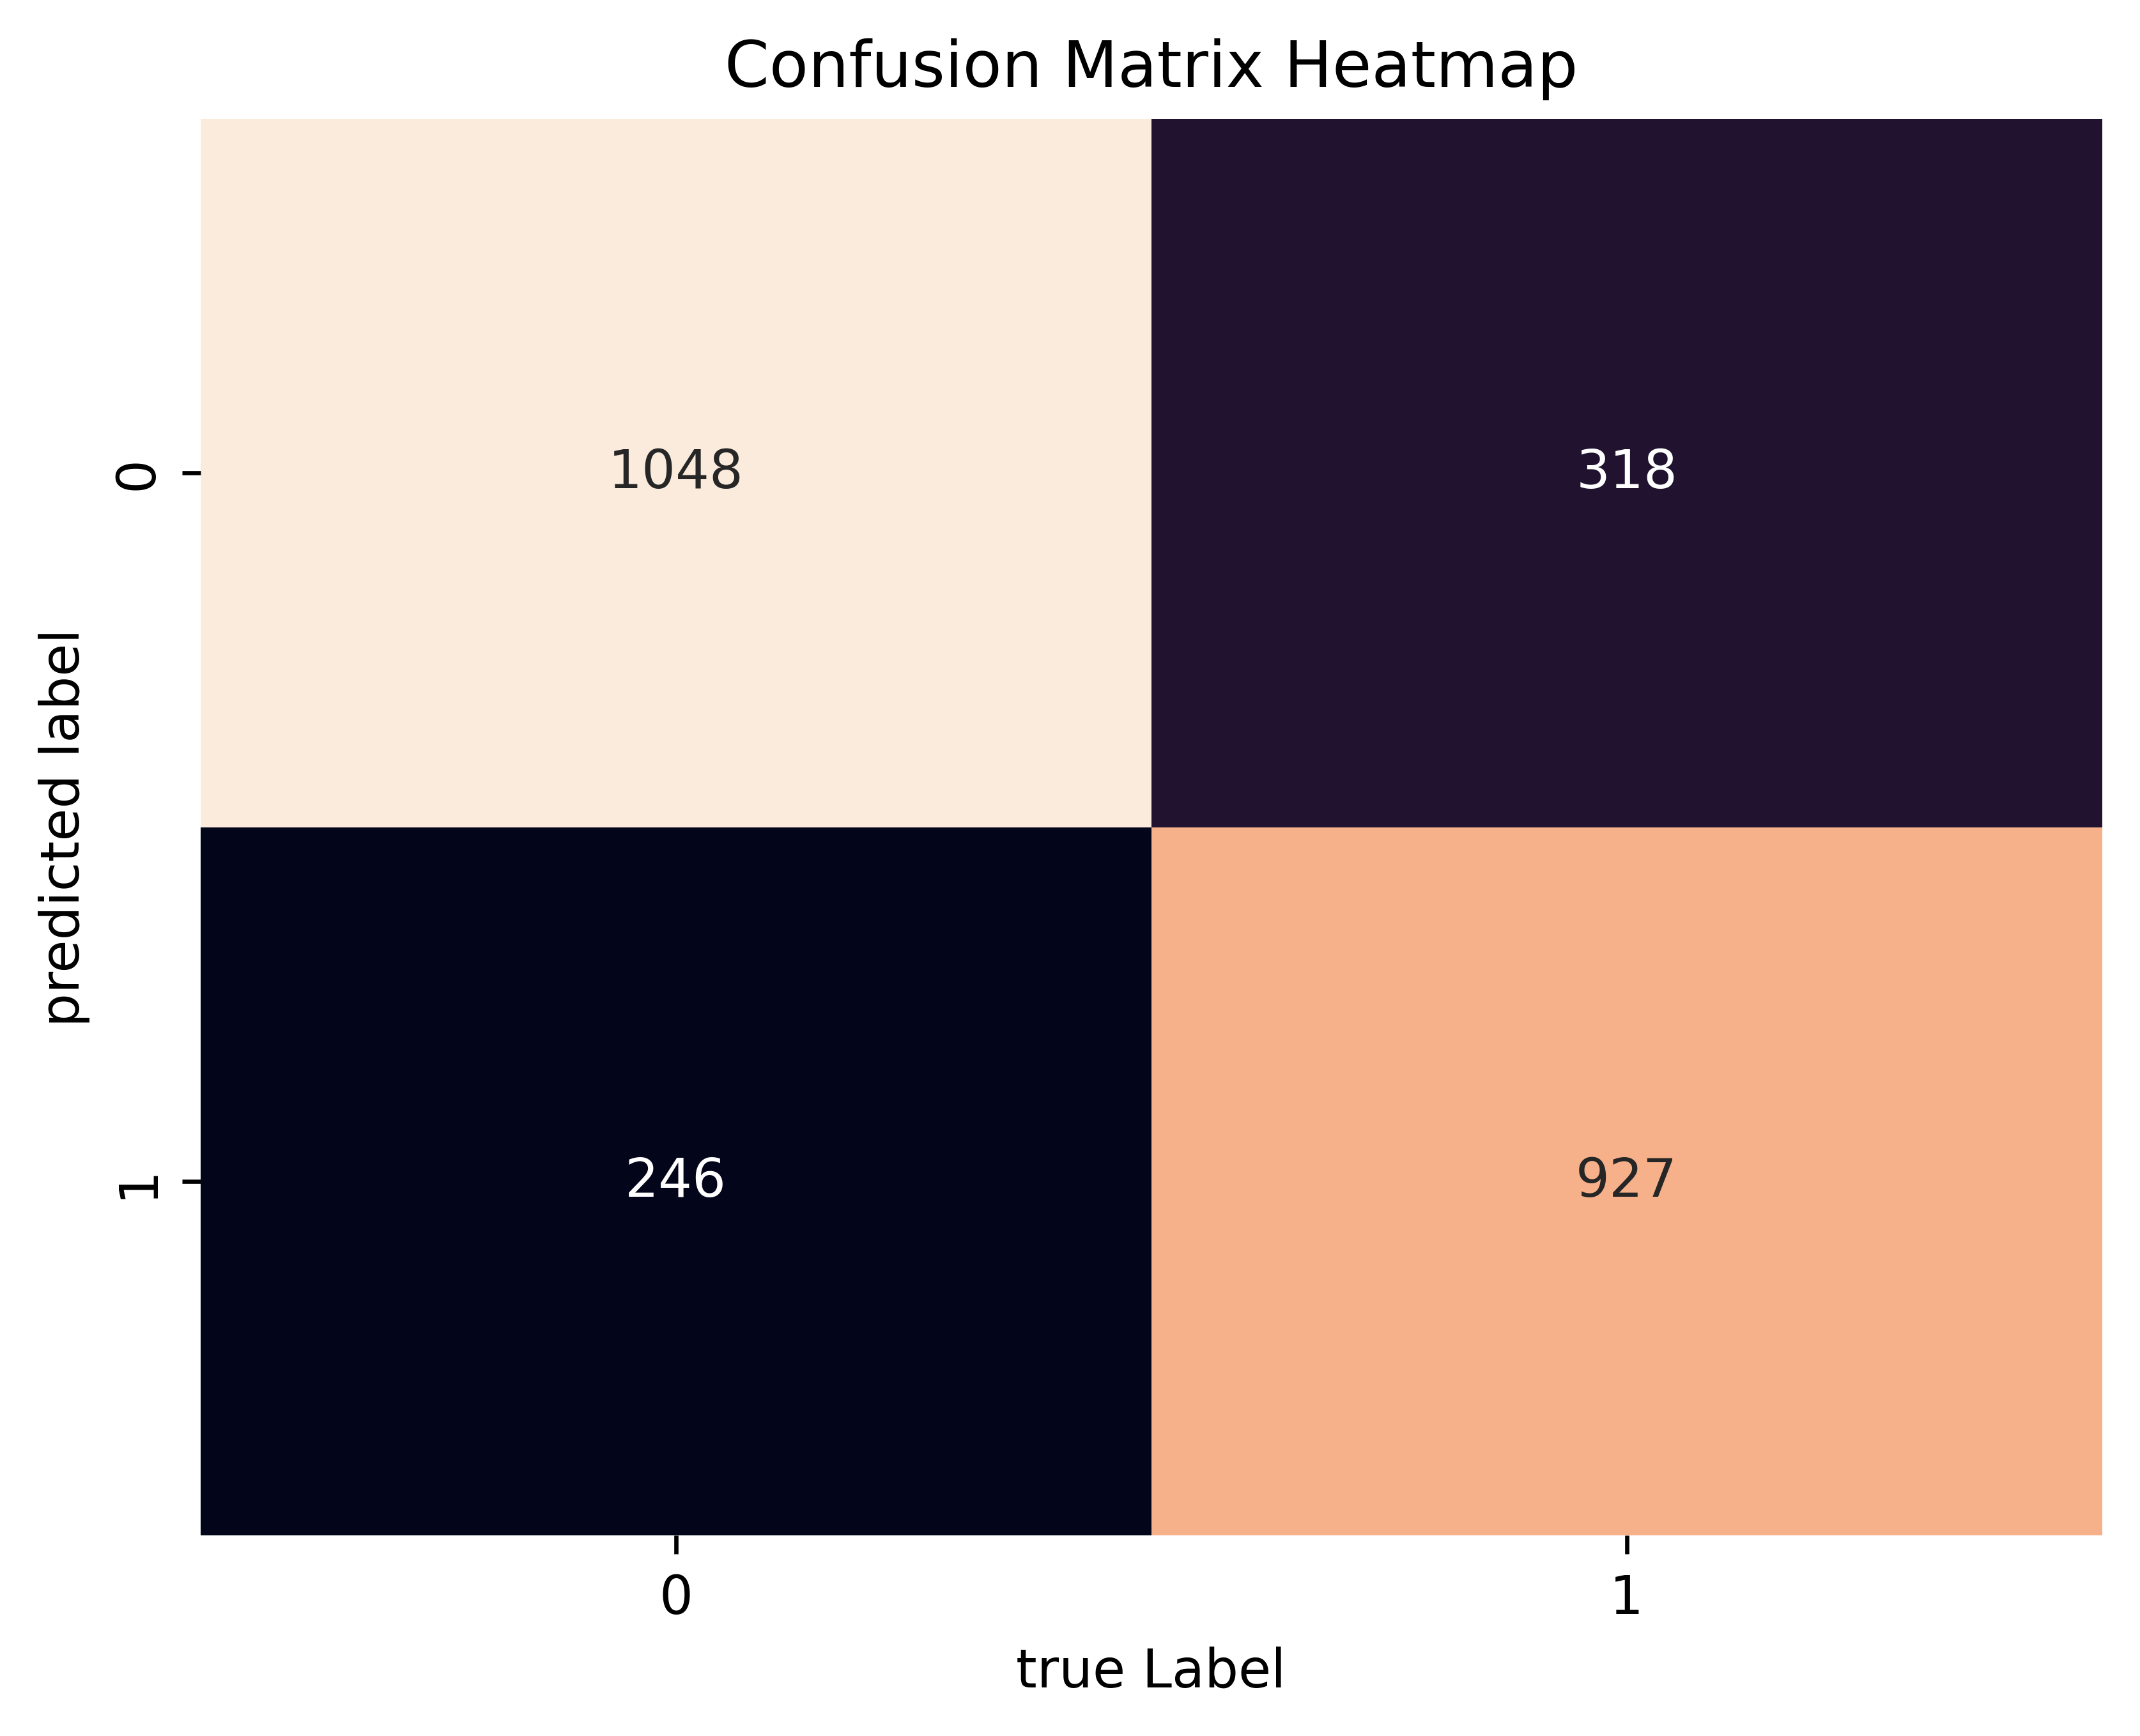
Data Visualization
16

Slide 17
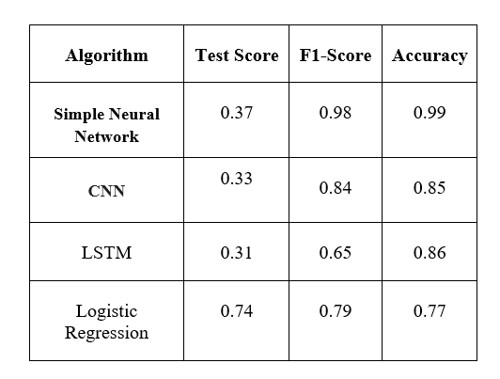
Result Analysis
17

Slide 18
Conclusion
In this paper, the research selected experiment, comparison and appropriate machine learning methods to analyze and classify sentiment based on customer opinions. Applications of opinion classification depend on the field, analysis model and source of collected data. In this research, we proposed an application solution in natural language analysis, namely, consumer sentiment analysis based on comments posted on the websites. The solution is tested on several different machine learning methods to compare the pros and cons of the models and select the best model by Accuracy measurement.
18

Slide 19
Future Work
The effective analysis of user sentiments on the web and social media platforms is valuable for businesses to understand customer perceptions of their products or services.
Sufficient Time Period
Geographic Coverage
Addressing Potential Biases
Alignment with Other Market Sources
By considering these measures, researchers and businesses can conduct a more comprehensive and reliable analysis of customer sentiments using The data.
19

Slide 20
Reference
[1] Nguyen, Bang, Van-Ho Nguyen, and Thanh Ho. "Sentiment analysis of customer feedbacks in online food ordering services." Business Systems Research: International journal of the Society for Advancing Innovation and Research in Economy 12.2 (2021): 46-59.
[2] Singla, Zeenia, Sukhchandan Randhawa, and Sushma Jain. "Statistical and sentiment analysis of consumer product reviews." 2017 8th International Conference on Computing, Communication and Networking Technologies (ICCCNT). IEEE, 2017.
[3] Tang, Yachun. "Research on Word Vector Training Method Based on Improved Skip-Gram Algorithm." Advances in Multimedia 2022 (2022).
[4] Asgari-Chenaghlu, Meysam. Word Vector Representation, Word2vec, Glove, and Many More Explained. Diss. University of Tabriz, 2017.
[5] Nguyen, Bang, Van-Ho Nguyen, and Thanh Ho. "Sentiment analysis of customer feedbacks in online food ordering services." Business Systems Research: International journal of the Society for Advancing Innovation and Research in Economy 12.2 (2021): 46-59.
[6] Zhang, Shaozhong, et al. "Research on Logistics Service Assessment for Smart City: A Users’ Review Sentiment Analysis Approach." Electronics 11.23 (2022): 4018.
20

Slide 21
Reference
[7] Bhatt, Aashutosh, et al. "Amazon review classification and sentiment analysis." International Journal of Computer Science and Information Technologies 6.6 (2015): 5107-5110..
[8] Laksono, Rachmawan Adi, et al. "Sentiment analysis of restaurant customer reviews on tripadvisor using naïve bayes." 2019 12th international conference on information & communication technology and system (ICTS). IEEE, 2019..
[9] Sharma, Tamanna, Anu Bajaj, and Om Prakash Sangwan. "Deep learning approaches for textual sentiment analysis." Research Anthology on Implementing Sentiment Analysis Across Multiple Disciplines. IGI Global, 2022. 256-267.
[10] BİLEN, Burhan, and Fahrettin HORASAN. "LSTM network based sentiment analysis for customer reviews." Politeknik Dergisi 25.3 (2021): 959-966.
[11] Nandwani, Pansy, and Rupali Verma. "A review on sentiment analysis and emotion detection from text." Social Network Analysis and Mining 11.1 (2021): 81.
[12] Singla, Zeenia, Sukhchandan Randhawa, and Sushma Jain. "Statistical and sentiment analysis of consumer product reviews." 2017 8th International Conference on Computing, Communication and Networking Technologies (ICCCNT). IEEE, 2017.
21

Slide 22
Reference
[13] Alzahrani, Mohammad Eid, et al. "Developing an intelligent system with deep learning algorithms for sentiment analysis of e-commerce product reviews." Computational Intelligence and Neuroscience 2022 (2022).
[14] Alsubari, Saleh Nagi, et al. "Development of integrated neural network model for identification of fake reviews in E-commerce using multidomain datasets." Applied Bionics and Biomechanics 2021 (2021).
[15] Elmurngi, E. I., & Gherbi, A. (2018). Unfair reviews detection on amazon reviews using sentiment analysis with supervised learning techniques. J. Comput. Sci., 14(5), 714-726.
[16] Dharma, Arie Satia, and Yosua Giat Raja Saragih. "Comparison of Feature Extraction Methods on Sentiment Analysis in Hotel Reviews." Sinkron: jurnal dan penelitian teknik informatika 7.4 (2022): 2349-2354.
[17] Vaishanvi, S., et al. "Product Recommendation Using Sentiment Analysis." 2022 International Conference on Engineering and Emerging Technologies (ICEET). IEEE, 2022.
22

Slide 23
Thank you

