Slide 1

Electricity demand and price forecasting
- V Divya sai mani chandana vd8196752@gmail.com
19-July-2024

Slide 2
Contents
Problem Statement
Data Introduction
Exploratory Data Analysis
Feature Engineering
Visualization
Model Implementation
Comparison of Model
Conclusion

Slide 3
Problem Statement
This project explores the use of machine learning to predict both electricity demand and price.
The goal is to support smart grid operations and facilitate data-driven decision-making in the energy market.
Datasets provided: Weather Dataset – Contains weather details with historical data and relevant features. Energy Dataset – Contains the historical load usage and generation of electricity.
Outcomes: Improved Demand Forecasting Enhanced Price Prediction Data-Driven Insights

Slide 4
Data Introduction
Weather Dataset: Dataset Size: (178396,17). Timestamp: ‘dt_iso’ . The columns includes: Temperature Precipitation Additional Weather Data
Energy Dataset: Dataset Size: (35064,27). Timestamp: ‘time’ . The columns includes: Energy Generation Sources Hydro Generation Renewable and Other Generation Forecasts Load and Price Data

Slide 5
Exploratory Data Analysis
Merging the data -
Initially the data contains weather data : (178396, 17) Energy data : (35064, 27)
After aggregating the weather data columns with date and time column weather data : (35064, 14)
Merged the two datasets with date and time column merged data : (35064, 41)

Slide 6
Exploratory Data Analysis
Missing values imputation – Missing values is replaced using ffill and bfill after identifying the number of missing values from each column.
Outlier detection and replacement – Identify Outliers:
Calculate Q1 (25th percentile) and Q3 (75th percentile)
Compute IQR (Interquartile Range):
IQR=Q3−Q1
Define bounds: Lower=Q1−1.5×IQR, Upper=Q3+1.5×IQR
Replaced the outliers with median value of the respective columns.

Slide 7
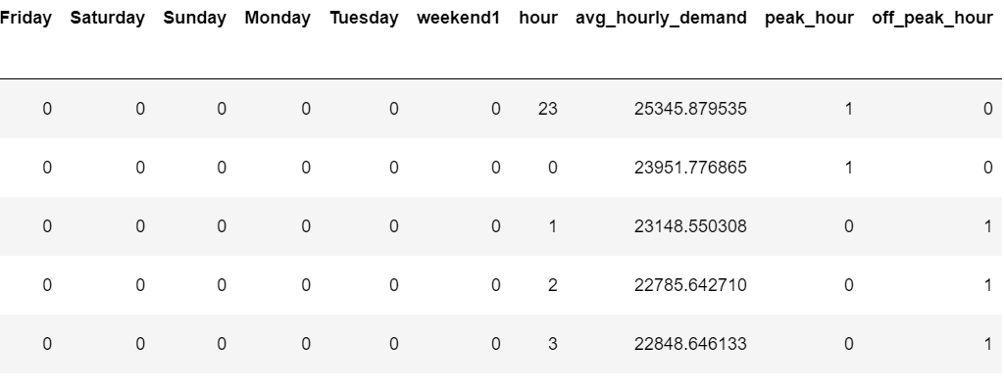
Feature Engineering
Columns Created: month day weekday weekend hour weekend
Average Hourly Demand: Calculate avg_hourly_demand by hour.
Peak/Off-Peak Classification: Create peak_hour and off_peak_hour based on avg_hourly_demand.

Slide 8
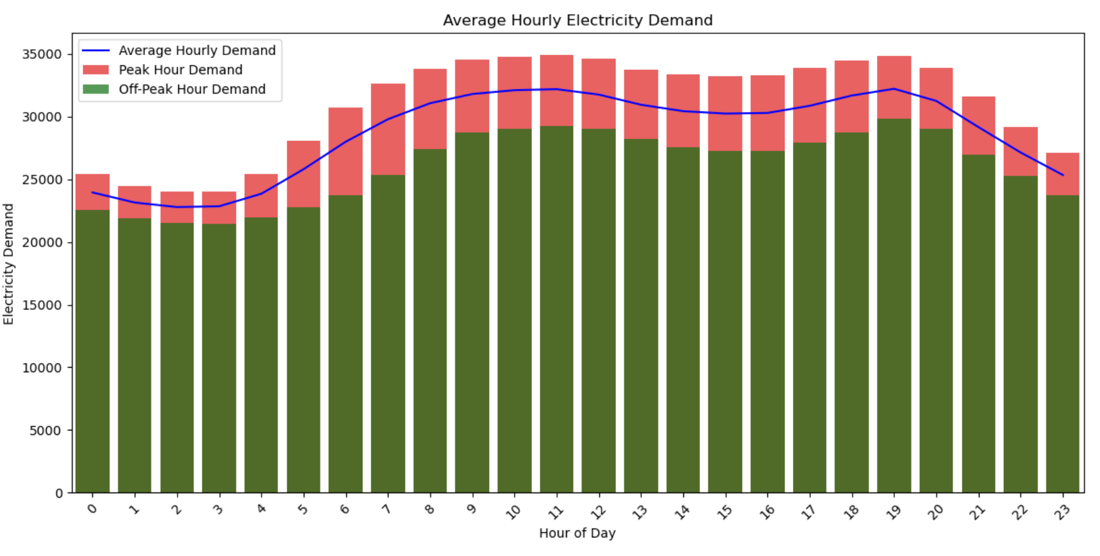
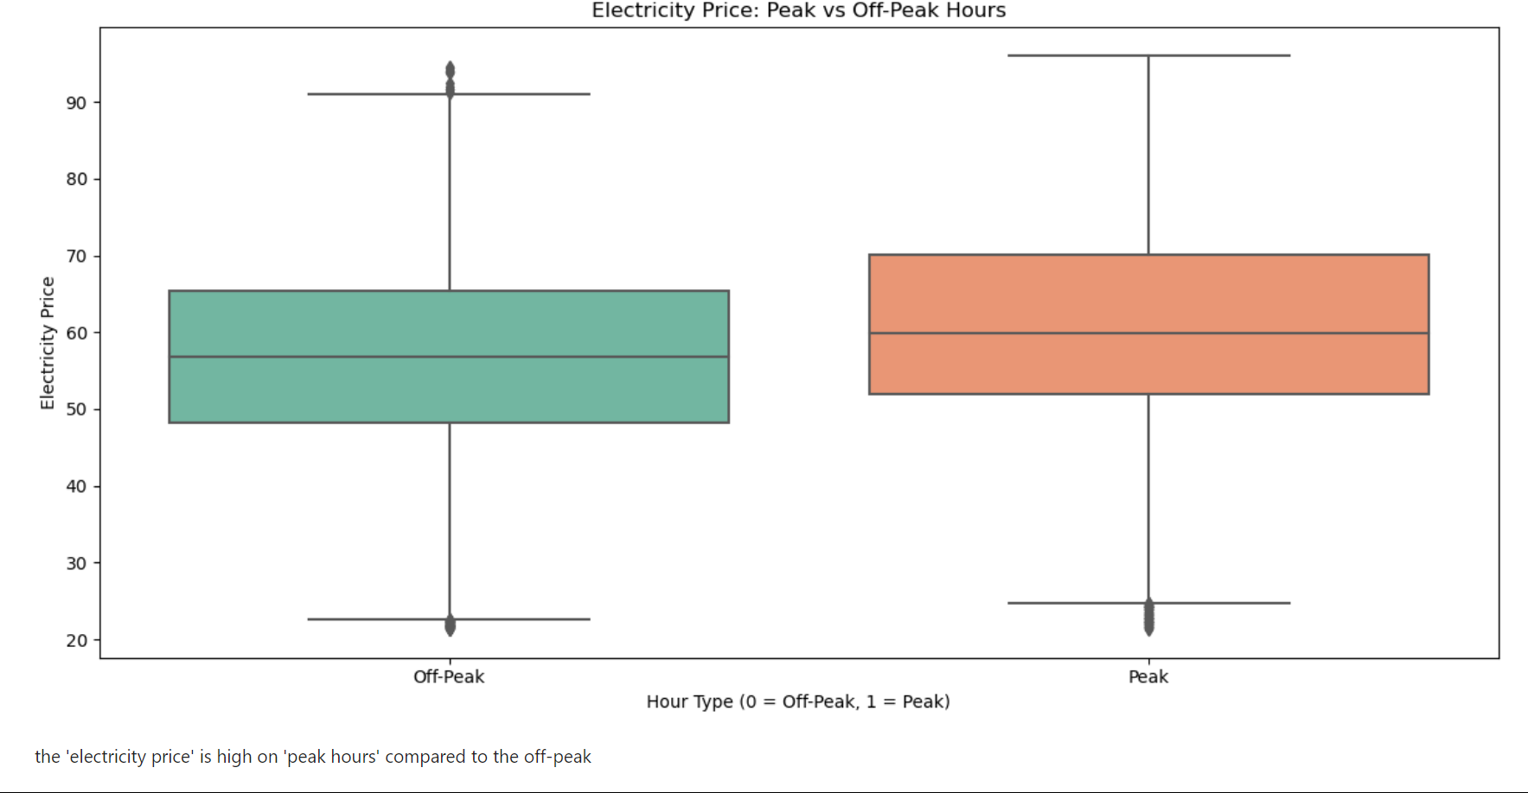
Visualization
Average hourly demand for peak and off-peak hours
'electricity demand ' : 'average hourly demand' is only on 'peak hours' only
the 'electricity price' is high on 'peak hours' compared to the off-peak

Slide 9
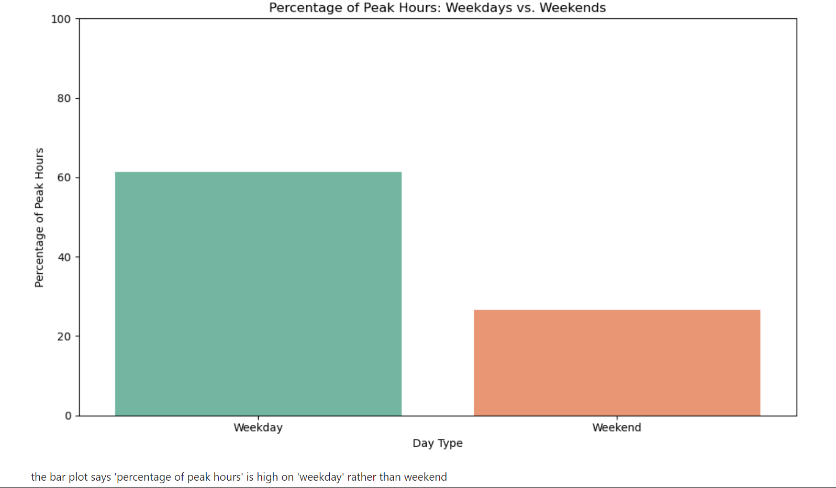
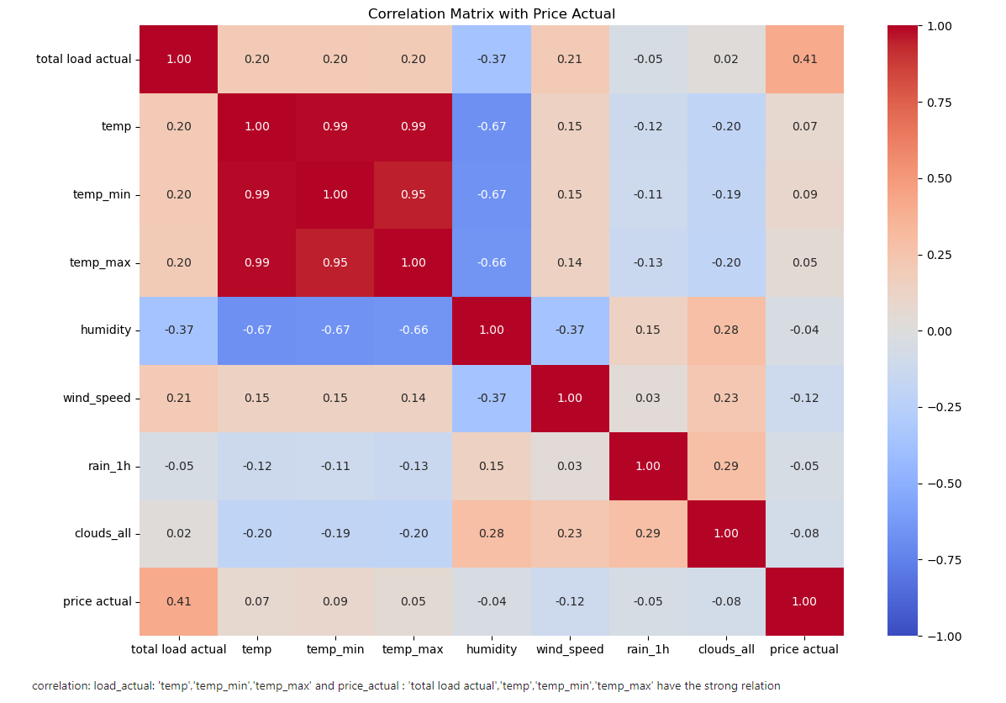
Visualization
Percentage of peak hours on weekday and weekends
correlation Matrix
the bar plot says 'percentage of peak hours' is high on 'weekday' rather than weekend
'temp','temp_min','temp_max’ has strong relation

Slide 10
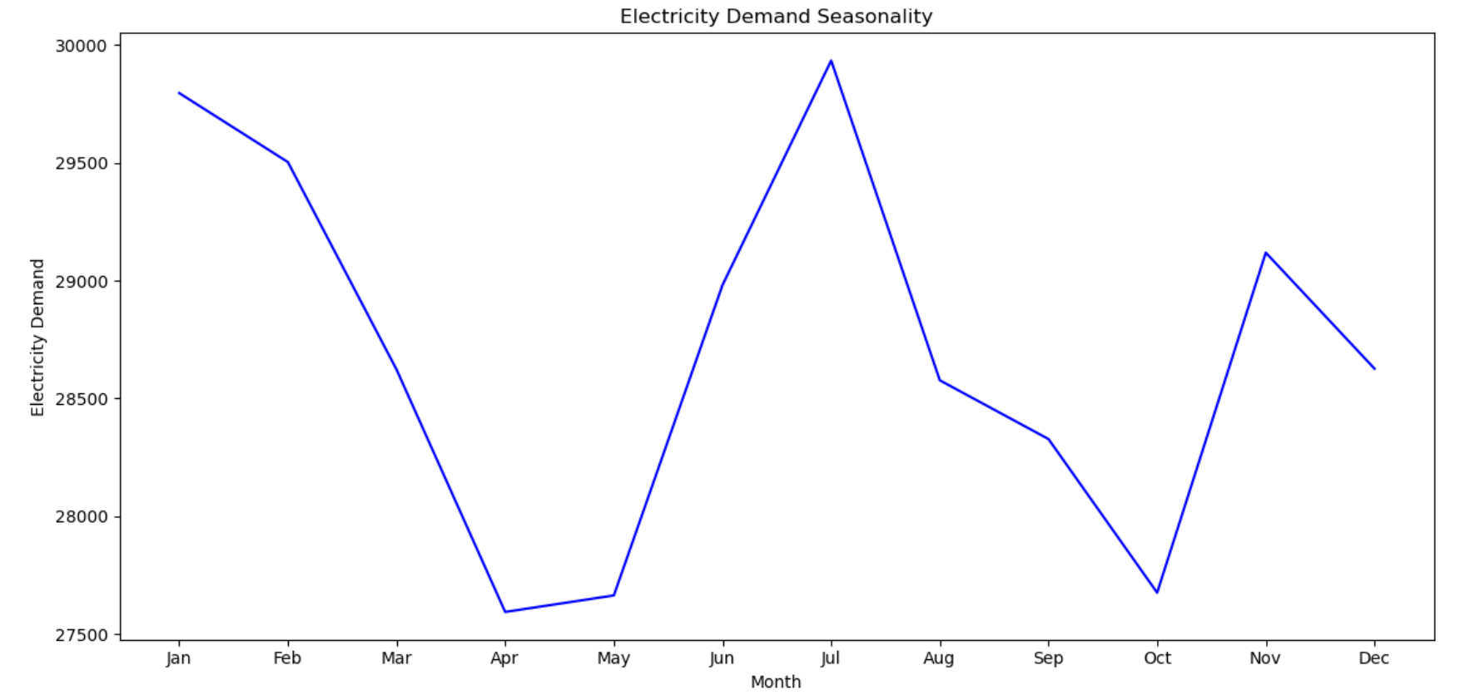
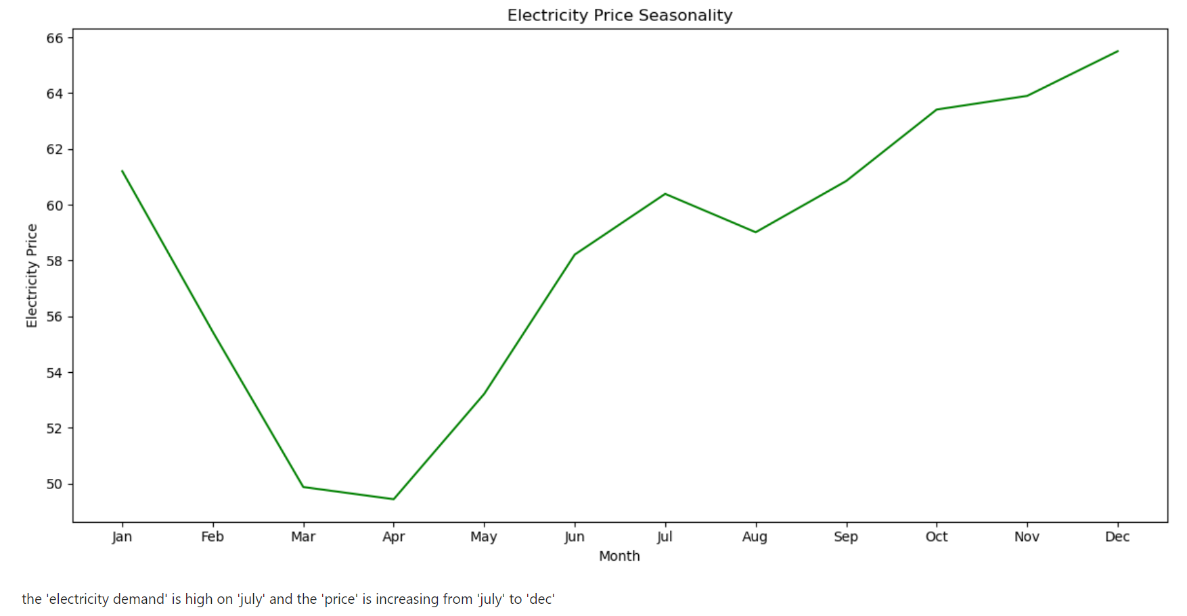
Visualization
Demand over seasonality
the 'electricity demand' is high on ‘July' and the 'price' is increasing from ‘July' to 'dec'

Slide 11
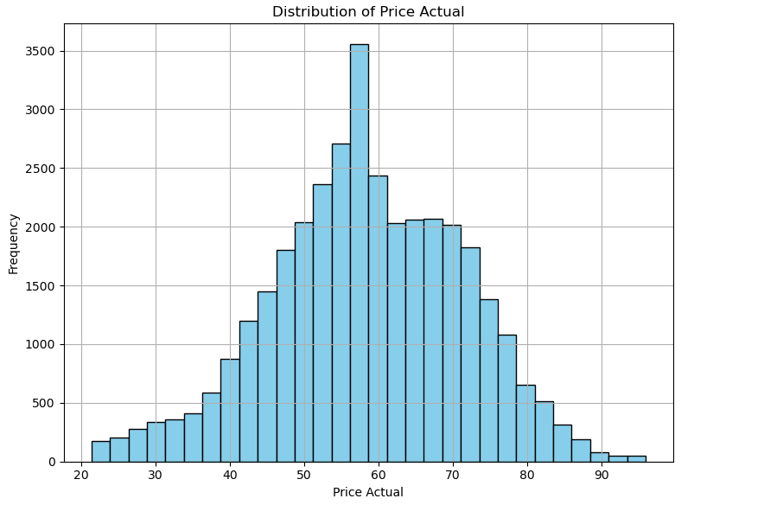
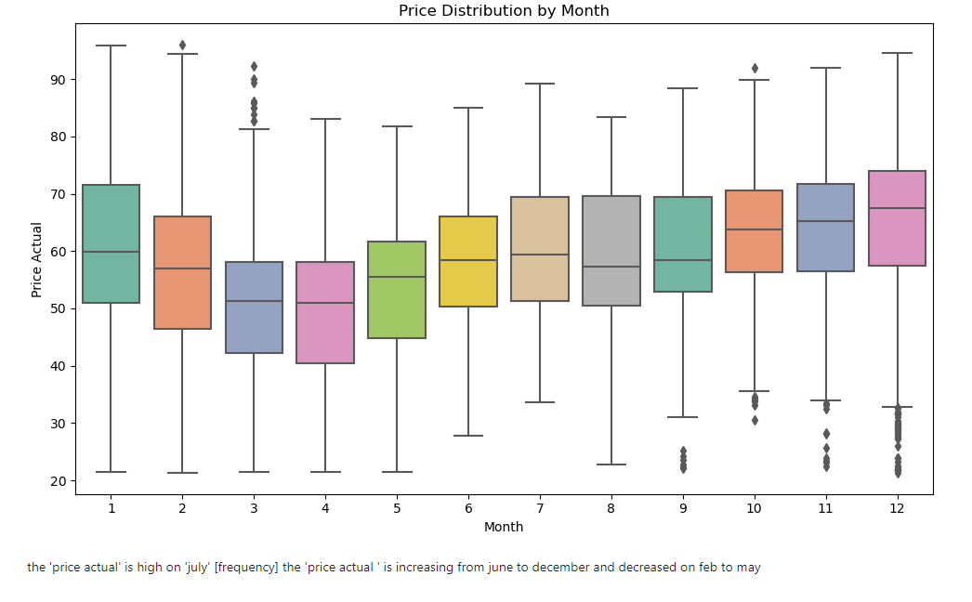
Visualization
Histogram for price actual
Box plot for price actual
the 'price actual' is high on ‘July'
the 'price actual ' is increasing from June to December and decreased in Feb. to may

Slide 12
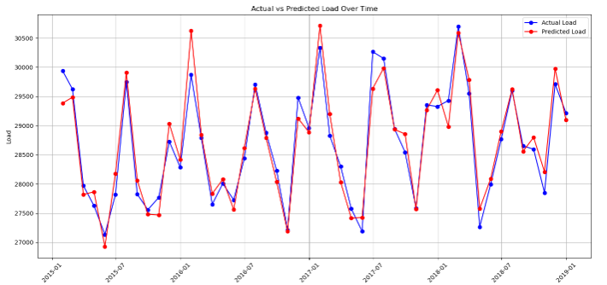
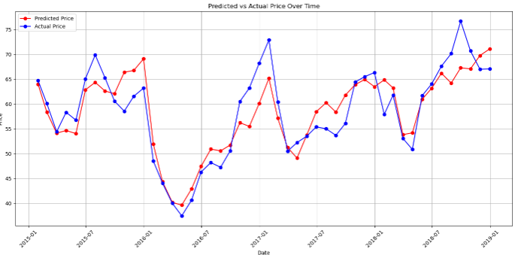
Model Implementation – linear regression
For Load Actual
For Price Actual
Total Load Actual - Test Set: MAE: 1050.88 RMSE: 1363.56 MAPE: 3.76% R^2: 0.91 Adjusted R^2: 0.91
Price Actual - Test Set: MAE: 6.18 RMSE: 8.07 MAPE: 11.60% R^2: 0.61 Adjusted R^2: 0.60

Slide 13
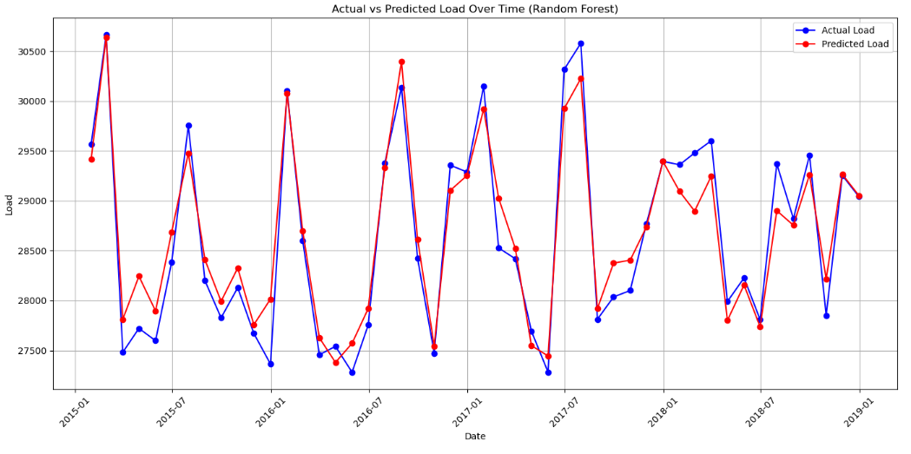
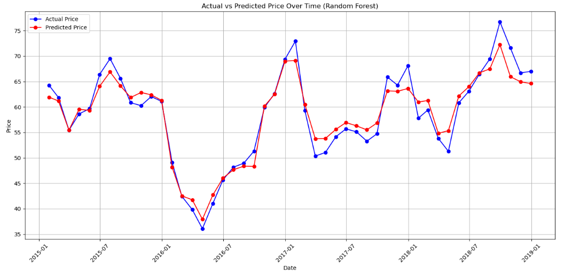
Model implementation – Random forest
For Load Actual
For Price Actual
Total Load Actual - Test set: MAE: 935.04 RMSE: 1209.91 MAPE: 3.32% R^2: 0.93 Adjusted R^2: 252.47
Price Actual - Test set: MAE: 4.55 RMSE: 6.21 MAPE: 8.81% R^2: 0.77 Adjusted R^2: 797.53

Slide 14
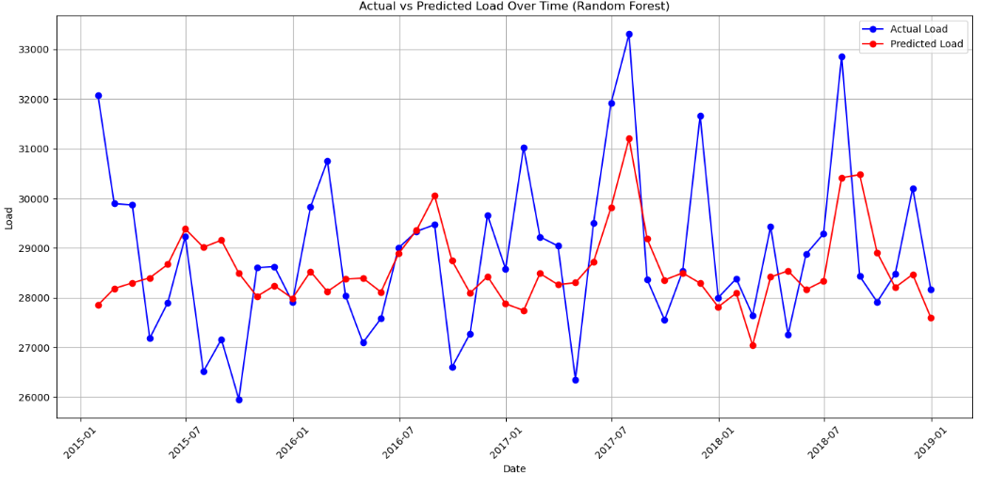
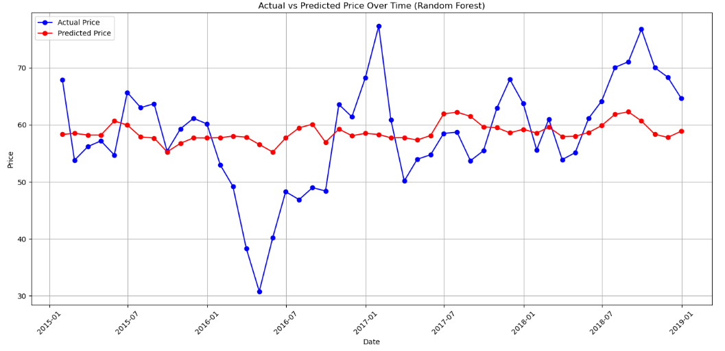
Random forest with hyper parameter tuning
For Load Actual
For Price Actual
Total Load Actual - Test set: MAE: 3638.82 RMSE: 4313.85 MAPE: 13.00% R^2: 0.08 Adjusted R^2: 0.07
Price Actual - Test set: MAE: 9.91 RMSE: 12.26 MAPE: 19.37% R^2: 0.05 Adjusted R^2: 0.04

Slide 15
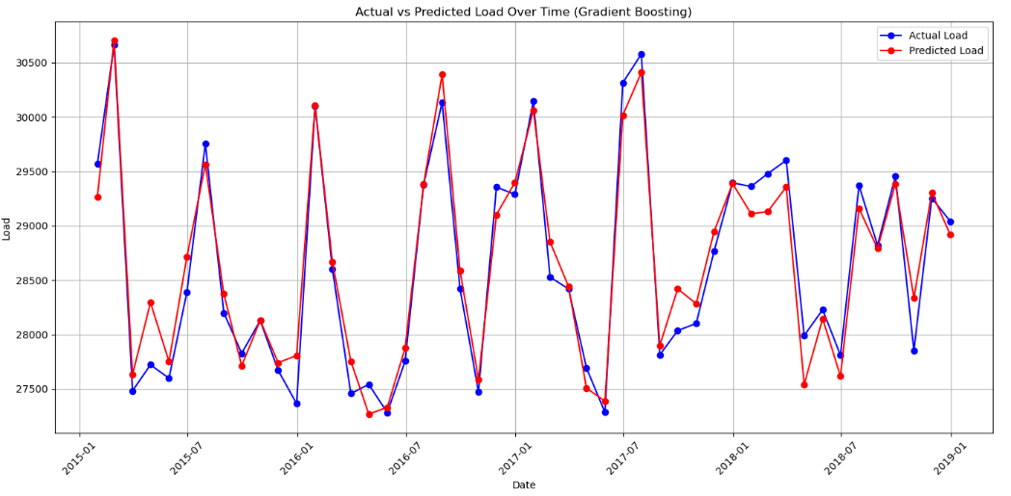
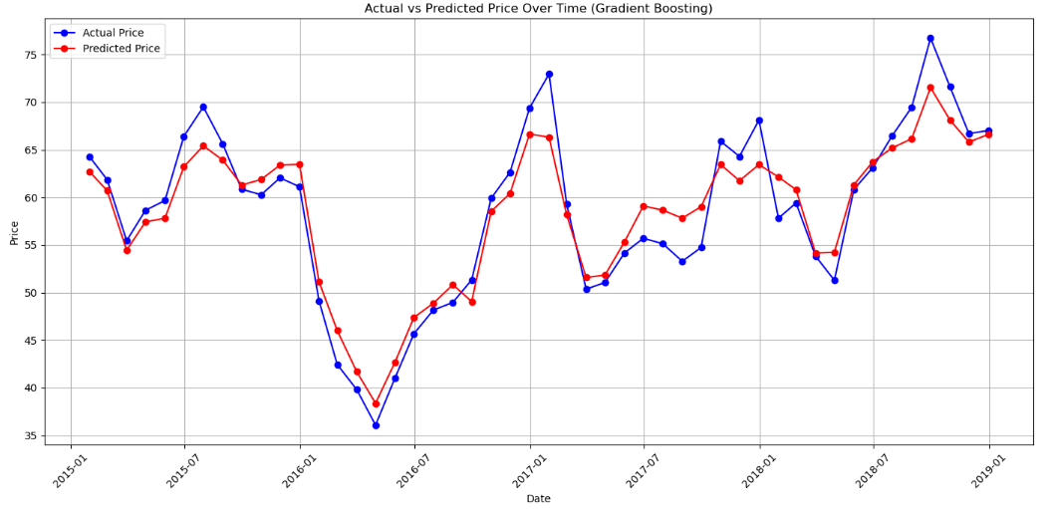
Gradient Boosting Regressor
For Load Actual
For Price Actual
Total Load Actual - Test set: MAE: 946.05 RMSE: 1201.30 MAPE: 3.34% R^2: 0.93 Adjusted R^2: 0.93
Price Actual - Test set: MAE: 5.08 RMSE: 6.87 MAPE: 9.78% R^2: 0.72 Adjusted R^2: 0.71

Slide 16
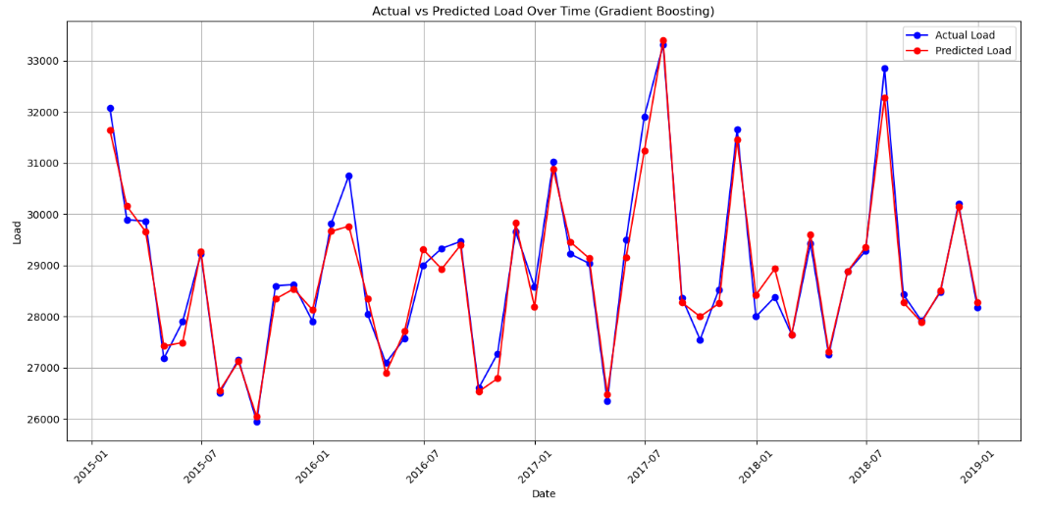
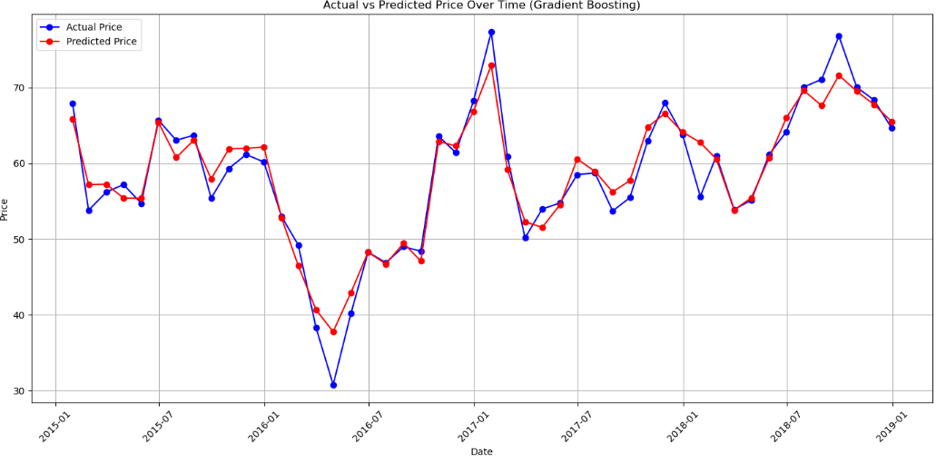
Gradient Boosting with hyper parameter tuning
For Load Actual
For Price Actual
Total Load Actual - Test set: MAE: 810.40 RMSE: 1051.26 MAPE: 2.83% R^2: 0.95 Adjusted R^2: 0.93
Total Load Actual - Test set: MAE: 4.22 RMSE: 5.76 MAPE: 8.11% R^2: 0.79 Adjusted R^2: 0.72

Slide 17
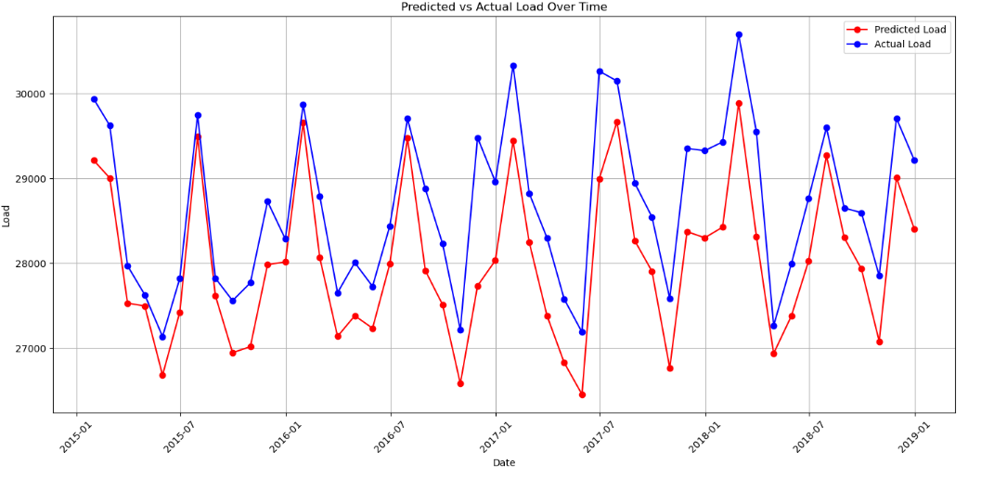
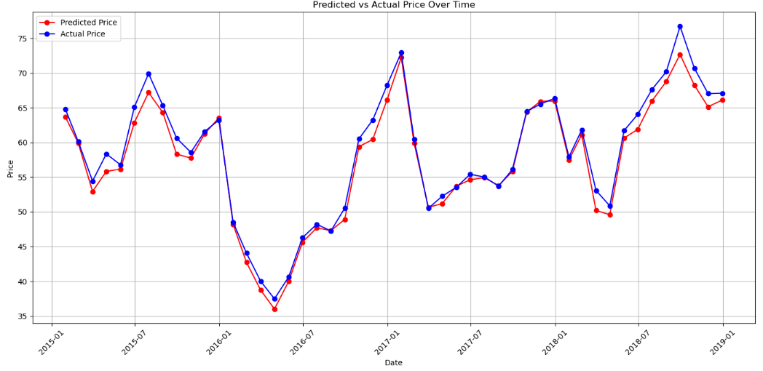
Long short - term memory
For Load Actual
For Price Actual
Total Load Actual - Test Set: MAE: 1122.36 RMSE: 2127.36 MAPE: 3.92% R^2: 0.78 Adjusted R^2: 0.77
Price Actual - Test Set: MAE: 3.84 RMSE: 5.54 MAPE: 7.29% R^2: 0.82 Adjusted R^2: 0.80

Slide 18
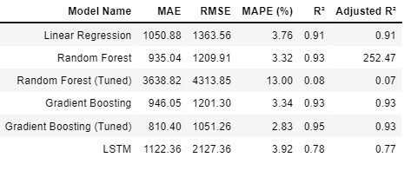
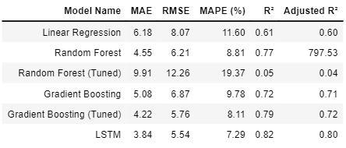
Comparison of Model
Load Model Comparison Table
Price Model Comparison Table

Slide 19
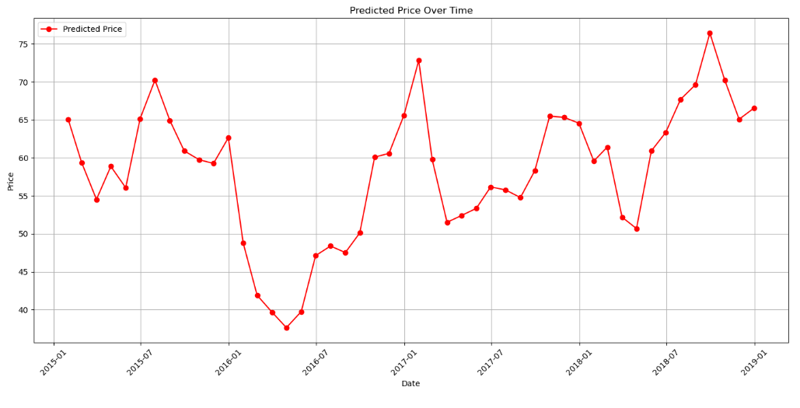
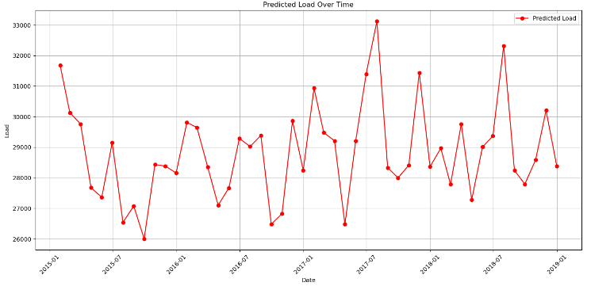
conclusion
Price – Lond Short-Term Memory
Load – Gradient boosting with tuning
These are the best models for price and load prediction

Slide 20


