Slide 1
Electricity Demand and Price Forecasting
Presented By :- Anthony Brighton Stalin Nadar
Date :- 19 July 2024
1

Slide 2
Table of Content
Problem statement
Data Introduction
Exploratory Data Analysis
Data Preprocessing
Feature Engineering
Visualisation
Machine Learning Model
Linear Regression
Decision Tree
Random Forest (with and without hyper parameter tuning)
Gradient Boosting (with and without hyper parameter tuning)
Long Short-Term Memory (LSTM)
Machine Learning Model Performance Matrices
Feature Importance
Conclusion
2

Slide 3
Problem statement
The need for accurate forecasting of electricity demand and prices.
Importance for grid management, financial planning, and energy trading.
Challenges due to the variability and complexity of influencing factors.
3

Slide 4
Data Introduction
Data Source: There are two Datasets.
Energy Dataset - Includes feature related to energy production and consumption.
Weather Dataset - Includes various weather related features.
Time Period: From December 2014 to March 2019.
Target Variables : total load actual and total price
4

Slide 5
Exploratory Data Analysis
5

Slide 6
Data Preprocessing
Data Aggregation.
Handling missing values: Techniques like forward fill and backward fill.
Identify and remove duplicate records.
Outlier Treatment: Remove or cap/floor outlier.
6

Slide 7
Feature Engineering
Created new features are as follows:-
Month: January to December.
Day of the Week: Monday to Sunday.
Peak/Non-Peak hours: Peak hours are from 7 AM to 10 PM and non-peak hours are the remaining hours.
7

Slide 8
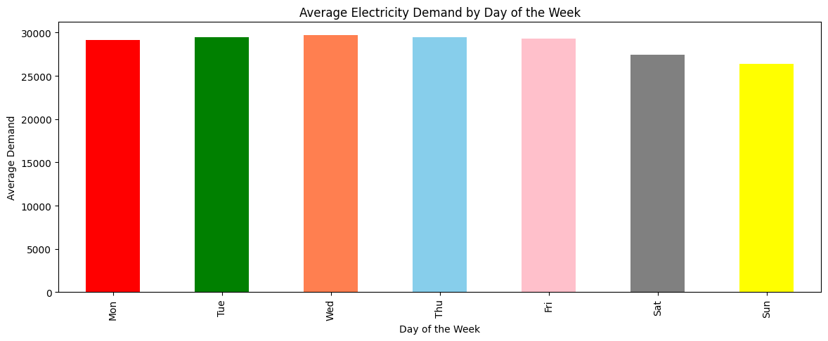
Visualization
Electricity demand is more in weekdays as compared to weekends
8

Slide 9
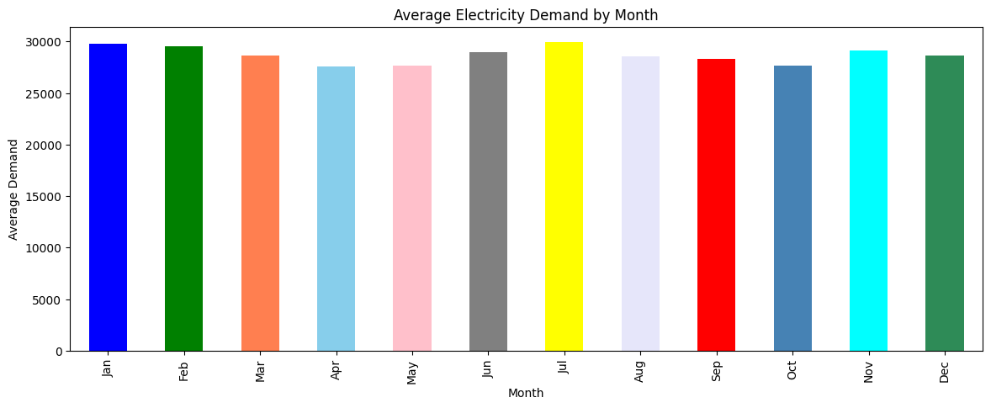
Visualization
Electricity demand is higher in summer months (June, July, August) for air conditioning or in winter months (November, December, January, February) for heating
9

Slide 10
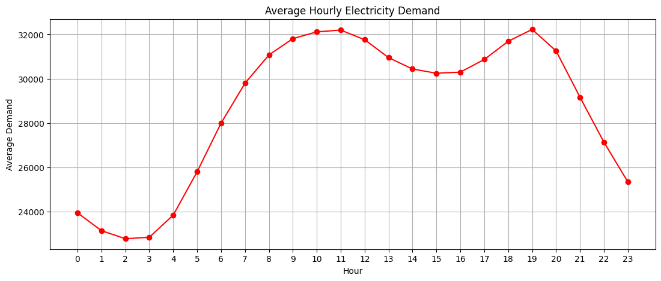
Visualization
Higher demand in the morning and evening while lower demand in the mid night and early morning
10

Slide 11
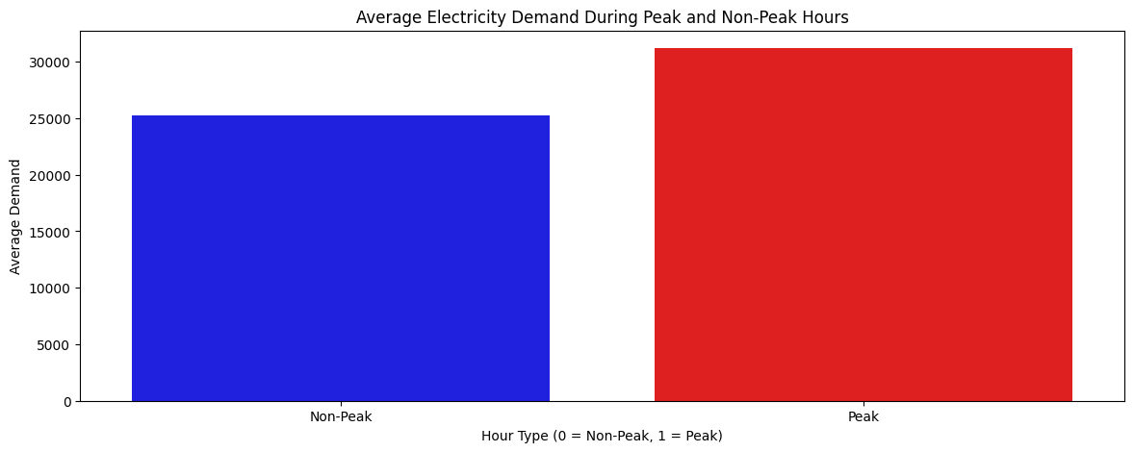
Visualization
Higher demand in Peak hours while lower demand in Non-Peak hours
11

Slide 12
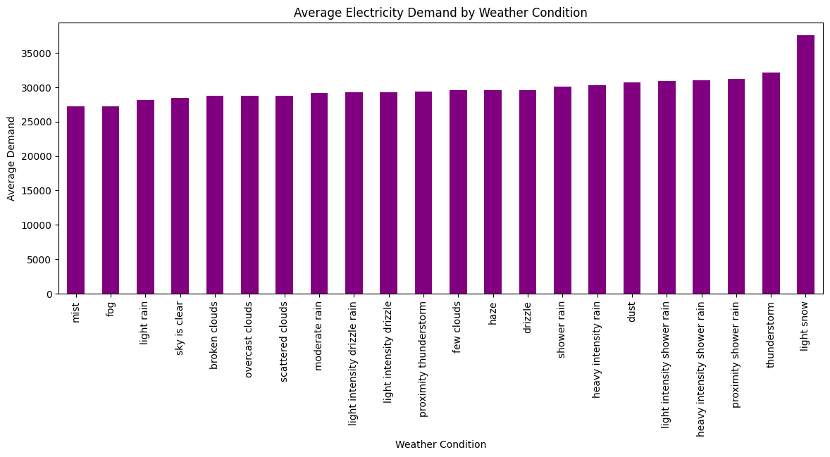
Visualization
Electricity demand is increases as the temperature decreases
12

Slide 13
Machine Learning Model
13

Slide 14
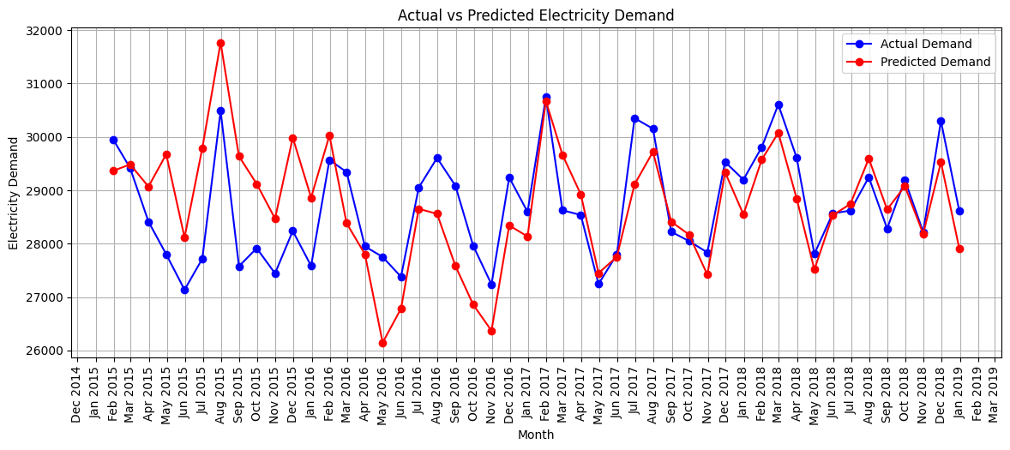
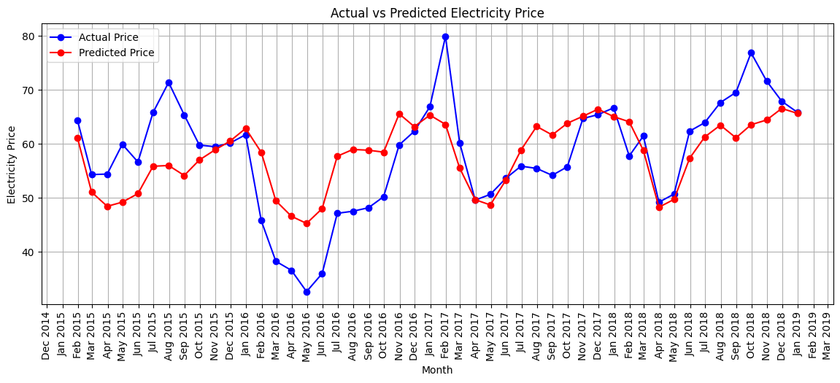
Linear Regression Model
Demand
MAPE : 7.12%
MAE : 2011.97 RMSE : 2575.01
R2 : 0.68
Adjusted R2 : 0.68
Price
MAPE : 16.27%
MAE : 8.22
RMSE : 10.39
R2 : 0.45
Adjusted R2 : 0.68
14

Slide 15
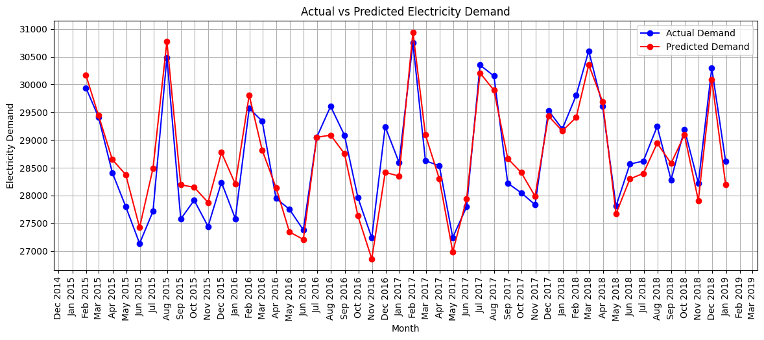
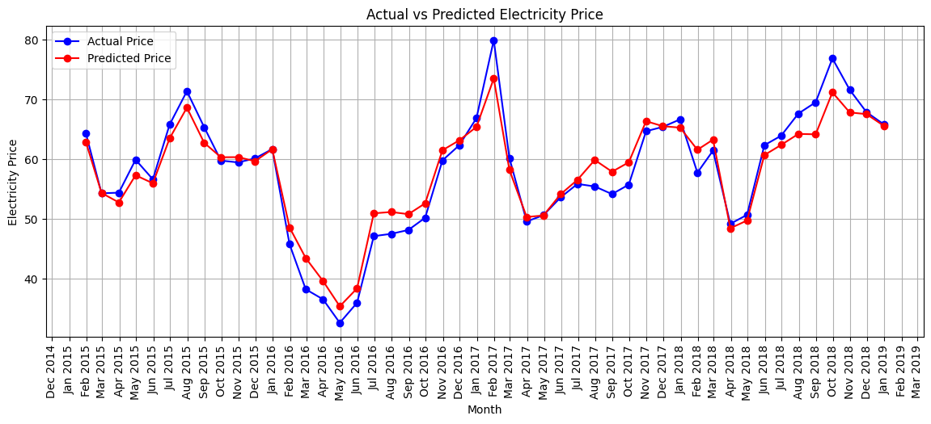
Decision Tree Model
Demand
MAPE : 5.24%
MAE : 1479.84 RMSE : 2249.16
R2 : 0.76
Adjusted R2 : 0.76
Price
MAPE : 11.22%
MAE : 5.92
RMSE : 8.96
R2 : 0.59
Adjusted R2 : 0.76
15

Slide 16
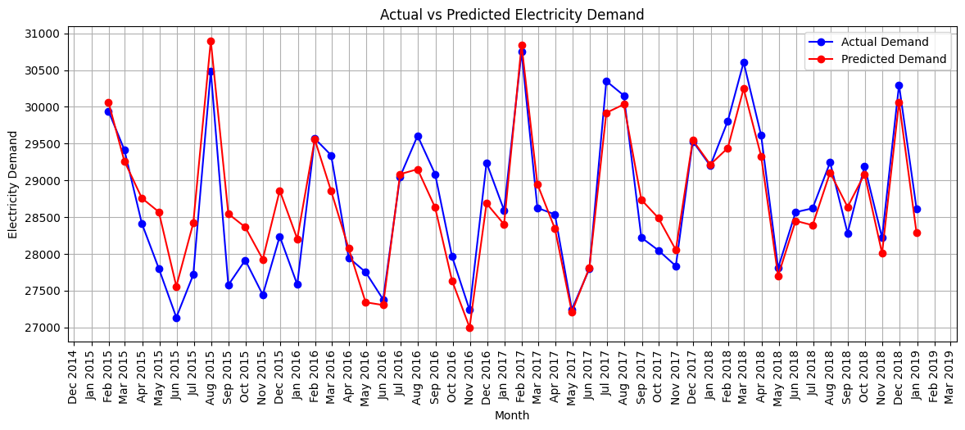
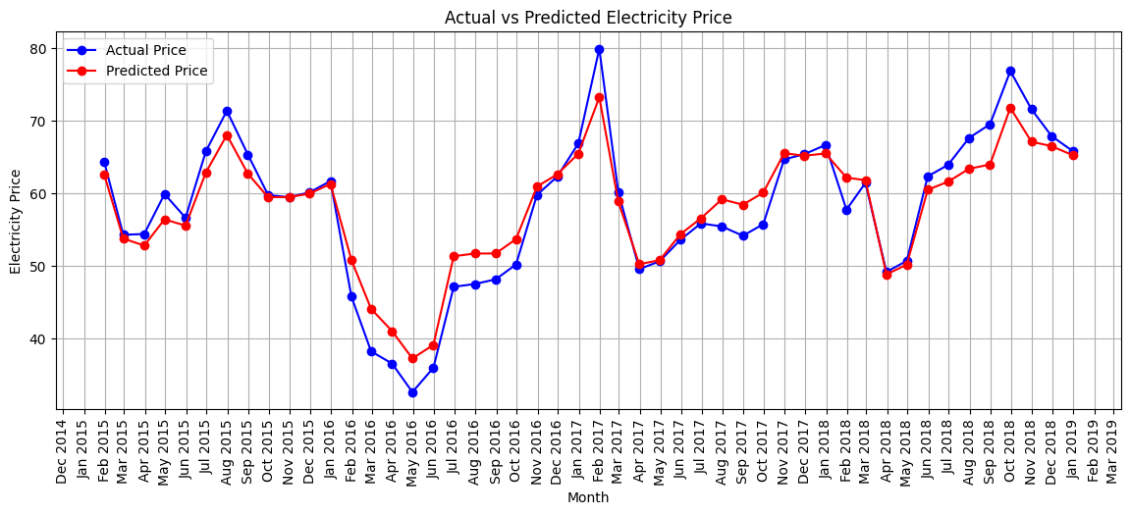
Random Forest Model
Demand
MAPE : 3.87%
MAE : 1085.50
RMSE : 1556.46
R2 : 0.88
Adjusted R2 : 0.88
Price
MAPE : 8.82%
MAE : 4.50
RMSE : 6.12
R2 : 0.81
Adjusted R2 : 0.81
16

Slide 17


Random Forest with Hyper Parameter Tuning
Demand
MAPE : 3.95%
MAE : 1108.99
RMSE : 1576.78
R2 : 0.88
Adjusted R2 : 0.88
Price
MAPE : 9.12%
MAE : 4.68
RMSE : 6.27
R2 : 0.80
Adjusted R2 : 0.88
17

Slide 18
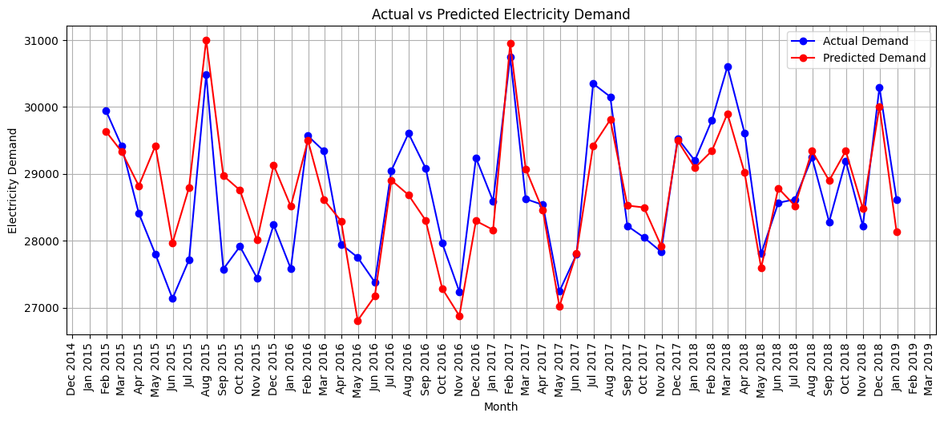
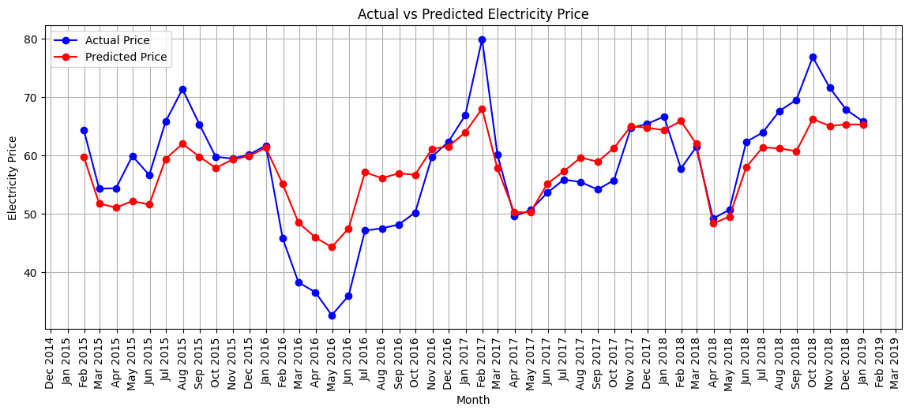
Gradient Boosting Model
Demand
MAPE : 5.54 %
MAE : 1566.50
RMSE : 2060.54
R2 : 0.80
Adjusted R2 : 0.80
Price
MAPE : 13.91 %
MAE : 6.99
RMSE : 8.79
R2 : 0.60
Adjusted R2 : 0.80
18

Slide 19
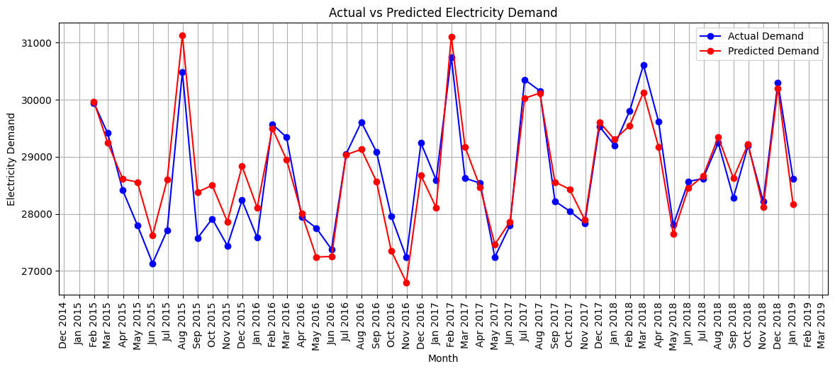
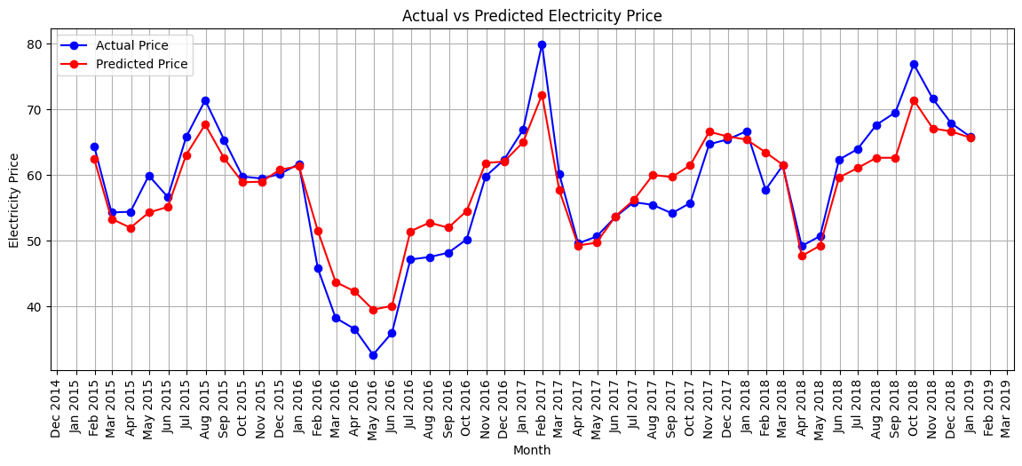
Gradient Boosting with Hyper Parameter Tuning
Demand
MAPE : 4.54 %
MAE : 1282.80
RMSE : 1752.67
R2 : 0.85
Adjusted R2 : 0.85
Price
MAPE : 10.54 %
MAE : 5.43
RMSE : 7.01
R2 : 0.75
Adjusted R2 : 0.75
19

Slide 20
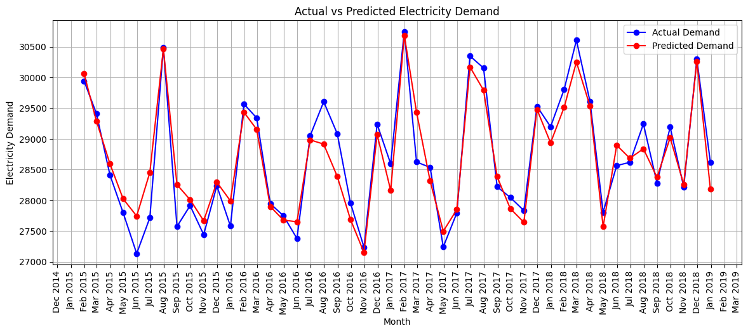
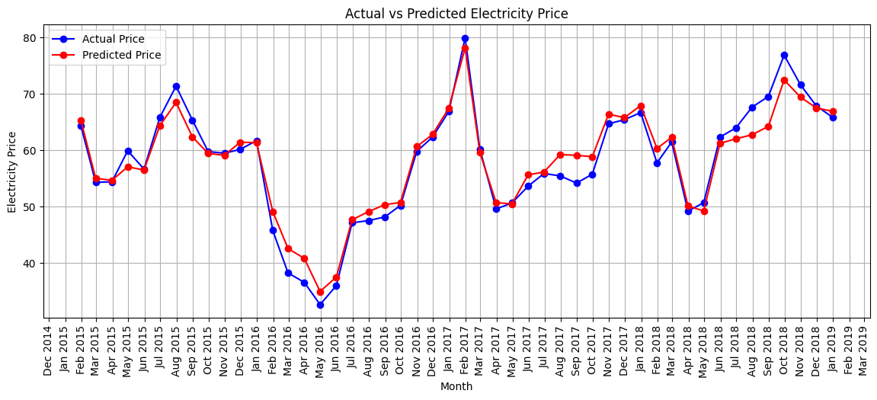
Long Short-Term Memory (LSTM) Model
Demand
MAPE : 4.04 %
MAE : 1141.06
RMSE : 1525.42
R2 : 0.89
Adjusted R2 : 0.89
Price
MAPE : 8.91 %
MAE : 4.62
RMSE : 6.10
R2 : 0.81
Adjusted R2 : 0.89
20

Slide 21
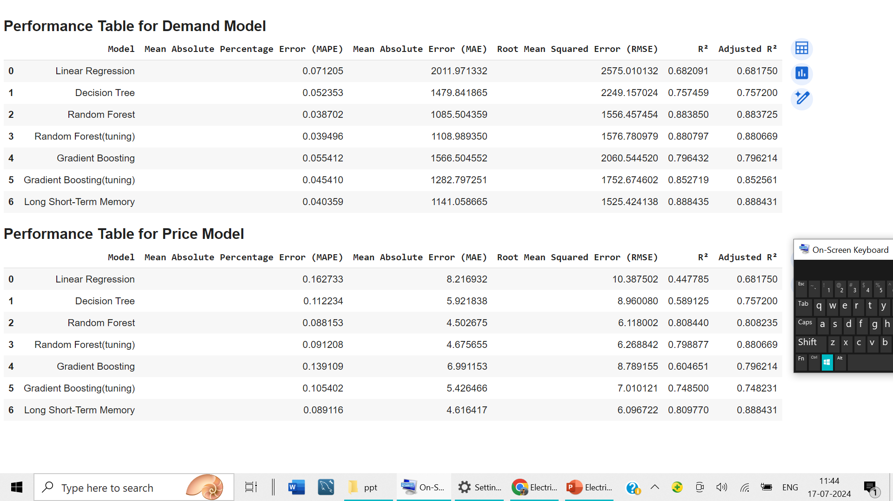
Machine Learning Model Performance Matrices
21

Slide 22
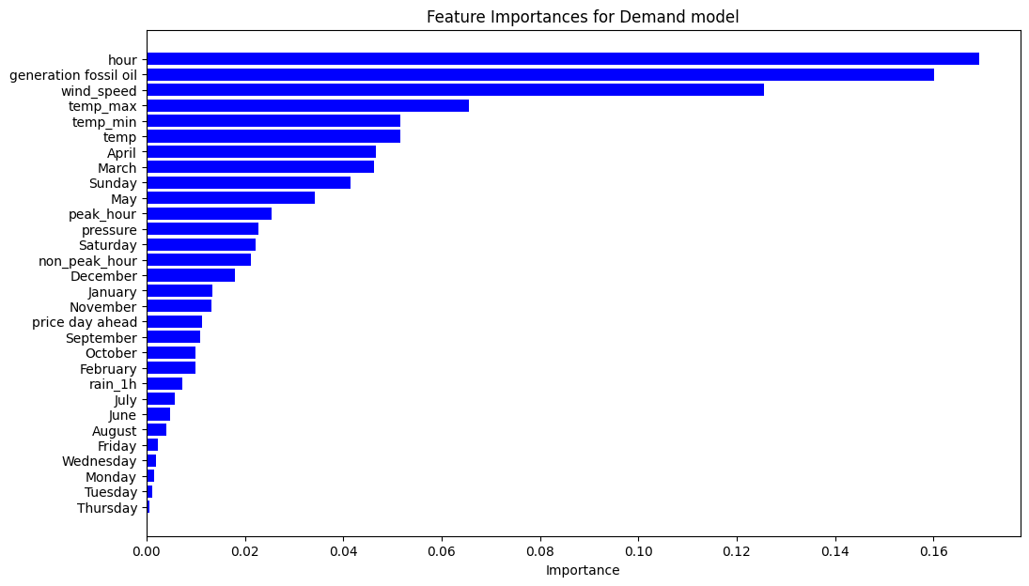
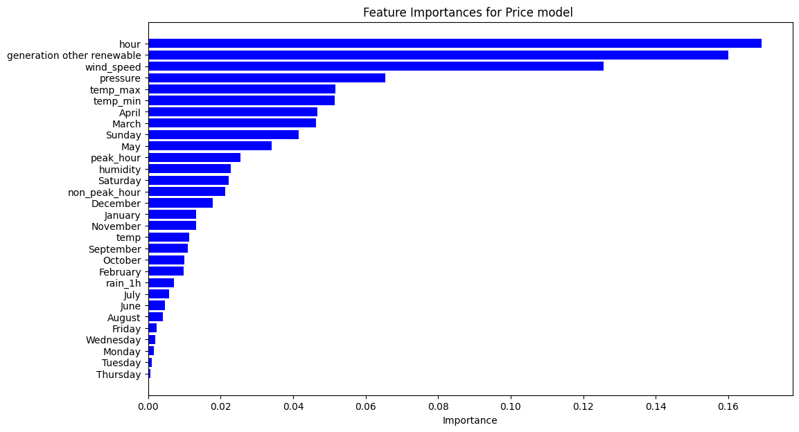
Feature Importance
Demand
Price
22

Slide 23
Conclusion
Random Forest model is better compared to other model as it has the least MAPE, MAE, RMSE and best R² value
Long Short-Term Memory model is better compared to other model as it has the less MAPE, MAE, RMSE and best R² value
Important Variable for Demand model: peak_hour, non_peak_hour, hour, generation fossil oil, temp, temp_min, temp_max, Sunday, Saturday, April, March, May, pressure, humidity, wind_speed
Important Variable for Price model: peak_hour, non_peak_hour, hour, generation other renewable, temp, temp_min, temp_max, Sunday, Saturday, April, January, October, pressure, humidity, wind_speed
23

Slide 24
Thank You!!!

