Slide 1
HELP International NGO
Clustering and PCA Assignment
Prepared by: Sagar Kamble (DDS1930260)

Slide 2
Problem Statement: Segment the data set by analysing the socio-economic contents and find backword countries.
Point considered while performing analysis:
There are number of features available for analysing the data such as child mortality rate, overall health, Average Income, GDP per capita of country, Import-Export.
From basic analysis we can say that countries which has economically backword have high child mortality rate and low health ratio so we need to find those countries by applying machine learning.

Slide 3
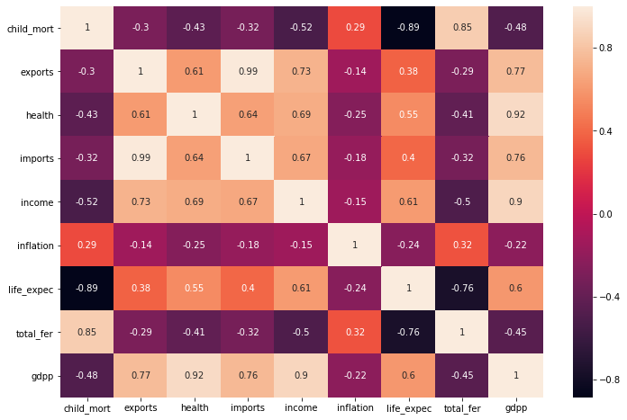
Correlation between each features:
From the heat map we can say almost every feature is correlated to each other
Some of the highly correlated features
Export - Import : 0.99
Import – GDP : 0.76
Export – GDP : 0.77
Child_mort – Life_expec : -0.89
We can reduce the feature in the data set By applying PCA (Principle Component Analysis)

Slide 4
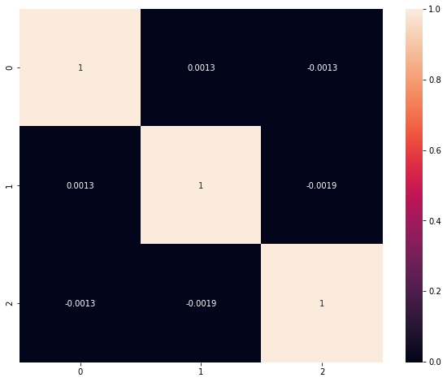
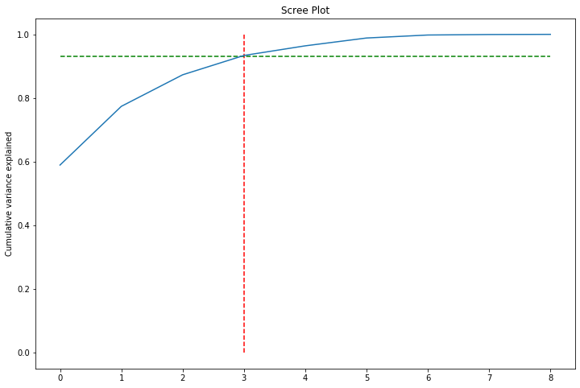
PCA:
PCA observations:
After applying the PCA we get three principle components which explain 93 percent of variance.
Correlation between those three components are less as compare to the original dataset.
In scree plot red and green line indicate the 1st observation.

Slide 5
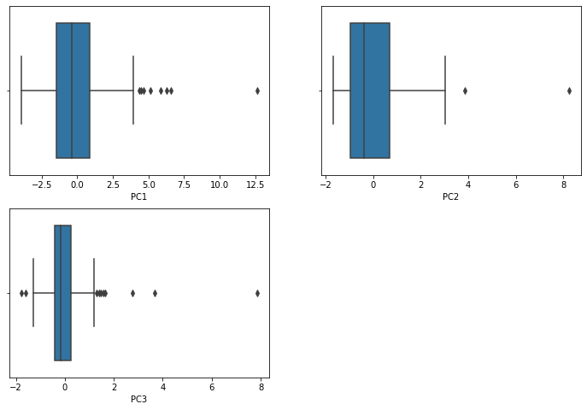
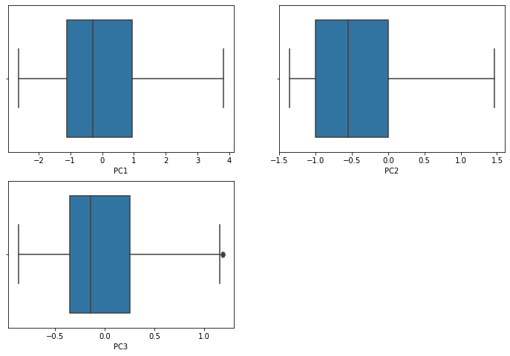
Outlier Treatment:
Box Plot before outlier treatment
Box Plot After outlier treatment
After finding the principle components we perform outlier treatment for removing the inconsistency in the data set which can affect the any ML algorithm

Slide 6
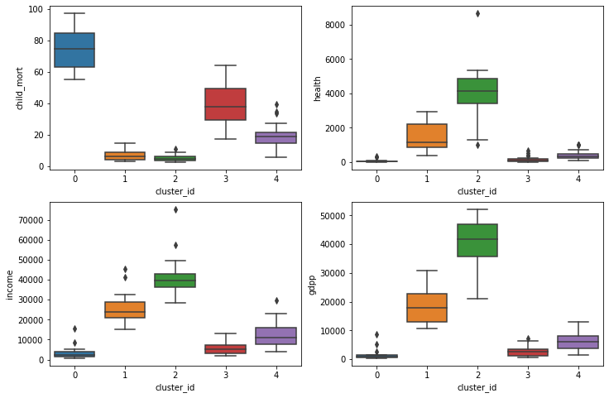
K-mean Clustering:
Using silhouette analysis and elbow curve we get k value as 5
From the clusters obtain after applying K-mean
Cluster 0 and cluster 3 has low income, GDP and health ratio with high child mortality rate
Cluster 1 and cluster 2 has low child mortality rate and high income, GDP and health ration
Cluster 4 behaviour is mix which has pretty low child mortality rate but not have high health, income, and GDP as 0 and 3.
So basically we need to focus on cluster 0 and 3.

Slide 7
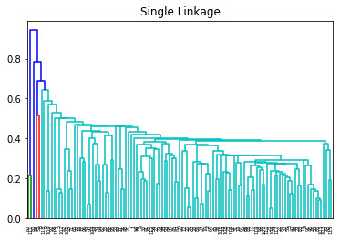
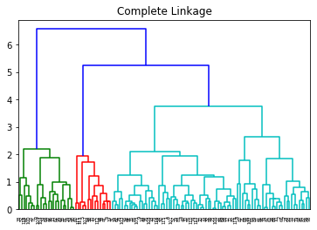
Hierarchical Clustering:
In hierarchical clustering we select both single linkage and complete linkage and get above results.

Slide 8
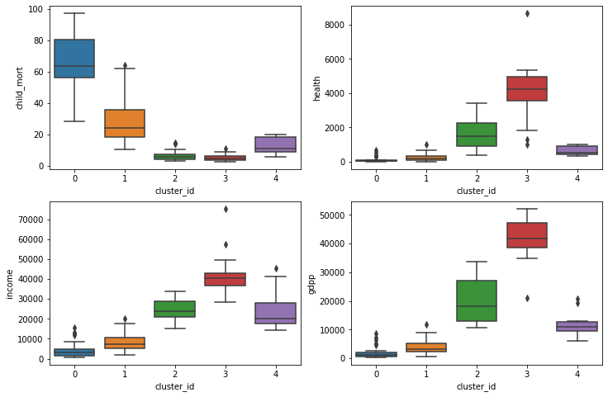
Hierarchical Clustering:
Using Hierarchical clustering we get almost similar result only cluster ID get interchange
Cluster 0 in k mean and in hierarchical clustering has 19 similar values
Cluster 0 and cluster 1 has low income, GDP and health ratio with high child mortality rate
Cluster 2 and cluster 3 has low child mortality rate and high income, GDP and health ration
Cluster 4 behaviour is mix which has pretty low child mortality rate but not have high health, income, and GDP as 0 and 3.
So basically we need to focus on cluster 0 and 1.

Slide 9
List of the countries:
In the analysis of socio-economically backword countries GDP, child mortality, Income are most important factors
Based on clusters we get lets decide the cut-off for above mention feature to find out list of countries on which we can focus.
Cut-off
Child mortality = 74
GDP per Capita = 1600
Income = 3540
From above cut-off value we get following countries on which we can focus and utilize the amount of money for development.
Countries: Afghanistan, Benin, Burkina Faso, Burundi, Cameroon, Central African Republic, Chad, Comoros, Congo, Dem. Rep., Cote d'Ivoire, Gambia, Ghana, Guinea, Guinea-Bissau, Haiti, Lesotho, Liberia, Malawi, Mali, Mauritania, Mozambique, Niger, Sierra Leone, Sudan, Togo, Uganda, Zambia.

