Slide 1
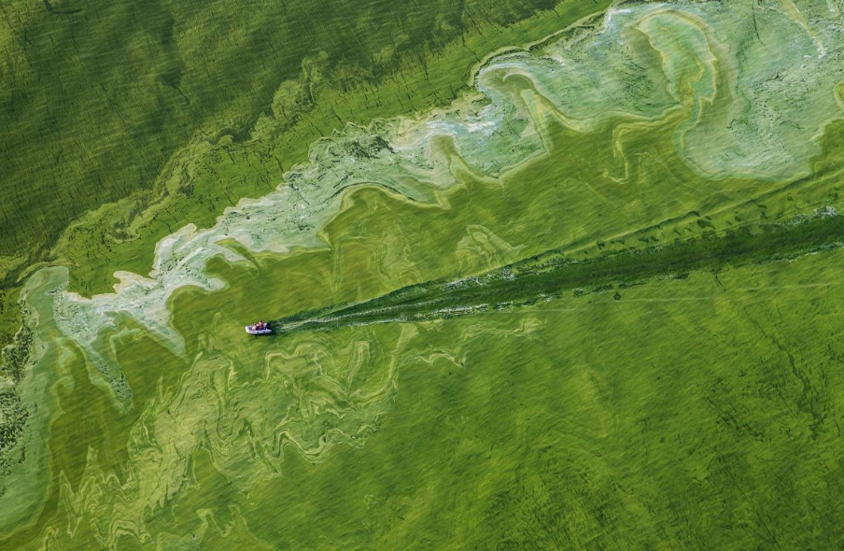

Using data science and machine learning address cyanobacteria bloms in Wrocester
Nathan Ahlgren
Clark University, Biology Department
Photo: Peter Essick // Lake Erie

Slide 2
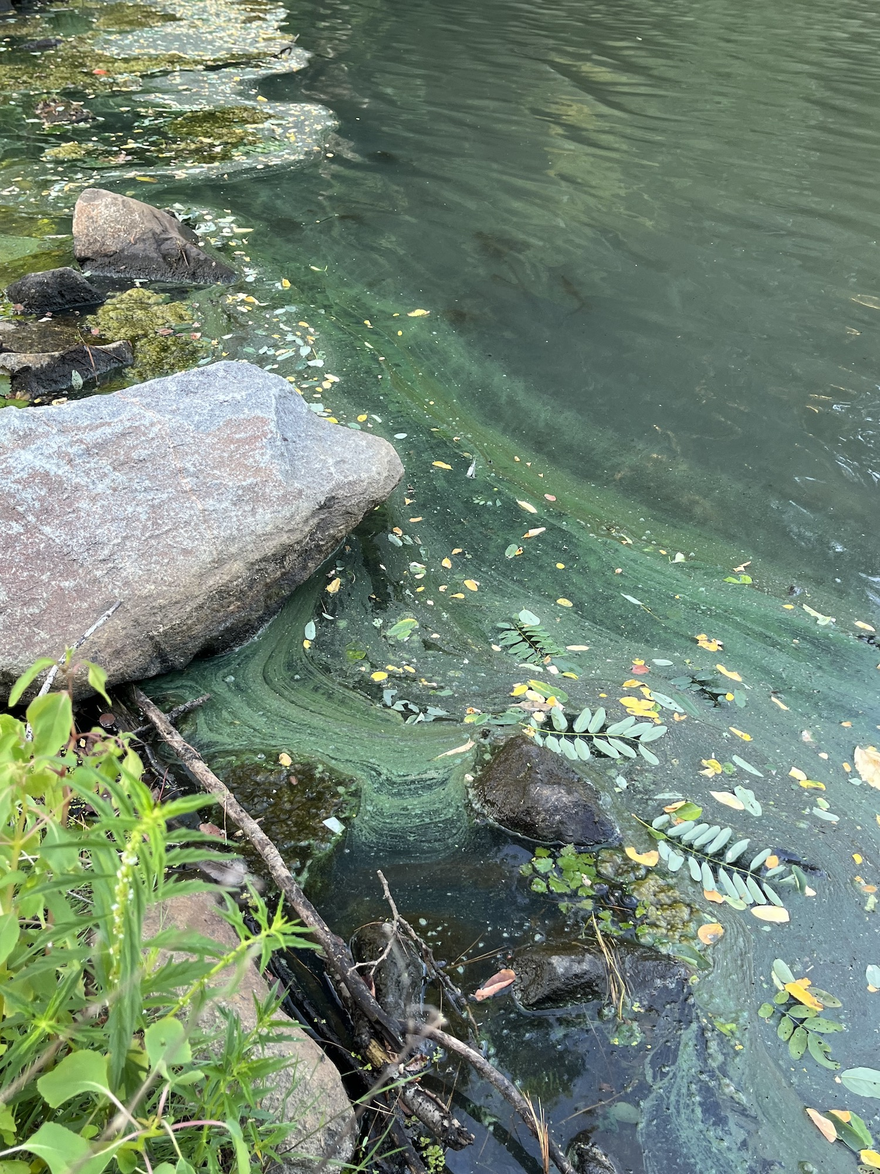
The growing threat of cyanobacterial blooms
Some cyanobacteria can produce toxic compounds
Threat to humans and pets when cyanobacteria reach high levels (blooms)
Bloom events are increasing
  Climate change (Paerl and Huisman 2009)
  Excess nutrients
There is a need to easily detect & predict blooms
Cyanobacteria bloom in Patch Reservoir

Slide 3
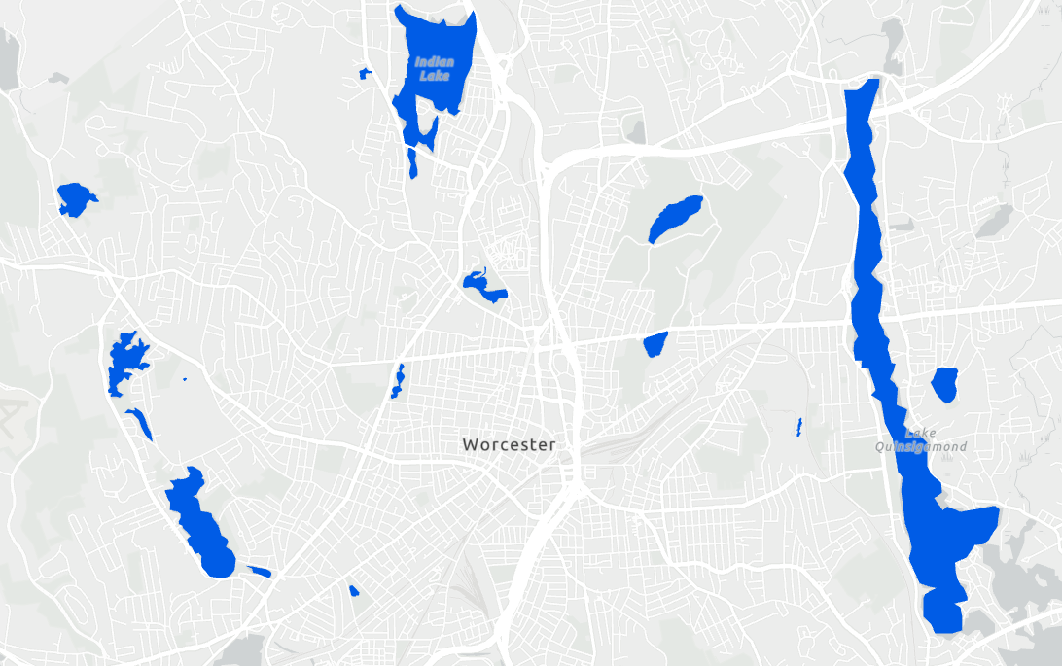
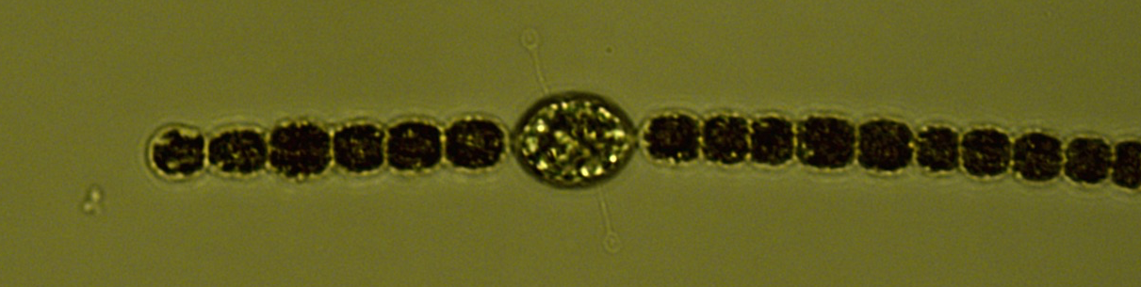

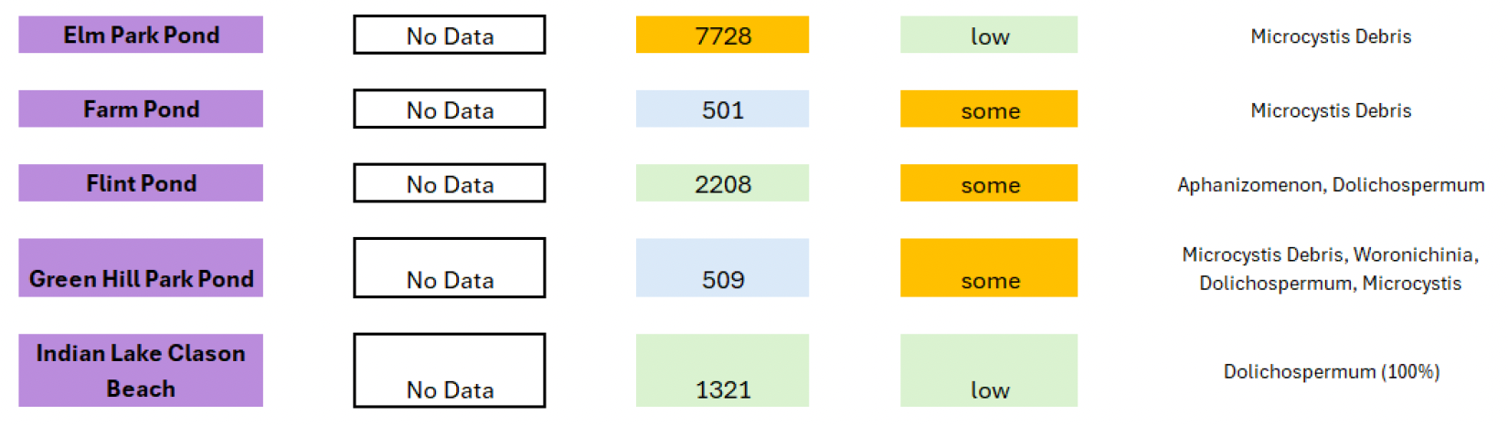
Worcester monitors ~20 ponds biweekly
Sample collection
    12 days per year
    20 ponds
    240 samples per year
    Measurements
    Cyanobacteria pigment: Phycocyanin
    Particle concentration
    Cyanobacterial density & type
    Temperature
    Chlorophyll pigment
    Weather data?
Map by Jackie Wallis

Slide 4
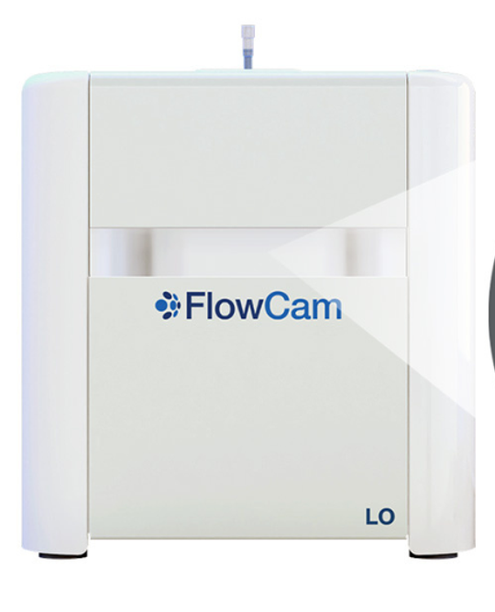
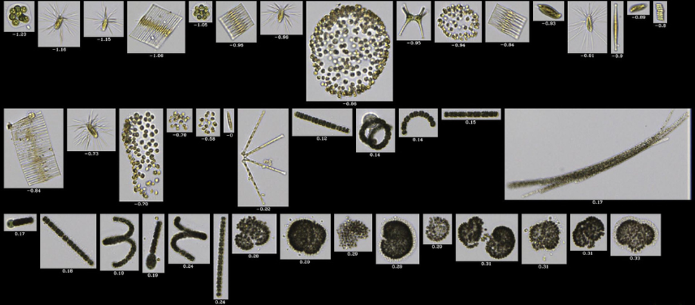
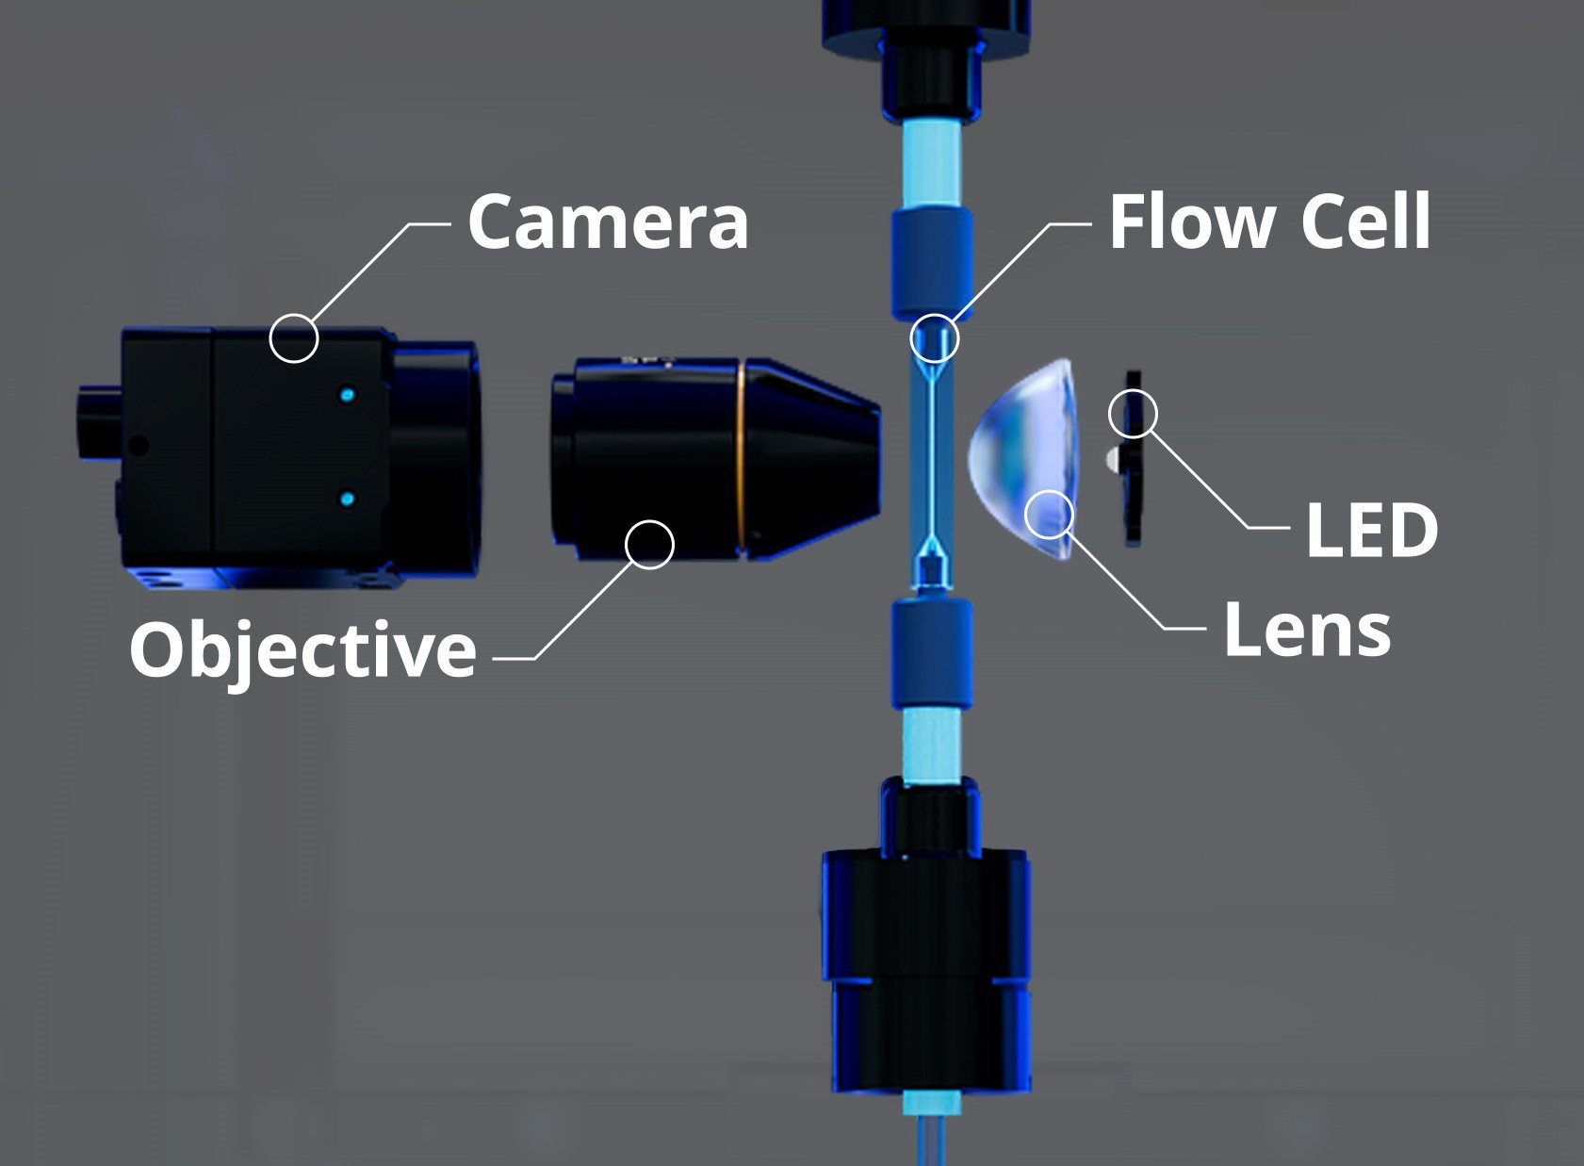
Monitoring cyanobacteria can be hard
Gold standard: Microscope
  Low throughput
  Manual identification
  Expertise needed
Sample collection
(12 days X 20 ponds = 240 samples!)
Newer approach: FlowCam
    Automated microscope
    1000s of images in a few minutes
    Still requires identification expertise
Nick
Phytoplankton species

Slide 5
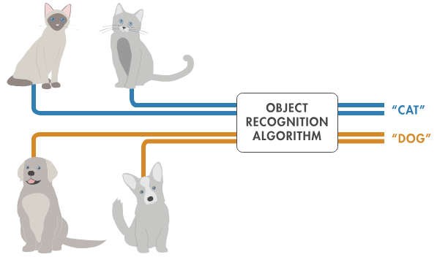
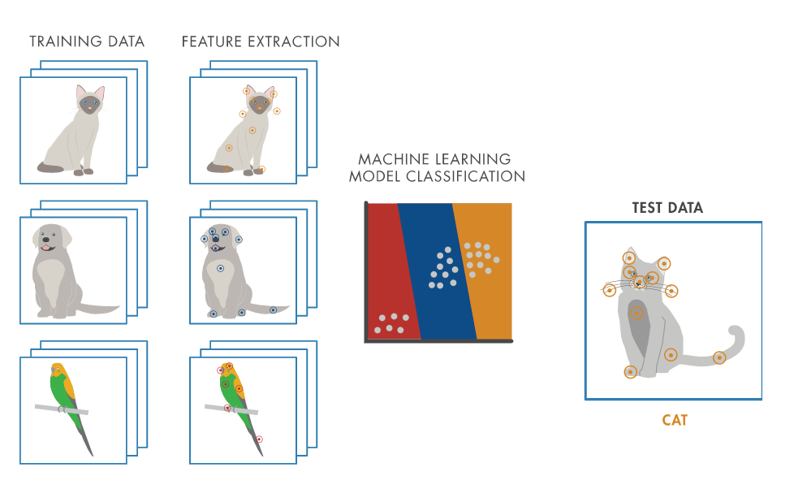
Using machine learning for classification
570,000 images from 2021-2023
800 images per sample!
Subsample these to build groups of phytoplankton

Slide 6
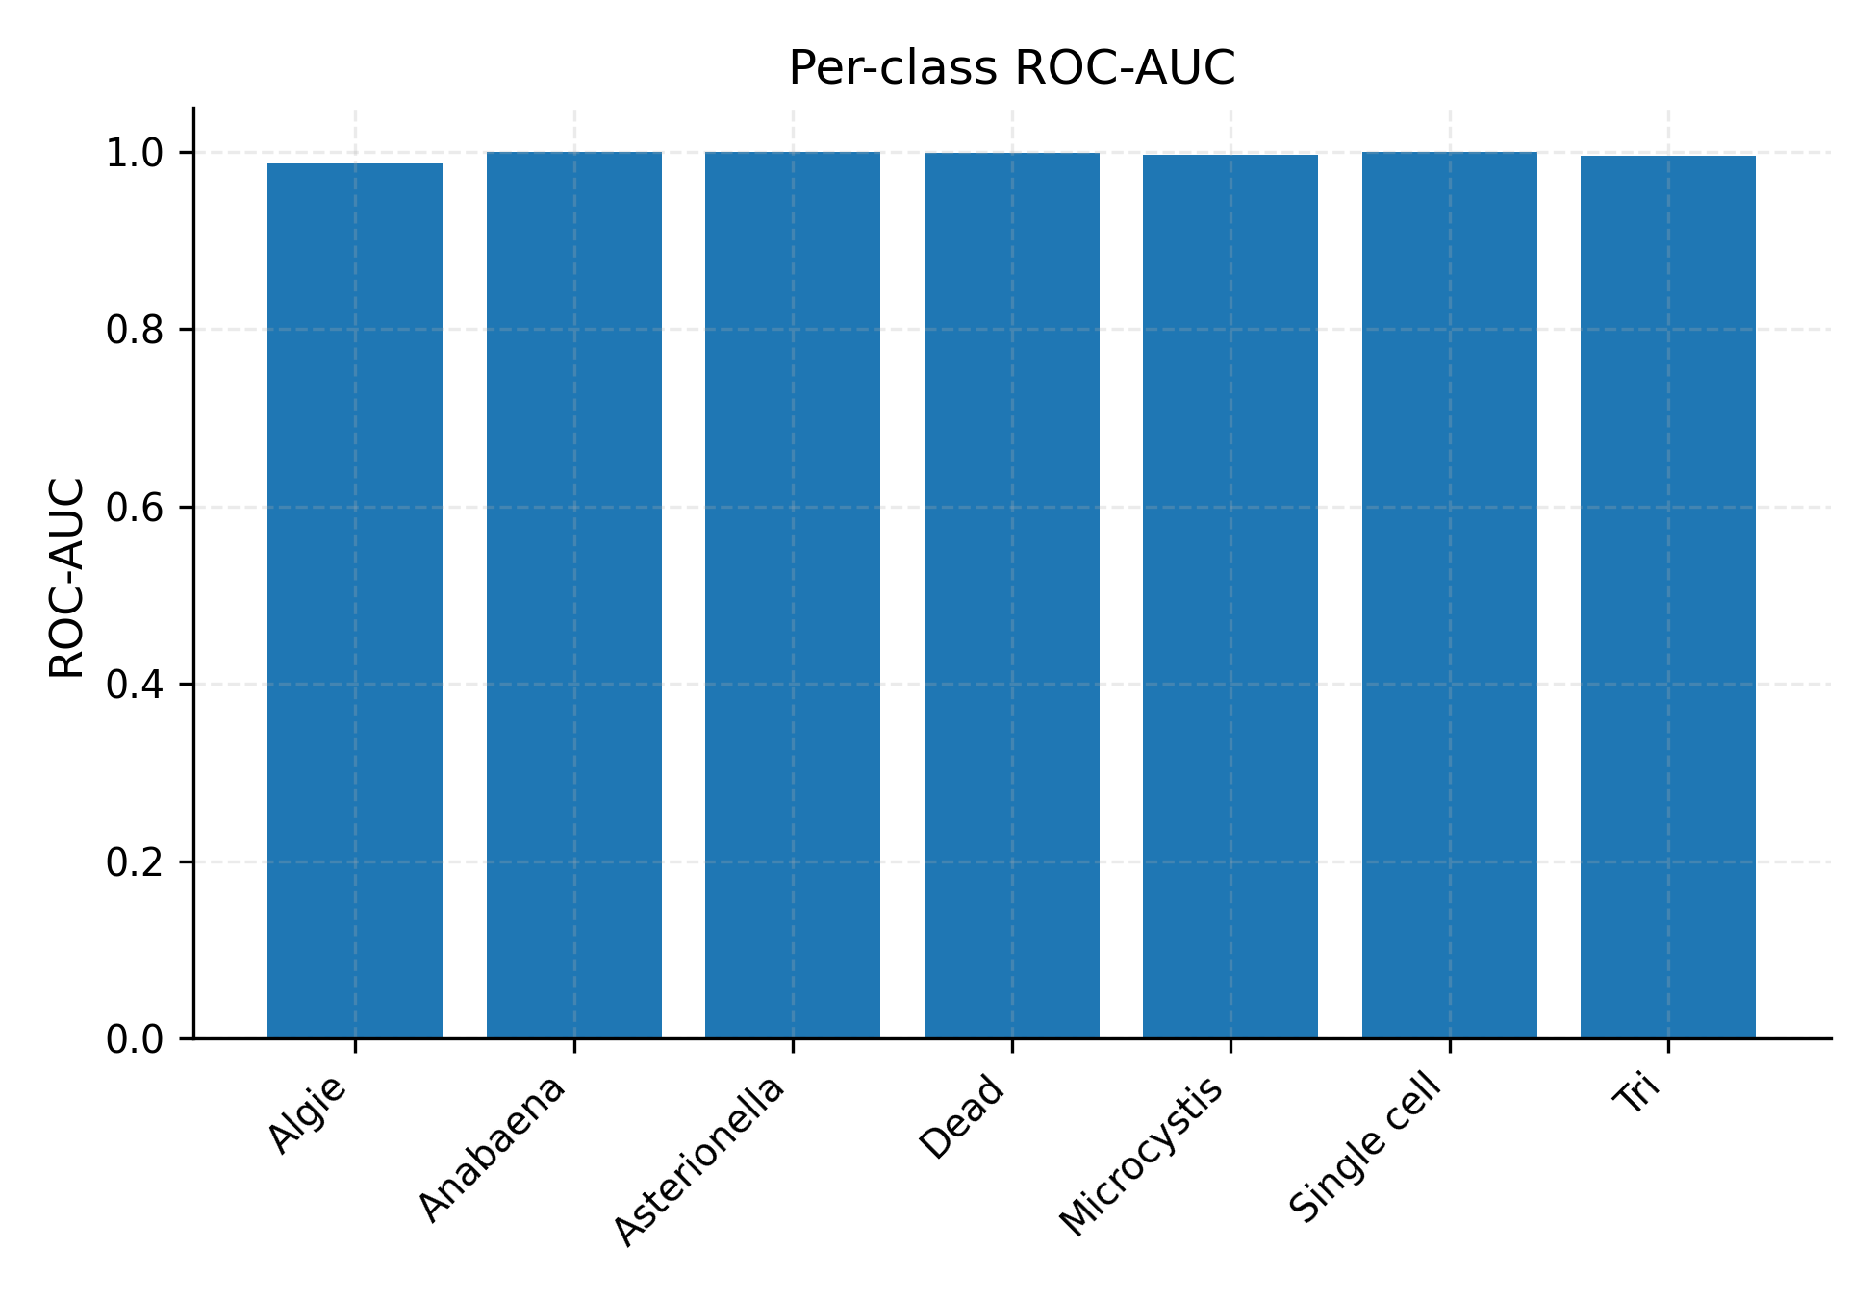



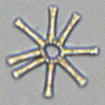
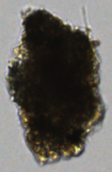
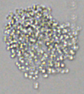

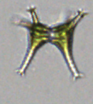
Initial ML results: very high accuracy and precision
Receiver operator curves
(1 = perfect results)
Algae
Asterionella
Debris
Microcystis
Single cells
Filamentous
cyanobacteria
Desmid
Kavi Francis

Slide 7
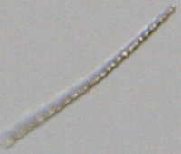
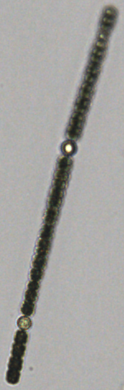

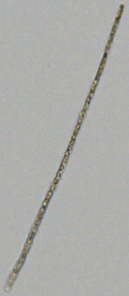
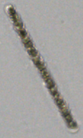

Project ideas and needs
Organize measurement data from prior years
  Create statistical models to find patterns in blooms and possibly predict future blooms?
Organization of FlowCam image data
  2021-2026
  500k images per year
Refine and validate machine learning tool to classify FlowCam data
Filamentous cyanobacteria
Thank you!
Questions?

Slide 9
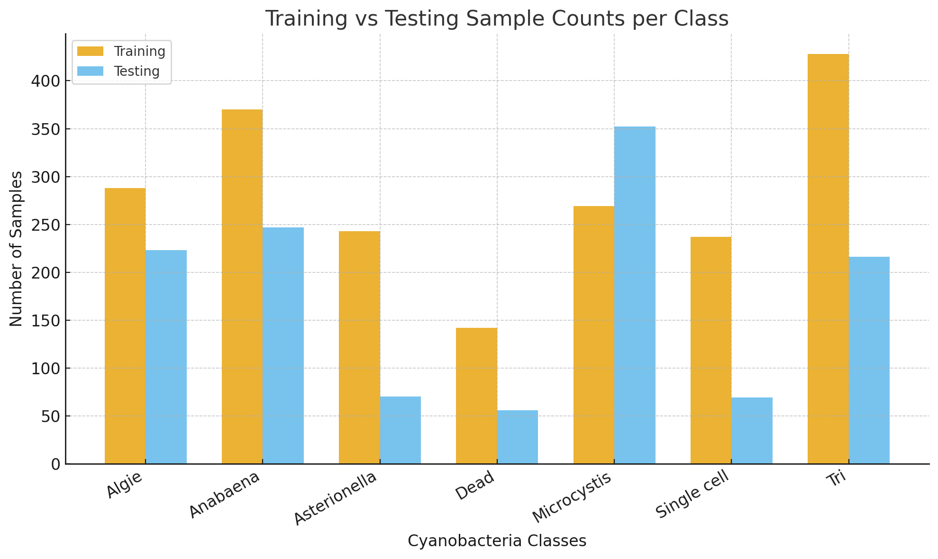
The first round of training and testing data
Train the ML model with some of these images
Evaluate the accuracy, precision of the model on the other images
Number of images
Filamentous
cyanobacteria
Asterionella
Debris
Microcystis
Single cells
Desmid
Algae

Slide 10
On-going work
Identify more specific genera of filamentous cyanobacteria
Clustering approaches to parse out image datasets
Validating more images
  Participation from volunteers to ID?
Test congruence of image analysis with DNA sequencing analysis
Filamentous cyanobacteria
Thank you!
Questions?

Slide 11
Organize measurement data from prior years
  Opportunity to create statistical models to find patterns in blooms and possibly predict future blooms?
Organization of FlowCam image data
  2021-2026
  500k images per year
Refine and validate machine learning tool to classify FlowCam data

Slide 12
FlowCam output and analysis
Captures hundreds of microscopic images per sample
Analysis is still manual
Nick
800 images per sample!
Machine learning approaches have the potential to automate this process

Slide 13

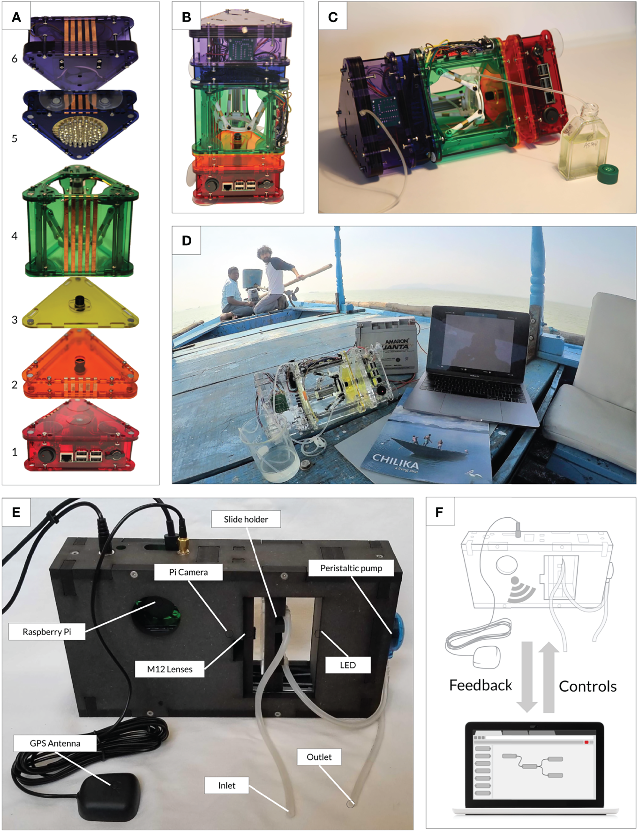
$1000 system
vs.
$100,000 FlowCam

Slide 14
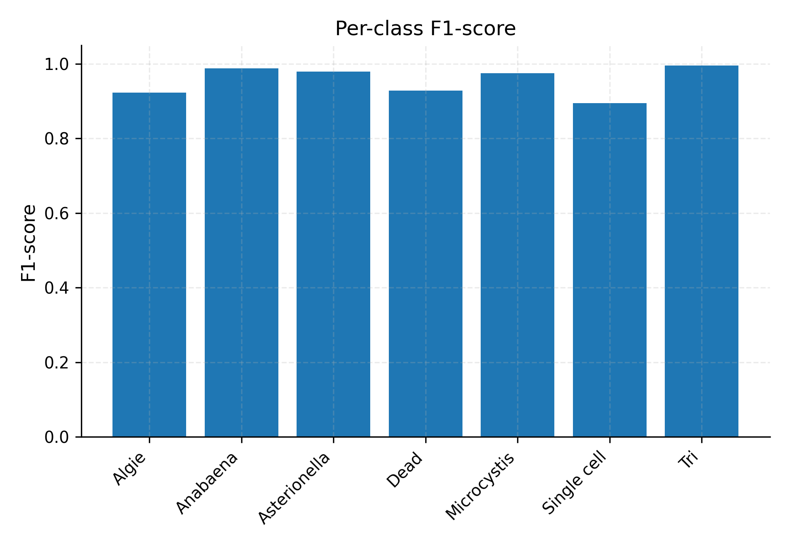
9) Per-class F1-score
F1 per genus; top performers: Tri, Anabaena
Notes:
Harmonic mean of precession and recall
F1 Score = 2 * (Precision * Recall) / (Precision + Recall)
F1 score as low as 0.6 might be considered good.

Slide 15
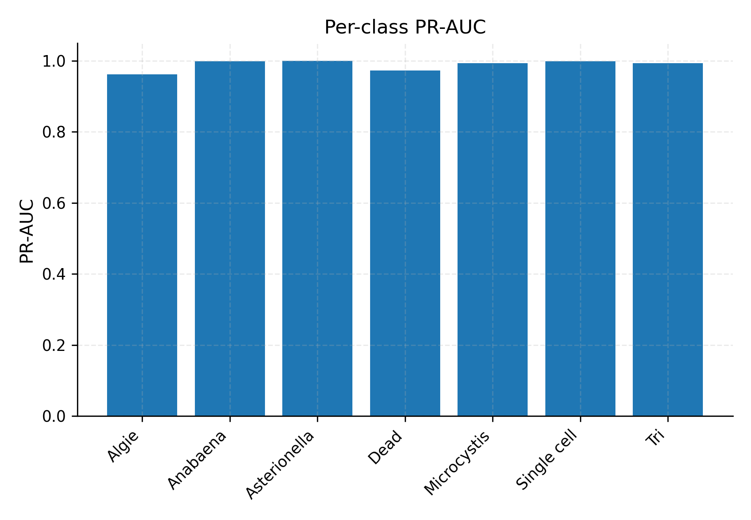
10) Per-class PR-AUC
High precision over wide recall across classes
Notes:
(True Positive/(False Positive + True Positive) )/ (True Positive/(True Positive + False Negative))

Slide 16
11) Per-class ROC-AUC
Near-perfect separability by ROC
Notes:
True positive rat/false positive rate

Slide 17
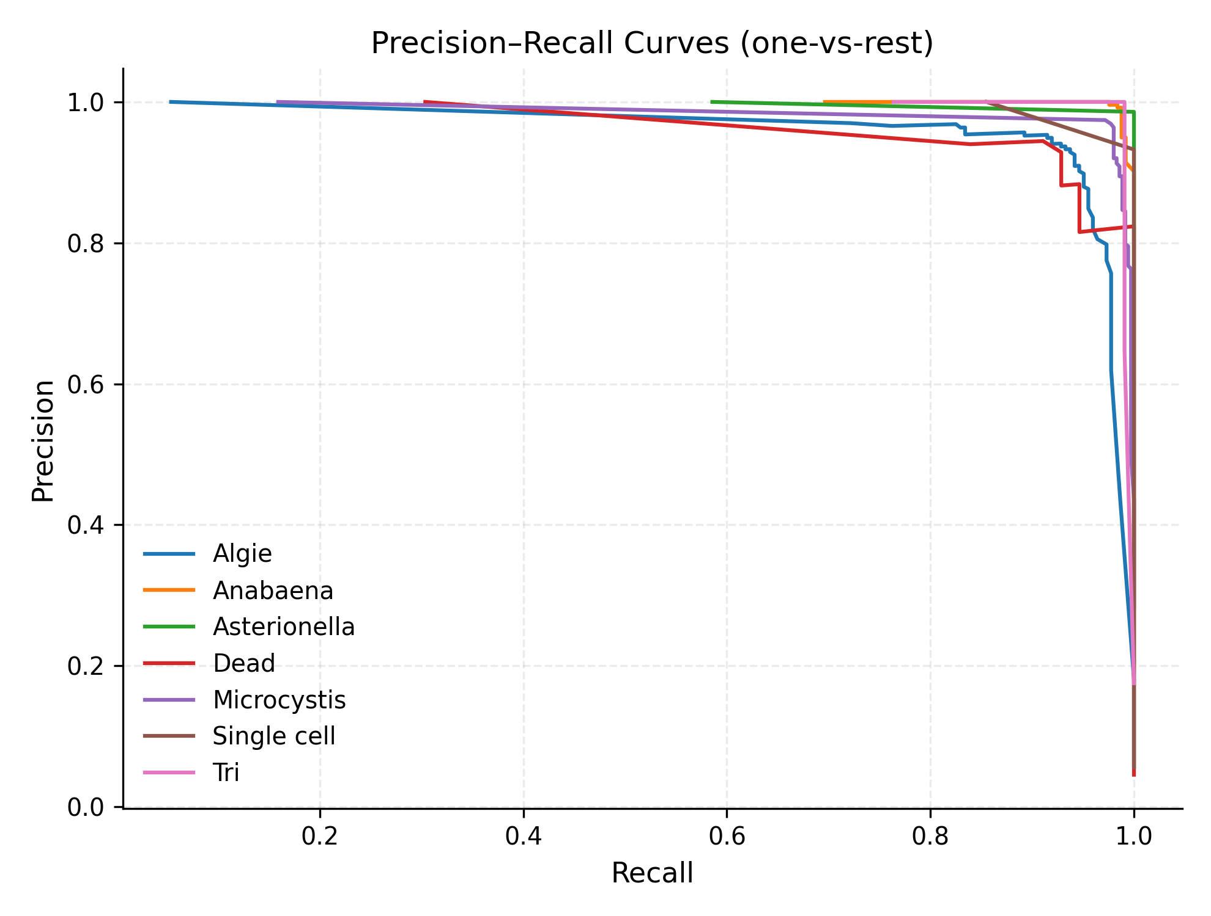
12) Precision-Recall Curves (OVR)
Operating points set via Fβ=2.0 thresholds

Slide 18
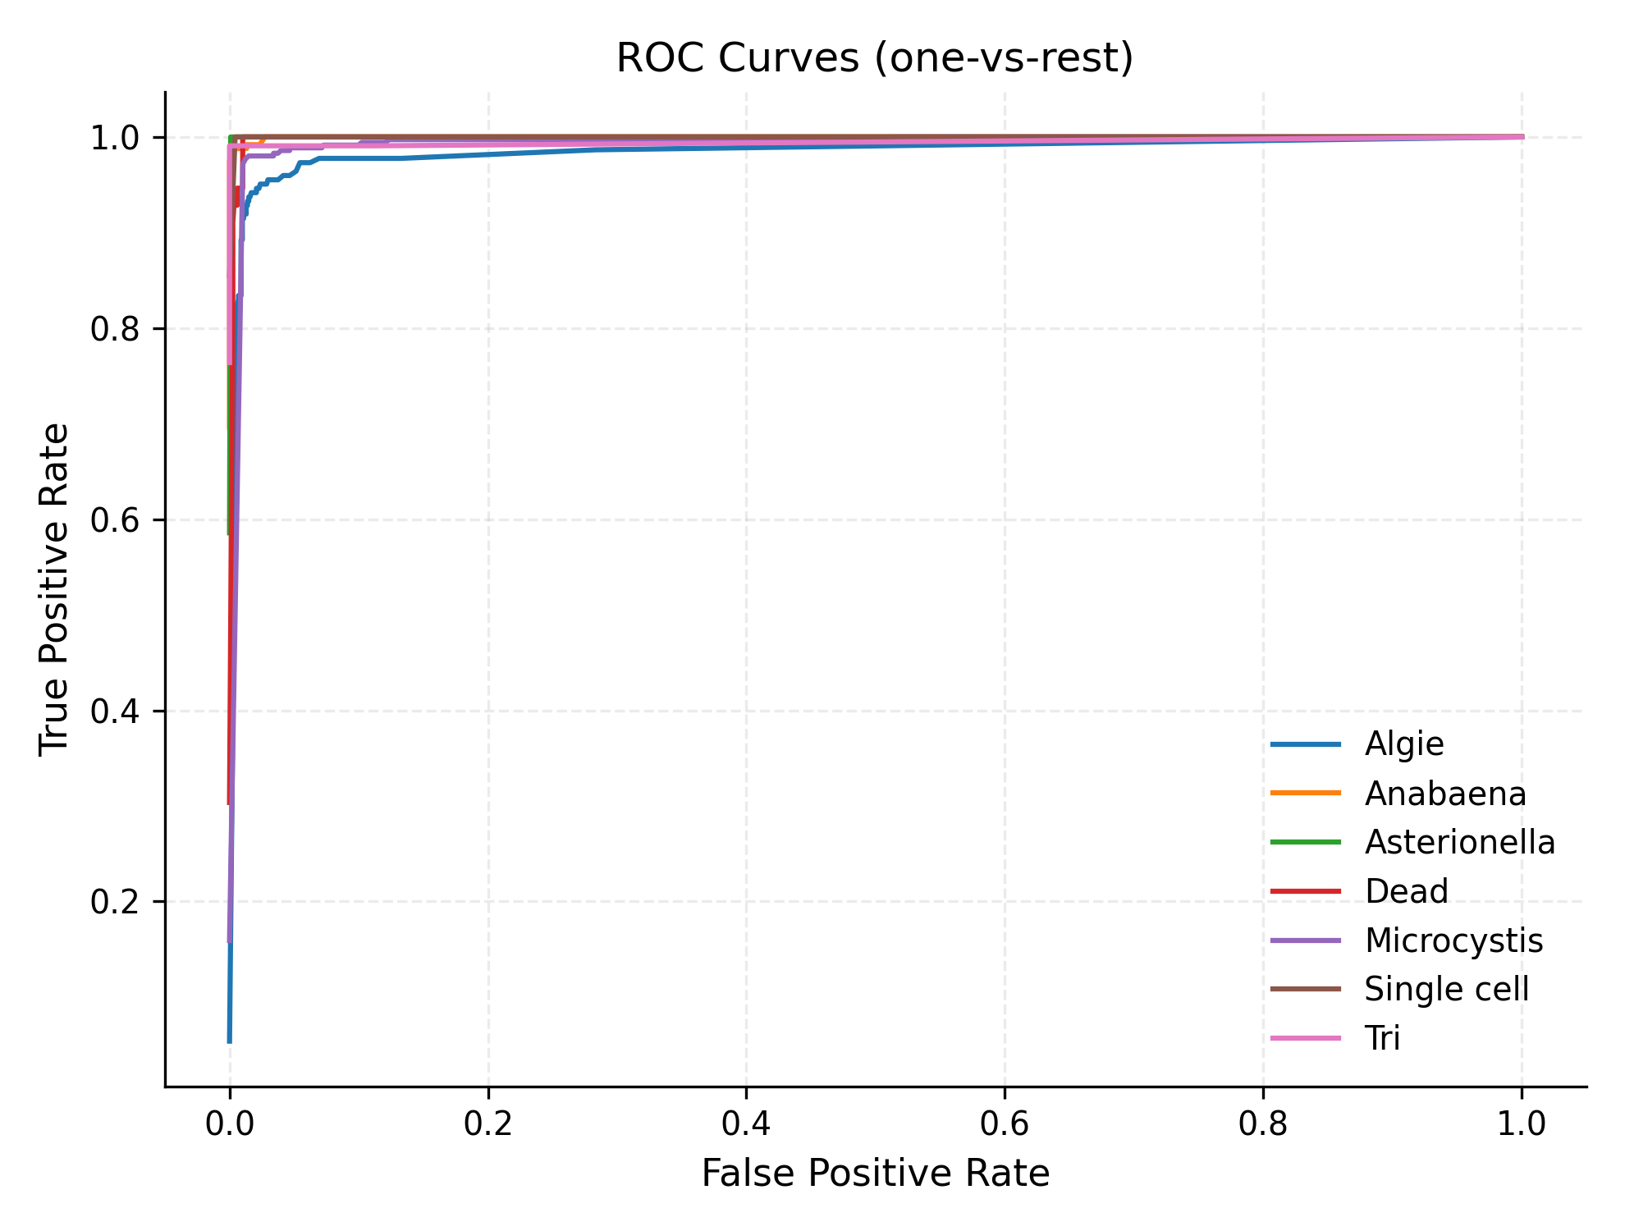
13) ROC Curves (OVR)
Low FPR at high TPR; curves cluster near top-left

Slide 19
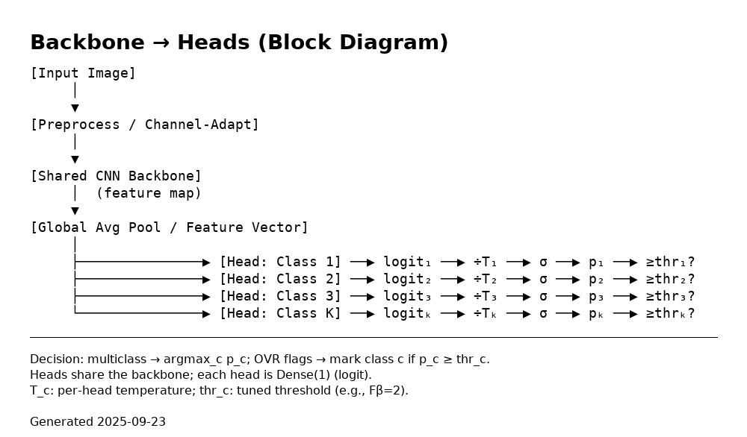
4) Modeling Approach (Multi Binary)
Shared EfficientNetV2‑S backbone → K binary heads (one‑vs‑rest)
Per‑head temperature scaling; thresholds chosen by Fβ=2.0
Easy to add/remove genera; robust to class imbalance

Slide 20

6) Imbalance Controls
Imbalance Controls
neg_ratio = 3.0 → sample 3 negatives per positive
synthetic_ratio = 0.30 → 30% blended synthetic positives
Hard Negative Mining → mine misclassified examples;
expand negative pool each round
Total training: 60 epochs*Best epoch selected based on Value loss
Test-Time Augmentation (TTA): ×5; combine = uniform average
Decision rule:
  For class $c$: $p_{c}=σ\left({\text{logit}}_{c}/T_{c}\right)$
  Use ${\text{thr}}_{c}$ and/or argmax across classes
Augmentation montage
Notes:
Imbalance Controls
neg_ratio = 3.0 → sample 3 negatives per positive
synthetic_ratio = 0.30 → 30% blended synthetic positives
Hard Negative Mining → mine misclassified examples;
expand negative pool each round
Scheduler: Cosine learning rate
Warmup: 2 epochs
Total training: 60 epochs
Batch size: 32
Inference / Manifest
Manifest stores, per head/class:
Temperature $T_{c}$
Threshold ${\text{thr}}_{c}$
Test-Time Augmentation (TTA): ×5; combine = uniform average
Decision rule:
For class $c$: $p_{c}=σ\left({\text{logit}}_{c}/T_{c}\right)$
Use ${\text{thr}}_{c}$ and/or argmax across classes

Slide 21
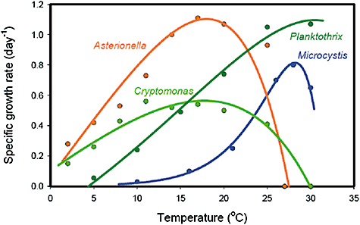
Evidence that warming temperatures favor cyanobacterial blooms
Temperature dependence of the specific growth rates of the cyanobacteria Microcystis aeruginosa (Reynolds, 2006) and Planktothrix agardhii (Foy et al., 1976), the diatom Asterionella formosa (Butterwick et al., 2005) and the cryptophyte Cryptomonas marssonii (Butterwick et al., 2005). The data are from controlled laboratory experiments using light-saturated and nutrient-saturated conditions. Solid lines are least-squares fits of the data to the temperature response curve of Chen and Millero (1986).
Environ Microbiol Rep, Volume: 1, Issue: 1, Pages: 27-37, First published: 05 February 2009, DOI: (10.1111/j.1758-2229.2008.00004.x)

