Slide 1
KUbernetes
Presented By – Dhaval Suthar, Ravi Kiran, Veena Iyer, Prajakta Sumbe

Slide 2
What is kubernetes? Why all the buzz
Containerization(Dockerization): Light weight alternative to full machine virtualization that involves encapsulating an application in a container with it own
How can you manage and deploy all of your containerized application ?
E.g. companies are not just using 1 or 2 containers in productions, it's number comes between 10's and 100's or maybe more than that. They use these containers for load balancing the traffic and to ensure the high availability. As the traffic increases, then there is a need for scaling up the containers so that it can service the increasing number of requests coming every second. In case there is less demand and the traffic is decreasing, they have to scale down the containers, do you think it can all be done manually?
That’s where Kubernetes comes into the picture.

Slide 3
What is kubernetes? Why all the buzz
Kubernetes is an automated intervention is what makes work easier for the companies. It does the container orchestrations, service discovery & load balancing, scaling up and down the containers for you.
Originally developed by Google as an offshoot of its project, Kubernetes is an open-source container orchestration platform designed to automate the deployment, scaling, and management of containerized applications.
Sometimes referred to as “K8s” Kubernetes makes it easy to deploy and operate applications based on a microservice architecture.
Helps you move faster as it allows you to deliver a self-service Platform-as-a-service (PaaS) that creates a hardware layer abstraction for development teams
IT Flexibility : It is portable as it runs on AWS, Azure & GCP
Cost Saving: Kubernetes is cost efficient. Kubernetes and containers allow for much better resource utilization than hypervisors and VMs do.

Slide 4
Docker vs. Kubernetes: It’s Not About One or the Other
According to Docker’s own definition, a container image “is a lightweight, stand-alone, executable package of a piece of software that includes everything needed to run it: code, runtime, system tools, system libraries, settings.” Containerization is hugely advantageous in the age of DevOps, cloud architectures, and increasingly distributed computing environments, all of which has led to Docker’s rapid and widespread adoption.
While Docker provided an open standard for packaging and distributing containerized applications, there arose a new problem. How would all of these containers be coordinated and scheduled? How do all the different containers in your application communicate with each other? How can container instances be scaled?
If you have 10 containers and four applications, container orchestration isn’t that big of a deal. If you have a 1,000 containers and 400 services, it’s a much more complicated picture. Enter Kubernetes and container orchestration. Kubernetes is a tool for automating the deployment, management, and scaling of containerized applications. And automation is key; it’s one reason why Kubernetes is increasingly a Go-To tool for site reliability engineers and other infrastructure and operations pros. Kubernetes makes the ongoing orchestration of potentially thousands of containers manageable; it’s what helps ensure your service is always running.

Slide 5
Kubernetes vs. Docker Swarm
So, Docker and Kubernetes are emphatically not an either-or choice; rather, it can be helpful to think of Docker and Kubernetes as two significant pieces of a larger system
If there’s a misconception that Docker and Kubernetes are competitors, or an either-or proposition, it’s not entirely without reason. That’s largely because the Docker ecosystem includes its own container orchestration solution, Docker Swarm, that functions as an alternative to Kubernetes.
Docker added robust support for Kubernetes earlier this year when they unveiled Docker Enterprise Edition 2.0, which enables users to run both Kubernetes and Docker Swarm on the same cluster.
In certain non-production use cases, such as using containers only in test or development environments, using Docker without Kubernetes might be perfectly fine. Docker Swarm has a reputation for being easier to use, whereas Kubernetes typically comes with a steeper learning curve for most users.

Slide 6
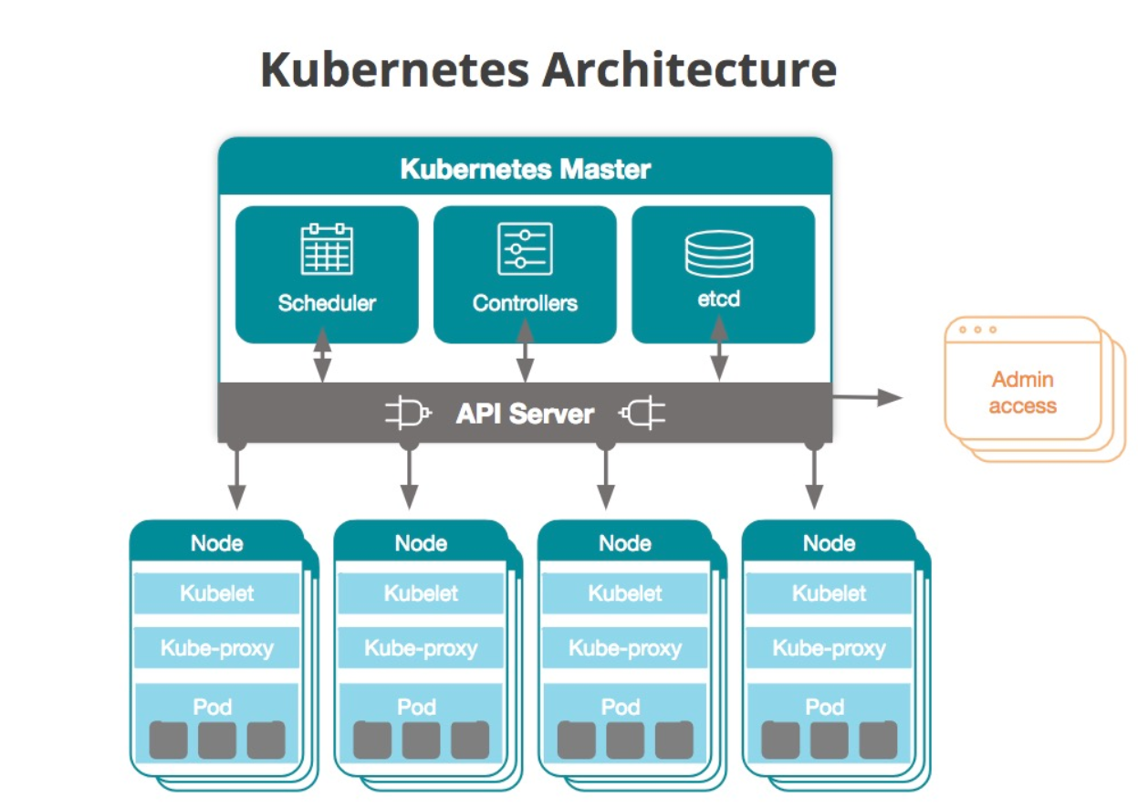
Kubernetes – how does it work?

Slide 7
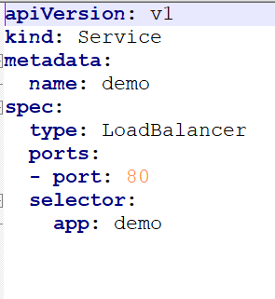
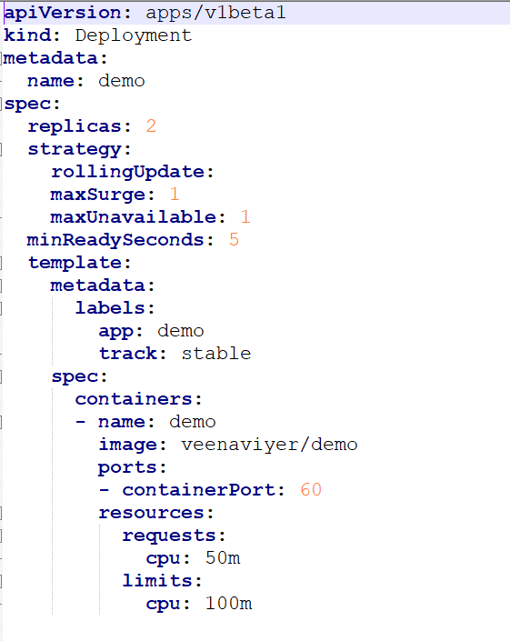
Kubernetes – Services.yaml; deployment.yaml

Slide 8
Good Reads!!
https://blog.newrelic.com/engineering/what-is-kubernetes/
https://blog.newrelic.com/technology/docker-vs-kubernetes/
https://www.seldon.io/
https://kubernetes.io/docs/concepts/services-networking/connect-applications-service/
https://stackify.com/canary-deployments/
https://www.kubeflow.org
https://www.redhat.com/en/topics/containers/what-is-kubernetes
https://cloud.google.com/kubernetes-engine/

