Slide 1
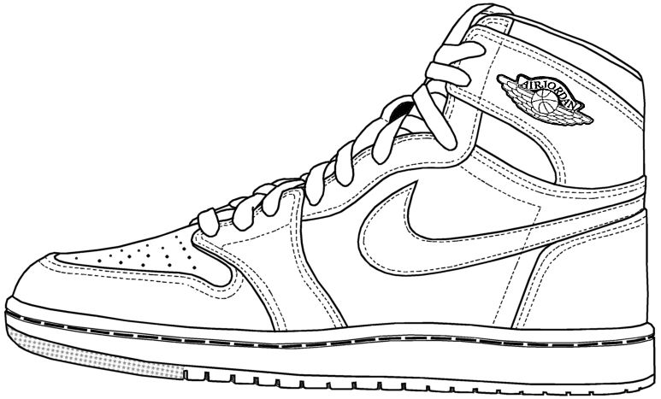
Predicting Sneakers
Using Machine Learning and Twitter Data to Predict Successful Sneaker Launches
By Team 1

Slide 2
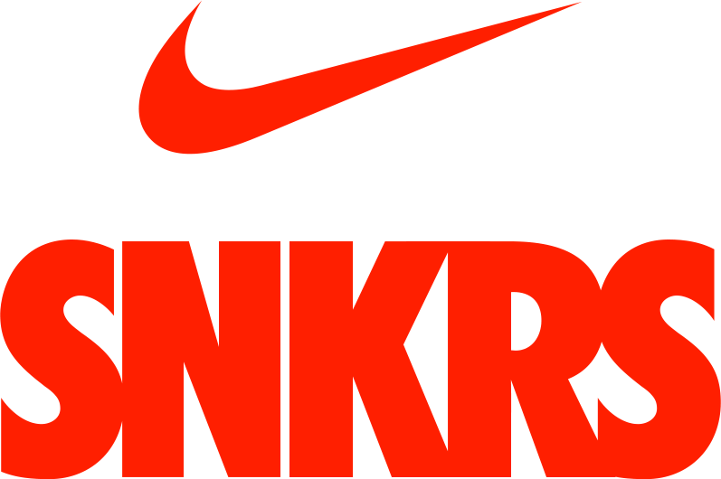
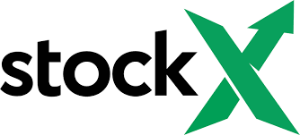
&
Notes:
Launched in 2015 Nike SNKRs app is Nike’s shop for consumer’s to have a chance at randomly being selected to purchase their most exclusive releases. A report from Quartz suggested the revenue the application generated was over $70 million dollars in 2016 which grew to $750 million dollars in 2019, in addition to making up 20% of Nike’s digital business.
Once sold on apps like SNKRS many will resell their shoes on stockX, an incredibly popular resale site where buyers and sellers can bid on sneakers they weren’t able to buy at retail. ‘
Sneaker culture is continuing to grow and with near daily releases on the SNKRS app alone our team intends to capitalize on these services.

Slide 3
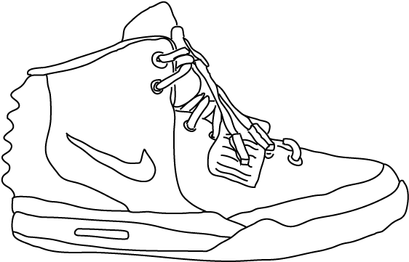

Predicting the Most Profitable Releases
Notes:
Our team turns the hype of sneaker releases found on Twitter as an indicator for predicting the resale value of an upcoming sneaker releases.
We’ve constructed a “hype” index that is a positive popularity indicator for a given sneaker on twitter.

Slide 4
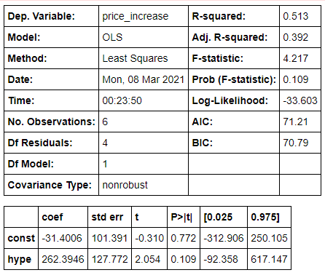
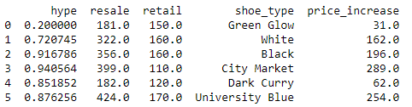

Predicting the Most Profitable Releases
Notes:
For the purposes of our demonstration today we’ve collected data on seven releases on Nike SNKRs app over the past week. As you can see on screen we are building our predictions currently with an R-square of .513. One shoe we want to make note of from our testing set is the Nike Dunk High Dark Curry’s, which were incredibly popular on Twitter but only had a $62 resale price increase, we feel the issue is that there were too high of a supply. We see our business being expandible to other popular brands such as Adidas and Puma as well as more parts of the fashion industry besides sneakers.

Slide 5
You Don’t Want To Miss Out
Low-Operating Costs
No Notable Competition
An Emerging Market
$30,000 stake at 12% of our company!
Notes:
With low operating costs in a growing marketspace with no notable competition we see our ability to step in as contractors for popular brands such as Nike to help consult on how they can further optimize their release calendar to scale their profitability.
Whether that’s by managing the supply for a given release or further investigating retail pricing of sneakers. We are coming today looking for a $30,000 stake at 12% of the company!

Slide 6
Credits
https://www.indigo9digital.com/blog/how-nike-is-turning-your-smart-phone-into-a-digital-shopping-assistant
https://qz.com/quartzy/1655111/nikes-snkrs-app-is-fueling-its-digital-business/

