Slide 1

The World of Television Happens in 16 Milliseconds

Slide 2
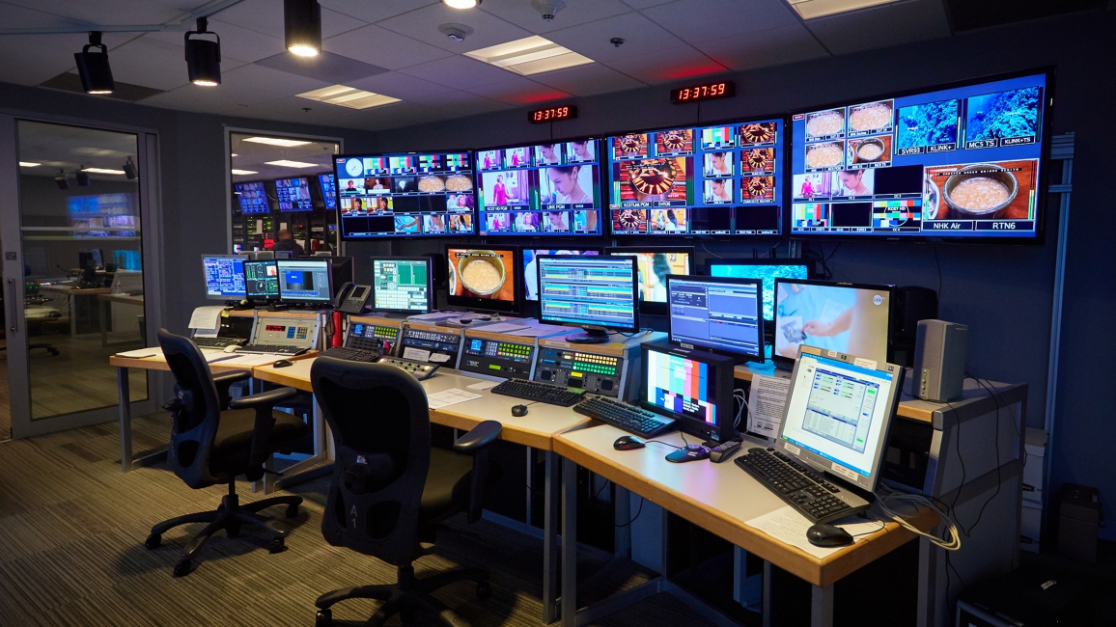
Broadcast television is the result of multiple camera angles and other video sources

Slide 3
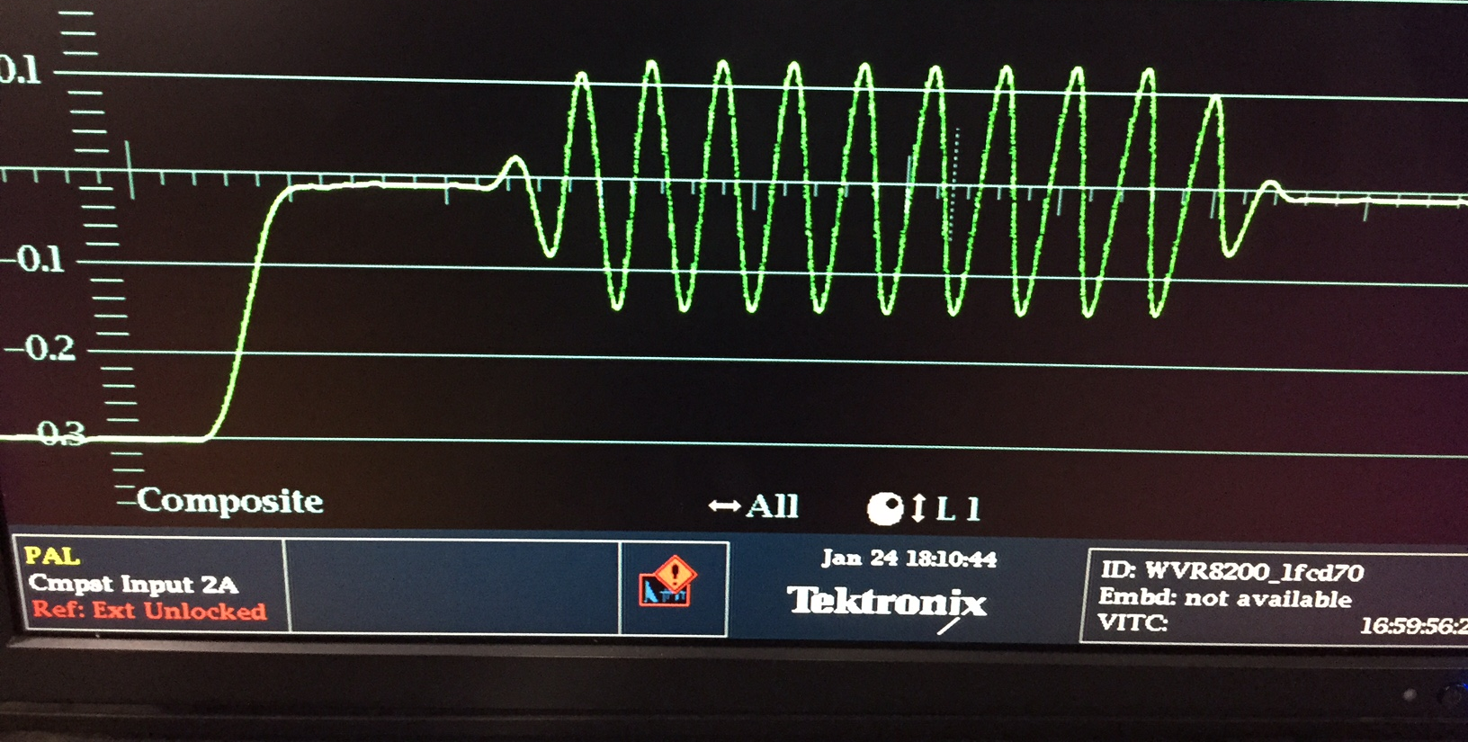
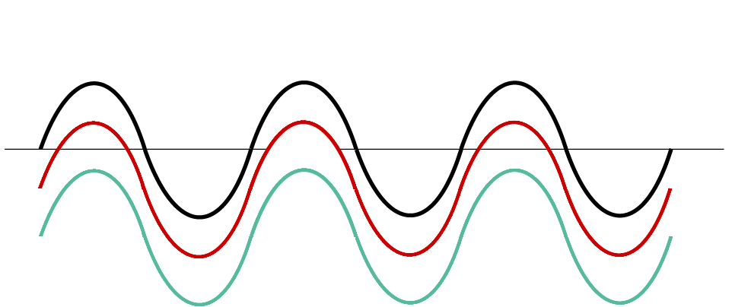
What makes this possible is a technology called video reference, commonly referred to as black burst or house sync. An analog black video signal that other video sources align themselves to.

Slide 4
Without Reference relock time
is around 2-3 seconds

Slide 5
Video Formats and Standards:
(Vertical Raster) (Transport) (Frames Per Second)
SD 276 Mb/s - 525i29.97 / 625i25
HD 1.5 Gb/s - 720p50, 59.94, 60 / 1080i/p 23.98, 24, 25, 29.97, 30
HD 3 Gb/s - 1920x1080p 47.98, 48, 50, 59.94, 60
UHD 6 Gb/s - 3840x2160p 23.98, 24, 25, 29.97, 30
UHD 12 Gb/s - 3840x2160p 47.98, 48, 50, 59.94, 60
(2k/4k and RGB formats omitted - Not used in Broadcast)

Slide 6
Analog Reference Formats:
(Vertical Raster) (Transport) (Frames Per Second)
SD 276 Mb/s - 525i29.97 / 625i25
HD 1.5 Gb/s - 720p50, 59.94, 60 / 1080i/p 23.98, 24, 25, 29.97, 30
HD 3 Gb/s - 1920x1080p 47.98, 48, 50, 59.94, 60
UHD 6 Gb/s - 3840x2160p 23.98, 24, 25, 2997, 30
UHD 12 Gb/s - 3840x2160p 47.98, 48, 50, 59.94, 60
(2k/4k and RGB formats omitted - Not used in Broadcast)

Slide 7

NTSC 29.97/30, 59.94/60
PAL 25/50
Based on the electrical frequency of the country 50hz or 60hz

Slide 8
KEY TAKEAWAY FROM ALL THIS!!
Reference allows for switching of video
sources in under 16 Milliseconds

Slide 9
What is the best reference format to use
for your studio’s workflow?
Data Acquisition -> Data Science

Slide 10
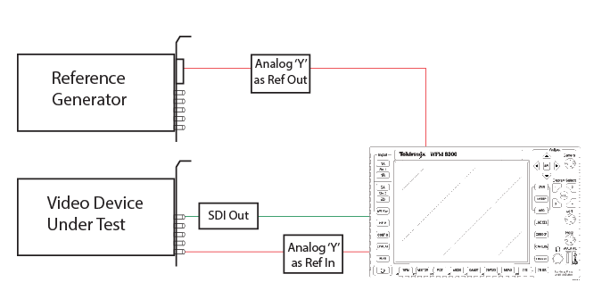
Wiring Diagram for Data Acquisition

Slide 11
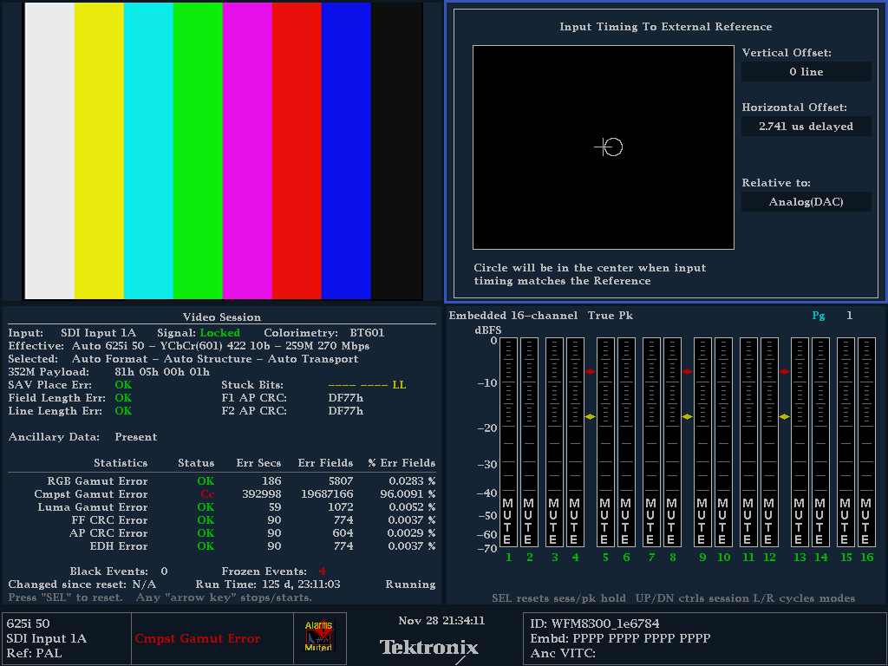
WFM8300 Front Panel

