Slide 1
Working of Driver Protection System
Deepesh Padala 20BEC0264
RADAR:
Contains an ultrasound sensor(HC-SR04), as well as a servo motor
The motor moves every degree, and gets the distance of the nearest obstacle. If it’s below 0.5m, it sounds a buzzer. You can also view the radar gui on the screen
Drowsiness Detection for cars:
Contains resistive touch sensor, on the steering wheel, if the driver gets drowsy and loosens the grip on the wheel, it can sense and alert the driver
Optional Features:
- Using image processing and AI to detect if the person is drowsy or not
- Adding a TENS unit to the wrist of the driver, to give a small shock the driver, in case he/she falls asleep, apart from waking the driver up, it will also force his arm to tighten the grip on the wheel, by making the muscle contract involuntarily

Slide 2
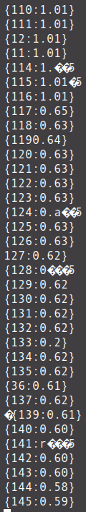
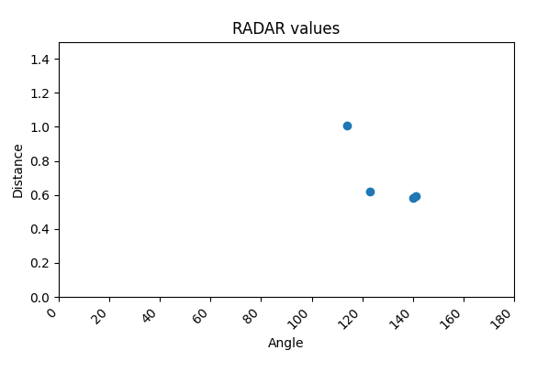
Progress made from Review 1 to 2
Found many applications for the project
Built the RADAR part, and able to view values on the screen
Blue dots are obstacles

Slide 3
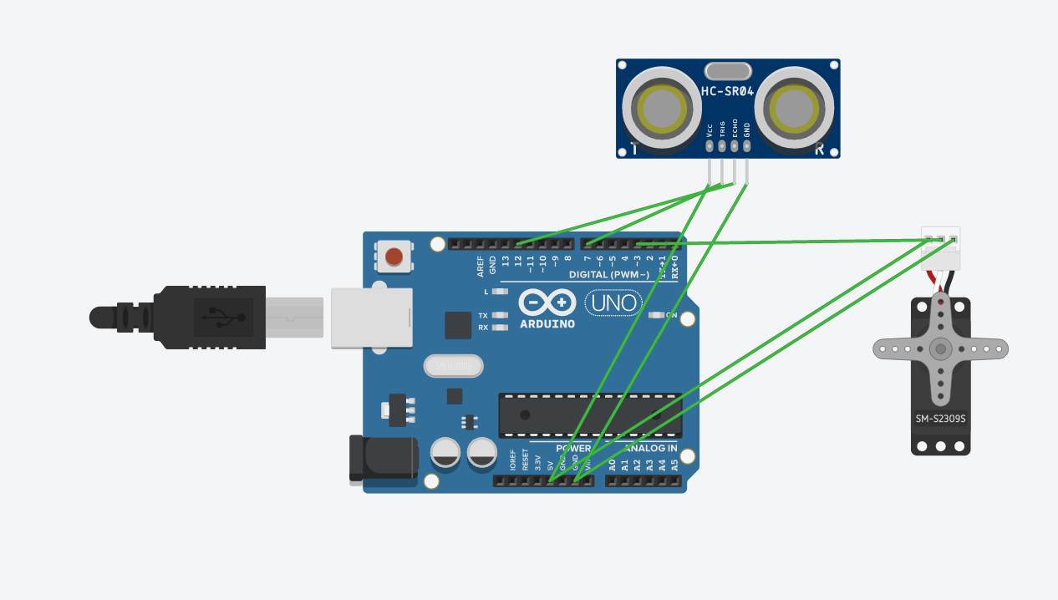
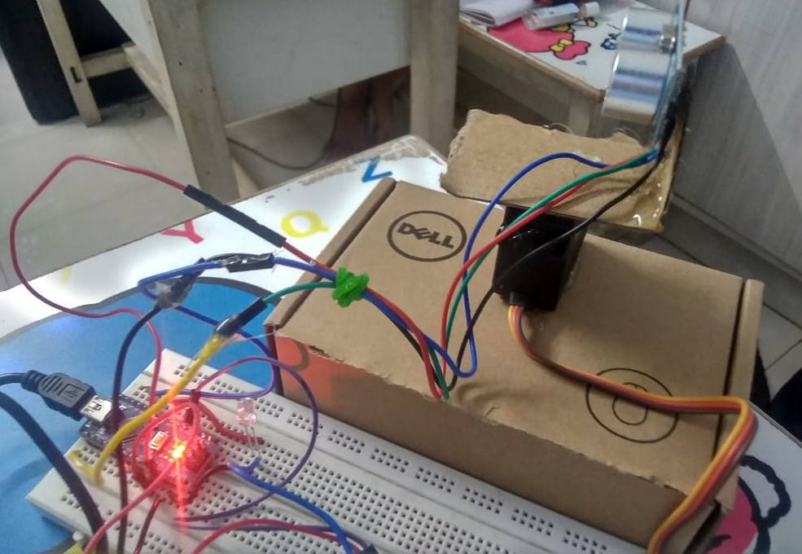
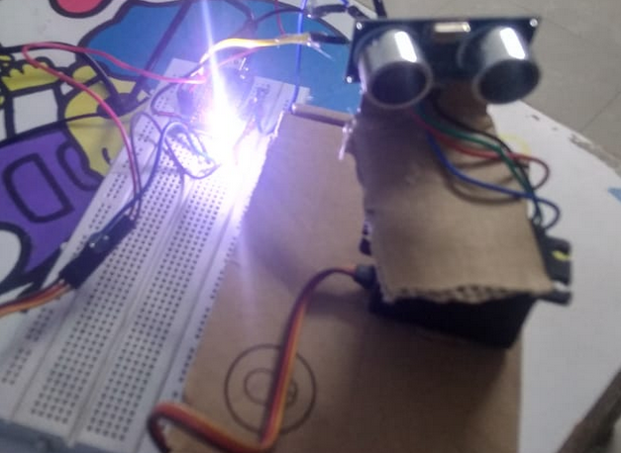
Circuit and Circuit Diagram
Buzzer was not available, had to use a really bright LED instead

