Slide 1
Functions

Slide 2
object
function()
cookies <- bake( batter, temp=400 )
assignment

Slide 3
arguments (function input)
makeCookies <- function( flour, eggs, sugar )
{
batter <- mix( flour, eggs, sugar )
cookies <- bake( batter, temp=400 )
return( cookies )
}
“recipe”
return value (function output)

Slide 4
argument
function( x1 )
{
x2 <- step1( x1 )
x3 <- step2( x2 )
x4 <- step3( x3 )
return( x4 )
}
assignment
object
“recipe”
return

Slide 5
Data Structures

Slide 6
vector
V1 = [ 3, 7, 2, 9, ]
element
value=2

Slide 7
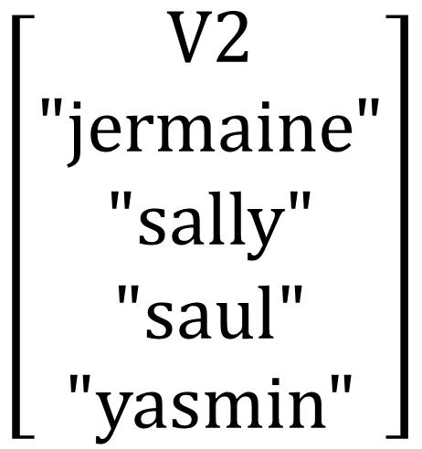
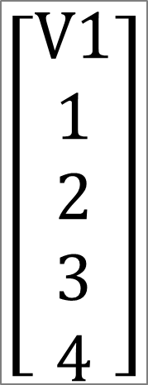


data frame
$$\left[\begin{aligned}V1 \\ 1 \\ 2 \\ 3 \\ 4\end{aligned}\right]$$
$$\left[\begin{aligned}V2 \\ "jermaine" \\ "sally" \\ "saul" \\ "yasmin"\end{aligned}\right]$$
$$\left[\begin{aligned}V3 \\ male \\ female \\ male \\ female \end{aligned}\right]$$
$$\left[\begin{aligned}V4 \\ TRUE \\ TRUE \\ FALSE \\ FALSE \end{aligned}\right]$$
numeric
character
factor
logical

Slide 8
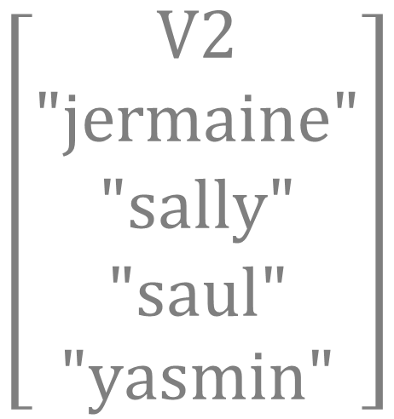

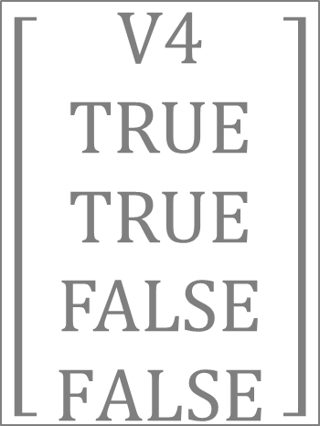

data frame
$$\left[\begin{aligned} V1 \\ 1 \\ 2 \\ 3 \\ 4\end{aligned}\right]$$
$$\left[\begin{aligned}V2 \\ "jermaine" \\ "sally" \\ "saul" \\ "yasmin"\end{aligned}\right]$$
$$\left[\begin{aligned}V3 \\ male \\ female \\ male \\ female \end{aligned}\right]$$
$$\left[\begin{aligned}V4 \\ TRUE \\ TRUE \\ FALSE \\ FALSE \end{aligned}\right]$$
numeric
character
factor
logical

Slide 9
R Markdown Settings

Slide 10
---
title: “Lab 07"
output: html_document:
---
# Setup
Global options
Load packages
Load data
# Your Work Here
```{r my_plot}
plot( x, y )
```
yaml header
always include these in document setup

Slide 11
---
title: "Markdown Document Overview"
output: html_document:
---
# Setup
Set global options
Load packages
Load data
# Your Work Here
```{css, echo=F}
table
{
margin-top:60px;
margin-bottom:60px;
}
```

Slide 12
Logical Statements

Slide 13
these.female <- gender == “female”
Male
TRUE
Study
Sample
FALSE

Slide 14
gender == “female” & study == “control”
gender
study
male
control
female
treatment
female
Female
control
Selected Group
Study
Sample
female
Female
control
control
male
control
female
treatment
male
treatment

Slide 15
gender == “male” & beard == TRUE
!( gender == “male” & beard == TRUE )
gender == “male” & beard == FALSE
gender
beard
Bearded Men
male
TRUE
male
TRUE
female
FALSE
female
FALSE
Not (!) Bearded Men
Men Without Beards
male
FALSE
male
FALSE
female
TRUE

Slide 16
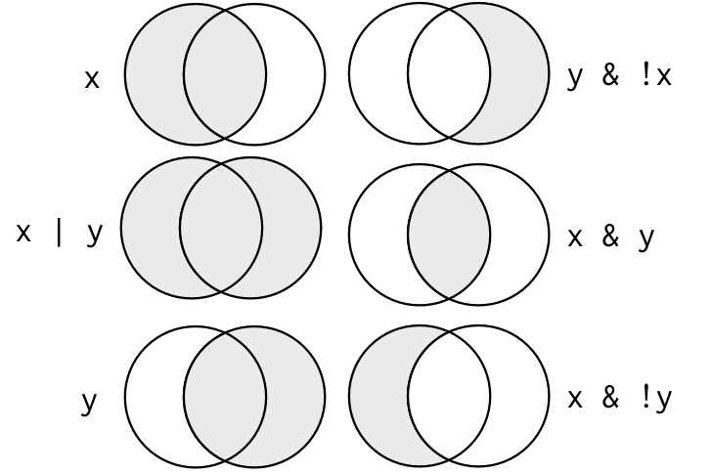
x
y

Slide 17
x
y

Slide 18
X <- c(“A”,”B”)
Y <- c(“B”,”C”)
X
Y
A
B
C

