Slide 2
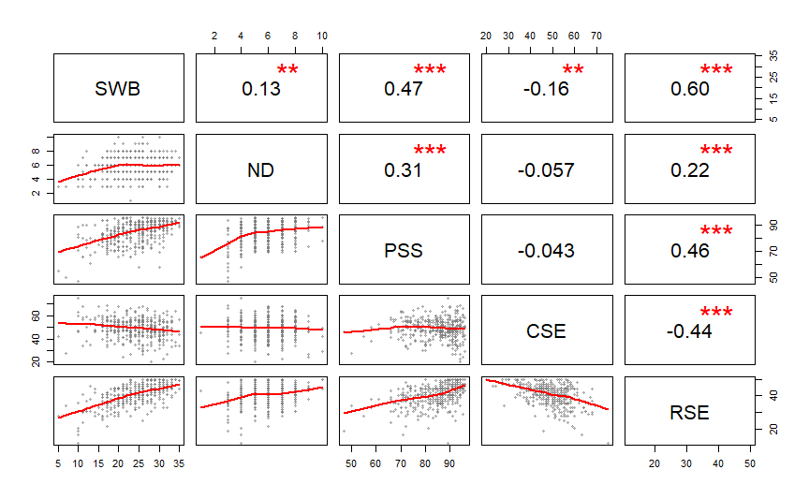
SWB
PSS
CSE
RSE
ND

