Slide 1
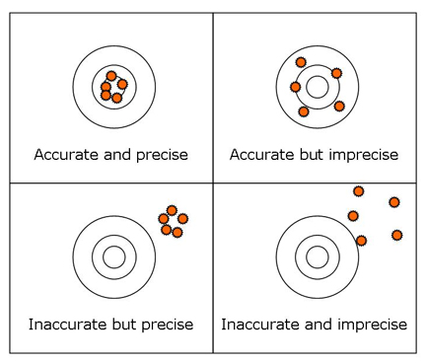
How do we evaluate the quality of a regression model?
Our estimate of program impact should be:
Accurate (“unbiased”)
Precise (“efficient”)
unbiased = no omitted variable bias efficient = small standard errors

Slide 2
Taxonomy of control variables
B1 = program impact
X3
Y
Full Model: Y = B0 + B1⋅X1 + B2⋅X2 + B3⋅X3 + e
X2
X1
policy variable
controls
Type A: Control is uncorrelated with X1
Type B: Control is correlated with X1
X3
Y
Y
Explains extra Y
Smaller standard errors
More precise estimates
Removes bias from B1
More accurate estimates
X2
X1
X1

Slide 3




How well will each model perform?
$$y=b_{0}+b_{1}x_{1}+b_{2}x_{2}+b_{3}x_{3}$$
$$y=b_{0}+b_{1}x_{1}+b_{2}x_{2}$$
X3
X1
X2
X1
X2
$$y=b_{0}+b_{1}x_{1}+b_{3}x_{3}$$
$$y=b_{0}+b_{1}x_{1}$$
X3
X1
X1

Slide 4
How do controls impact our model?
X3
Full Model: Y = B0 + B1⋅X1 + B2⋅X2 + B3⋅X3 + e
X1
X2

Slide 5

X3
Full Model: Y = B0 + B1⋅X1 + B2⋅X2 + B3⋅X3 + e
X1
X2
A
B
$$y=b_{0}+b_{1}x_{1}+b_{2}x_{2}$$
C
D
X1
X2
B: The competing hypotheses X2 helps isolate the independent contributions that X1, but the lack of the uncorrelated control variable X3 results in large standard errors.

Slide 6

X3
Full Model: Y = B0 + B1⋅X1 + B2⋅X2 + B3⋅X3 + e
X1
X2
A
B
$$y=b_{0}+b_{1}x_{1}+b_{3}x_{3}$$
X3
C
D
X1
C: This is a complicated case because the uncorrelated control results in small standard error, which can give false confidence when the absence of X2 results in omitted variable bias.

Slide 7

X3
Full Model: Y = B0 + B1⋅X1 + B2⋅X2 + B3⋅X3 + e
X1
X2
A
B
$$y=b_{0}+b_{1}x_{1}$$
C
D
X1
D: The absence of an important competing hypotheses (omitted variable X2) results in biased slopes, and the lack of beneficial controls leads to large standard errors.

Slide 8

X3
Full Model: Y = B0 + B1⋅X1 + B2⋅X2 + B3⋅X3 + e
X1
X2
A
B
$$y=b_{0}+b_{1}x_{1}+b_{2}x_{2}+b_{3}x_{3}$$
X3
C
D
X1
X2
A: The competing hypotheses X2 helps isolate the independent contributions that X1 makes to the outcome, and the unrelated variable X3 reduces standard errors.

Slide 9
Exam question: match the cases
X3
Full Model: Y = B0 + B1⋅X1 + B2⋅X2 + B3⋅X3 + e
X1
X2
X3
A
B
X1
X2
X1
B
C
C
D
X3
X1
X2
X1
A
D

Slide 10




Taxonomy of control variables
controls
B1 = program impact
X3
Y
Full Model: Y = B0 + B1⋅X1 + B2⋅X2 + B3⋅X3 + e
X2
X1
policy variable
Quality of B1:
Omit X3
NO
YES
NO
$$y=b_{0}+b_{1}x_{1}+b_{2}x_{2}+b_{3}x_{3}$$
$$y=b_{0}+b_{1}x_{1}+b_{2}x_{2}$$
Omit
X2
Unbiased & Precise
Unbiased & Imprecise
$$y=b_{0}+b_{1}x_{1}+b_{3}x_{3}$$
$$y=b_{0}+b_{1}x_{1}$$
YES
Biased & Precise
Biased & Imprecise

Slide 11
Match the cases on the right to the descriptions of model fit on the left
Teacher Quality
Test Scores
Full Model: TS = B0 + B1⋅CS + B2⋅SES + B3⋅TQ + e
Class Size
Socio- Economic Status
TQ
A
B
CS
SES
CS
CASE 1
CASE 2
C
D
TQ
CS
SES
CS
CASE 3
CASE 4

