Slide 2
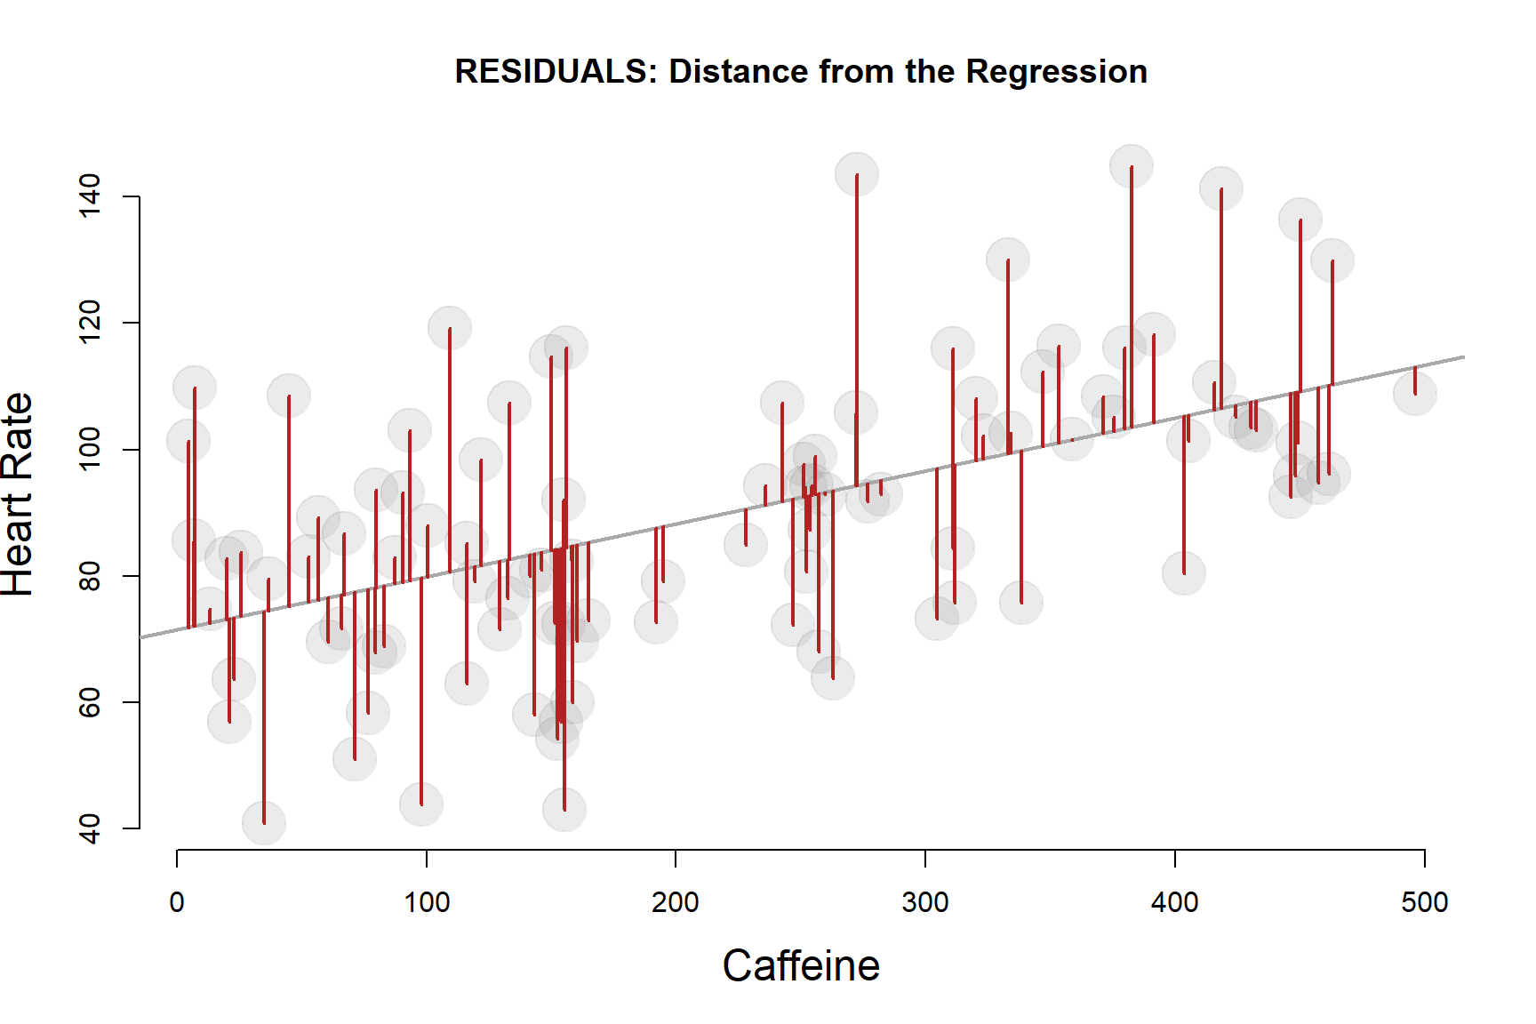
Week 1:
The residuals

