Slide 1
seven sins of regression
Fundamentals of
PROGRAM EVALUATION
JESSE LECY

Slide 2
(1) Omitted Variable Bias
Y
X
Z

Slide 3
When it matters:
x
y
Spurious Correlations
z
x
y
Indirect Effects
z

Slide 4
When it doesn’t matter:
x
y
z

Slide 5
(2) Multicollinearity
Y
Cannot tell the independent effects of either variable.
The standard errors of each slope will be inflated.
Z
X

Slide 6
(2) Multicollinearity
A
The higher the multicollinearity, the smaller B will be, which means larger the standard errors. When standard errors are large the confidence intervals are bigger and it is less likely that the slope will be statistically significant.
B
B
X1
X2

Slide 7
(3) Measurement Bias
Y
Y
A1
CASE 1
A2
X
Note:
A1 = A2
X

Slide 8
(3) Measurement Bias
Y
Y
A1
CASE 1
A2
X
Note:
B1 = B2
X
Y
Y
CASE 2
B2
B1
X
X

Slide 9
(3) Measurement Bias
Measurement Error is random error.
Measurement error in the dependent variable only affects the standard errors.
Measurement error in the independent variables causes attenuation.
Attenuation always pushes the slope towards zero, no matter if the relationship is positive or negative.

Slide 10
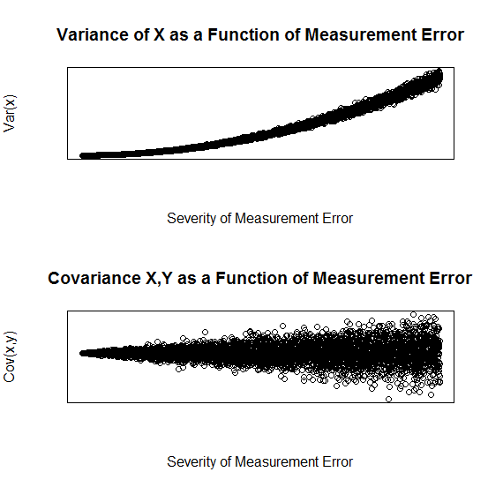
Random Measurement error example
+/-5
+/-50
+/-100
+/-5
+/-50
+/-100
Incrementally add Measurement Error to X,
Hold Y constant

Slide 11
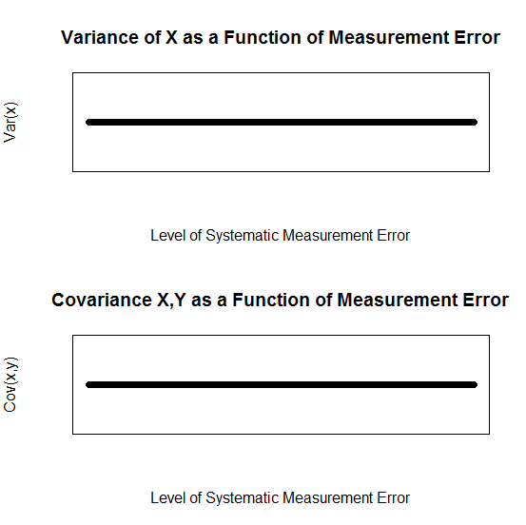
Systematic Mis-Measurement (add same amount to each observation)
Non-random
Measurement error example
+5
+50
+100
+5
+50
+100

Slide 12
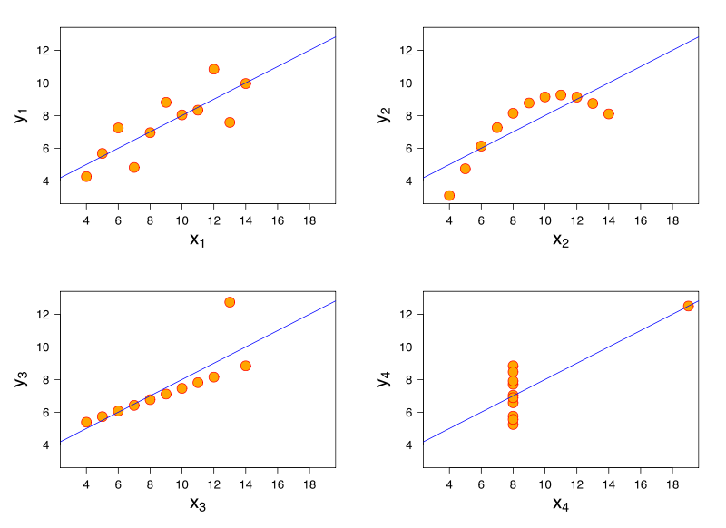
(4) Misspecification Bias

Slide 13
(5) Group Differences (Heterogeneity Bias)
If you have natural group structures in your data and there are innate differences in the groups that are correlated with your study variable then you will likely end up with heterogeneity bias in your estimates if you do not include the groups in your model.
A group can be many individuals in one or more time-periods. A “group” can also be one individual measured over time.

Slide 14
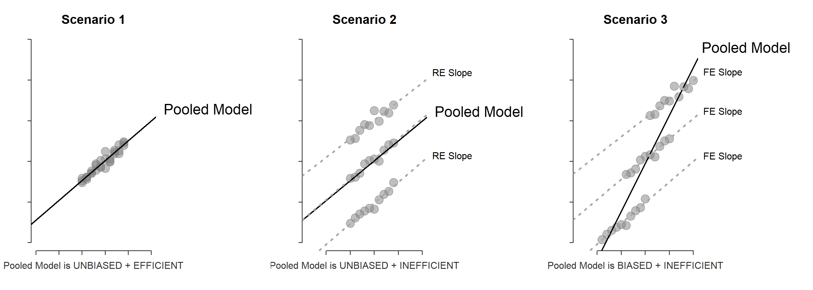
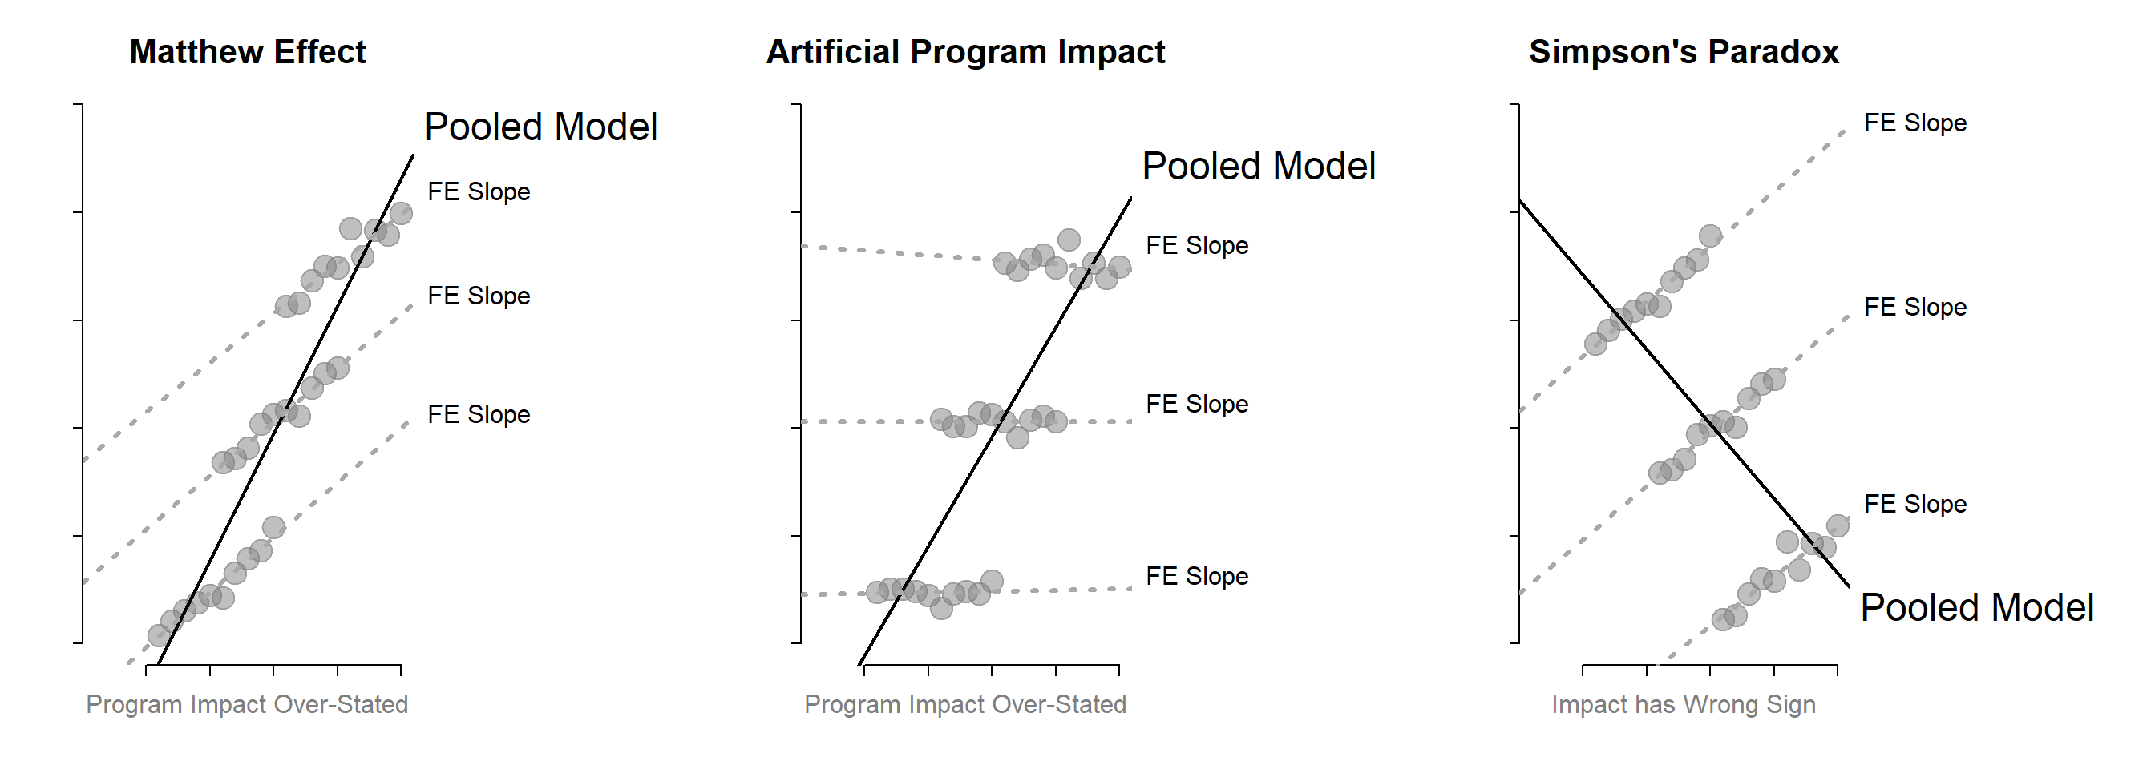

Slide 15
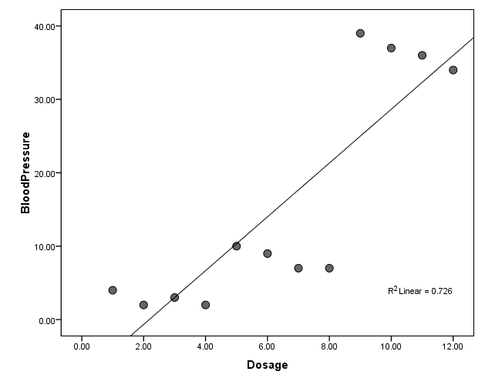
Cross-Section Variation

Slide 16
Regression Model:

Slide 17
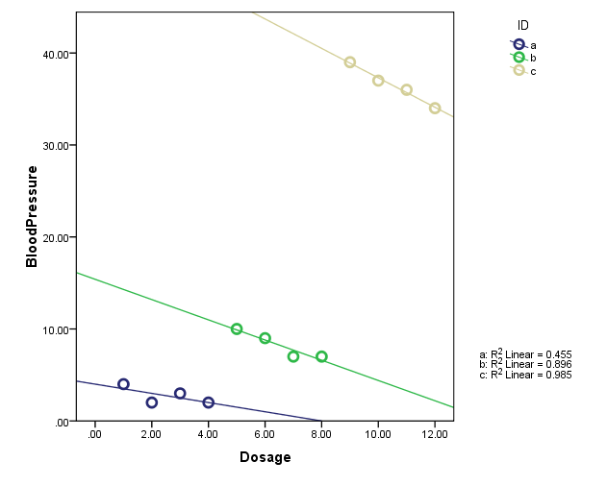
Within Group Variation

Slide 18
Heterogeneity Bias
Blood Pressure
Group Membership
Dosage

Slide 19
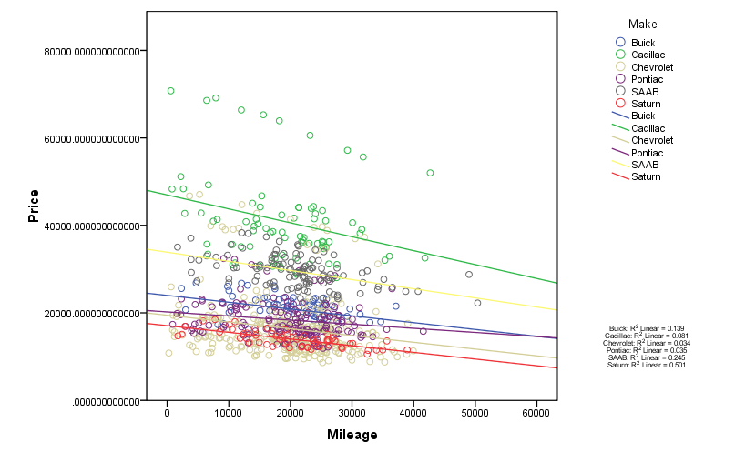
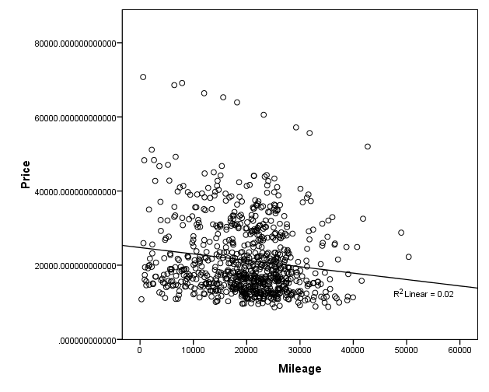
Another Example: Used Car Sales

Slide 20
Heterogeneity Bias
Price
Group Membership
(car type)
Mileage

Slide 21
(6) Bias Via Selection
Does extra tutoring improve exam scores?
Self-Selected Group
Assigned Groups
Group2
Exam Score
Exam Score
Group1
Time Spent at Office Hours
Time Spent at Office Hours

Slide 22
Selection Bias: Example 1
Self-Selected Group
Assigned Groups
Midterm
Test
Score
Midterm
Test
Score
Math
Skills
Time in Office Hours
Math Skills
Time in Office Hours

Slide 23
Selection Bias: Example 1
Self-Selected Group
Midterm
Test
Score
Time in Office Hours
Propensity to succeed
If ability is negatively or positively correlated with the decision to participate in the program then those in the treatment group (utilize service / join program) will be different than those in the control group

Slide 24
(7) Simultaneity Bias
X1
Y
X2
When the causal structure forms a feedback loop. For example, monetary policy at the national level (changing interest rates impacts inflation, which impact growth, which impacts interest rates).
It is very difficult to determine the independent effects in this case.
We will not cover an example of this in class.
Just make a mental note, when you hear simultaneity it comes from this feedback structure.

