Slide 1
control variables
Fundamentals of
PROGRAM EVALUATION
JESSE LECY

Slide 2
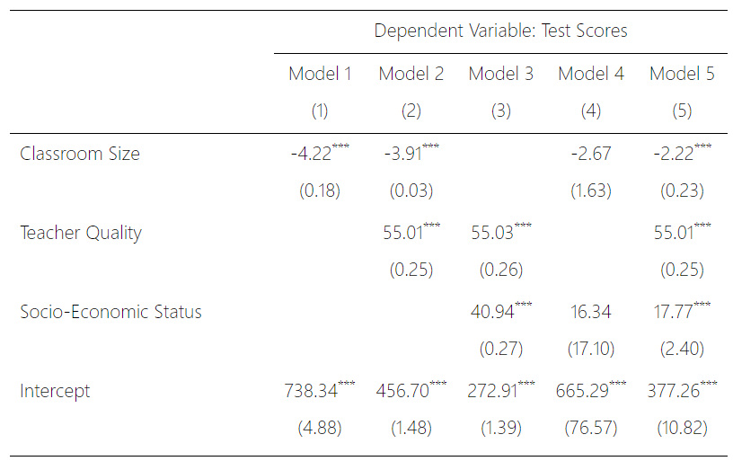
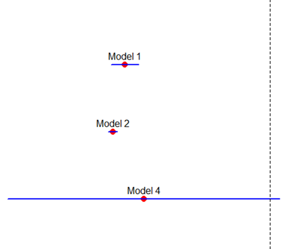
Why are slopes and standard errors changing when we add “control” variables?

Slide 3
Ballentine venn diagrams
Visual representations of multiple regression models to allow for reasoning regarding model specification and fit.

Slide 4
Ballentine venn diagram
Variance of Y
Y
X1
Variance of X1

Slide 5
Ballentine venn diagram
Y
X1
Cov( X1, Y )

Slide 6
Slope
slope

Slide 7
Slope
Y
B
A
C
var( X1 ) = A+C
Cov( X1, Y ) = A

Slide 8
The Residual and R²
Residual
Portion
Y
B
A
C
X1
Explained Portion

Slide 9
R-squared and Regression Residual
Y
A
X1
Y
B
X1
The variance of X1 and cov(X1,Y) are the same in these two cases. The var(Y) is larger in the top case. Although the “explained” portion is the same in both models, there is more variance to explain on top.

Slide 10
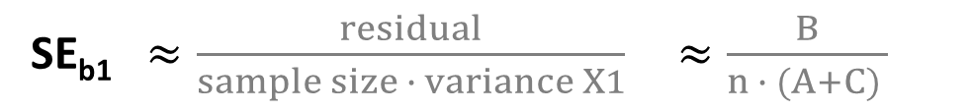
Coefficient Standard Error
Y
There are three ways to make the standard error smaller, and thus improve the confidence intervals around b₁ :
Increase sample size
Explain more variance of Y
Increase variance of X
B
A
C
X1
SE_{b1} $≈\frac{residual}{sample size ∙ variance X1}$ $≈\frac{B}{n ∙ (A+C) }$

Slide 11
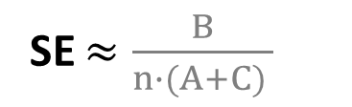
Explain more y
There are three ways to make the standard error smaller, and thus improve the confidence intervals around b₁ :
Increase sample size
Explain more variance of Y
Increase variance of X
SE $≈\frac{B}{n∙(A+C) }$
Heart Rate
B
Control
A
Caffeine
C
Adding a control variable can explain some of Y, thus leading to smaller residuals.

Slide 12
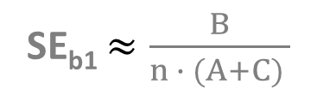
Increase var(x)
There are three ways to make the standard error smaller, and thus improve the confidence intervals around b₁ :
Increase sample size
Explain more variance of Y
Increase variance of X
SE_{b1} $≈\frac{B}{n ∙ (A+C) }$
Heart Rate
Heart Rate
B
B
A
A
Range of 0 to 1000
mg Caffeine
Range of 0 to 500
mg Caffeine
C
C
In an experiment assigning the treatment levels over a range of 0 to 1000mg increases the variance of X compared to a study that uses 0 to 500mg.

Slide 13
Two types of control variables:

Slide 14
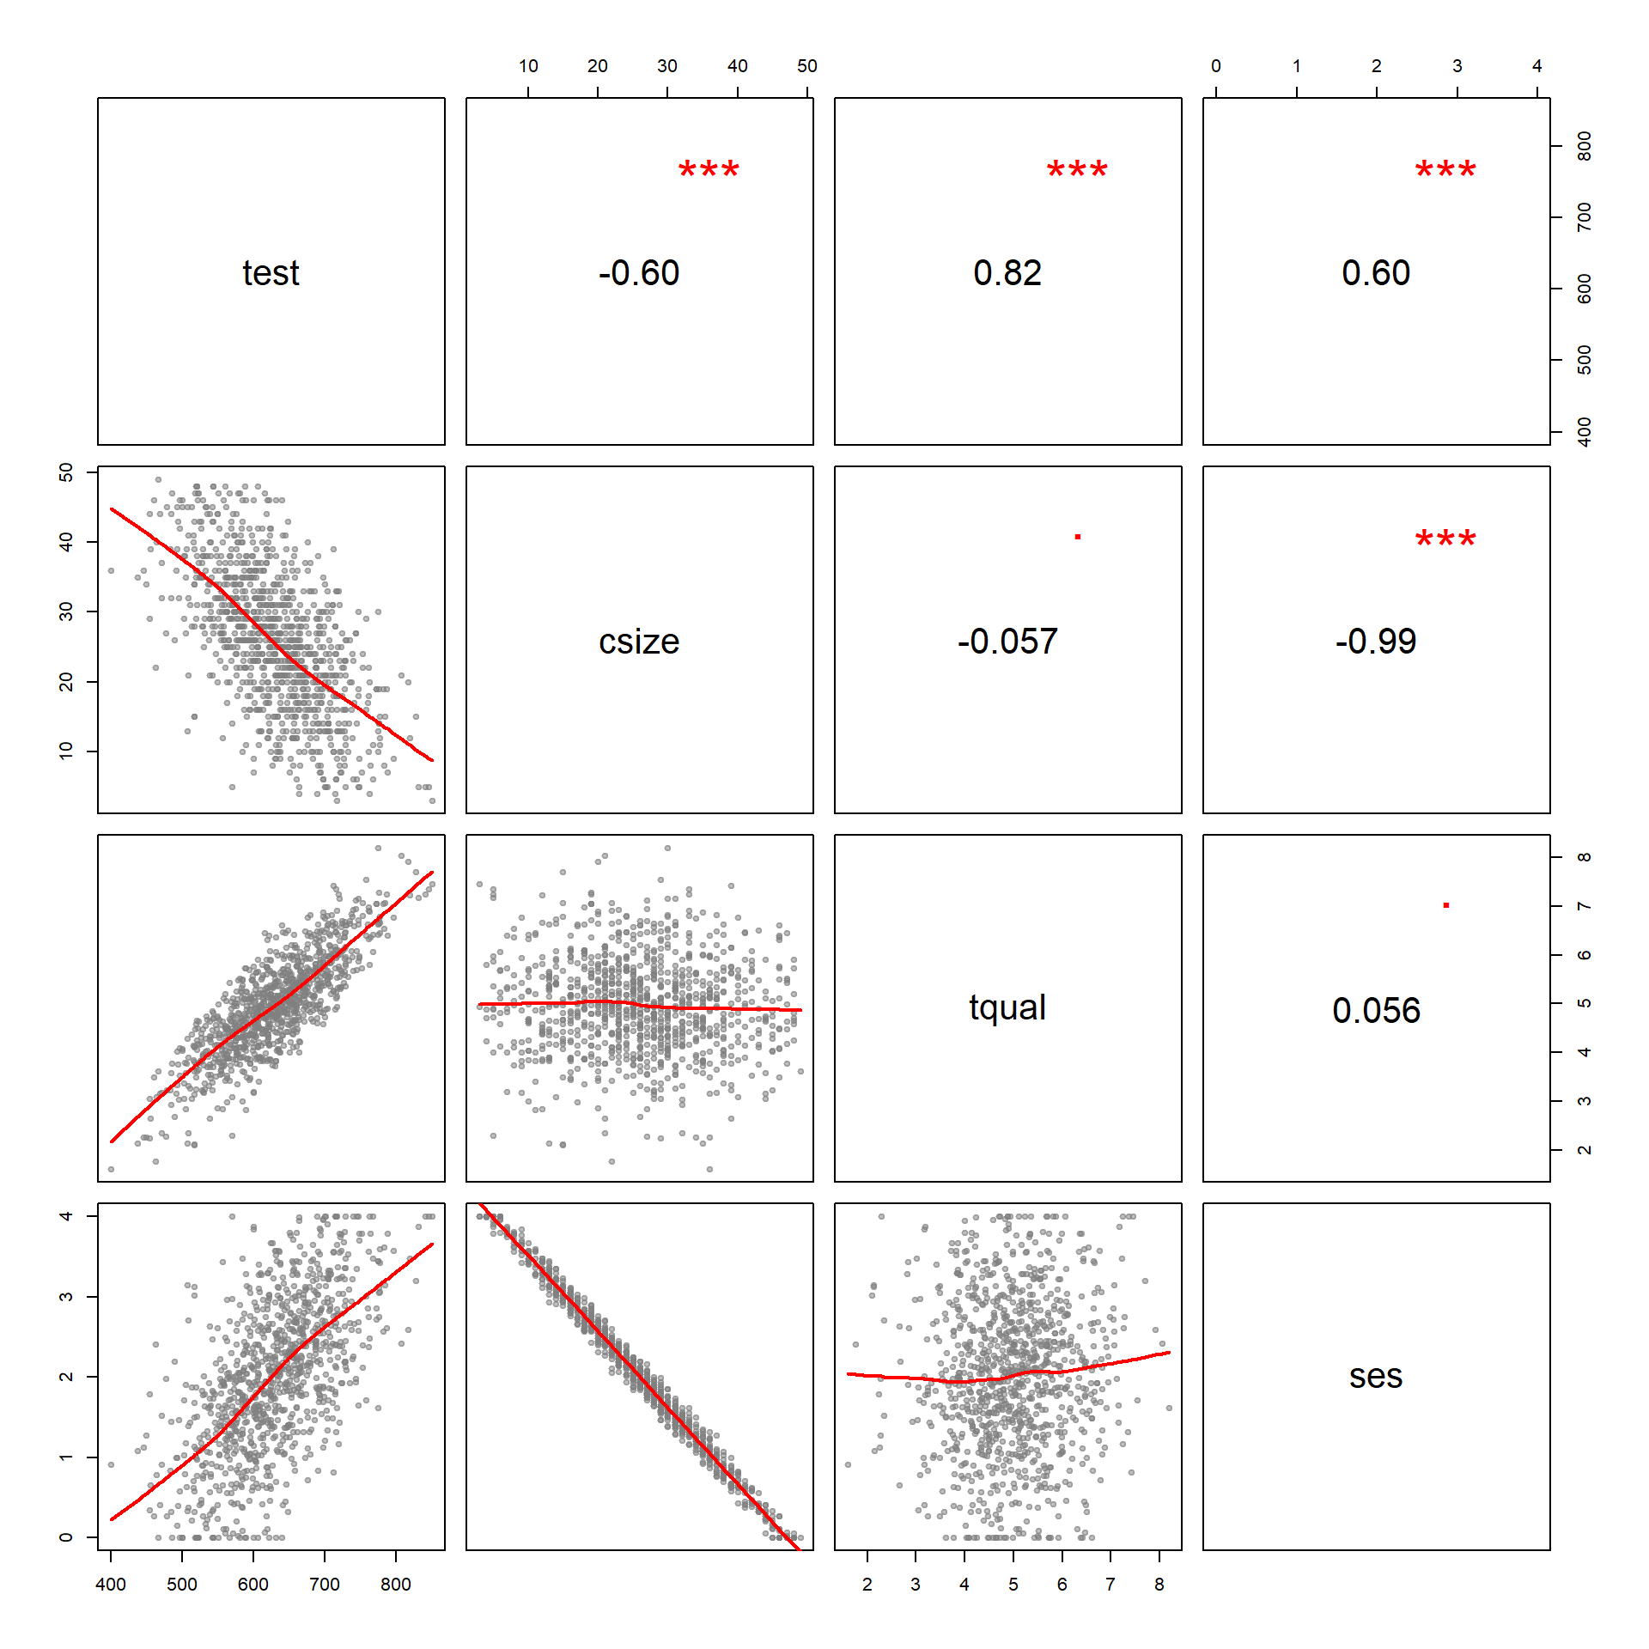

Slide 15
First type: Uncorrelated with the policy variable
Test Score
Test Score
Teacher Quality
A
a
B
B
C
C
Class Size
Class Size
Slope does not change.
Standard error becomes smaller.

Slide 16
The slope is approximately the same, but the standard error is six times smaller.

Slide 17
Second type: correlated with the policy variable
Test Score
Test Score
A
a
B
b
C
c
Socio-Econ. Status
Class Size
Class Size
Slope changes (can increase or decrease depending on size of b relative to c).
The standard error typically becomes larger (again depends on ratio).

Slide 18
The slope is smaller (close to zero), and the standard error is almost ten times as large.

Slide 19
coffee study example

Slide 20
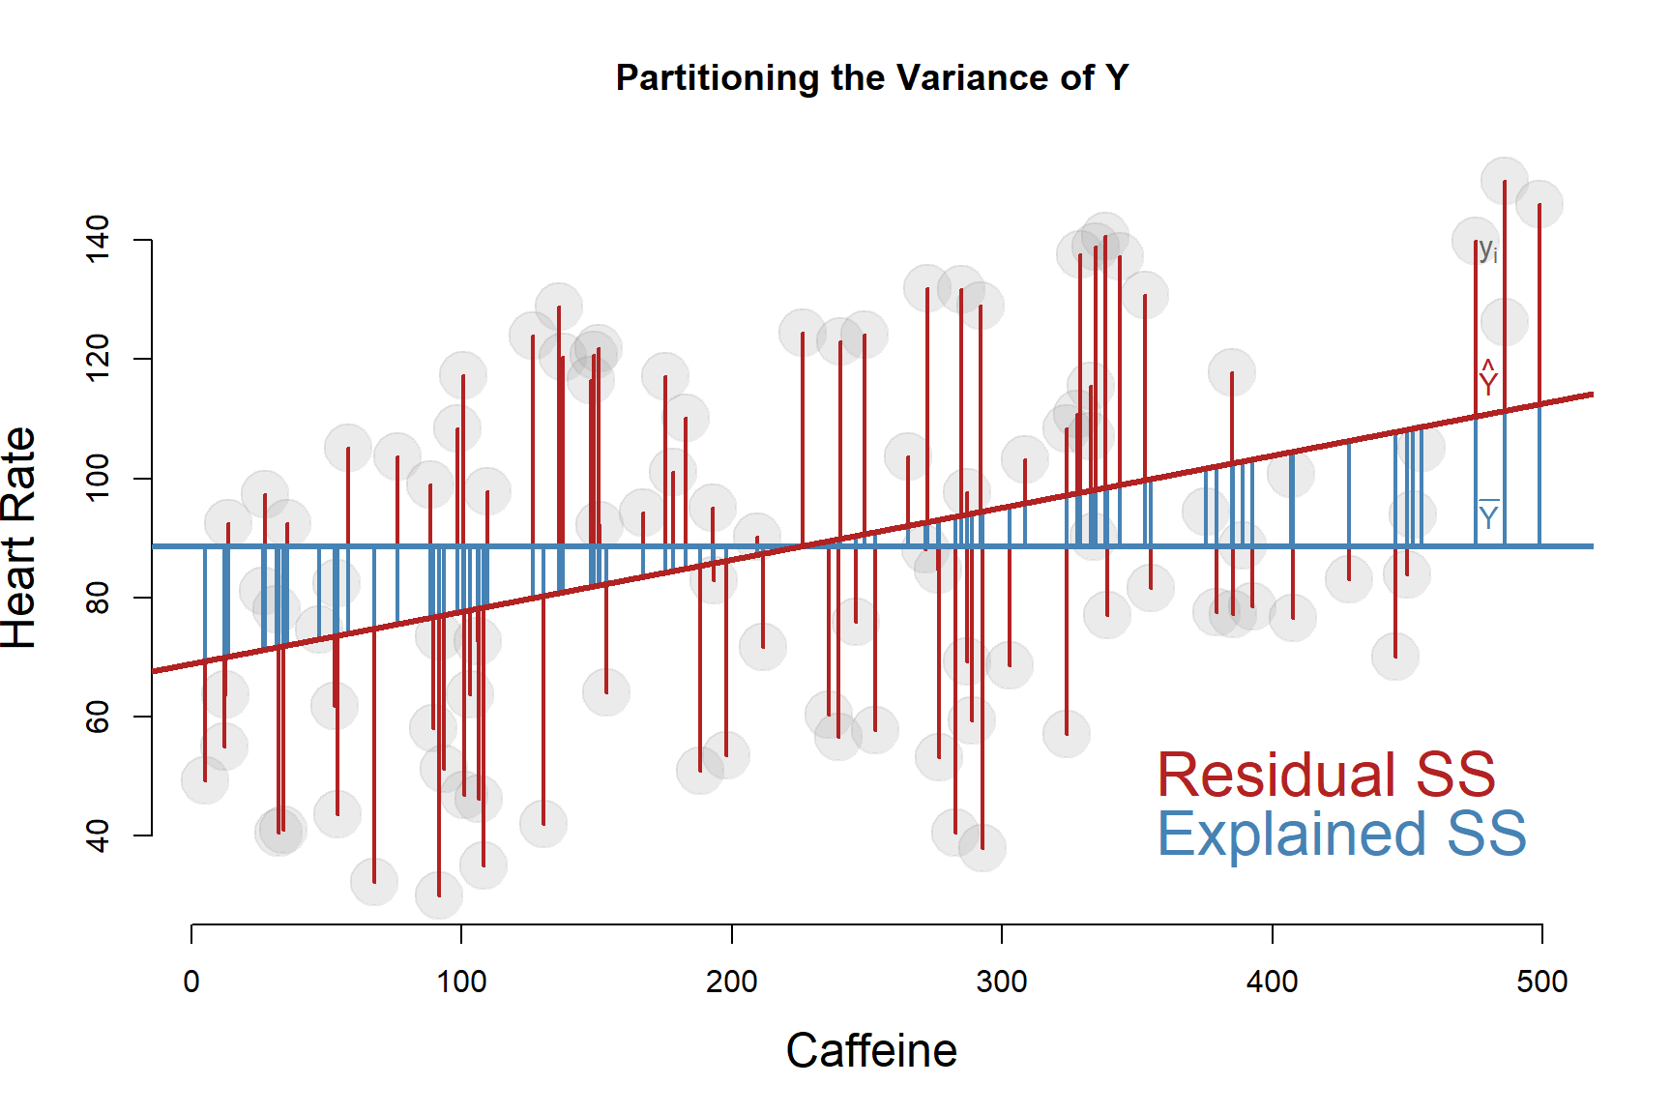
Reconsider the caffeine study as an observational study on coffee consumption. Now caffeine is not assigned, but level of consumption is a choice by individuals. We can add controls.

Slide 21
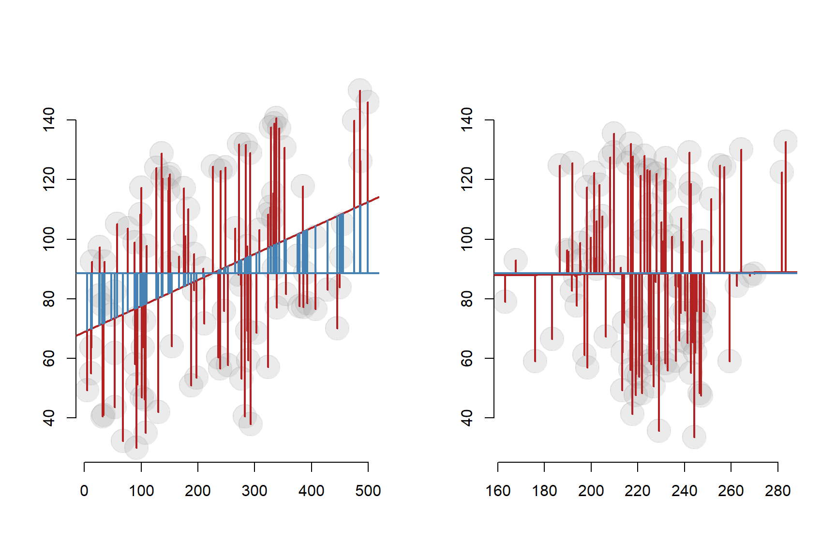
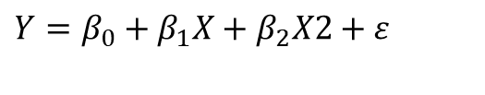

$$Y=b_{0}+b_{1}X+e$$
$$Y=β_{0}+β_{1}X+β_{2}X2+ε$$
If the new control variable X2 is highly-correlated with our policy variable, we primarily remove the EXPLAINED variance from the model.

Slide 22
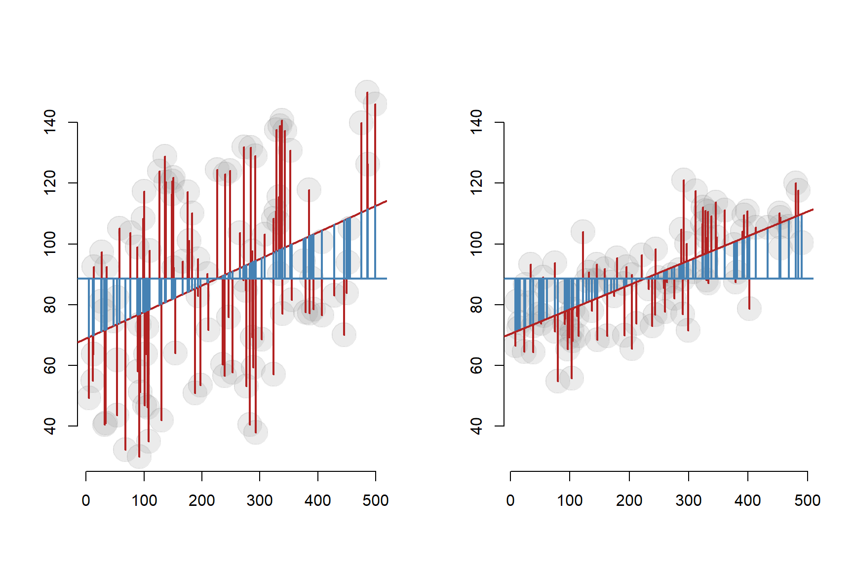
$$Y=b_{0}+b_{1}X+e$$
$$Y=β_{0}+β_{1}X+β_{2}X2+ε$$
If the new control variable X2 is NOT correlated with our policy variable and correlated with the outcome, we primarily remove the RESIDUALS from the model.

Slide 23
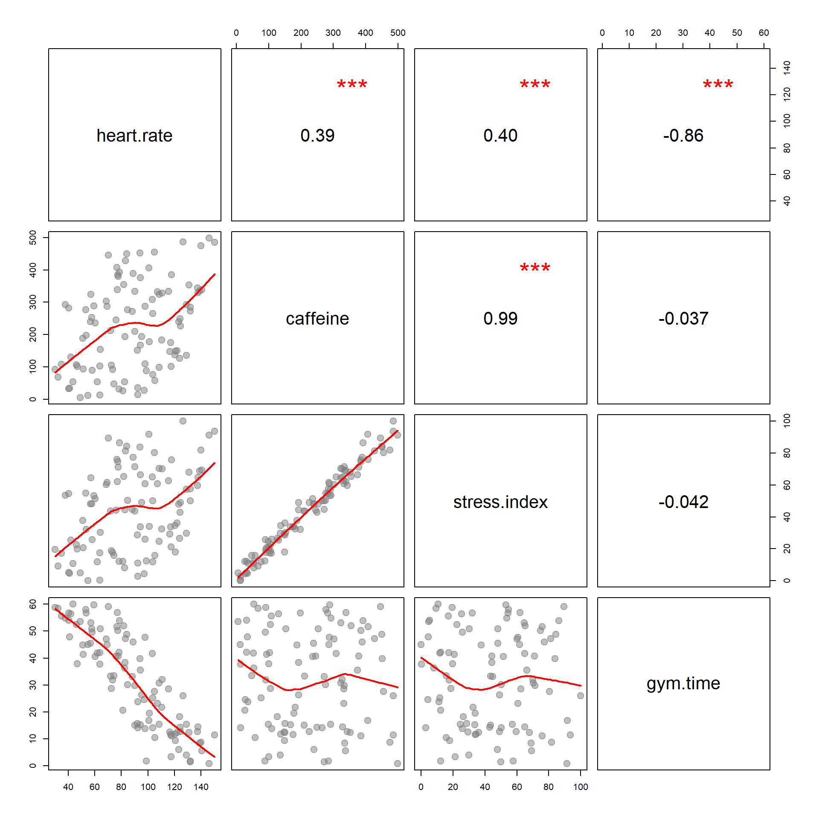

Slide 24
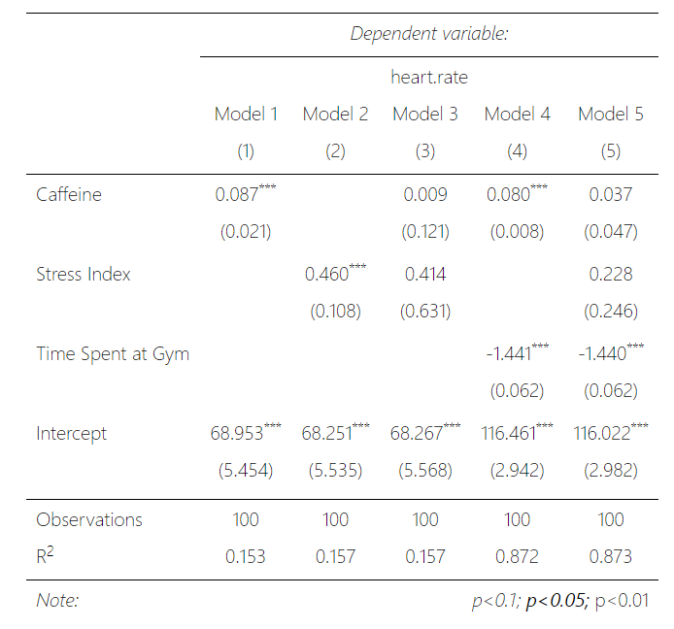

Slide 25
Class size example

Slide 26
Partitioning the Variance of Y
Teacher Quality
B
A
A
Test Score
B
TS
*Test Score
TQ
A
Teacher Quality
Control variables target either the Explained SS or the Residual SS.

Slide 27
Effects of the Control Variable
Test Score
Test Score
TQ
e₁
e₂
CS
CS
Uncorrelated control variables target the Residual SS, thus removing unexplained variance from the model and improving the relationship between the policy variable and Y.

Slide 28
Effects of the Control Variable
Test Score
Test Score
TQ
e₁
e₂
e₁ > e₂
CS
CS
e₁
e₂

Slide 29
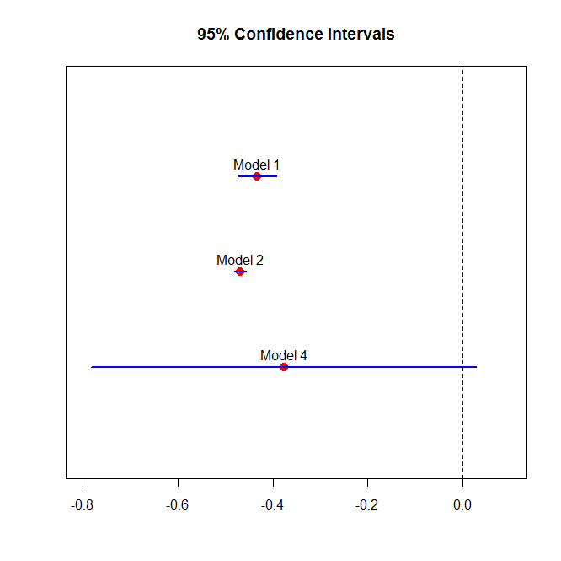
Model 2 has smaller standard errors
Model 1
Test Score
CS
Model 2
Test Score
TQ
CS
Test Score
Model 4
CS
SES

Slide 30
The Residual and R²
Residual
Portion
Y
B
A
C
X1
Explained Portion

Slide 31
The other type of control targets the explained SS
Y
B
a
b
X1
control

Slide 32
What happens when we remove the explained SS from the model?
Test Score
A
CS
SES
B
TS

