Slide 2
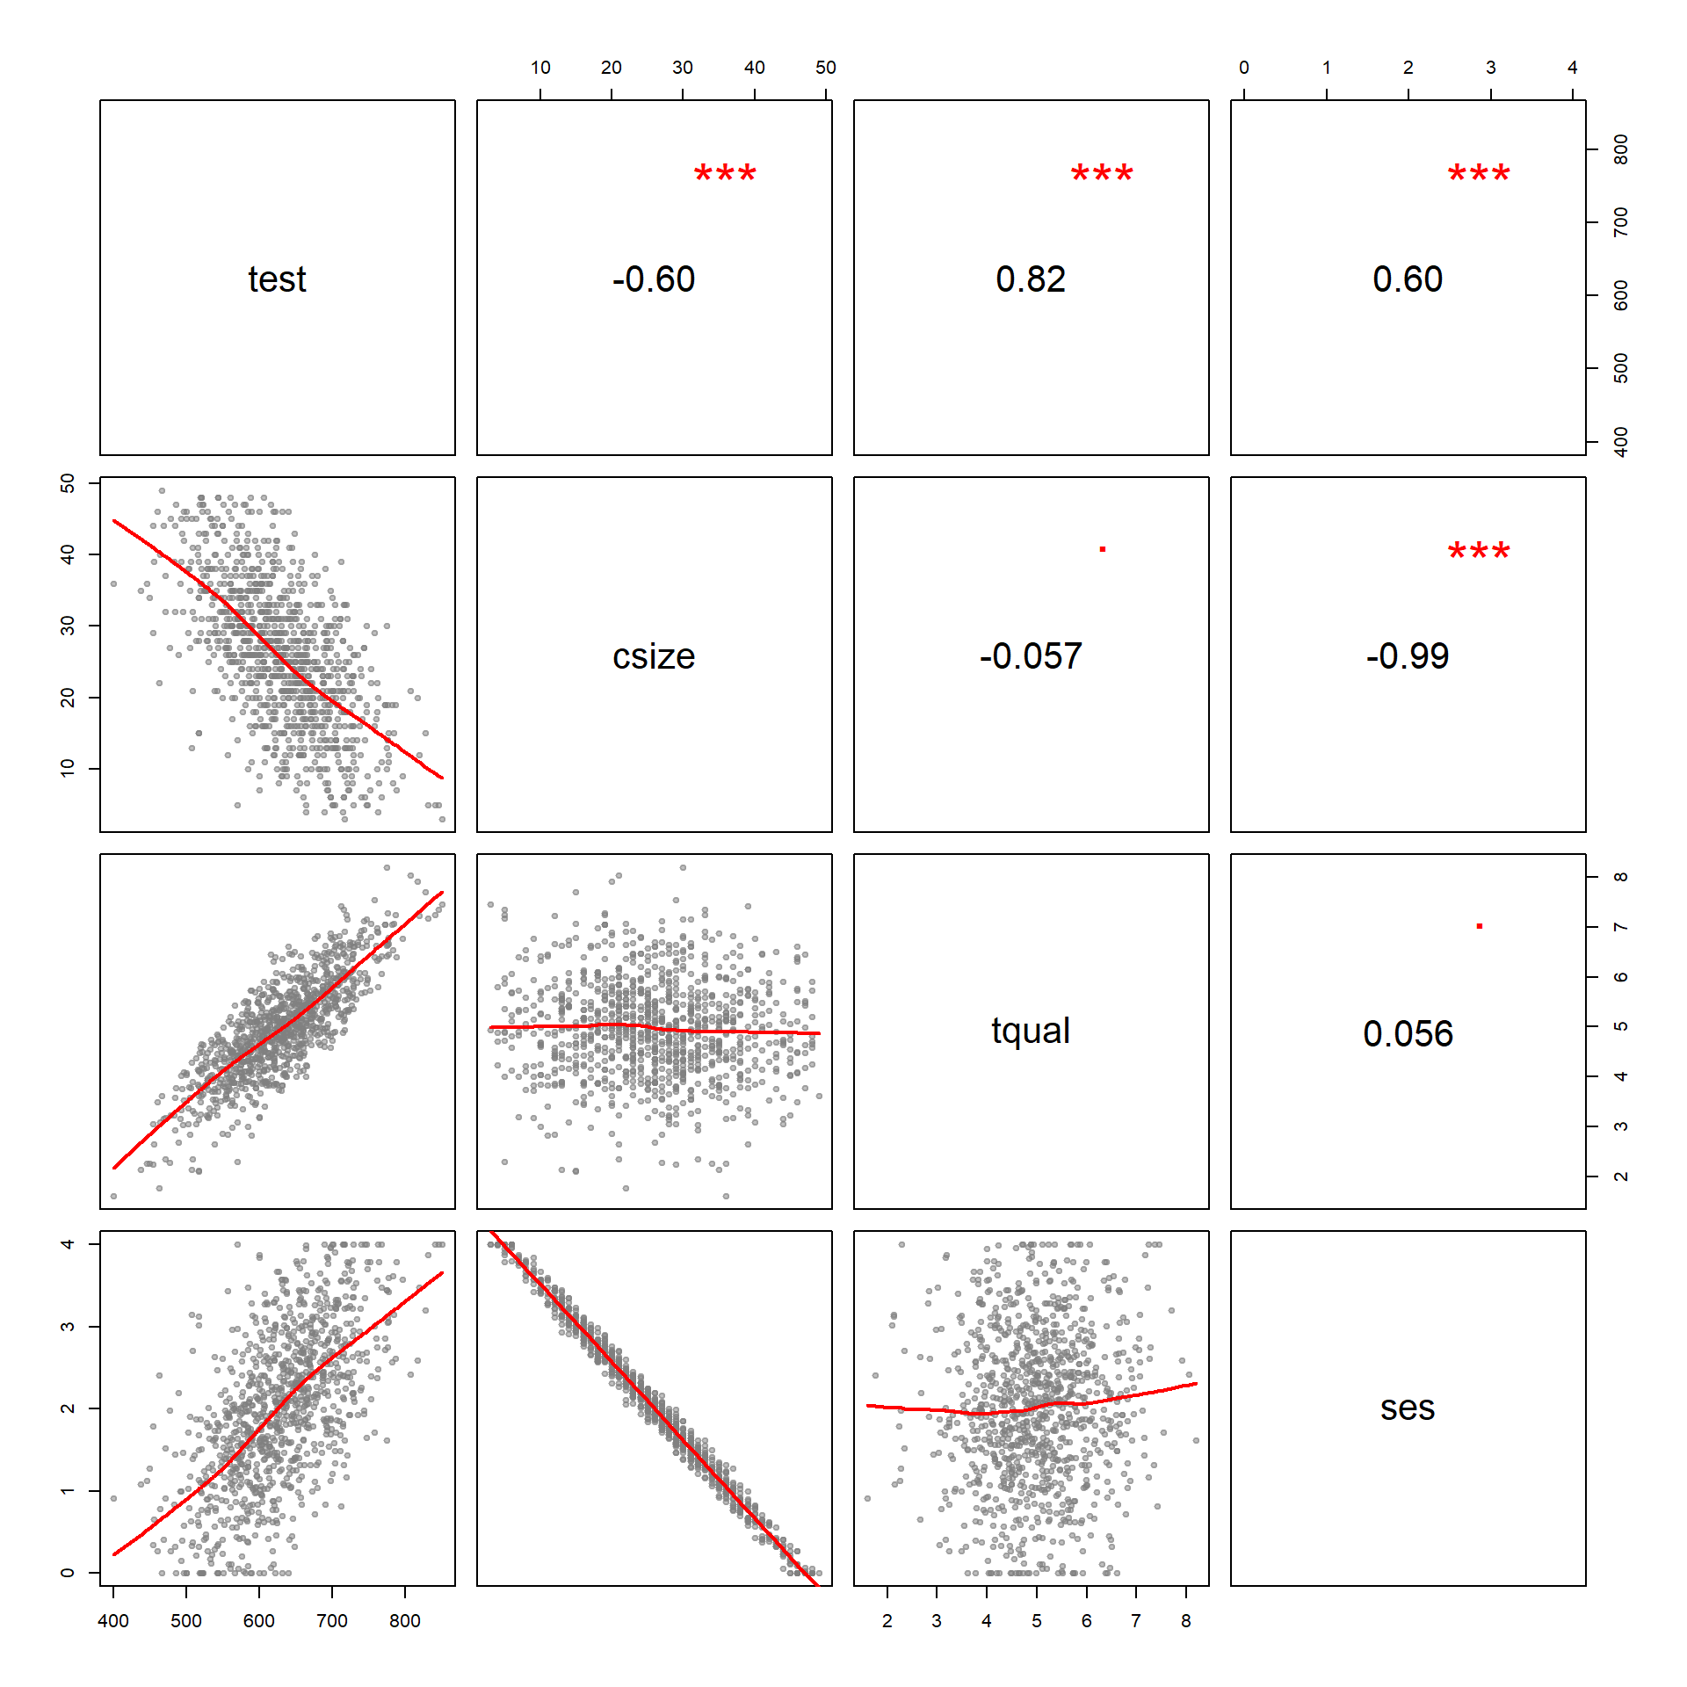
cor( test, ses )
plot( test, ses )

Slide 3
Teacher
Quality
r = 0.82
R² = r^2 = 0.67
a
b
Test Score
b
67% overlap
Class Size
a
36% overlap
r = -0.60
R² = r^2 = 0.36

