Slide 1
Regression Review
Fundamentals of
PROGRAM EVALUATION
JESSE LECY

Slide 2
Regression Review
The Road Map
Of the Mean:
Of the Slope:
Variance:
(for x)
(using the residual)
Standard Deviation:
Standard Error:
Confidence Interval
(of the mean)
(of the slope)
All of the statistical concepts that you have learned in the previous course using variance, standard errors, and confidence intervals of a estimates of the mean from a single variable apply to regression, but they have to be adapted.
Make note that statistical concepts always need to be followed by the phrase “of the” because they are general concepts and the specific calculations are determined by the variables you are working with. The standard error around an estimated mean is different than the standard error around an estimated slope.

Slide 3
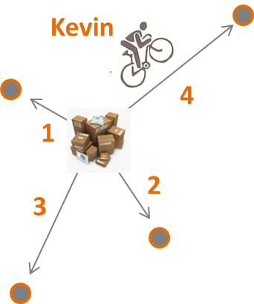
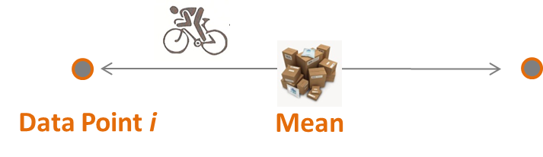
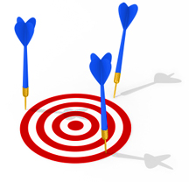
Regression Review
Useful metaphors
Variance
Standard Deviation
Standard Error
Confidence Interval
b₁
b₁
B₁

Slide 4

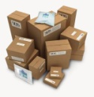
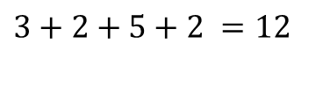

Regression Review
Variance
Which cyclist rode the furthest?
Larry
Kevin
5
4
2
1
2
3
3
2
$$3+2+5+2 =12$$
3$+2+4+1=10$
Variance = total dispersion of the data

Slide 5
Regression Review
Standard deviation
What is the typical distance of a trip?
Larry
Kevin
5
4
2
1
2
3
3
2
Standard deviation is the average distance of each data point to the mean.

Slide 6
Regression Review
This is a visual metaphor for variance.
Data Point i
Mean
This is the standard deviation.
Variance is a measure of average dispersion.
You first need a reference point in order to calculate average distance. You can’t ask “how far have I traveled if I am in Chicago?” without knowing where you started from. Use the mean as the starting point for each distance. Dispersion is the distance from the mean.
The problem is that when you use the mean then the sum of all distances from the mean will always be zero. As a result, you must square them first.
Divide by N so you have an average squared distance from the mean. For an estimate is actually N-1 for reasons we will not discuss here. This is variance.
We want to reconcile the units so that the number is meaningful. We squared everything, so we take the square root. This is the standard deviation.
Intuitively, it is the “average” amount each point must travel to reach the mean.

Slide 7
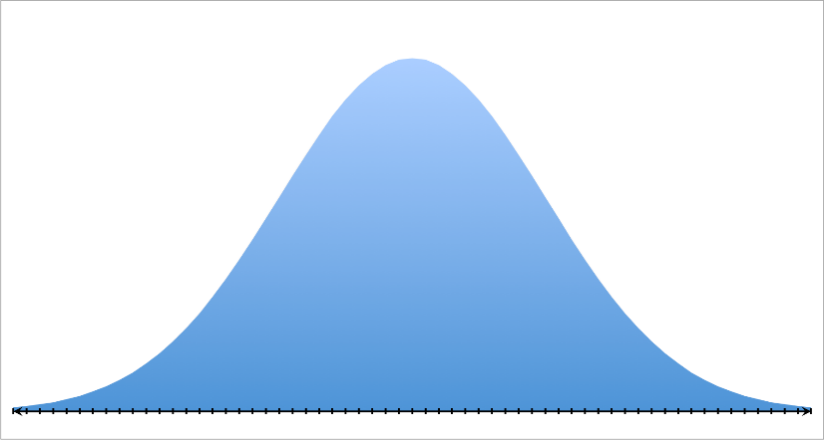

Regression Review
Variance
Larry
5
4
2
2
2
3
All Trips by Larry as Histogram
$$μ=5$$
Standard Deviation

Slide 8
Regression Review
Standard deviation versus Standard error
The standard deviation is, how far the data is from the mean, on average.
~
The standard error is, how far our best guest is from ‘the truth’, on average.
The ‘truth’ means different things depending upon what kind of standard error you are calculating.

Slide 9
Regression Review
coVariance
I
II
IV
III
Covariance tells us, on average when X is above-average, do we expect Y to also be above average?
It helps us measure the strength of a relationship.

Slide 10
What is Covariance?
Regression Review
Classroom size and test scores
X | Y | X-Xbar | Y-Ybar | (X-Xbar)(Y-Ybar)
3 | 5 | 3 - 6 (-) | 5 - 3 (+) | (-)(+) = (-)
5 | 2 | 5 - 6 (-) | 2 - 3 (-) | (-)(-) = (+)
10 | 2 | 10 - 6 (+) | 2 - 3 (-) | (+)(-) = (-)
First we convert all of our measures into distances from the mean. This allows us to determine whether an individual case is above-average (positive number) or below-average (negative number) on a measure.

Slide 11
What is Covariance?
Regression Review
Classroom size and test scores
X | Y | X-Xbar | Y-Ybar | (X-Xbar)(Y-Ybar)
3 | 5 | 3 - 6 (-) | 5 - 3 (+) | (-)(+) = (-)
5 | 2 | 5 - 6 (-) | 2 - 3 (-) | (-)(-) = (+)
10 | 2 | 10 - 6 (+) | 2 - 3 (-) | (+)(-) = (-)
We then multiply the two measures to determine whether they tend to be positively or negatively related.
If someone receives an above-average level of the treatment, and their outcome is above-average. That is a positive relationship.
Or conversely, if they receive a below-average level of the treatment and their performance is below-average, that is also a positive relationship since (-)(-) = (+).

Slide 12
What is Covariance?
Regression Review
Classroom size and test scores
X | Y | X-Xbar | Y-Ybar | (X-Xbar)(Y-Ybar)
3 | 5 | 3 - 6 (-) | 5 - 3 (+) | (-)(+) = (-)
5 | 2 | 5 - 6 (-) | 2 - 3 (-) | (-)(-) = (+)
10 | 2 | 10 - 6 (+) | 2 - 3 (-) | (+)(-) = (-)
(−,+)= (−)
(+,+)=(+)
(− , − )=(+)
(+, −)= (−)

Slide 13
Negative Covariance Example
Regression Review
Class size and student performance
Test
Scores
Class Size
High negative correlation results in a large negative slope in a regression

Slide 14
positive Covariance Example
Regression Review
Class size and student performance
Test
Scores
Class Size
High positive correlation results in a large positive slope in a regression

Slide 15
Small Covariance
Regression Review
Low correlation, small b₁ in a regression

Slide 16
outliers
Regression Review
What impact will this outlier have on the covariance measure?

Slide 17






outliers
Regression Review
$3∙3$=9
$$−1∙1=−1$$
$$−2∙1=−2$$
$$1∙−1=−1$$
$$2∙−1=−2$$
$$−10∙−10=−100$$
What impact will this outlier have on the covariance measure?

Slide 18
outliers
Regression Review
What about now?

Slide 19
The regression slope
Regression Review

Slide 20
The Intuitive Regression Formula
Regression Review
Note the regression always passes through the mean of X and mean of Y.

Slide 21
The Intuitive Regression Formula
Regression Review
Cov(x,y)
Var(x)
We want to interpret the slope causally, meaning the outcome is going to change b₁ amount because of a one-unit change in X. Intuitively we can think of the math as:
Change in Y
Change in X
This is not entirely mathematically correct, but the intuition is there.

Slide 22
What is Correlation?
Regression Review
The correlation is the covariance in simple units

Slide 23
What is Correlation?
Regression Review
Recall that the standard deviation translates the variance from sums-of-squares back into the original units.
Since we have two variables in the covariance, which unit should we use to describe the measure?

Slide 24
What is Correlation?
Regression Review
Test Score ∙ Class Size
(this is an odd unit)
Test Score ∙ Class Size
Test Score ∙ Class Size
(now we have no units)
The correlation is the covariance in “standard” units:
-1 < cor(x,y) < +1

Slide 25
Strength of Correlation
Regression Review
Case A
Case B
Which of these has the stronger correlation?

Slide 26
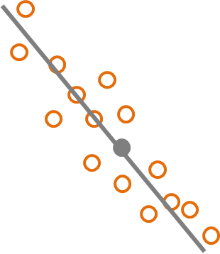
Strength of Correlation
Regression Review
Case A
Case B
Which of these has the stronger correlation?

Slide 27
Strength of Correlation
Regression Review
Case A
Case B
Which of these has the stronger correlation?

Slide 28
Strength of Correlation
Regression Review
Case A
Case B
Which of these has the stronger correlation?

Slide 29
Strength of Correlation
Regression Review
Case A
Case B
Which of these has the stronger correlation?

Slide 30
Regression Review
What should be clear in my mind?
What is variance and standard deviation?
The difference between standard deviation and standard error.
Definitions of covariance and correlation.
The “intuitive” regression formula.

