Slide 1
Omitted variable bias
Fundamentals of
PROGRAM EVALUATION
JESSE LECY

Slide 2
A note on terms in this section:
“Full Model”, i.e. the “truth”. The slopes will be correct because we have all of the variables included, therefore we use Greek letters.
SES
“Naive Model” - We are missing variables and therefore we do NOT know if the slopes are correct. They represent our best guess. They may contain bias. We use Latin characters to denote this.
You might be used to thinking in terms of population statistics and sample. In regressions, you can have the entire population in your sample, but if you are missing variables in your regression then your slopes will be wrong. To map concepts, when I say “full model” think population statistic (the truth), and when I say “naïve model” think sample statistic (the best guess).

Slide 3
The Main Question to ask yourself:
( full model )
( naïve model )
Does omitting a variable introduce bias into our estimate of program impact?
If we have an omitted variable, will our estimate of the program impact (b1) sufficiently represent the true program impact (β1)?

Slide 4
Note!
We will ALWAYS have omitted variables in observational studies because we either can’t measure the variable we care about, or else it’s just not available in the data we have available.
The real question is not whether it is there, but how much will it affect our estimates?

Slide 5
What We Know So Far:
We think about control variables as variables that remove variance from our model so we can focus on the policy variable.
Test Score
Test Score
Teacher Quality
A
a
B
b
Socio-Econ. Status
C
c
Class Size
Class Size

Slide 6
What We Know So Far:

Slide 7
What We Know So Far:
Test Score
Test Score
Teacher Quality
A
a
B
B
C
C
Class Size
Class Size
When we add a control that is uncorrelated with the policy variable, it explains extra variance of Y but does not affect the policy slope.

Slide 8
What We Know So Far:
Test Score
Test Score
A
a
B
b
C
c
Socio-Econ. Status
Class Size
Class Size
When we add a control variable that IS correlated with the policy variable it affects both the slope and the standard error.

Slide 9
Omitted Variable Bias:
All that we are doing with omitted variable bias is asking, what happens when we leave the control variable out of the model?

Slide 10
Case #1
Y
X1
X2
(omitted
variable)
Since the omitted variable X2 is uncorrelated with the policy variable X1, then leaving it out does not change the slope b1. There is no bias.

Slide 11
Case #2
Y
X1
X2
(omitted
variable)
In this case, omitting X2 from the model will change the slope b1 because X1 and X2 have shared covariance. Our naïve estimate WILL be biased.

Slide 12
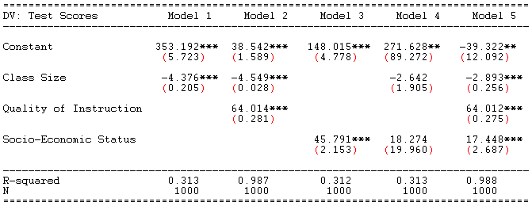
How do omitted variable impact regression results?
SES & TQ
omitted
SES
omitted
TQ
omitted
Full
Model
Bias is the difference between the “truth” (Model 5 in this case) and what we would get if we ran a naïve regression (Model 1 here).
Note that the bias can be quite large.
We overestimate the impact of our program by 51% !

Slide 13
Calculating Omitted Variable Bias:
The definition of bias is the difference between the true slope and our best guess of the slope:
Note that this is not very useful in practice because if you know the true slope β1 you will not need to calculate bias!

Slide 14
Where Bias Comes From:
Y
X1
Y
Direct Effect
Indirect Effect
X2
X1
X2
b1 = Direct Effect + Indirect Effect
β1 = Direct Effect
bias = b1 – β1 = Indirect Effect

Slide 15
The Math:
Y
β1
X1
Y
Direct Effect
Indirect Effect
α1
X2
β2
X1
X2
(full regression)
(auxiliary regression)
(path diagram for X1→X2→Y )

Slide 16
The Math:
True Slope plus Bias
Y
X1
Y
X2
X1
If we run a naïve model and exclude X2 then the slope b1 will include both the direct and indirect effects.

Slide 17
Note:
To run the auxiliary regression, just think about the effects of X1 working through X2, so make sure X2 is on the left hand side of the auxiliary regression.
β1
X1
Y
α1
X2
β2

Slide 18
Omitted Variable Bias Derived
(Don’t need to know for the test)

Slide 19
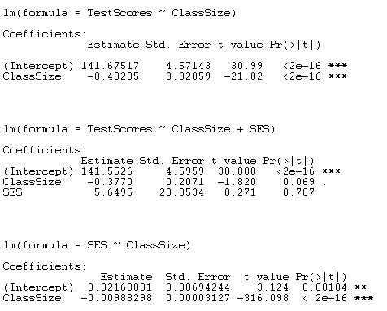
Example of Calculations:
(naïve regression)
(full regression)
(auxiliary regression)
β1
X1
Y
α1
X2
β2

Slide 20
The take-away:
(1)
Bias is the product of two slopes: X1→X2 & X2 →Y
(2)
The naïve slope is the actual slope plus bias
(3)
The sign of a slope is always determined by the sign of the covariance, i.e. the correlation

Slide 21
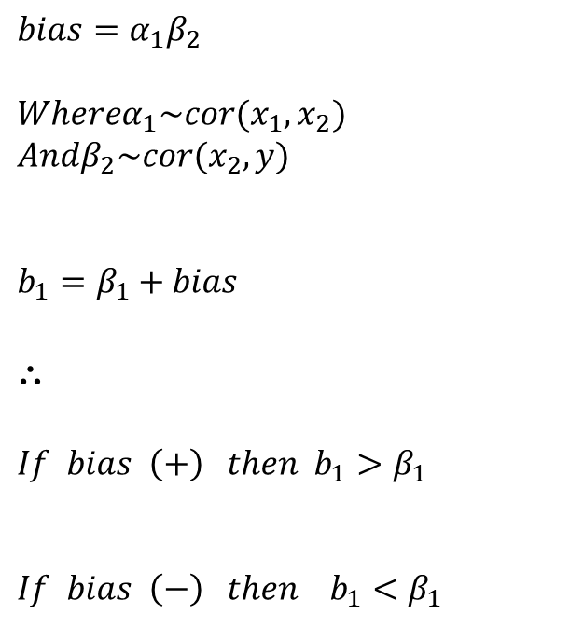
Why does this matter?
$$bias=α_{1}β_{2}$$ $$Whereα_{1}\sim cor(x_{1},x_{2}) \\ Andβ_{2}\sim cor(x_{2},y)$$ $$b_{1}=β_{1}+bias$$
$$∴$$
$$If bias \left(+\right) then b_{1}>β_{1}$$
$$If bias \left(−\right) then b_{1}<β_{1}$$
Case 1: Naïve slope is too large
Case 2: Naïve slope is too small
naïve slope
Case 2
Case 1
If the naïve slope is too large is can make it look significant when it’s not

Slide 22
When does o.v.b. occur?

Slide 23
Case 1: Omitted variable correlated with policy variable
In this case, the omitted variable X2 is correlated with the policy variable X1. There is shared co-variance, represented by the region B. This is the region that is discarded as part of the regression procedure
Y
A
X1
B
C
X2
The naïve slope, b₁, and the full-model slope, B₁, will now be different because of the exclusion of the region B. The naïve model will be biased as a result of omitting X2.

Slide 24
Case 1: Omitted variable correlated with policy variable
Y
A
X1
B
C
X2
X1
Y
Path Diagram
X2

Slide 25
Case 2: Omitted variable uncorrelated with policy variable
In this case, the omitted variable X2 is uncorrelated with the policy variable X1. There is no overlap in the Venn Diagram.
Y
X1
A
C
X2
Since the naïve slope, b₁, and the full-model slope, B₁, are the same, there is no bias that results from omitting X2.

Slide 26
Case 2: Omitted variable uncorrelated with policy variable
Y
A
C
X1
X2
X1
Y
Path Diagram
X2

