Slide 1
INTRO TO counterfactual ANALYSIS
Jesse Lecy

Slide 2
Core Concepts
Definition of a counterfactual
Philosophical Definition: NOT P then NOT Q
Statistical Definition: Y(t)-Y(c) = effect
Meaningful null hypotheses
Construction of the counterfactual
True experiments
Quasi-experiments

Slide 3
Philosophical foundations

Slide 4
A counterfactual assertion is a conditional whose antecedent is false and whose consequent describes how the world would have been if the antecedent had obtained.
The counterfactual takes the form of a subjunctive conditional: “If P had obtained, then Q would have obtained”. In understanding and assessing such a statement we are asked to consider how the world would have been if the antecedent condition had obtained. For example, “If the wind had not reached 50 miles per hour, the bridge would not have collapsed” or “If the Security Council had acted, the war would have been averted.”
There is a close relationship between counterfactual reasoning and causal reasoning. If we assert that “P caused Q (in the circumstances Ci)”, it is implied that we would assert: “If P had not occurred (in circumstances Ci) then Q would not have occurred.” So a causal judgment implies a set of counterfactual judgments.
Lewis, David K. 1973. Counterfactuals. Cambridge: Harvard University Press.

Slide 5
Translated to Statistics
Pr( A | B ) means the probability that A occurs given that B has occurred. We can augment this notation by incorporating the notion of “how the world would have been if the antecedent had obtained” using an intervention or a “treatment”:
Pr( Y = TRUE | Treatment = TRUE ) - Pr( Y = TRUE | Treatment = FALSE )
In cases where the outcome is continuous, such as income levels or wheat yield per acre, the notation would only be slightly different:
[ mean(Y) | Treatment = TRUE ] - [ mean(Y) | Treatment = FALSE ]
Or more succinctly:
Treatment Effect = Y(t) - Y(c)
world with treatment
world without

Slide 6
Translated to Statistics
The outcome is measured now as a difference of means instead of a change in probabilities of observing success.
Thus, we typically care about the Average Treatment Effects because it is the easiest thing to measure (the average outcome for the treatment and control groups) and most succinct way to communicate program effectiveness in evaluation studies.

Slide 7
Translated to Statistics
The outcome is measured now as a difference of means instead of a change in probabilities of observing success.
Thus, we typically care about the Average Treatment Effects because it is the easiest thing to measure (the average outcome for the treatment and control groups) and most succinct way to communicate program effectiveness in evaluation studies.
Note! The part of this statement that is rarely explicit but really important, the dosage that represents the typical treatment.
For example, going to the gym results in more muscle mass. What does “going to the gym” mean? How many visits per week, and time spent each visit? Not to mention activities during the visit.

Slide 8

Temperature of world
WITH Paris Climate Accord
in year = 2050
Temperature of world WITHOUT Paris Climate Accord
in year = 2050
Effect of climate accord = Y(t) – Y(c)

Slide 9
Unfortunately we don’t have two worlds for this experiment!
Effect of climate accord = Y(t) – Y(c)

Slide 10
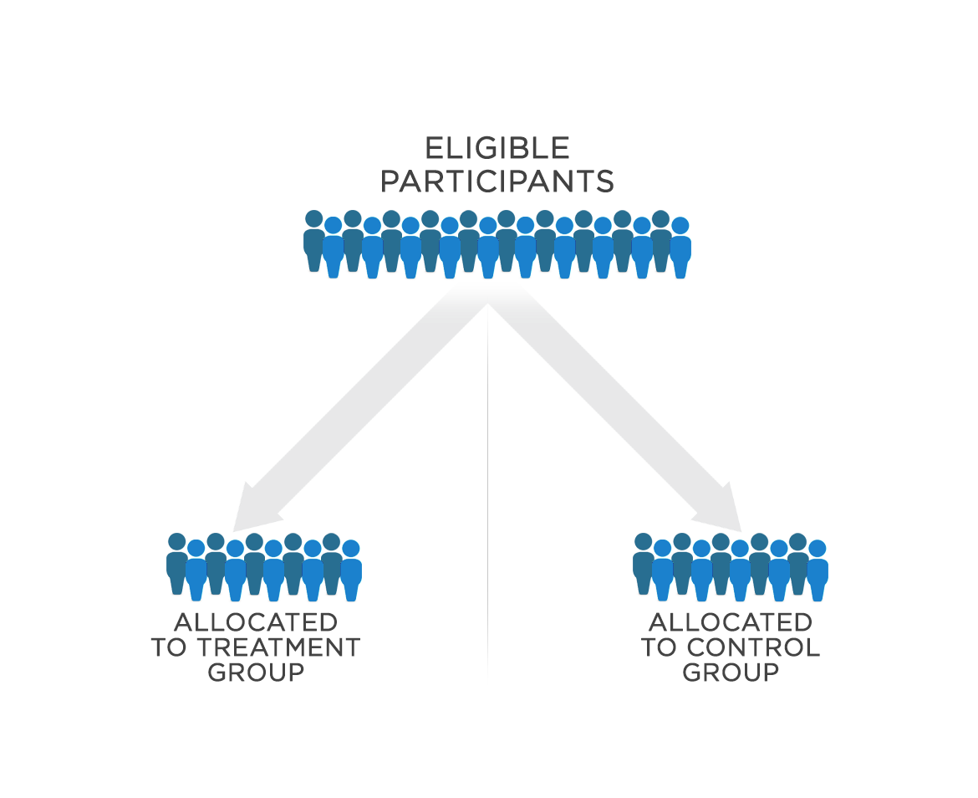
Experimental Design
While we can’t turn back time and do it all over with the exact same participants and conditions, we can create groups that represent states of the world.

Slide 11

Gains from fertilizer = weight_{treatment} – weight_{control}
apple tree
fertilized
apple tree
NOT fertilized

Slide 12

_{Non-experimental studies}
tree
fertilized
tree
NOT fertilized
Is the difference due to the treatment (fertilizer), or to differences in the groups?
(confounding factors that disallow causal claims)

Slide 13
Selecting a meaningful null

Slide 14
Were suicide rates HIGH for a specific high school in suburban California?
There have been multiple student suicides over the past year in a specific school district.
The current district superintendent cut support for school counseling services. Parents are considering filing a lawsuit against the school district because they feel the cuts in spending resulted in loss of support for mental health services, thus leading to increased rates in suicide.
You have been hired as an expert evaluator to build evidence for the case. They would like you to determine whether increases in rates at the school district are notable, and thus potentially linked to the recent cuts in counseling services.
How do you operationalize this research question? Any statistical test requires a null hypothesis.

Slide 15
Review: Hypothesis-testing

Slide 16
The program evaluation framework: “Discrete” treatment groups (yes/no)
Heart Rate
Treatment (Caffeine)
Control (No caffeine)

Slide 17

The program evaluation framework
$Program Effect = T2−C2$
Heart Rate
Treatment (Caffeine)
Control (No caffeine)
T2= Mean of treatment group after treatment
Mean of control group after treatment period= C2

Slide 18
DIFFERENCE
OF MEANS
b₁ = MEAN_{treat} - MEAN_{control}
Heart Rate
b₁
Control (No caffeine)
Treatment (Caffeine)
b₁ = 0
CONFIDENCE INTERVAL

Slide 19
b₁ = MEAN_{treat} - MEAN_{control}
Heart Rate
b₁
Control (No caffeine)
Treatment (Caffeine)
b₁ = 0
NULL HYPOTHESIS
(b₁=0 means NO IMPACT)

Slide 20
STATISTICAL SIGNIFICANCE (CONF. INT. CONTAINS ZERO?)
b₁ = MEAN_{treat} - MEAN_{control}
Heart Rate
b₁
Control (No caffeine)
Treatment (Caffeine)
b₁ = 0
NOT SIGNIFICANT
(NO PROGRAM IMPACT)

Slide 21
STATISTICAL SIGNIFICANCE (CONF. INT. CONTAINS ZERO?)
b₁ = MEAN_{treat} - MEAN_{control}
Heart Rate
Treatment (Caffeine)
b₁
Control (No caffeine)
b₁ = 0
SIGNIFICANT
(POSITIVE PROGRAM IMPACT)

Slide 22
STATISTICAL SIGNIFICANCE (CONF. INT. CONTAINS ZERO?)
b₁ = MEAN_{treat} - MEAN_{control}
Heart Rate
Control (No caffeine)
b₁
Treatment (Caffeine)
b₁ = 0
SIGNIFICANT
(NEGATIVE PROGRAM IMPACT)

Slide 23
b₁ = MEAN_{treat} - MEAN_{control}
b₁ = T2 – C2
No Program Impact
Outcome
b₁
Control
Treatment
b₁ = 0

Slide 24
b₁ = MEAN_{treat} - MEAN_{control}
b₁ = T2 – C2
Positive Program Impact
Outcome
Treatment
b₁
Control
b₁ = 0

Slide 25
Definition of EFFECT in program eval:
Observed change + confidence interval
(size of observed impact plus accuracy, can we say with confidence it’s positive)
b₁ = MEAN_{treat} - MEAN_{control}
Heart Rate
b₁
Control (No caffeine)
Treatment (Caffeine)
b₁ = 0

Slide 26
Back to the example

Slide 27
Were suicide rates HIGH for a specific high school district in suburban California?

Slide 28
Were suicide rates HIGH for a specific high school district in suburban California?
Null
Null Hypothesis: Population Average
Suicide rates are HIGHER than the population average
(significant at a
0.05 level)
95% CI:
Average Suicide Rate at HS

Slide 29
Were suicide rates HIGH for a specific high school district in suburban California?
Null
95% CI:
Average Rate Per Year at HS
Null Hypothesis: Population Average
Suicide rates are NO DIFFERENT than the population average
(NOT significant at a
0.05 level)
Null
Null Hypothesis: All HS Students
OR All Californians

Slide 30
Were suicide rates HIGH for a specific high school district in suburban California?
Null
95% CI:
Average Rate Per Year at HS
Null Hypothesis: Population Average
These are all valid counterfactuals. How we define our comparison drives the conclusions.
Null
Null Hypothesis: All HS Students
OR All Californians
Suicide rates are LOWER than the population average
(significant at a
0.05 level)
Null
Null Hypothesis: All Suburban HS Students

Slide 31
Were suicide rates HIGH for a specific high school district in suburban California?
The conclusions we reach are not at all dependent upon the model or lack of significance – they are driven entirely by the selection of the counterfactual. All of these are reasonable counterfactuals. Which best answers the research question?
Suicide rates are HIGHER
Null
Null Hypothesis: Population Average
Suicide rates are NO DIFFERENT
Null
Null Hypothesis: All HS Students
OR All Californians
Suicide rates are LOWER
Null
Null Hypothesis: All Suburban HS Students

Slide 32
A valid counter-factual allows us to answer the following two questions:
Compared to what? The program outcomes are different than outcomes in the comparison group. The comparison group is defined by the researcher. In some special cases the comparison group is identical (statistically speaking) to the treatment group. In this case we call it a “control” group.

Slide 33
A valid counter-factual allows us to answer the following two questions:
Compared to what? The program outcomes are different than outcomes in the comparison group. The comparison group is defined by the researcher. In some special cases the comparison group is identical (statistically speaking) to the treatment group. In this case we call it a “control” group.
How big is the program effect? Is the difference meaningful (statistically significant and socially salient)? In the simple case the program effects is just the difference of the average outcome of the treatment and control group, but in practice there are many ways we calculate an effect.

Slide 34
Which is a more meaningful finding?
study HS district
Suicide rates at the high school are MUCH LARGER than expected (triple the comparison group rate) But NOT statistically significant
at the alpha=0.05 level
Null
CASE A:
comparison
group rate
Suicide rates are SLIGHTLY LARGER than the comparison group
(0.25 cases per year in the district)
And statistically significant
Null
CASE B:

Slide 35
It can be harder than you think to identify a meaningful counterfactual!

Slide 36
Donaldson, H., Doubleday, R., Hefferman, S., Klondar, E., & Tummarello, K. (2011). Are Talking Heads Blowing Hot Air? An Analysis of the Accuracy of Forecasts in the Political Media. Hamilton College, Public Policy, 501.
A class at Hamilton College led by public policy professor P. Gary Wyckoff has analyzed the predictions of 26 prognosticators between September 2007 and December 2008. The Hamilton students sampled the predictions of 26 individuals who wrote columns in major print media and who appeared on the three major Sunday news shows – Face the Nation, Meet the Press, and This Week.
They evaluated the accuracy of 472 predictions made during the 16-month period. They used a scale of -10 to +10 to rate the accuracy of each. https://www.poynter.org/reporting-editing/2011/claim-krugman-is-top-prognosticator-cal-thomas-is-the-worst/

Slide 37
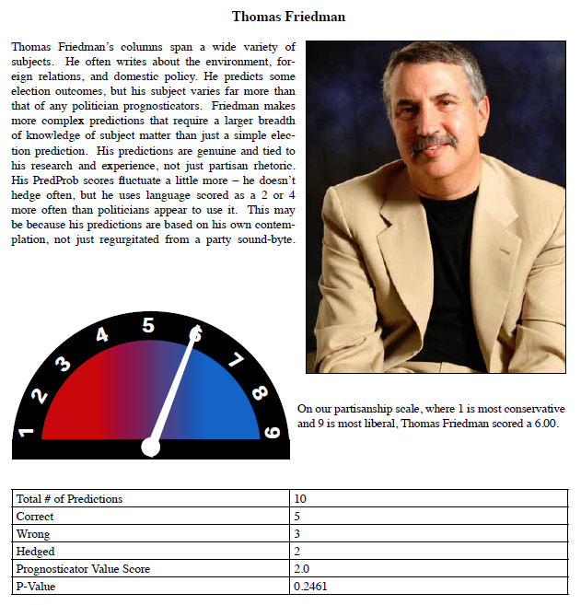
Scored 2 out of 10 on the prognostication scale: p-value of 0.2461 (NOT statistically significant)

Slide 38
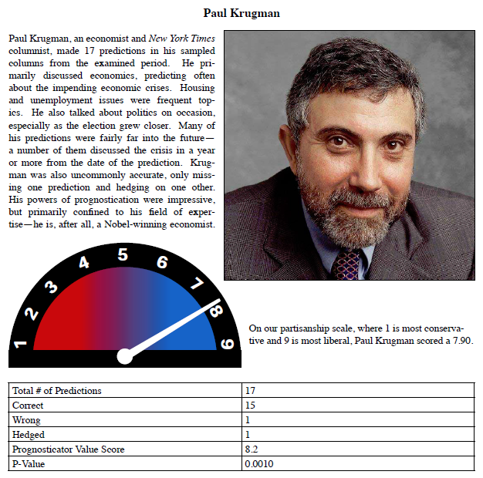
Scored 8.2 out of 10 on the prognostication scale: p-value of 0.001 (statistically significant)

Slide 39
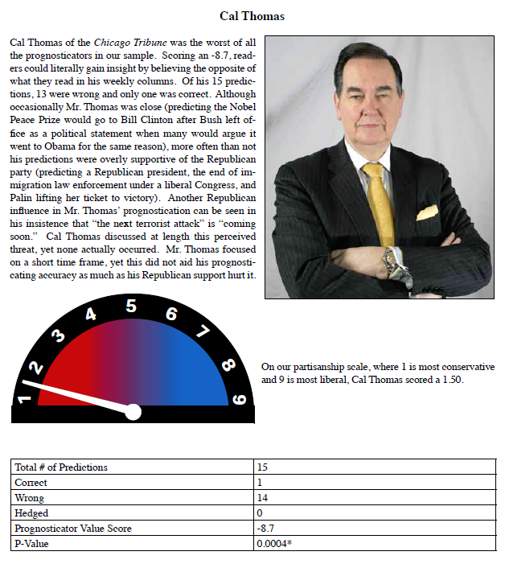
Scored -8.7 out of -10 on the prognostication scale: p-value of 0.0004 (statistically significant)

Slide 40
Null
Paul Krugman
What does the null hypothesis represent in this study? How are they calculating statistical significance?
Is this a strong / valid counterfactual?
Null
Thomas Friedman
Null
Cal Thomas
Null Hypothesis: Zero on the prognosticator scale

Slide 41
Donaldson, H., Doubleday, R., Hefferman, S., Klondar, E., & Tummarello, K. (2011). Are Talking Heads Blowing Hot Air? An Analysis of the Accuracy of Forecasts in the Political Media. Hamilton College, Public Policy, 501.
A class at Hamilton College led by public policy professor P. Gary Wyckoff has analyzed the predictions of 26 prognosticators between September 2007 and December 2008. The Hamilton students sampled the predictions of 26 individuals who wrote columns in major print media and who appeared on the three major Sunday news shows – Face the Nation, Meet the Press, and This Week.
They evaluated the accuracy of 472 predictions made during the 16-month period. They used a scale of -10 to +10 to rate the accuracy of each.
The students found that only nine of the prognosticators they studied could predict more accurately than a coin flip. Two were significantly less accurate, and the remaining 14 were not statistically any better or worse than a coin flip.
Is a coin flip a good null model for a prediction made on the news? What are some other counterfactuals they could have used?

Slide 42
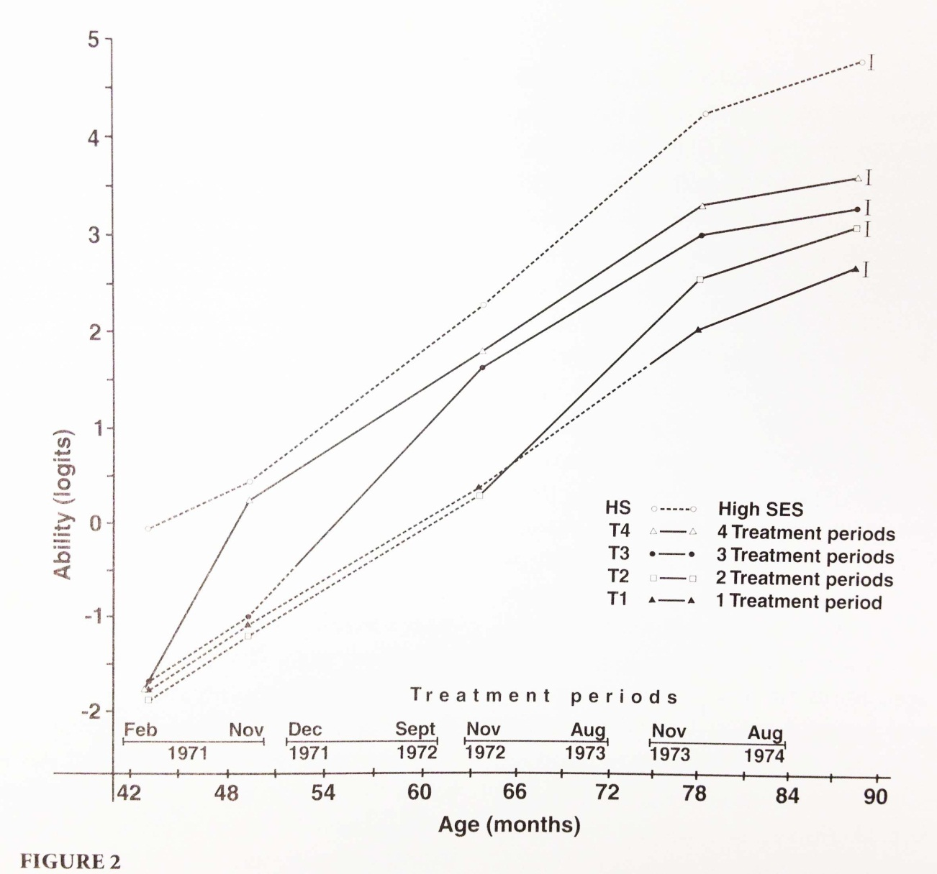
Another Example:

Slide 43
What was the counterfactual in this study?
Which group was treated?
Which was the control?
Treatment Groups
x
G1_{t=0} G1_{t=1} G1_{t=2} G1_{t=3} G1_{t=4}
G2_{t=0} G2_{t=1} G2_{t=2} G2_{t=3} G2_{t=4}
G3_{t=0} G3_{t=1} G3_{t=2} G3_{t=3} G3_{t=4}
G4_{t=0} G4_{t=1} G4_{t=2} G4_{t=3} G4_{t=4}
x
x
x
G1 to G4 are group IDs, t=i are time periods 1 to 4
Control Groups
Read: Bingham, R., & Felbinger, C. (2002). Evaluation in practice: A methodological approach. CQ Press. CH-05: Improving Cognitive Ability in Chronically Deprived Children [pdf]

Slide 44
Treatment Group Control Group
x
G1_{t=0} G1_{t=1} G1_{t=2} G1_{t=3} G1_{t=4}
G2_{t=0} G2_{t=1} G2_{t=2} G2_{t=3} G2_{t=4}
G3_{t=0} G3_{t=1} G3_{t=2} G3_{t=3} G3_{t=4}
G4_{t=0} G4_{t=1} G4_{t=2} G4_{t=3} G4_{t=4}
x
x
x
Specific tests: treatment gains for late treatment?

Slide 45
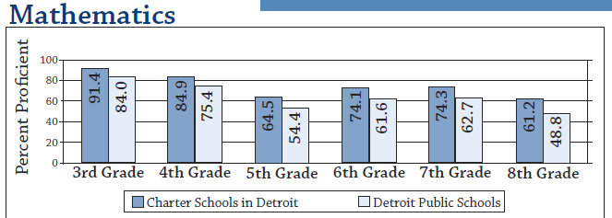
Example: Do Charter Schools Outperform Public Schools?
“Don't get me wrong. I am not opposed to charter schools on principle. My beef with charter schools is that most skim the most motivated students out of the poorest communities, and many have disproportionately small numbers of children who need special education or who are English-language learners.
The typical charter, operating in this way, increases the burden on the regular public schools, while privileging the lucky few. Continuing on this path will further disable public education in the cities and hand over the most successful students to private entrepreneurs.” ~ D.R.
http://www.rightmichigan.com/story/2011/6/21/23927/4600
http://blogs.edweek.org/edweek/Bridging-Differences/2009/11/obama-and-duncan-are-wrong-abo.html

Slide 46
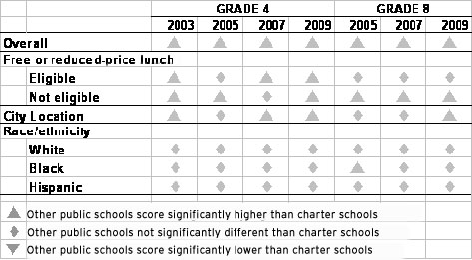
Obama and Duncan Are Wrong About Charters
By Diane Ravitch on November 16, 2009 1:12 PM
Updated analysis by Diane Ravitch
Raw comparison of charters to publics – charters look better (higher test scores on average)
After we control for the type of population the schools serve we see that charters are more likely located in better communities – when they serve the same students as public schools they often perform worse.
http://blogs.edweek.org/edweek/Bridging-Differences/2009/11/obama-and-duncan-are-wrong-abo.html

Slide 47
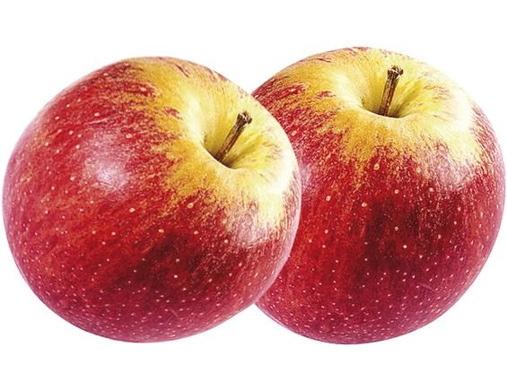
?
Mathematically charter schools outperform pubic on test score. But do they have a causal effect on student performance? What’s the appropriate counterfactual?

Slide 48
True experiments

Slide 49
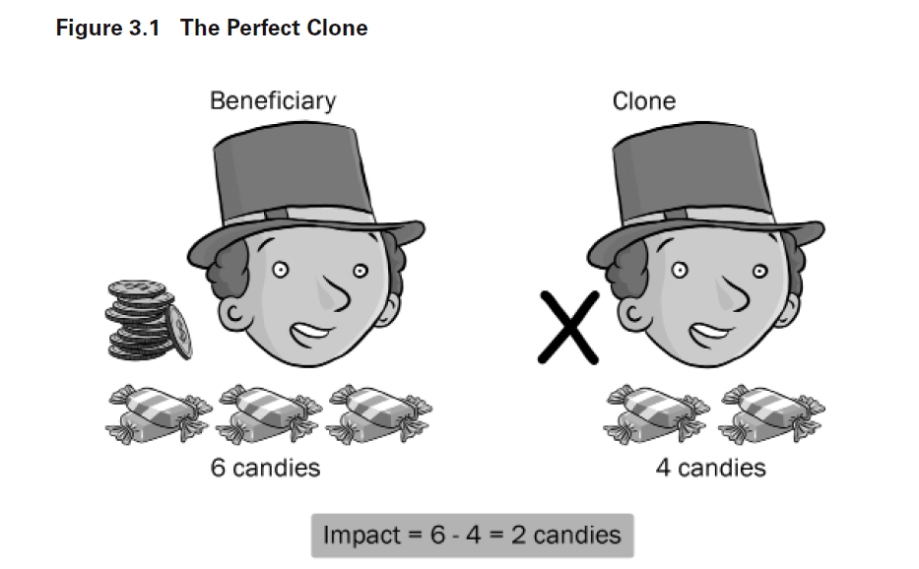

Slide 50
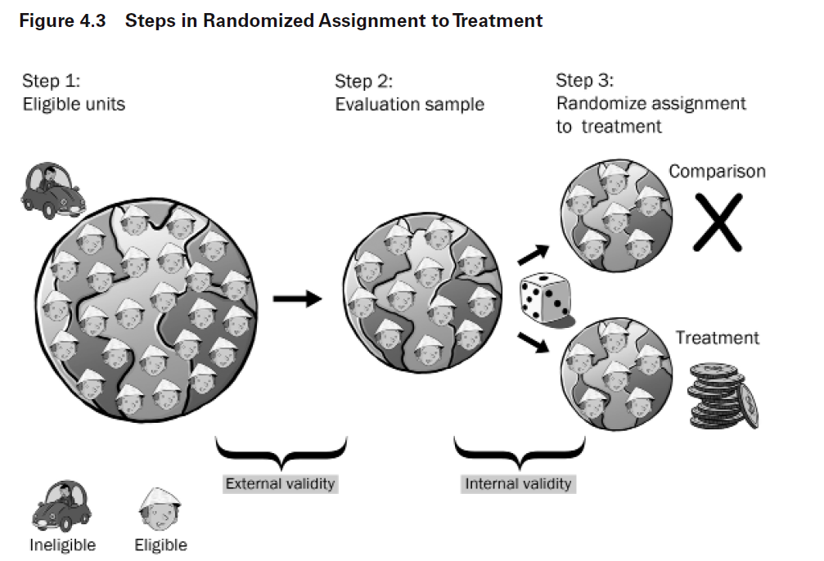

Slide 51
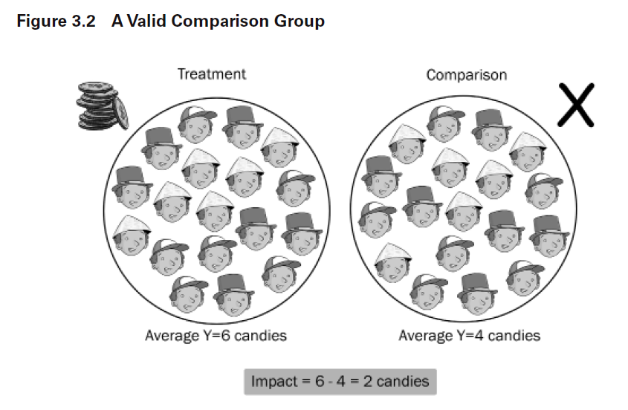
b₁ = T2 – C2

Slide 52
Non-experiments

Slide 53


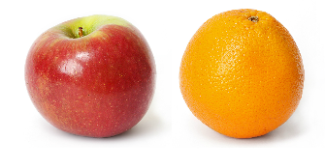

Experiments
Quasi-Experiments
Observational Studies

Slide 54
When careful, quasi-experimental methods can produce the same results as experimental methods
Cook, T. D., Shadish, W. R., & Wong, V. C. (2008). Three conditions under which experiments and observational studies produce comparable causal estimates: New findings from within‐study comparisons. Journal of Policy Analysis and Management: The Journal of the Association for Public Policy Analysis and Management, 27(4), 724-750.
Aiken, L. S., West, S. G., Schwalm, D. E., Carroll, J. L., & Hsiung, S. (1998). Comparison of a randomized and two quasi-experimental designs in a single outcome evaluation: Efficacy of a university-level remedial writing program. Evaluation Review, 22(2), 207-244.
West, S. G., Biesanz, J. C., & Pitts, S. C. (2000). Causal inference and generalization in field settings: Experimental and quasi-experimental designs.

Slide 55
Estimated Program Effect
?
Y(treatment) – Y(CONTROL) = Y(treatment) – Y(COMPARISON)
This course covers the conditions under which these cases should be equivalent

