Slide 1
Varieties of the counterfactual
Jesse Lecy

Slide 2
The three types of counterfactuals
Pre-Post with comparison group
Post-test only design
Reflexive design (pre-post only)

Slide 3
Assume you have selected a reasonable comparison.
Suicide rates are HIGHER
Null
Null Hypothesis: Population Average
Suicide rates are NO DIFFERENT
Null
Null Hypothesis: All HS Students
OR All Californians
Suicide rates are LOWER
Null
Null Hypothesis: All Suburban HS Students

Slide 4
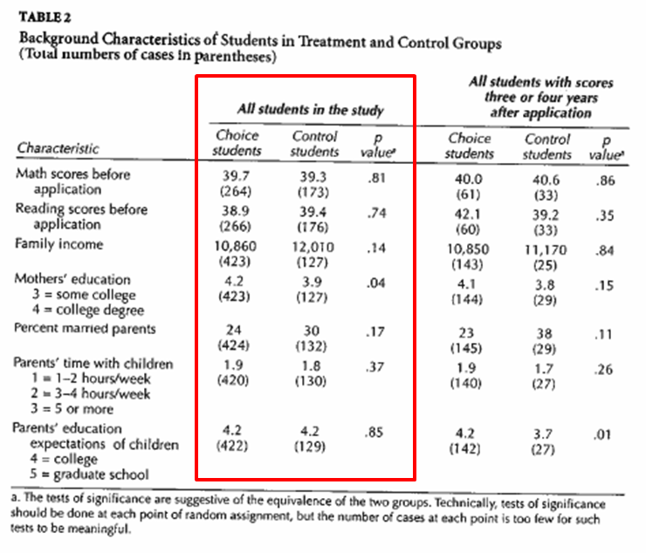
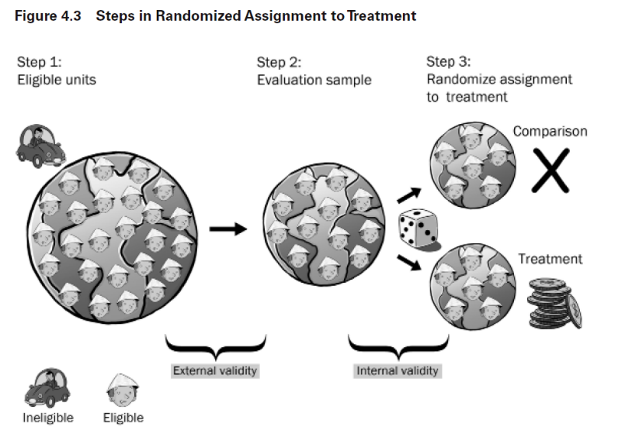
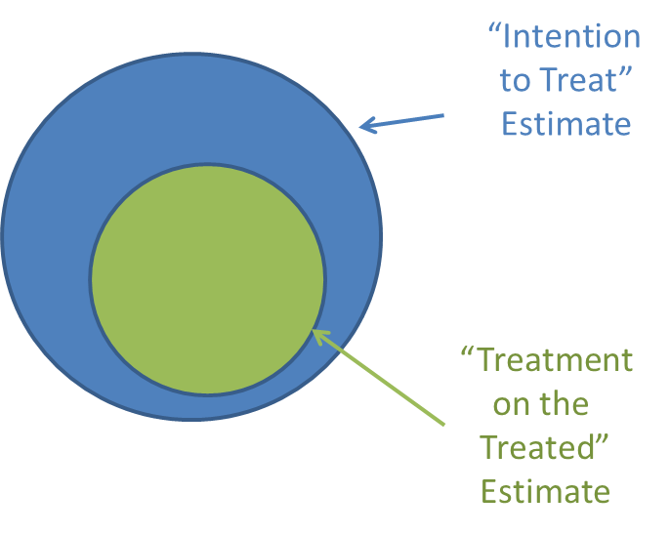
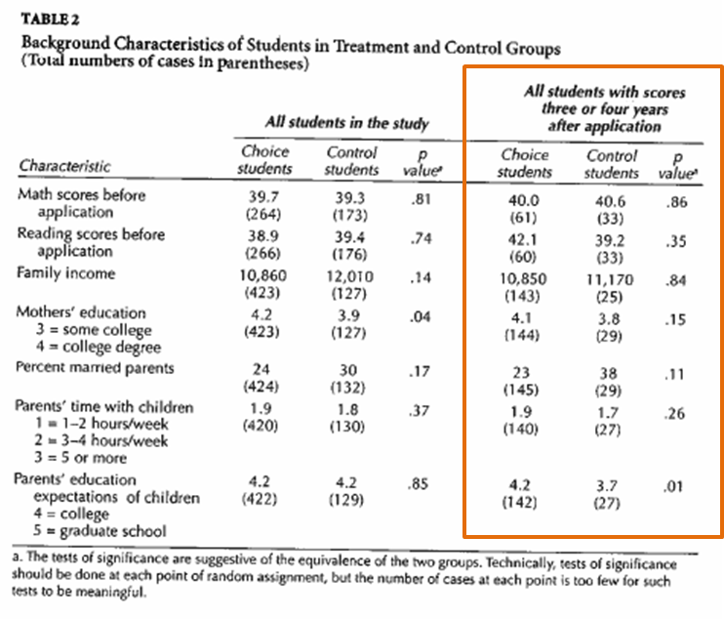
You have created your groups, tested for equivalence and attrition bias, decided on the type of measure you will use in the study (ITT or TOT).

Slide 5

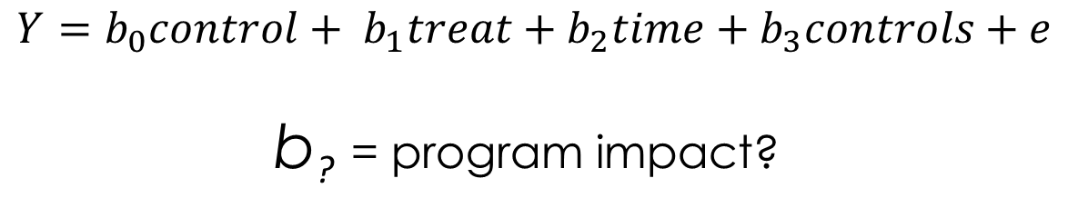
Now how do we actually calculate program impact?
$$Y=b_{0}control+ b_{1}treat+b_{2}time+b_{3}controls+e$$
b? = program impact?

Slide 6
The Three types of counterfactual estimates

Slide 7
3 valid counterfactuals:
Each variety of counterfactual has a different formula for the program effect estimate.
Pre-Post Reflexive Estimator effect = T2-T1
Post-Only Estimator
effect = T2-C2
Pre-Post w Comparison Estimator
effect = (T2-T1) – (C2-C1)
(Diff-in-Diff)
effect
effect
A
effect:
A-B
B
t=1
t=2
t=1
t=2
t=1
t=2
Program
Program
Program
Treatment Groups, T1=before, T2=post-program measure
Control Groups, C1=before, C2=post-program measure

Slide 8
3 valid counterfactuals:
Each variety of counterfactual has a different formula for the program effect estimate.
Pre-Post Reflexive Estimator effect = T2-T1
Post-Only Estimator
effect = T2-C2
Pre-Post w Comparison Estimator
effect = (T2-T1) – (C2-C1)
Note that C1, C2, T1, and T2 here represent the average level of the dependent variable for each group.
You will learn how to run each of these three counterfactuals as a regression model eventually, but for now think of the statistical test used to determine program effects as a t-test (comparison of mean) of the treatment group and counterfactual group.
(Diff-in-Diff)
effect
effect
A
effect:
A-B
B
t=1
t=2
t=1
t=2
t=1
t=2
Program
Program
Program
Treatment Groups, T1=before, T2=post-program measure
Control Groups, C1=before, C2=post-program measure

Slide 9
b₀ will measure Y-bar of the omitted group C2
b₀ +b₁ represents the Y-bar of T2
Recall from Unit on Dummy Variable Models
Y = b₀ + b₁(TreatDummy) + e
b₁ = MEAN_{treat} - MEAN_{control}
b₁ = T2 – C2
(basic set-up for a comparison of group means in regression)
Outcome
Treatment
b₁
T2
Control
C2
b₁ = 0
(group means)
The default hypothesis test in the regression then uses b₁ to test for a meaningful difference between T2 and C2

Slide 10
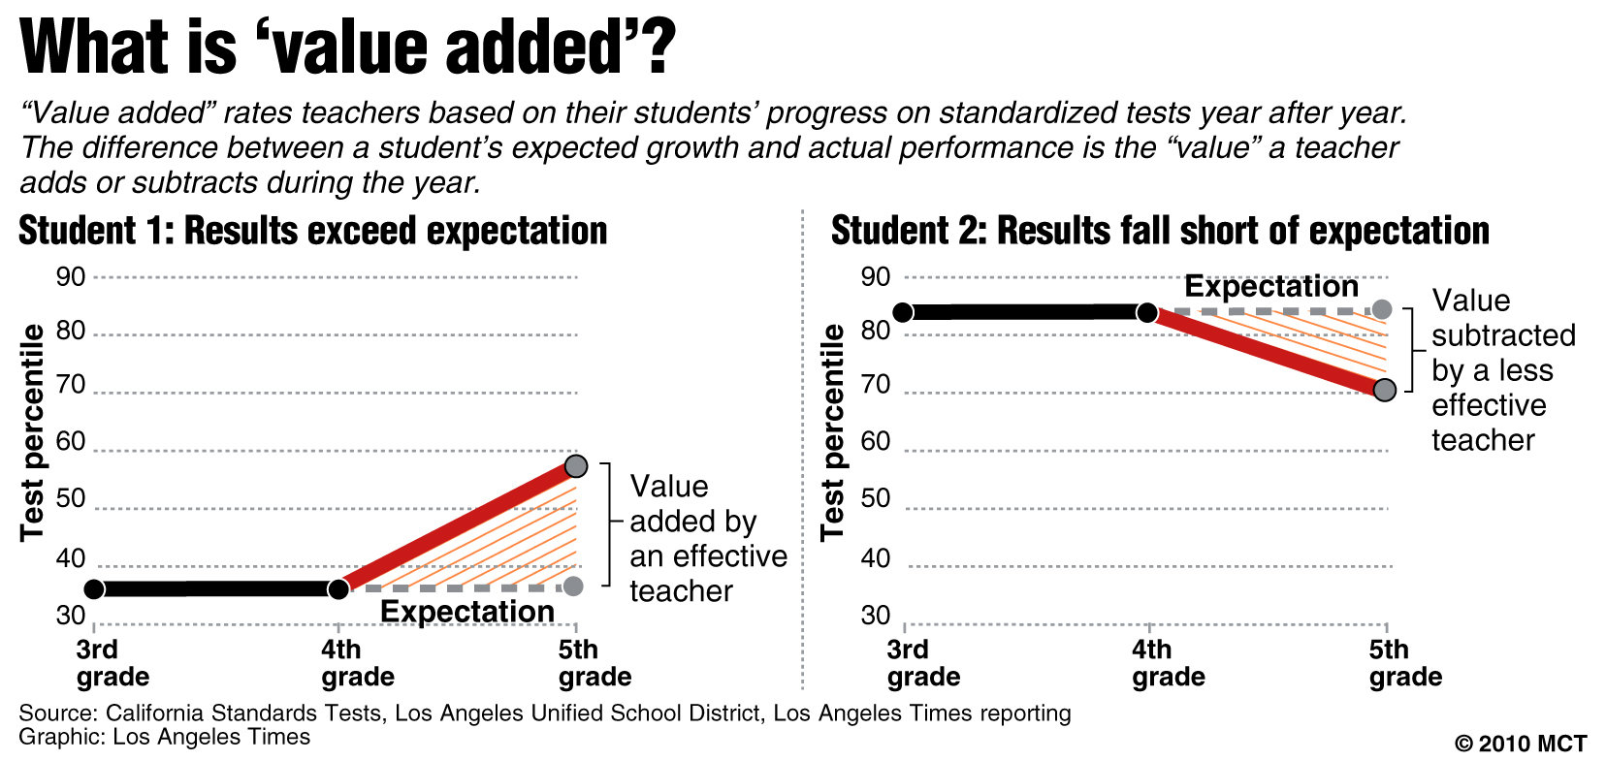
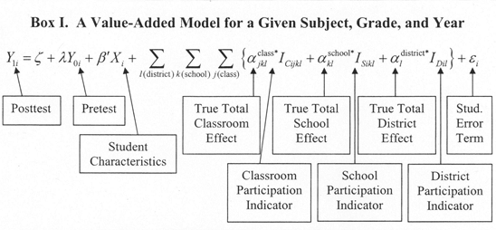
When we have lots of groups, lots of time periods, and lots of control variables at different levels our models will eventually look like this.
But not this semester.

Slide 11
Difference-in-Difference Estimator
T2
Pre-Post w Comparison Estimator
effect = (T2-T1) – (C2-C1)
T1
A
effect:
A-B
C2
C1
B
(Diff-in-Diff)
t=1
t=2
Program
Accounts for initial difference in groups and secular trends

Slide 12
Difference-in-Difference Estimator
Pre-Post w Comparison
effect = (T2-T1) – (C2-C1)
effect:
A-B
A
Gains during the program period by treatment group
Gains independent of the program (secular trends)
B
t=1
t=2
Program

Slide 13
T2
T2 – T1 = Total Gains in Treatment Group
C2
C2 – C1 = Total Gains in Control Group (trend)
T1
C1
(T2-T1)-(C2-C1) = Program Impact

Slide 14
Difference-in-Difference Estimator
effect = (T2-T1) – (C2-C1)
Two important things to note:
The groups prior to the treatment are not identical. The difference in difference is robust because it does not require equivalent treatment and “control” (comparison) groups.
The comparison group measures the changes we would expect to observe in the treatment group over time independent of the treatment. This assumption must be true for the diff-in-diff estimator to be unbiased.
effect:
A-B
A
B
t=1
t=2
Program

Slide 15
Example: Estimating the gender pay gap for Executive Directors
Outgoing ED Salary
Incoming ED Salary
(use only males)
C2
Male ED
Recruitment Premium: C2 - C1
C1
Males replaced by Males
Counterfactual
Salary Female ED would have received if they got same bump
Males replaced by Females
Female ED
Pay Gap
T1
T2
Counterfactual Pay – Actual Pay
Counterfactual Pay: Baseline Pay (T1) + Typical (male) Recruitment Premium ( C2 – C1 )

Slide 16
Estimating the gender pay gap for Executive Directors
Outgoing ED
Incoming ED
(only males)
C2
Note that in the diff-in-diff the groups do not have to be identical prior to the treatment (new hire)
This is the major strength of the estimator.
Male ED
C1
Counterfactual
Female ED
T1
T2

Slide 17
Estimating the gender pay gap for Executive Directors
Outgoing ED
Incoming ED
Also note that we never compare C2 to T2 (the two post-treatment groups)
(only males)
C2
The proper counterfactual is how much would female EDs be getting paid if they were given recruitment premiums as incoming male EDs.
C1
CF
T1
T2
C2
The comparison group is there to capture the trend, which is then used to construct the counterfactual.
C1

Slide 18
“Control” Versus “Comparison” Groups
Outcome
T2
Policy / program group
The term “control group” typically refers to a group created through randomization, so they are assumed to be identical. We sometimes use the terminology “comparison group” to differentiate the these cases. The control groups represents the counterfactual, the comparison group does not (it just captures trend in this case).
T1
C2
C1
Control / comparison group
time=1
time=2
Program
Single Difference: Difference in Difference:
Effect = T2 – T1 Effect = (T2 – T1) – (C2 – C1)
Effect = T2 – C2
*trend*

Slide 19
Difference-in-Difference Estimator
T2
Pre-treatment period
Parallel lines test:
T1-T0 = C1- C0
T1
T0
effect:
A-B
C2
A
C1
Treatment Occurs
B
C0
t=1
t=2
Parallel lines assumption: for the diff-in-diff counterfactual to be valid C2-C1 has to accurately capture the secular trend (gains independent of the treatment). The test of this is comparing rates of change in treatment and comparisons groups prior to the intervention. They should b the same.
Program

Slide 20
2 remaining counterfactuals:
Pre-Post Reflexive Estimator effect = T2-T1
Post-Only Estimator
effect = T2-C2
Pre-Post w Comparison Estimator
effect = (T2-T1) – (C2-C1)
(Diff-in-Diff)
effect
effect
A
effect:
A-B
B
t=1
t=2
t=1
t=2
t=1
t=2
Program
Program
Program

Slide 21
Validity of the reflexive estimator:
Reflexive (Pre-Post)
In some special cases we expect there to be no change independent of the treatment. When this is true the reflexive estimator T2-T1 is appropriate and unbiased.
(T2 – T1) – (C2 – C1) = T2 – T1
IFF
C2 – C1 = 0
(no trend)
Outcome
T2
T1
T2 – T1
C1
C2
time=1
time=2
C2-C1=0
Program

Slide 22
b₀ will measure Y-bar of the omitted group T1
b₀ +b₁ represents the Y-bar of T2
In reflexive models T1 is the counterfactual or control group, otherwise the regression set-up is the same
Y = b₀ + b₁(TreatDummy) + e
b₁ = MEAN_{treat} - MEAN_{control}
b₁ = T2 – T1
The default hypothesis test in the regression then uses b₁ to test for a meaningful difference between T2 and T1
Outcome
POST
T2
PRE
b₁
T1
Reflexive Design:
T1 is the control
b₁ = 0

Slide 23
The comparison group is necessary to capture any changes that we expect during the study period independent of the treatment group. If we fail to account for those changes we will incorrectly attribute all change to the program and over-state program impact.
C2
C2 – C1 = Total Gains in Control Group (trend)
C1
T2
Program Impact?
C2 – C1
T1

Slide 24
Validity of the post-test only estimator:
Post-Only
If we have confidence that the two groups are identical prior to the treatment, then mathematically T2-C2 will still account for gains independent of the treatment. This condition is necessary for the post-test only estimator to be unbiased.
In experimental design, this is usually accomplished through randomization or lottery. Observational students typically use matching models to create equivalent groups.
(T2 – T1) – (C2 – C1) = T2 – C2
IFF
C1 – T1 = 0
(equivalent at time 1)
T2
Outcome
C2
T1
C1
time=1
time=2
Program

Slide 25
b₀ will measure Y-bar of the omitted group C2
b₀ +b₁ represents the Y-bar of T2
Recall from Unit on Dummy Variable Models
Y = b₀ + b₁(TreatDummy) + e
b₁ = MEAN_{treat} - MEAN_{control}
b₁ = T2 – C2
(basic set-up for a comparison of group means in regression)
Outcome
Treatment
b₁
T2
Control
C2
b₁ = 0
(group means)
The default hypothesis test in the regression then uses b₁ to test for a meaningful difference between T2 and C2

Slide 26
T2
Post-Test Only Measure
True Effect = T2 – C2
C2
If C1 = T1
T1
Measured effect accurately represents program impact
C1
Outcome
T2
T2 – C2 Too big
biased
T1
C1 < T1
C2
C1
T1
Measured effect overstates program impact
C1
time=1
time=2
Program
T2 – C2 Too small
C1>T1
biased
C1
T1
Measured effect understates program impact

Slide 27
Examples

Slide 28
Example from education policy – which estimator is this?

Slide 29
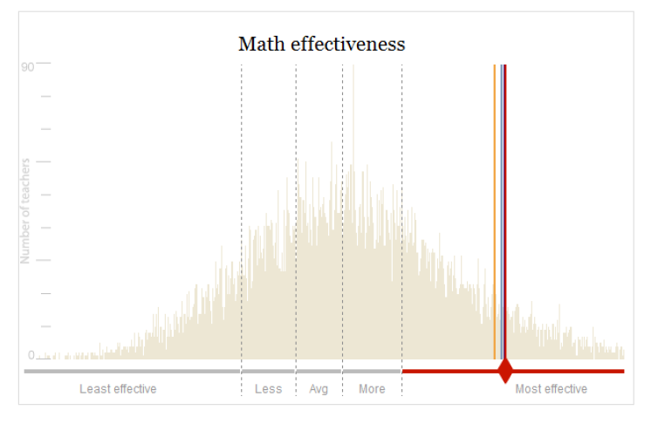
Comparing teacher “effects”
Change in student performance from the beginning of the academic year to the end of the academic year (measured in percentile units).
Reflexive measure because our notion of “impact” comes from comparing performance of the same students over time, not comparing one classroom to another at a point in time.
Note, because we use percentiles for performance (tests will be different at the end of each grade so it is hard to compare raw scores) there is an element of a difference-in-difference design. But percentiles require that the average change across all groups (the secular trend or expectation of gain independent of the treatment) has to be zero across all groups because of the math. But if it is a sub-population there could be a trend, in which case the diff-in-diff might be appropriate.

Slide 30
Revisit the micro-finance example

Slide 31
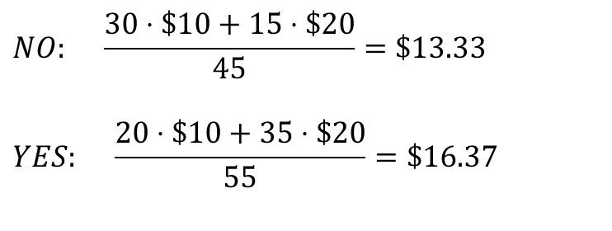
Microfinance example of bias from selection INTO a study group
The loan appears to have an impact!
Number of each “type” of person in the study
Takes Loan?
 | NOT Entrepreneurial | Entrepreneurial
No Loan | 30 | 15
Takes a Loan | 20 | 35
$$NO: \frac{30⋅\$10+15⋅\$20}{45}=\$13.33$$
$$YES: \frac{20⋅\$10+35⋅\$20}{55}=\$16.37$$
Average weekly income after loan period
Which counterfactual estimator are we using here? Which counterfactual estimator would be unbiased?
 | NOT Entrepreneurial | Entrepreneur
No Loan | $10 | $20
Takes a Loan | $10 | $20
Income not impacted by the loan
You are more likely to take a loan if you know you are good at business

Slide 32
Microfinance example of bias from selection OUT OF a study group
Reflexive design
Program causes no change in income after loan
$3.00
$2.50
$2.00
$1.50
$1.00
$3.00
$2.50
$2.00
$1.50
$1.00
Mean = $2.00
Mean = $2.00
T1
Ave household daily income before program
T2 After program
T2 - T1 = 0
causal estimate is unbiased

Slide 33
Random Attrition Example
$3.00
$2.50
$2.00
$1.50
$1.00
$3.00
$2.50
$2.00
$1.50
$1.00
Attrit
Mean = $2.00
Mean = $2.00
Attrit
T2 - T1 = 0 Impact study accurately represents program effects
Program is not determined to be effective (no change)

Slide 34
Which estimator is used here?
Non-Random Attrition Example
$3.00
$2.50
$2.00
$1.50
$1.00
$3.00
$2.50
$2.00
$1.50
$1.00
Mean = $2.50
Mean = $2.00
Attrit
T2 – T1 ≠ 0
We over-estimate program effects
Program appears to be effective

Slide 35
Which estimator is used here? Can we use a different one?
Non-Random Attrition Example
$3.00
$2.50
$2.00
$1.50
$1.00
$3.00
$2.50
$2.00
$1.50
$1.00
Mean = $2.50
Mean = $2.00
Attrit
Reflexive →
T2 – T1 ≠ 0
We over-estimate program effects
Program appears to be effective

Slide 36
Which effect measure is used here? Intention to treat, or treatment on the treated?
Non-Random Attrition Example
$3.00
$2.50
$2.00
$1.50
$1.00
$3.00
$2.50
$2.00
$1.50
$1.00
Mean = $2.50
Mean = $2.00
Attrit
Can we use a better treatment measure?
T2 – T1 ≠ 0
We over-estimate program effects
Program appears to be effective

Slide 37
Which effect measure is used here? Intention to treat, or treatment on the treated?
Non-Random Attrition Example
Remove attriters from T1
$3.00
$2.50
$2.00
$1.50
$1.00
$3.00
$2.50
$2.00
$1.50
$1.00
Mean = $2.50
Mean = $2.50
T2 – T1 = 0
Attrit
This is not about ITT vs TOT! To calculate those we need data on both groups in T2.
Rather this is about how we use data when attrition is present

Slide 38
Preview of CPP 525: advanced regression

Slide 39
Counterfactuals in practice: Quasi-Experiment Methods
Difference-in-Difference: Effect = (T2-T1) – (C2-C1)
Difference-in-Difference Analysis
Fixed Effects Models
Reflexive Design: Effect = T2 – T1
Pre-Post Design with only a Treatment Group
Time Series Regression
Post-Test Only Design: Effect = T2 – C2
True Experiments (T2-C2)
Post-Test Only Comparison, No Baseline (T2-C2)
Propensity Score Matching
Regression Discontinuity Design

Slide 40
These will start to make more sense.

