Slide 1
Campbell Scores: Eliminating competing hypotheses

Slide 2
Core Concepts
Causal Analysis and the Counter-Factual
The Competing Hypotheses Framework
Calculation of Program Effect (effect size)
Randomization Process
Control versus Comparison Group
Treatment Effect
Average Treatment Effect (ATE)
Intention to Treat (ITT)
Treatment on the Treated (TOT)

Slide 3
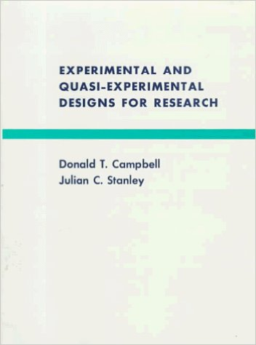
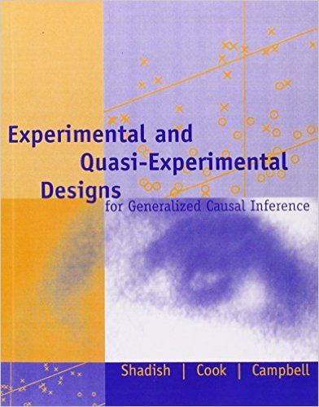
( inspiration for these assignments )

Slide 4
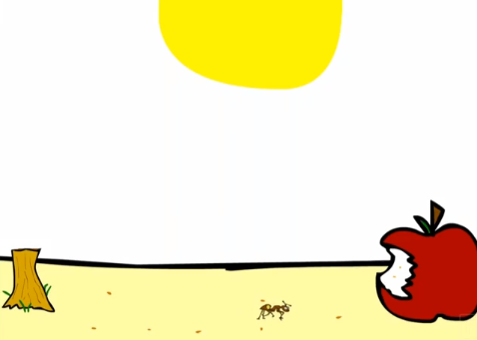
Eliminating Competing Hypotheses to Improve Internal Validity
Can Ants Count?
http://www.youtube.com/watch?v=7DDF8WZFnoU

Slide 5
Competing Hypotheses
The Program Hypothesis:
The change that we saw in our study group above and beyond the comparison group (the effect size) was a result of the program.
The Competing Hypothesis:
The change that we saw in our study group above and beyond the comparison group was a result of _______.
(insert any item of the Campbell Score)
This is a general example of “the identification problem” in statistics. It’s one thing to run a model and get significant results (the outcome definitely changed for the treatment group). Another thing to say we have properly identified the program or intervention as the cause of the change.

Slide 6
The Campbell Score: Ten Competing Hypotheses
Omitted Variable Bias
Selection / Omitted Variables
Non-Random Attrition
Trends in the Data
Maturation
Secular Trends
Testing
Seasonality
Regression to the Mean
Study Calibration
Measurement Error
Time-Frame of Study
Contamination Factors
Intervening Events
Guilty until proven innocent
Innocent until proven guilty (must have evidence from the study or solid reasoning beyond simple speculation)

Slide 7
Scoring Items on Homework
Your job is to make a strong case. Use the definitions of Campbell Score items provided and evidence that is presented in the case studies to make your arguments.
Note that the first two items are intimately linked with omitted variable bias in program evaluation studies. Since this is the most common and most problematic issue we worry about, rigorous evaluations need to demonstrate that this problem has been addressed in order to establish a baseline of internal validity. Since most observational studies will be significantly affected by selection and attribution problems, these first two items have a “guilty until proven innocent” criteria.
The subsequent items are potential causes of concern for the internal validity of a study. Even if selection has been addressed, these other 8 things can impact our ability to generate valid causal inferences from a study, but they are less common so you cannot simply assume they will be a problem. You need to make a reasonable argument that the problem might exist in the study based upon data and evidence that is present, or sound logic and reasoning beyond speculation.
The Campbell Scores help you establish metrics for the quality of evidence provided in the study.

Slide 8
Competing Hypothesis #1
Selection Into a Program
If people have a choice to enroll in a program, those that enroll will be different than those that do not.
This is a source of omitted variable bias.
The Fix:
Randomization into treatment and control groups, or a rigorous matching process.
Randomization must be “happy”!

Slide 9
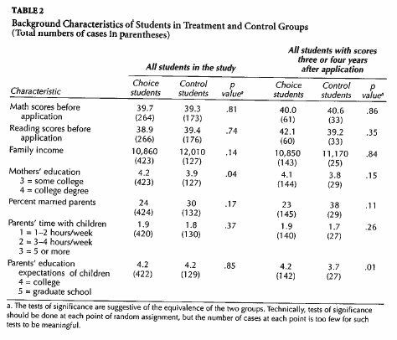
Test for “Happy” Randomization
This contrast suggests a difference in mother’s education level, but because 0.04 > 0.05/7, we do NOT reject the null that these two groups are the same. We can consider this randomization process to be “happy”.
We test for equivalence of groups by comparing their measured characteristics. The Bonferroni correction allows you to test the hypothesis that collectively multiple contrasts performed together do not suggest differences in treatment vs. control groups. Adjust the alpha by dividing 0.05 by the number of tests in a table.

Slide 10
Competing Hypothesis #2
Non-Random Attrition
If the people that leave a program or study are different than those that stay, the calculation of effects will be biased.
The Fix:
Examine characteristics of those that stay versus those that leave.
Microfinance Example: Artificial effects in reflective (before/after) study
$3.00
$2.50
$2.00
$1.50
$1.00
$3.00
$2.50
$2.00
$1.50
$1.00
Mean = $2.50
Mean = $2.00
Attrit

Slide 11
Test for Attrition
TEST:
T2 = C2
on all contrasts
(only use measures from before the treatment occurred)
If attrition was non-random but occurred equally across groups then it will typically not bias results. Not helpful in reflexive designs.
Can also be tested in another way:
If T1 = T2 then attrition was random
(useful for reflexive studies)

Slide 12
T1
C1
T2
Random
Attrition
C2
Population characteristics equivalent
on all contrasts
T2
C2
Example Nonrandom Attrition Problems
Attrition in one group but not another
Different rates of attrition
Attrition from different parts of the distribution (all high performers from one group, all low performers from another)

Slide 13
Separating Trend from Effects
T2-C2 removes trend
Outcome
T2
Treatment Effect
Total Gains
During Study
C2
C1 = T1
Trend
Time=1
Time=2

Slide 14
Separating Trend from Effects
T2-C2 does NOT fully remove trend
Outcome
T2
Total Gain of Treat-Group T2-T1
T2-C2
C1 ≠ T1
C2
Actual Trend
Removed By T2-C2
Time=1
Time=2
NOTE, diff-in-diff separates trends even when groups are not equivalent.

Slide 15
Separating Trend from Effects
T2-C2 removes too much trend
Outcome
T2
T2-C2
Total Gain
C2
Removed By T2-C2
Actual Trend
C1 ≠ T1
Time=1
Time=2
NOTE, diff-in-diff separates trends even when groups are not equivalent.

Slide 16
Competing Hypothesis #3
Maturation
Occurs when growth is expected naturally, such as increase in cognitive ability of children because of natural development independent of program effects.
The Fix:
Use a comparison group to remove the trend.
A
Pre-Post With Control
B
Effect: A-B
T=1
T=2
Program

Slide 17
Competing Hypothesis #4
Secular Trends
Very similar to maturation, except the trend in the data is caused by a global process outside of individuals, such as economic or cultural trends.
The Fix:
Use a comparison group to remove the trend.
A
Pre-Post With Control
B
Effect: A-B
T=1
T=2
Program

Slide 18
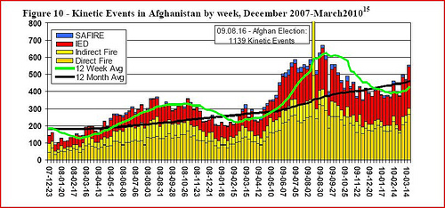
Competing Hypothesis #5
Seasonality
Data with seasonal trends or other cycles will have natural highs and lows.
The Fix:
Only compare observations from the same time period, or average observations over an entire year (or cycle period).
Invalid
program impact claim

Slide 19
Competing Hypothesis #6
Testing
When the same group is exposed repeatedly to the same set of questions or tasks they can improve independent of any training.
The Fix:
This problem only applies to a small set of programs. Change tests, use post-test only designs, or use a control group that receives the test.
A
Pre-Post With Control
B
Effect: A-B
T=1
T=2
Program

Slide 20
Competing Hypothesis #7
Regression to the Mean
Every time period that you observe an outcome, during the next time period the outcome naturally has a higher probability of being closer to the mean than it does of staying the same or being more extreme. As a result, quality improvement programs for low-performing units often have a built-in improvement bias regardless of program effects.
The Fix:
Take care not to select a study group from the top or bottom of the distribution in a single time period (only high or low performers).

Slide 21
Regression to the Mean Example
Average = 15.6
Only sent to batting coach when having a slump. Which direction does the trend go after a slump? Is it because of the batting coach? (NO – reg to mean)

Slide 22
Surgery Is One Hell Of A Placebo
Weirdly enough, surgery’s invasiveness may explain some of its potency. Studies have shown that invasive procedures produce a stronger placebo effect than non-invasive ones, said researcher Jonas Bloch Thorlund of the University of Southern Denmark. A pill can provoke a placebo effect, but an injection produces an even stronger one. Cutting into someone appears to be more powerful still.
Even without a robust placebo effect, an ineffective surgery may seem helpful. Chronic pain often peaks and wanes, which means that if a patient sought treatment when the pain was at its worst, the improvement of symptoms after surgery could be the result of a condition’s natural course, rather than the treatment. That softening of symptoms from an extreme measure of pain is an example of the statistical concept of regression to the mean.
https://fivethirtyeight.com/features/surgery-is-one-hell-of-a-placebo

Slide 23
Competing Hypothesis #8
Measurement Error
If there is significant measurement error in the dependent variables, it will bias the effects towards zero and make programs look less effective.
The Fix:
Use better measures of dependent variables.

Slide 24
Competing Hypothesis #9
Study Time-Frame
If the study is not long enough it make look like the program had no impact when in fact it did. If the study is too long then attrition becomes a problem.
The Fix:
Use prior knowledge or research from the study domain to pick an appropriate study period.
Examples:
Michigan Affirmative Action Study
Iowa liquor law change

Slide 25
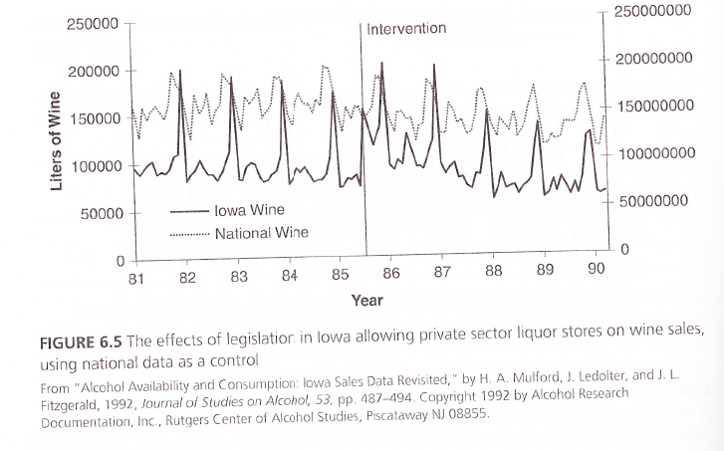
Time frame: one-year post policy change: conclusion is POLICY CHANGE BAD
Significant jump in
consumption!

Slide 26
Evaluation two or more years after policy change: conclusion POLICY GOOD
(new stores stocking shelves)
Note “consumption” is measured as wholesale volume, not consumer consumption, so there is a serious measurement problem as well!

Slide 27
Competing Hypothesis #10
Intervening Events
Has something happened during the study that affects one of the groups (treatment or control) but not the other?
Example, treatment group school burns down. Prices change for substitute goods for control group.
The Fix:
If there is an intervening event, it may be hard to remove the effects from the study.

