Slide 1
Testing the validity of the counterfactual
Jesse Lecy

Slide 2
Core Concepts
The Selection Problem
Tests for Group Equivalence
Tests for Nonrandom Attrition
Omnibus Test
Bonferroni Correction

Slide 3
Nature gives us correlations: The selection problem in evaluation research

Slide 4
If we reduce classroom size we should see student performance improve. Right?
10
15
20
25
30

Slide 5

The Math of cities
Listen: 4:30 – 15:30
http://www.radiolab.org/2010/oct/08/its-alive/

Slide 6

The Math of cities
Patents / Crime / Salary
( outcomes )
$$y=b_{0}+b_{1}x$$
Walking Speed?

Slide 7
The Math of cities
If you increase the WALKING SPEED of a city, would you increase the number of patents produced?

Slide 8
The Math of cities
Patents / Crime / Salary
( outcomes )
$$y=b_{0}+b_{1}x$$
Population

Slide 9
The Math of cities
If you increase the POPULATION of a city, would you increase the number of patents produced?

Slide 10
The problem with correlations:
Walking Speed
Number of Patents
Population

Slide 11
Nature gives us correlations

Slide 12
Example #1
x
y
z
X and Z both impact Y
no correlation

Slide 13
Example #2
No causal relationship but high correlation
x
y
z
Z impacts both X and Y

Slide 14
Example #3
x
y
no direct causal relationship but highly correlated
z
Causal chain

Slide 15
Reverse causality
Y = b₀ + b₁X + e
x
y
Both models are highly significant, how do we know which one is the causal relationship?
x
y
X = b₀ + b₁Y + e

Slide 16

The program evaluation framework
$$Heartrate=b_{0}+b_{1}∙Caffeine+ε$$
Treatment Effect =
typical dosage x slope b₁
Slopes represent change in Y as a result of a one-unit change in X
Rarely is one-unit of X meaningful, so be sure to translate the slope to an appropriate dosage to generate a meaningful impact measure
If the treatment is one espresso:
Espresso contains ~ 50mg caffeine
Heart rate increase = (50)(b1)
Effect Size = (dosage)(b1)
( change in response to one unit increase in caffeine )
slope b₁
Notes:
In an experiment there is full control over the treatment variable, and it is the only thing being manipulated

Slide 17

Discrete treatment case: model is the same except Caffeine is a dummy not a level
$$Heartrate=b_{0}+b_{1}∙Caffeine+ε$$
Heart Rate
Treatment (Caffeine)
Control (No caffeine)

Slide 18
No effect of treatment on outcome
Notes:
Null case – the treatment has no effect

Slide 19
How do we know when the interpretation is causal?
When is b₁ an impact, and when is it just a relationship in data?
Effect?
Effect?
Notes:
In one case, correlation implies causality. In another, it does not

Slide 20
The selection problem in evaluation research

Slide 21
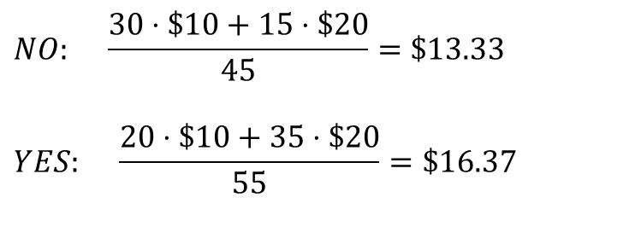
Microfinance example of bias from selection INTO a study group
Number of each “type” of person in the study
(latent traits can be hard to observe thus hard to control for in a study)
You are more likely to take a loan if you know you are good at business
 | NOT Entrepreneurial | Entrepreneurial
No Loan | 30 | 15
Takes a Loan | 20 | 35
Takes Loan?
$$NO: \frac{30⋅\$10+15⋅\$20}{45}=\$13.33$$
$$YES: \frac{20⋅\$10+35⋅\$20}{55}=\$16.37$$
Average weekly income AFTER loan period
 | NOT Entrepreneurial | Entrepreneur
No Loan | $10 | $20
Takes a Loan | $10 | $20
The loan appears to have an impact!
Even though we know it didn’t.
Income not impacted by the loan

Slide 22

Correlation version of last example:
Income
Selection mechanism
$$program is effective?$$
probability applies for a loan
Income
example of a spurious correlation caused by the “lurking” or omitted variable “business skill”
Probability of Taking a Loan
Business Skills
Business acumen measured as a level instead of a type here

Slide 23
“Selection” Problem
Those that participate in the program are different from those that do not participate.
This is the biggest problem in impact evaluation!

Slide 24
Microfinance example of bias from selection OUT OF a study group
Reflexive design
Program causes no change in income after loan
$3.00
$2.50
$2.00
$1.50
$1.00
$3.00
$2.50
$2.00
$1.50
$1.00
Mean = $2.00
Mean = $2.00
T1
Ave household daily income before program
T2 After program
T2 - T1 = 0
causal estimate is unbiased

Slide 25
Random Attrition Example
$3.00
$2.50
$2.00
$1.50
$1.00
T1
$3.00
$2.50
$2.00
$1.50
$1.00
T2
Attrit
Mean = $2.00
Mean = $2.00
Attrit
T2 - T1 = 0 Impact study accurately represents program effects
Program is not determined to be effective (no change)
(impact estimate is unbiased)

Slide 26
Non-Random Attrition Example
T2
$3.00
$2.50
$2.00
$1.50
$1.00
T1
$3.00
$2.50
$2.00
$1.50
$1.00
Mean = $2.50
Mean = $2.00
Attrit
T2 – T1 > 0
We over-estimate program effects
Program appears to be effective
(impact estimate BIASED)

Slide 27
Non-Random Attrition Example
$3.00
$2.50
$2.00
$1.50
$1.00
$3.00
$2.50
$2.00
$1.50
$1.00
Attrit
Mean = $2.00
T1
Mean = $1.50
T2
T2 – T1 < 0
We under-estimate program effects
Program appears to harm families
(impact estimate is BIASED)

Slide 28
What if the program has impact?
Program is effective: increases income by $1
$3.00
$2.50
$2.00
$1.50
$1.00
$4.00
$3.50
$3.00
$2.50
$2.00
Mean = $2.00
Mean = $3.00
True impact = T2-T1 = $1.00
Random Attrition
Non-Random Attrition A
Non-Random Attrition B
$3.00
$2.50
$2.00
$1.50
$1.00
$4.00
$3.50
$3.00
$2.50
$2.00
$3.00
$2.50
$2.00
$1.50
$1.00
$4.00
$3.50
$3.00
$2.50
$2.00
$3.00
$2.50
$2.00
$1.50
$1.00
$4.00
$3.50
$3.00
$2.50
$2.00
Mean = $2.00
Mean = $3.00
Mean = $3.50
Mean = $2.50
T2-T1 = $1.00
T2-T1 = $1.50
T2-T1 = $0.50
(UNBIASED)
(too big: BIASED)
(too small: BIASED)
(note that a biased effect can still be non-zero or significant,
but the smaller sample size will also impact statistical power)

Slide 29
Attrition with two study groups
T1
T2
C1
C2
$3.00
$2.50
$2.00
$1.50
$1.00
$4.00
$3.50
$3.00
$2.50
$2.00
$3.00
$2.50
$2.00
$1.50
$1.00
$3.00
$2.50
$2.00
$1.50
$1.00
Mean = $2.00
Mean = $3.00
Mean = $2.00
Mean = $2.00
Total gains: T2-T1 = $1.00
No secular trends: C2-C1 = 0
True impact: (T2-T1) - (C2-C1) = $1.00
Random Attrition
Non-Random Attrition A
Non-Random Attrition B
T1
T2
C1
C2
T1
T2
C1
C2
T1
T2
C1
C2
$3.00
$2.50
$2.00
$1.50
$1.00
$4.00
$3.50
$3.00
$2.50
$2.00
$3.00
$2.50
$2.00
$1.50
$1.00
$3.00
$2.50
$2.00
$1.50
$1.00
$3.00
$2.50
$2.00
$1.50
$1.00
$4.00
$3.50
$3.00
$2.50
$2.00
$3.00
$2.50
$2.00
$1.50
$1.00
$3.00
$2.50
$2.00
$1.50
$1.00
$3.00
$2.50
$2.00
$1.50
$1.00
$4.00
$3.50
$3.00
$2.50
$2.00
$3.00
$2.50
$2.00
$1.50
$1.00
$3.00
$2.50
$2.00
$1.50
$1.00
(3.00-2.00)-(2.00-2.00)= $1.00
(3.50-2.00)-(2.50-2.00)= $1.00
(2.50-2.00)-(2.00-1.50)= $1.00
UNBIASED
UNBIASED
UNBIASED
The comparison group absorbs the impact of attrition similar to how it absorbs secular trend

Slide 30
Attrition with two study groups
T1
T2
C1
C2
$3.00
$2.50
$2.00
$1.50
$1.00
$4.00
$3.50
$3.00
$2.50
$2.00
$3.00
$2.50
$2.00
$1.50
$1.00
$3.00
$2.50
$2.00
$1.50
$1.00
Mean = $2.00
Mean = $3.00
Mean = $2.00
Mean = $2.00
True impact:
(T2-T1) - (C2-C1)
= $1.00
Total gains: T2-T1 = $1.00
No secular trends: C2-C1 = 0
Random Attrition
Non-Random Attrition A
Non-Random Attrition B
T1
T2
C1
C2
T1
T2
C1
C2
T1
T2
C1
C2
$3.00
$2.50
$2.00
$1.50
$1.00
$4.00
$3.50
$3.00
$2.50
$2.00
$3.00
$2.50
$2.00
$1.50
$1.00
$3.00
$2.50
$2.00
$1.50
$1.00
$3.00
$2.50
$2.00
$1.50
$1.00
$4.00
$3.50
$3.00
$2.50
$2.00
$3.00
$2.50
$2.00
$1.50
$1.00
$3.00
$2.50
$2.00
$1.50
$1.00
$3.00
$2.50
$2.00
$1.50
$1.00
$4.00
$3.50
$3.00
$2.50
$2.00
$3.00
$2.50
$2.00
$1.50
$1.00
$3.00
$2.50
$2.00
$1.50
$1.00
T2-T1 = (3.00-2.00) = $1.00
T2-T1 = (3.50-2.00) = $1.50
T2-T1 = (2.50-2.00) = $0.50
UNBIASED
BIASED
BIASED
Note that we have no trend in the data so we can usually substitute the reflexive and diff-in-diff estimators (T2-T1 = [T2-T1]-[C2-C1]), but when non-random attrition is present we cannot

Slide 31
Attrition with two study groups
Random Attrition
Non-Random Attrition A
Non-Random Attrition B
T1
T2
C1
C2
T1
T2
C1
C2
T1
T2
C1
C2
$3.00
$2.50
$2.00
$1.50
$1.00
$4.00
$3.50
$3.00
$2.50
$2.00
$3.00
$2.50
$2.00
$1.50
$1.00
$3.00
$2.50
$2.00
$1.50
$1.00
$3.00
$2.50
$2.00
$1.50
$1.00
$4.00
$3.50
$3.00
$2.50
$2.00
$3.00
$2.50
$2.00
$1.50
$1.00
$3.00
$2.50
$2.00
$1.50
$1.00
$3.00
$2.50
$2.00
$1.50
$1.00
$4.00
$3.50
$3.00
$2.50
$2.00
$3.00
$2.50
$2.00
$1.50
$1.00
$3.00
$2.50
$2.00
$1.50
$1.00
(3.00-2.00)-(2.00-2.00)= $1.00
(3.50-2.00)-(2.50-2.00)= $1.00
(2.50-2.00)-(2.00-1.50)= $1.00
UNBIASED
UNBIASED
UNBIASED
Note that this only works when the attrition process is the same in both groups (random cases, mostly high performers, or mostly low performers exiting from the treatment and study groups at the same rate)

Slide 32
Randomized control trials (RCT’s): the “gold standard” for internal validity
Gertler, P. J., Martinez, S., Premand, P., Rawlings, L. B., & Vermeersch, C. M. (2016). Impact evaluation in practice. The World Bank.
>> Chapter 4. Randomized Selection Methods

Slide 33
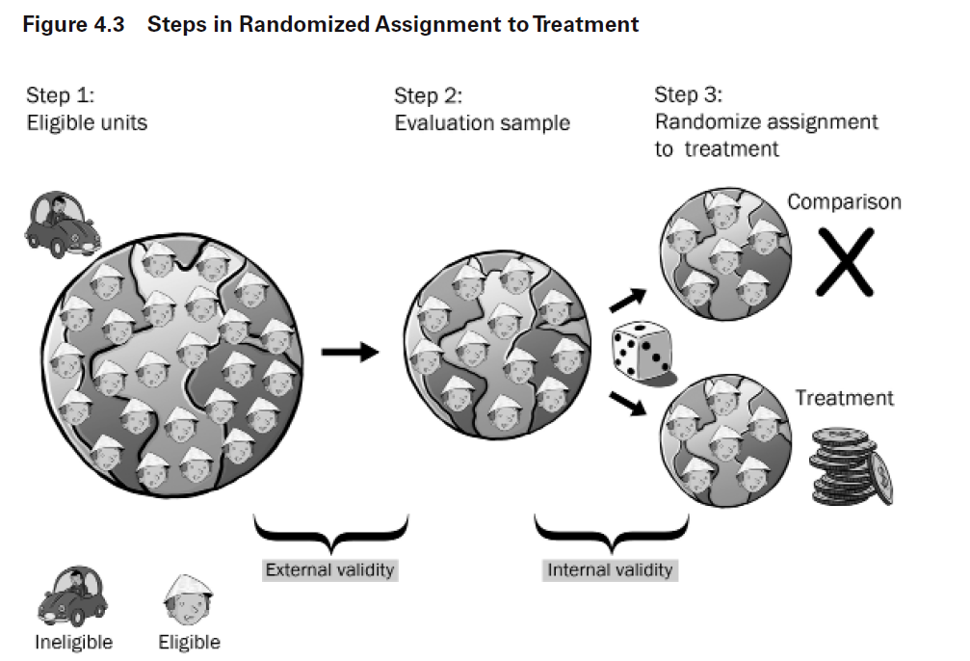

Slide 34
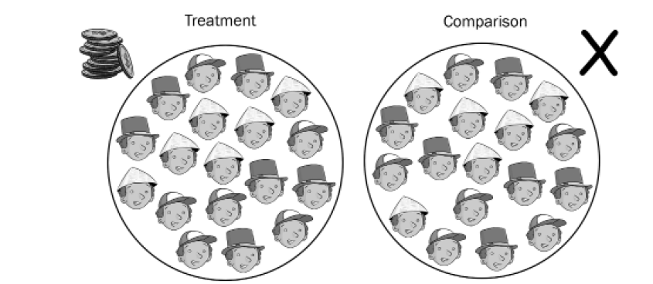
Our counterfactual framework is valid / robust when the groups only DIFFER BY THE TREATMENT but are OTHERWISE “IDENTICAL”
When true, we can interprett the differences in group outcomes after the treatment period to be caused by the treatment

Slide 35
How do we test the criteria: groups only OTHERWISE “IDENTICAL” ???

Slide 36

“Happy” randomization
Clap your hands if your treatment and control groups have no significant contrasts of measured participant traits

Slide 37
If we have a group of 100 people and we randomly assign them to two groups, 50 people each, how often would we expect the average weight of each group to differ?

Slide 38
If we have a group of 100 people and we randomly assign them to two groups, 50 people each, how often would we expect the average weight of each group to differ?
Mathematically: always !!!
weights will never be exactly identical so what do we mean by “different”?

Slide 39
If we have a group of 100 people and we randomly assign them to two groups, 50 people each, how often would we expect the average weight of each group to differ?
Statistically:
test of group means
Use a t-test and select a level of confidence that we are comfortable with

Slide 40
If we have a group of 100 people and we randomly assign them to two groups, 50 people each, how often would we expect the average weight of each group to differ?
Statistically:
test of group means
What does alpha=0.05 mean? [ --- 95% confidence interval --- ]

Slide 41
If we have a group of 100 people and we randomly assign them to two groups, 50 people each, how often would we expect the average weight of each group to differ?
Statistically:
test of group means
5 times out of 100 the two samples are drawn from the same population (or weight distribution), but we will still consider them to be different.
What does alpha=0.05 mean? [ --- 95% confidence interval --- ]

Slide 42

How often will randomization “fail”?
By definition of a test at a 95% confidence level, each measured characteristic like weight will differ
5 out of 100 times
“Unhappy Randomization”
Unhappy randomization is not failed randomization (process applied improperly), rather just bad luck of the draw

Slide 43
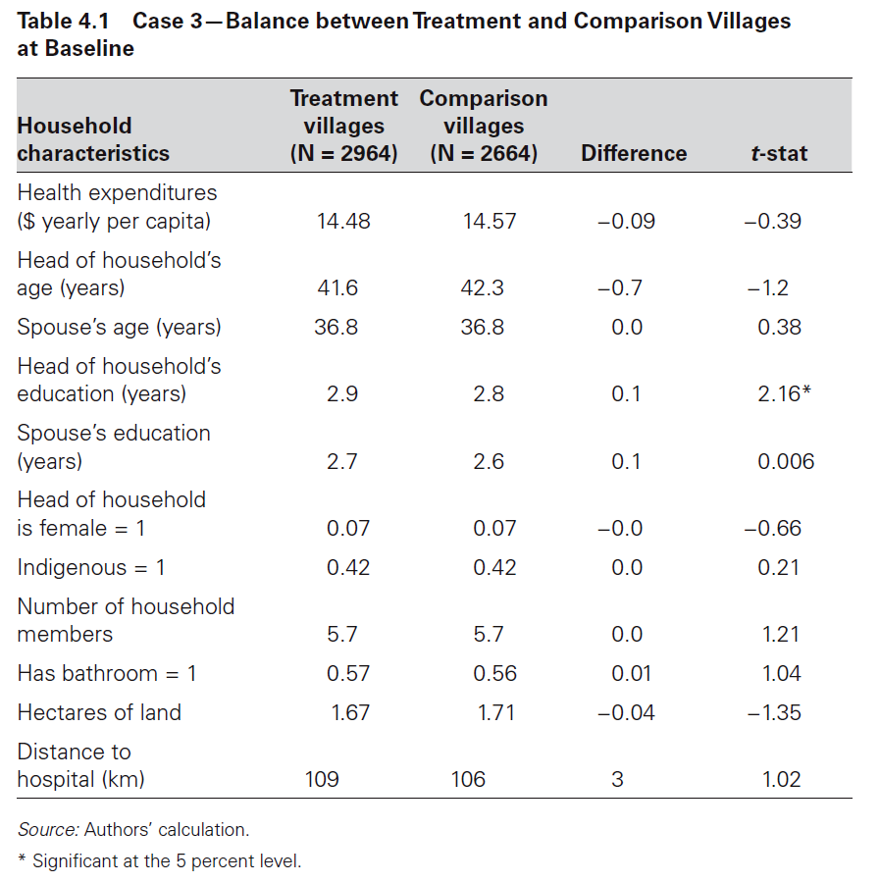
The most important table in every study: comparisons of treatment and control group characteristics For the counterfactual to be valid, the groups can ONLY differ by the treatment, not by any measured traits.
“contrasts”
Is this problematic?
What is the appropriate test for “identical” or equivalent groups?
We should observe no differences in measured traits. Assume a 95% confidence interval.

Slide 44
Bonferroni Correction:
When we want to be 95% confident that two groups are the same, and we can measure those groups using a set of contrasts, then our decision rule is no longer to reject the null (that the groups are the same) if the p-value < 0.05. A “contrast” is a comparison of means of any measured characteristic between two groups.
If we have a 5% chance of observing a p-value of less than 0.05 for each contrast, then the probability of observing at least one contrast with a p-value that small is greater than 5%! It is actually n*0.05 (minus prob of observing multiple < 0.05 at same time) where n is the number of contrasts.
So if we want to be 95% confident that the groups are different (not just the contrasts), we have to adjust our decision rule to α/n.
For example, if we have 10 contrasts, then our decision rule is now 0.05/10, or 0.005. The p-value of at least one contrast must be below 0.005 for us to conclude that the groups are different.
x1 <- rbinom( 10000, 6, 0.05 )
table( x1 ) / 10000
y1 <- rbinom( 10000, 6, 0.05/6 )
table( y1 ) / 10000

Slide 45
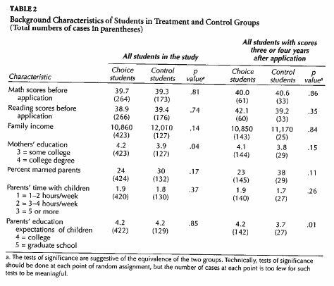
Test for Group Equivalence
seven
contrasts
reported
New alpha = ( 0.05 / 7 ) = 0.0071
Smallest p-value in table
0.04 > 0.0071 Do not reject :: Groups are equivalent

Slide 46
RCT versus Natural Experiments:
RCT assumes complete control over the assignment process
Natural Experiments often utilize randomization:
Charter School lotteries
Vietnam draft
Quasi-Experimental techniques can use other methods to create group equivalence (for example, matching)

Slide 47
Attrition

Slide 49
Tests for Selection-Into Study Group

Slide 50
Non-Random Attrition
If the people that leave a program or study are different than those that stay, the calculation of effects will be biased.
The Fix:
Examine characteristics of those that stay versus those that leave.

Slide 51
Non-Random attrition tests for selection OUT of the study group
Do group traits differ after attrition occurs?
Attrition is natural, the question is whether it is random (will not change the groups) or non-random (will change the groups)
Can also be tested by comparing traits of those that stay to those that leave.

Slide 52
Microfinance example of bias from selection OUT OF a study group
Reflexive design
Program causes no change in income after loan
$3.00
$2.50
$2.00
$1.50
$1.00
$3.00
$2.50
$2.00
$1.50
$1.00
Mean = $2.00
Mean = $2.00
T1
Ave household daily income before program
T2 After program
T2 - T1 = 0
causal estimate is unbiased

Slide 53
Random Attrition Example
$3.00
$2.50
$2.00
$1.50
$1.00
$3.00
$2.50
$2.00
$1.50
$1.00
Attrit
Mean = $2.00
Mean = $2.00
Attrit
T2 - T1 = 0 Impact study accurately represents program effects
Program is not determined to be effective (no change)

Slide 54
Non-Random Attrition Example
$3.00
$2.50
$2.00
$1.50
$1.00
$3.00
$2.50
$2.00
$1.50
$1.00
Mean = $2.50
Mean = $2.00
Attrit
T2 – T1 ≠ 0
We over-estimate program effects
Program appears to be effective

Slide 55
Non-Random Attrition Example
$3.00
$2.50
$2.00
$1.50
$1.00
$3.00
$2.50
$2.00
$1.50
$1.00
Attrit
Mean = $2.00
Mean = $1.50
T2 – T1 ≠ 0
We under-estimate program effects
Program appears to harm families

Slide 56
What do we mean by “treated”? How non-compliance changes our measure of effects

Slide 57
One of The Physicists Behind The Higgs Boson Has Made an Algorithm to Replace The Pill
It's up to 99.5% effective at stopping pregnancy.
Those more effective methods are ones that don't require people to remember to take a pill, put on a condom, or record their temperature daily, such as intrauterine contraception or implants.
That's because human error can mess with things quite a lot. In fact, the UK's National Health Service (NHS) explained that when the app was used perfectly all the time, only five out of every 1,000 women would fall pregnant every year - a rate slightly better than the pill (99.5 percent).
But for "typical use" - where the app isn't used entirely correctly every day - it's more likely that seven out of every 100 women would experience accidental pregnancies, which is around 93 percent efficiency.
What is the TRUE effectiveness of the app? 99.5 percent, or 93 percent?
https://www.sciencealert.com/one-of-the-physicists-behind-the-higgs-boson-has-made-an-algorithm-to-replace-the-pill

Slide 58
Estimation of the counter-factual:
Given Bed Nets
Control Group
Given Bed Nets AND Use Them!
Program Effect = T2 – C2
Is Group T (for treatment) those that are GIVEN bed nets, or those that USE them?

Slide 59
Terminology:
“Average” treatment effects
Treatment on the Treated (TOT) Effects
Intention to Treat (ITT) Effects
“Intention
to Treat” Estimate
2 Valid
Ways to
Measure the
Treatment
Given Bed Nets
“Treatment
on the
Treated” Estimate
Given Bed Nets AND Use Them!

Slide 60
Why do we need two measures?
The TOT Measure is the optimistic or best-case scenario. It tells us how effective the program or intervention is when followed with HIGH FIDELITY.
The ITT Measure is the more cynical or realistic version. We never expect that programs work exactly as designed. The ITT is closer to a measure of how the laboratory equipment works once it’s in the field. It is also a better estimate of how much change we can expect at the population level.
The different between the TOT and the ITT tells us how many gains can be made by improving program implementation! So both are useful and important!
“Intention
to Treat” Estimate
“Treatment
on the
Treated” Estimate

Slide 61
One of The Physicists Behind The Higgs Boson Has Made an Algorithm to Replace The Pill
It's up to 99.5% effective at stopping pregnancy.
Those more effective methods are ones that don't require people to remember to take a pill, put on a condom, or record their temperature daily, such as intrauterine contraception or implants.
That's because human error can mess with things quite a lot. In fact, the UK's National Health Service (NHS) explained that when the app was used perfectly all the time, only five out of every 1,000 women would fall pregnant every year - a rate slightly better than the pill (99.5 percent).
But for "typical use" - where the app isn't used entirely correctly every day - it's more likely that seven out of every 100 women would experience accidental pregnancies, which is around 93 percent efficiency.
Which is treatment on the treated effect?
Which is the intention-to-treat effect?
https://www.sciencealert.com/one-of-the-physicists-behind-the-higgs-boson-has-made-an-algorithm-to-replace-the-pill

Slide 62
NOTE !!!
These two measures are NOT about attrition.
They are about refusing the treatment or failing to follow the properly-prescribed treatment regiment (or one school burning down during the study).
Non-compliance means participants refuse to receive or comply with the treatment. But they do not refuse to participate in the study – we can still measure their performance in the second time period.
Attrition means people left the study. You can accept the treatment and still attrit. Or you can refuse treatment and refuse participation. Either way, attrition means we can’t measure the outcome in the post-treatment study period.
“Intention
to Treat” Estimate
“Treatment
on the
Treated” Estimate

