Slide 1
ITS NOTES:

Slide 2
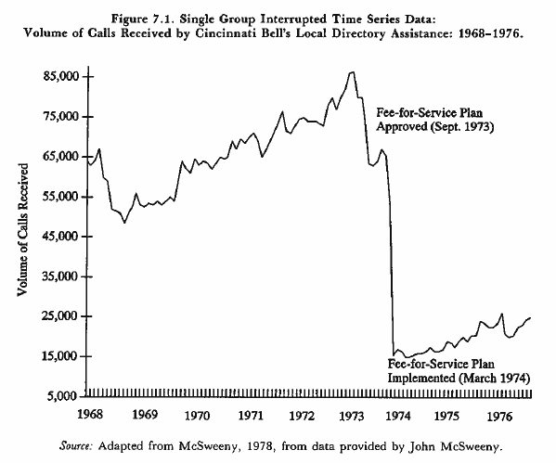
Interrupted Time Series

Slide 3
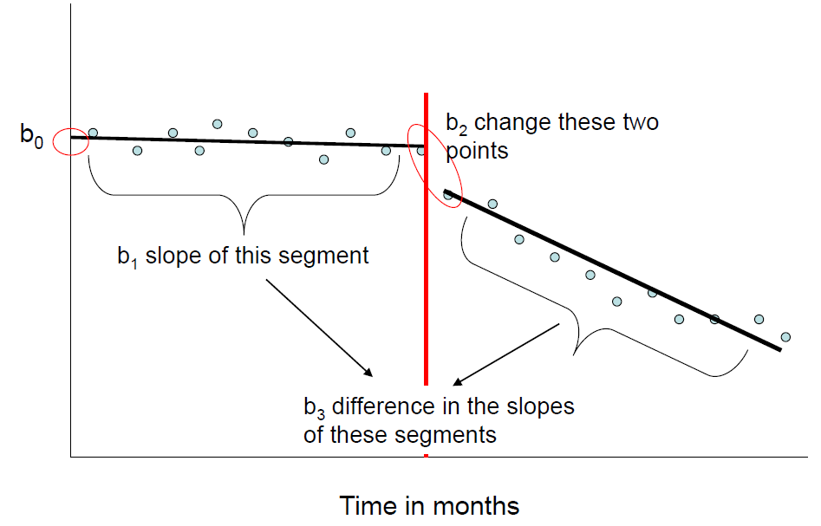
Interrupted Time Series Regression Models:
Y | T | D | P
17 | 1 | 0 | 0
19 | 2 | 0 | 0
22 | 3 | 0 | 0
24 | 4 | 1 | 1
27 | 5 | 1 | 2
27 | 6 | 1 | 3
30 | 7 | 1 | 4

Slide 4
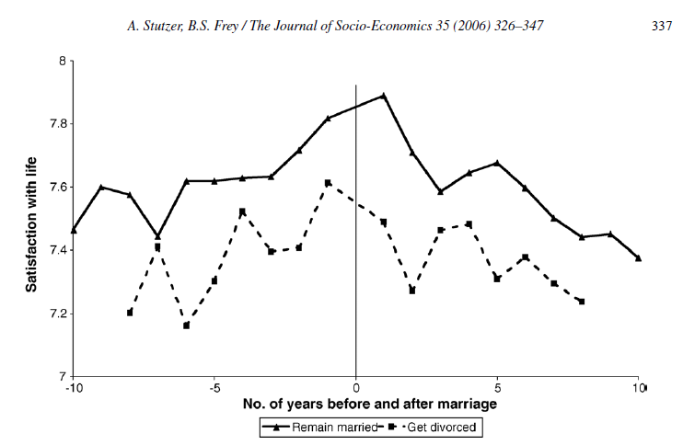
Time can be relative:

Slide 5
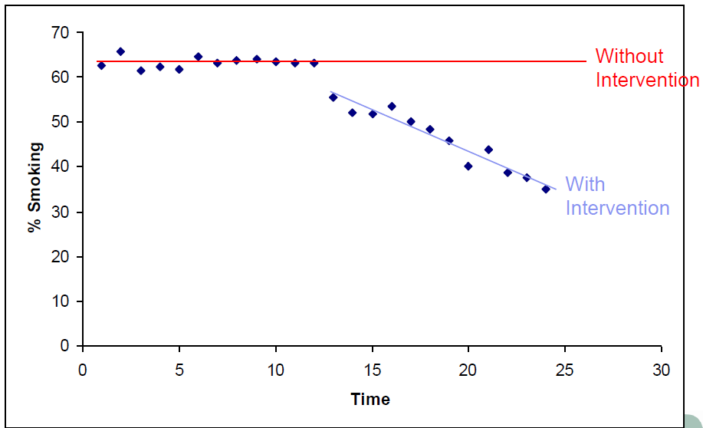
How do you define “effect size”?

Slide 6
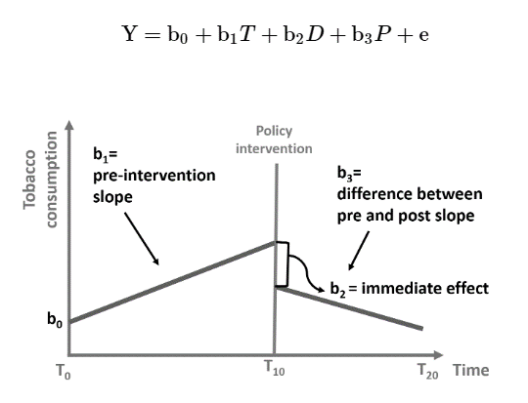

Effects:
Effect SIZE:
b2 = instantaneous effect
b3 = sustained effect
${\hat{y}}_{TREATED | time=t}−$ ${\hat{y}}_{CONTROL | time=t}$
Note, it’s a post-test only comparison!
Even though it’s a reflexive research design
Y-HAT world without treatment
COUNTERFACTUAL
Y-HAT world with treatment
hypothetical post-treatment
trend
pre-treatment
trend
Effect
Size
short run
long run

Slide 7
Y-HAT world without treatment
COUNTERFACTUALS
CHALLENGE: The effect goes from negative to zero to positive depending on where you measure it.
Y-HAT world with treatment
POSITIVE Effect
Sig. Effect
No Effect
NEGATIVE Effect
pre-treatment
trend
Effect
Size
No Effect
short run
long run
short run
long run
short run
med. run
long run
The effect size is the same no matter when measured.
CHALLENGE: The program looks ineffective at first, but the effect increases over time
Example: enroll in job training to escape minimum-wage trap: (1) initial lost wages, (2) start of new job, (3) long-term higher pay.
See Heinrich, C., Mueser, P. R., Troske, K. R., Jeon, K. S., & Kahvecioglu, D. (2009). New estimates of public employment and training program net impacts: A nonexperimental evaluation of the Workforce Investment Act program.

Slide 8
Regression to the mean
(e.g. low SES tutoring program without summer school)
Gains made during the academic year are erased by lack of continued engagement over the summer.
Is this program effective?
POSITIVE Effect
No Effect
No Effect
reading scores
(percentile rank)
start of program
start of summer
start of next academic year

Slide 9
Regression to the mean
(e.g. low SES tutoring program without summer school)
SPECIFICATION PROBLEMS!
What are the lines of best fit here?
start of program
start of summer
start of next academic year

Slide 10
Regression to the mean
(e.g. low SES tutoring program without summer school)
SPECIFICATION PROBLEMS!
What are the lines of best fit here?
b₁
What accurate coefficients would look like
b₂=0?
b₃=0
start of program
start of summer
start of next academic year

Slide 11
Regression to the mean
(e.g. low SES tutoring program without summer school)
SPECIFICATION PROBLEMS!
What are the lines of best fit here?
b₁
Program appears to be harmful over time
b₂
b₃
Actual coefficients:
(coefficients that minimize residuals)
start of program
start of summer
start of next academic year

Slide 12
Regression to the mean
(e.g. low SES tutoring program without summer school)
THE FIX:
We need more degrees of freedom. Design matrix for more slopes and intercepts to allow the model to identify a regression to the mean if it exists.
Y = b₀ + b₁T + b₂D1 + b₃TS1 + b₄D2 + b₅TS2
b0 | T | D1 | TS1 | D2 | TS2
1 | 1 | 0 | 0 | 0 | 0
1 | 2 | 0 | 0 | 0 | 0
 | …
1 | 10 | 1 | 1 | 0 | 0
1 | 11 | 1 | 2 | 0 | 0
 | …
1 | 21 | 0 | 0 | 1 | 1
1 | 22 | 0 | 0 | 1 | 2
b₂ > 0
b₃=0
b₁
b₅=0
b₀
b₄=0
recall b₄ is relative
to b₀ not to b₂
start of program
start of summer
start of next academic year
D2 and TS2 start at the point where you believe program effects fully regress back to the mean, but this is not an actual intervention point. Use theory to guide.

Slide 13
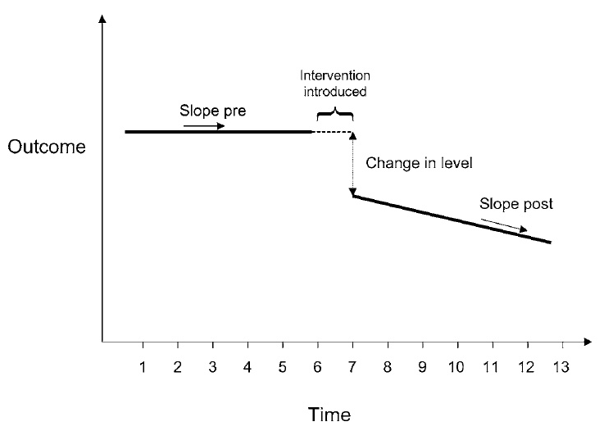
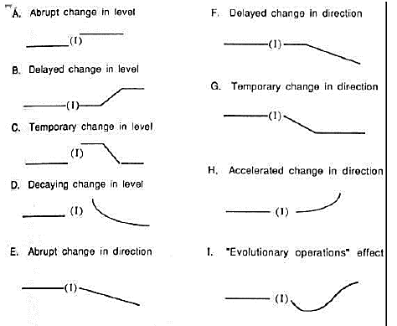
Treatment effects can be nuanced:

Slide 14
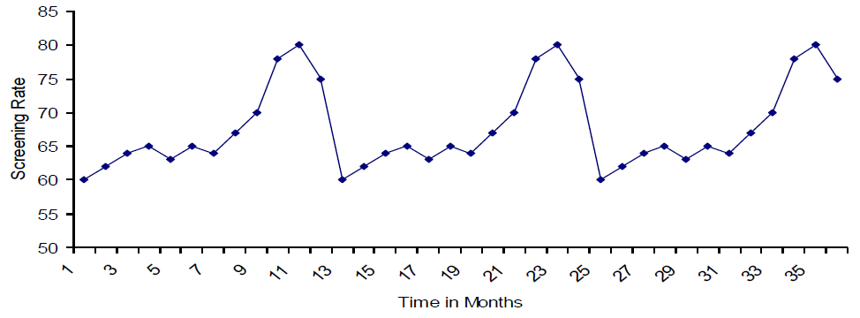
Possible Issues?
History
Contamination
Attrition
Seasonality

Slide 15
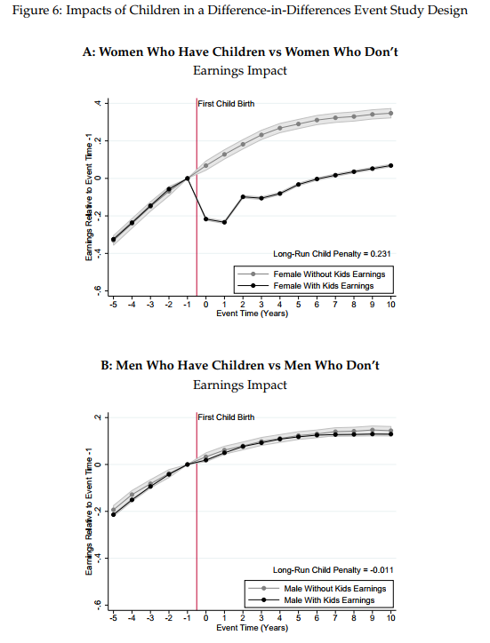
Kleven, H., Landais, C., & Søgaard, J. E. (2018). Children and gender inequality: Evidence from Denmark (No. w24219). National Bureau of Economic Research.

Slide 16
Strengthening the design: adding a comparison group

Slide 17
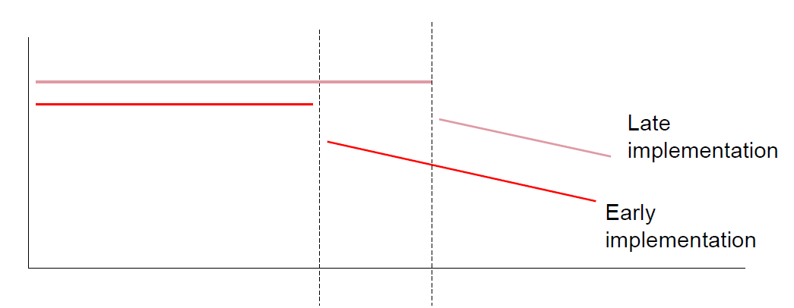
Strengthening Design: Implementation Phases

