Slide 1
R Shiny
Making Graphics Dynamic

Slide 2
R SHINY
WEB APPS FOR THE COMMON PERSON

Slide 3
RENDERING: CONVERT R TO DYNAMIC HTML

Slide 4
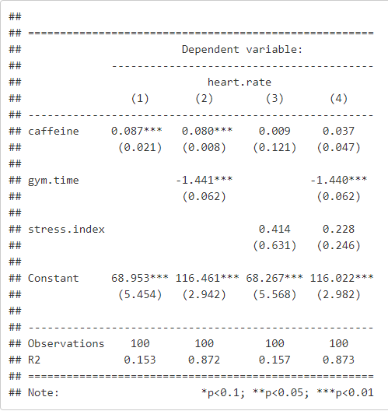
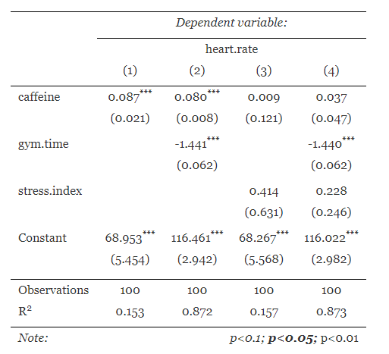
How does “knit” work in RMD?
Shiny functions work similar to other knitr functions that are used to convert your raw R output into HTML objects that make for nice documents.
Raw R output
After conversion to HTML table

Slide 5
Side note: this is what the RAW html table looks like
<table style="text-align:center"><tr><td colspan="5" style="border-bottom: 1px solid black"></td></tr><tr><td style="text-align:left"></td><td colspan="4"><em>Dependent variable:</em></td></tr> <tr><td></td><td colspan="4" style="border-bottom: 1px solid black"></td></tr> <tr><td style="text-align:left"></td><td colspan="4">heart.rate</td></tr> <tr><td style="text-align:left"></td><td>(1)</td><td>(2)</td><td>(3)</td><td>(4)</td></tr> <tr><td colspan="5" style="border-bottom: 1px solid black"></td></tr><tr><td style="text-align:left">caffeine</td><td>0.087<sup>***</sup></td><td>0.080<sup>***</sup></td><td>0.009</td><td>0.037</td></tr> <tr><td style="text-align:left"></td><td>(0.021)</td><td>(0.008)</td><td>(0.121)</td><td>(0.047)</td></tr> <tr><td style="text-align:left"></td><td></td><td></td><td></td><td></td></tr> <tr><td style="text-align:left">gym.time</td><td></td><td>-1.441<sup>***</sup></td><td></td><td>-1.440<sup>***</sup></td></tr> <tr><td style="text-align:left"></td><td></td><td>(0.062)</td><td></td><td>(0.062)</td></tr> <tr><td style="text-align:left"></td><td></td><td></td><td></td><td></td></tr> <tr><td style="text-align:left">stress.index</td><td></td><td></td><td>0.414</td><td>0.228</td></tr> <tr><td style="text-align:left"></td><td></td><td></td><td>(0.631)</td><td>(0.246)</td></tr> <tr><td style="text-align:left"></td><td></td><td></td><td></td><td></td></tr> <tr><td style="text-align:left">Constant</td><td>68.953<sup>***</sup></td><td>116.461<sup>***</sup></td><td>68.267<sup>***</sup></td><td>116.022<sup>***</sup></td></tr> <tr><td style="text-align:left"></td><td>(5.454)</td><td>(2.942)</td><td>(5.568)</td><td>(2.982)</td></tr> <tr><td style="text-align:left"></td><td></td><td></td><td></td><td></td></tr> <tr><td colspan="5" style="border-bottom: 1px solid black"></td></tr><tr><td style="text-align:left">Observations</td><td>100</td><td>100</td><td>100</td><td>100</td></tr> <tr><td style="text-align:left">R<sup>2</sup></td><td>0.153</td><td>0.872</td><td>0.157</td><td>0.873</td></tr> <tr><td colspan="5" style="border-bottom: 1px solid black"></td></tr><tr><td style="text-align:left"><em>Note:</em></td><td colspan="4" style="text-align:right"><sup>*</sup>p<0.1; <sup>**</sup>p<0.05; <sup>***</sup>p<0.01</td></tr> </table>

Slide 6
RENDER functions:
Raw R Version
R Shiny Version
renderPlot({
plot( x, y, main=“My Plot” )
})
plot( x, y, main=“My Plot” )
Converts this to a shiny object that can be updated and re-plotted inside a browser.

Slide 7
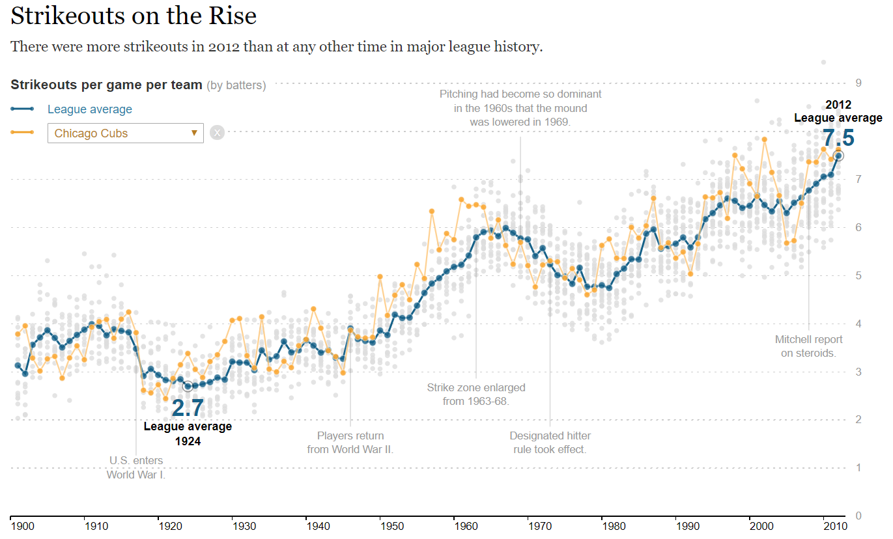
DYNAMIC OUTPUT
USER INPUT

Slide 8
RENDER functions:
The output functions take R code and “render” it as HTML objects that can be used in web browsers in order to display your dashboard. Shiny functions add some javascript features that allow output to be updated in real-time inside a browser.
Output Functions | Creates
renderImage | image
renderPlot | plot
renderTable | table
renderText | text
Note that HTML creates static text, tables, and images in web documents. Any time you are doing something active on a webpage (other than clicking a link), you are using the javascript language. It was created as a way to make web pages more interactive and responsive.
knitr → converts R to HTML when knitting RMD documents
shiny functions → convert R to javascript when knitting RMD documents

Slide 9
Anatomy of shiny FUNCTIONS: data flow
HTML Doc or Dashboard
Input widgets
sends rendered objects back to dashboard
RMD File
Load data
Load packages
Conduct analysis – generate tables and graphs
collect
parameters
render functions
“dynamic” output means that the user can change something about the tables or graphs by selecting new input parameters

Slide 10
Anatomy of shiny FUNCTIONS: USER INPUT
HTML Doc or Dashboard
Input widgets
sends rendered objects back to dashboard
RMD File
Load data
Load packages
Conduct analysis – generate tables and graphs
collect
parameters
render functions
“dynamic” output means that the user can change something about the tables or graphs by selecting new input parameters

Slide 11
INPUT WIDGETS
Building the user interface to gather user inputs

Slide 12
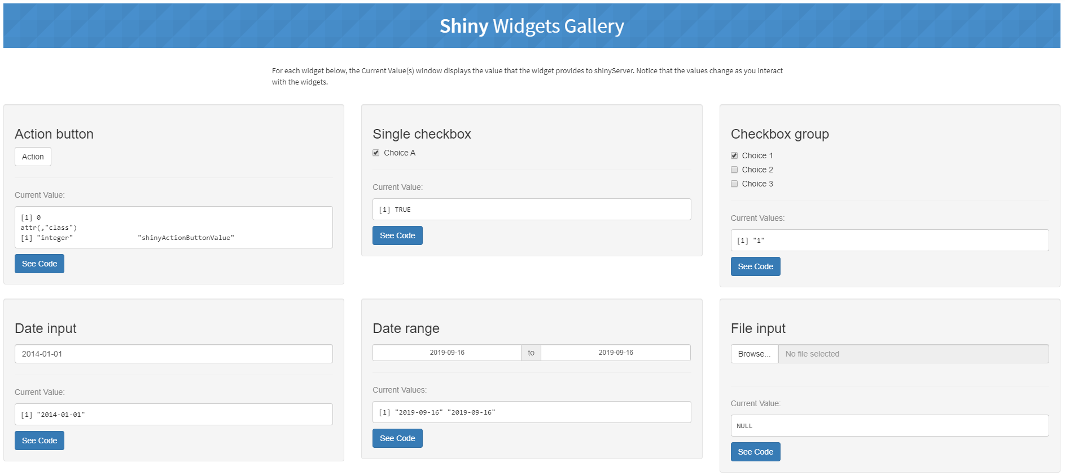

Slide 13
Standard shiny widgets (inputs)
Function Name | Widget
actionButton | Action Button
checkboxGroupInput | A group of check boxes
checkboxInput | A single check box
dateInput | A calendar to aid date selection
dateRangeInput | A pair of calendars for selecting a date range
fileInput | A file upload control wizard
helpText | Help text that can be added to an input form
numericInput | A field to enter numbers
radioButtons | A set of radio buttons
selectInput | A box with choices to select from
sliderInput | A slider bar
submitButton | A submit button
textInput | A field to enter text
Note each function will store different input values:
textInput = a single character element
selectInput = character elements from a list
sliderInput = two numbers in a range
checkboxInput = T / F

Slide 14
Widget components
How you will access the data:
input$name
Note that you do not create the input object and assign values at input$widget_name. That is done for you by the Shiny package.
Name for the widget. The user will not see this name, but you can use it to access the widget’s value. The name should be a character string.
Label. This label will appear with the widget in your app. It should be a character string, but it can be an empty string "".
actionButton( name=“submit", label = “Submit Your Form")
Creates an entry at input$submit

Slide 15
Anatomy of shiny FUNCTIONS: USER INPUT
HTML Doc or Dashboard
Input widgets
sends rendered objects back to dashboard
RMD File
Load data
Load packages
Conduct analysis – generate tables and graphs
collect
parameters
render functions
User inputs collected from widgets will change the data or parameters used in the analysis, changing the output

Slide 16
SHINY FUNCTIONS VS SHINY APPS
Using shiny in RMD documents versus building custom web apps

Slide 17
Using Shiny in RMD DOCUMENTS
Please note that if you look up tutorials on R Shiny you will find lots of information about how to build web apps. This was the original design and intended purpose of R Shiny.
HOWEVER, it requires you to build a user interface from scratch, so you need to learn a bunch of functions to lay out a web page and add container for widgets and output. These are useful if you need your final app to be fully customized where you have full control over the entire look and feel.
Shiny widgets have recently been integrated into RMD documents, making them much easier to use. The RMD documents do all of the hard work of creating a web page for us, and we already know how to add graphics. In this step we will just add widgets to gather user inputs.
We are using Shiny functions() inside of RMD documents, we are NOT building Shiny apps.

Slide 18
Using Shiny in RMD DOCUMENTS
---
title: "Lab-04 Dynamic Graphics"
output: flexdashboard::flex_dashboard
runtime: shiny
---
Header arguments in RMD
```{r}
selectInput( inputId=“my.widget”,
label=“Please select one”,
choices=c(“A”,”B”,”C”),
selected=“B” )
```
Widgets in RMD
```{r}
renderPlot({
# code here
})
```
Render functions in RMD

