Slide 1
economic development through
tax credits
The NMTC and LIHTC Programs
Jesse Lecy ∙ Spring, 2020

Slide 2
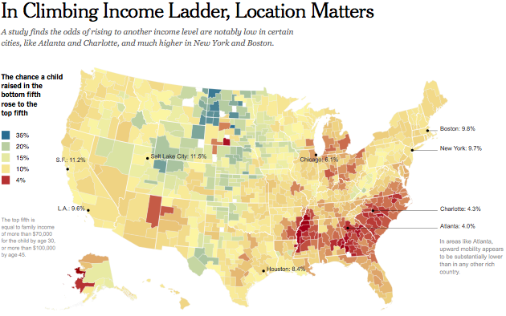
Place matters: social mobility as a function of place
Social mobility may not vary much across time. But it does vary by geography….It has to do with the quality of local schools, the level of local income, inequality, racial segregation, the extent of sprawl, the quality of social capital, and the number of two-parent households in a region.

Slide 3
How do we create strong communities?

Slide 4
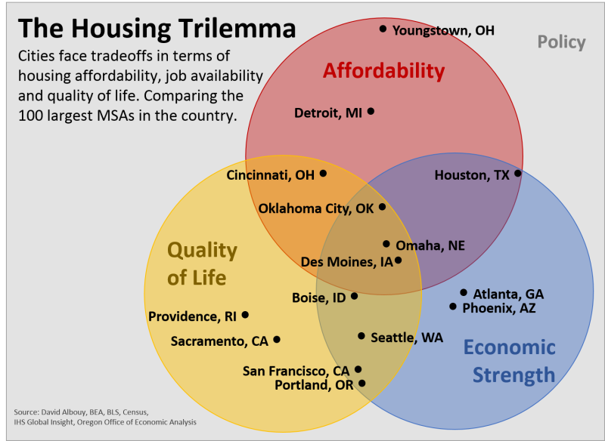
http://gizmodo.com/only-three-us-cities-have-good-jobs-housing-and-cultu-1781562314

Slide 5
Policy mechanisms for neighborhood improvement
Supply-Side Mechanisms – incentivize construction in low-income / high-risk communities
Public Housing
Low Income Tax Credits
Demand-Side Mechanisms
Vouchers – increase number of people that can afford to rent in a neighborhood
New Market Tax Credits - increase quality and desirability of a neighborhood

Slide 6
Place-Based
policy
Improving Housing Stock

Slide 7
Public housing: Part I
The Federal Government creates the Housing Act legislation (1949)
Governance mechanisms was poorly structured (each community that wanted to receive funding had to creating its own housing authority, meaning that communities that wanted to block public housing could just refuse to create an authority).
Projects concentrated poverty.
Because of challenges with governance, they did not keep up with demand for housing.
Those that were implemented were poorly designed and built, resulting in poor-quality housing.

Slide 8
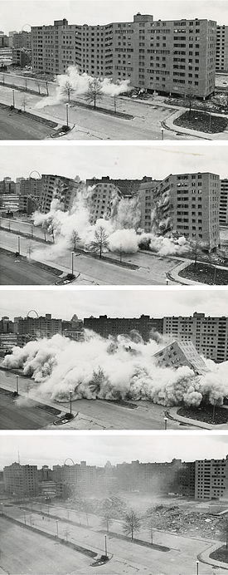
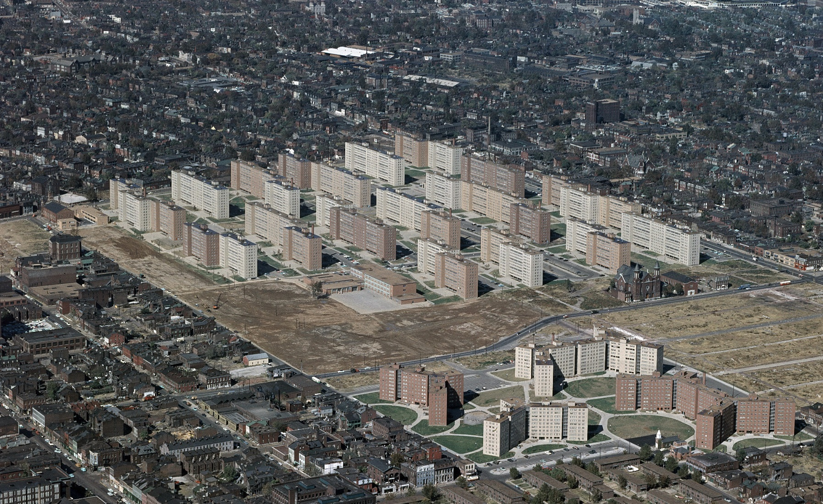
Pruitt–Igoe housing projects, st. louis
http://en.wikipedia.org/wiki/Pruitt%E2%80%93Igoe

Slide 9
Public housing: Part II
Low Income Housing Tax Credits (Tax Reform Act of 1986)
Introduces some elements of market discipline to public housing.
Private developers are subsidized to build affordable housing units (Section 42 tax credits).
Rent is capped relative to median income of the city.
Approximately 90% of all new affordable rental units are built using LIHTC credits.
On average it costs about $50,000 in subsidies per unit built (see Glaeser), and they last 15 years then convert to market rates.
Pros: almost all new affordable housing units being built utilize LIHTC support, implying it increases supply. Has leverages $75 billion in private sector equity for low income housing.
Cons: Further concentration of poverty.

Slide 10
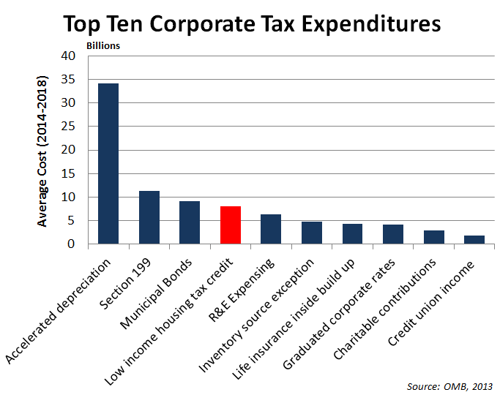
Public housing: Part II
Cost $6.7 billion in 2014.
The program is a corporate tax expenditure.
http://crfb.org/blogs/tax-break-down-low-income-housing-tax-credit

Slide 11

Side effect: The Poor Door
Toll Brothers’ 1 Northside Piers, for instance, includes 134 affordable rental units, allowing the developer to offer 421a tax abatements, which rewarded developers with 10 to 25 years of tax abatements for the inclusion of affordable rental units.
Luxury buildings complete segregate residents so people with subsidized rent do not mix with those paying full rent. This often includes amenities like gyms and group event spaces.
In some extreme cases they have built separate entrances to the building, what have come to be known as “poor doors”.
Toll Brothers' One Northside Piers have a separate entrance from the building tower and neighboring Two Northside Piers.
http://therealdeal.com/blog/2013/08/27/how-common-are-nycs-poor-doors-photos/

Slide 12
Public housing: Part II
Housing Vouchers (Section 8 of the Housing and Community Development Act of 1974)
Program participants pay 30% of income towards housing, and the rest is subsidized by the government.
Landlords apply to be part of the program and must pass an inspection to ensure minimum quality standards.
Pro: a market-based mechanism that gives participants choice regarding where they would like to live.
Pro: it is a relatively efficient mechanism.
Con: There were over 100,000 applications for 10,000 spots on a wait list.
Con: It can raise rent prices in the market slightly.

Slide 13
The Best Affordable Housing Plan in the U.S. Isn’t Good Enough
Right before the new year, the application process for two housing developments in New York City’s outer boroughs opened. The result: 92,000 people applied for 924 available affordable apartments at a complex in Queens, and 70,000 people applied for 38 available affordable apartments at a complex in Williamsburg, the Brooklyn neighborhood where one-bedrooms rent for an average of more than $3,000.
If one of the most ambitious housing plans in the U.S. can’t create even a fraction of the affordable housing a city needs, that doesn’t bode well for places like San Francisco, Austin, and anywhere else where housing demand is outpacing supply. And it exposes why, for reasons largely outside of local officials’ control, shrinking affordable housing in American cities remains an almost impossible problem to solve, at least without something that may be utterly impossible right now: an ambitious national housing policy.
http://www.slate.com/articles/business/moneybox/2015/01/nyc_affordable_housing_plan_de_blasio_s_efforts_are_ambitious_and_laudable.html

Slide 14
Place-Based
policy
Improving
Neighborhood
Amenities

Slide 15
Attracting investment to low-income communities
New Market Tax Credits (Community Renewal Tax Relief Act of 2000)
Tax credits to support businesses in distressed communities.
Channeled through Community Development Entities (induces public-private partnerships).
Investments made in grocery stores, hospitals, charter schools, and other businesses that help poor communities but are high-risk because of their location.
Roughly $1.4 billion in tax credits granted in 2011.

Slide 16
Reflection:

Slide 17
Rediscovery of cities is an opportunity for change
Revival of cities and gentrification of some spaces offers the opportunity to get the mix of housing right – some low-income, some middle-income, and some high-income.
http://www.strongtowns.org/journal/2015/2/18/podcast-show-206-joe-cortright-on-gentrification

Slide 18
Is housing policy place-based policy?
Affordable housing is important for keeping a city’s economy viable.
Efforts to use housing to address poverty have been a failure.
Policy mechanisms have been weak
Have resulted in concentration of poverty
One of the key weaknesses of housing policy is that it tends to locate affordable housing in poor communities, thus accelerating the feedback process of decline.

Slide 19
Policy-makers need to be clear
Which problem are you trying to solve?
Housing is expensive (relative to income) in a metropolitan area
The poor can’t afford housing
Policy recommendations will be very different for each problem.
Note the difference between place-based and people-based anti-poverty policies.

Slide 20
Pro-poverty programs CAN hurt the poor
Economic decline
Weak housing markets
Robert P. Inman. Making Cities Work: Prospects and Policies for Urban America
Federal housing subsidies
Not all cities grow, and leaders in declining places also need to understand how the workings of housing markets impact them. Recognizing that cheap housing is disproportionately attractive to the relatively poor, who tend to be among the less skilled, is particularly important. Mayors in cities experiencing weak demand should not exacerbate the situation by providing additional low-cost housing, even though it is subsidized by various existing federal programs. That being said, there is a good case for policy to address the negative externalities that arise from concentrated poverty in such places. Individual cities should not be held responsible for the financial burden of these policies, so there is a key role for higher levels of government here, too. For example, housing voucher programs should be made national in scope so that poor recipients can use them anywhere in the country. This encourages mobility of the less skilled to places with stronger labor markets by counterbalancing the incentives to stay in depressed markets with cheap housing that is priced well below construction costs.
Concentration of Poverty
Public services more expensive
Accelerated cycle of decline

Slide 21
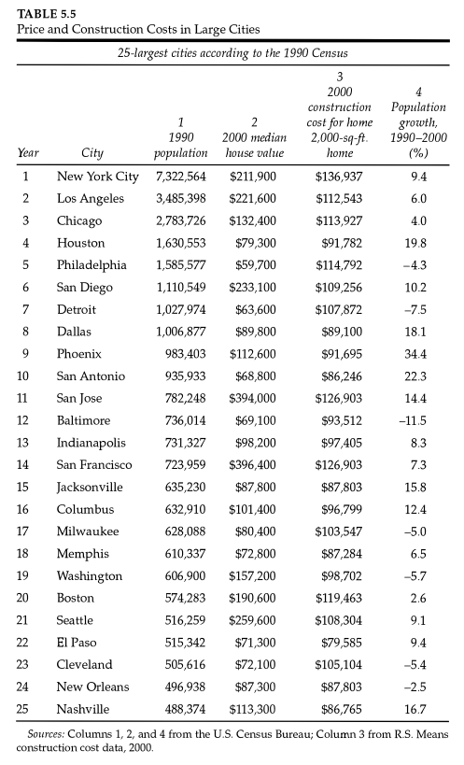
What determines the price of a house?
Supply-Side Factors
Demand-Side Factors
Regulation, Zoning & Preservation ?

Slide 22
Do we subsidize housing for the rich or the poor?
We spent $6.7 billion on LIHTC in 2014.
Compare to $89 billion in mortgage interest deductions in 2011.

Slide 23
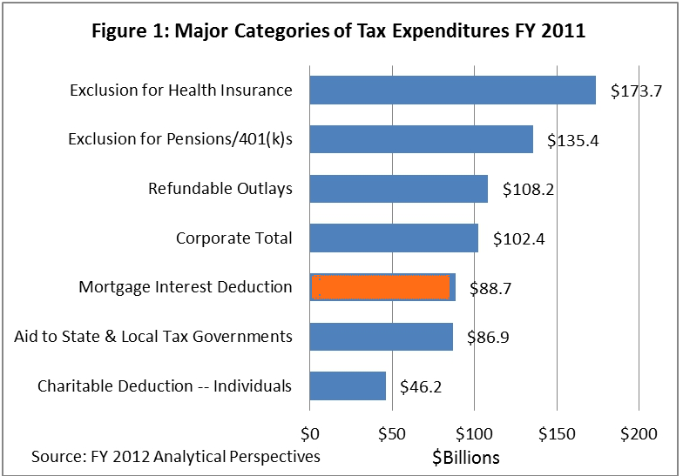
the mortgage interest deduction drives up home prices
It disproportionately benefits the wealthy and can make houses more expensive by subsidizing the full cost, leading to people buying bigger homes to maximize tax benefits (or at least relaxes budget constraints).
http://taxfoundation.org/article/testimony-scott-hodge-us-senate-budget-committee-hearing-distribution-and-efficiency-spending-tax

Slide 24
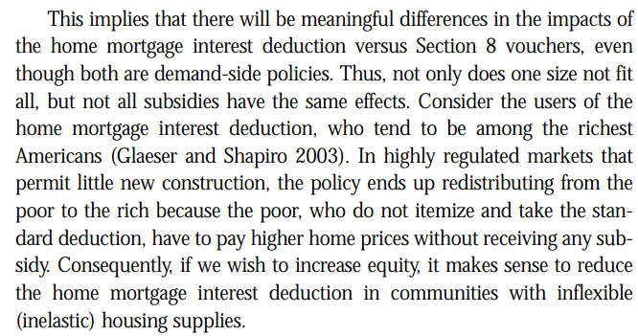
Glaeser, E., & Gyourko, J. (2009). Rethinking Federal Housing Policy.

Slide 25
Homeowners are a powerful voting block
An Economic History of Zoning and a Cure for Its Exclusionary Effects
The Homevoter Hypothesis is that the way to understand local government behavior is to see it through the eyes of homeowners — and not renters, developers, business interests, or machine politicians — who are resident in the community. Homeowners have a special interest in their community that helps overcome the free-rider problem in public affairs. For most of them, a home is by far their largest financial asset, and, unlike corporate stock owners, homeowners cannot diversify their holdings among several communities. Fear of a capital loss to their major asset and desire to increase its value motivate owners of homes to become “homevoters.” They vote their homes in local elections and at public hearings.
The homevoter approach to local government can explain why zoning came into being when it did and why during the 1970s it became more generally exclusionary. New transportation technologies, specifically the bus and truck in 1910s and the development of the interstate highway system in the 1960s, put suburban homeowners at risk from value-reducing development in their neighborhoods and communities. Because homeowners had no means of insuring their assets against these new threats, they and the developers of new homes responded with public land-use regulations that have become increasingly exclusionary.

Slide 26
Getting housing right:
Glaeser, E., & Gyourko, J. (2009). Rethinking Federal Housing Policy.
Use vouchers to subsidize the poor, not LIHTC.
Reform the home mortgage interest deduction.
Reform historical preservation and zoning practices to increase supply.
Use federal policy to punish municipalities that restrict too much construction when prices are high.
No one-size fits all solution, focus on supply or demand sides depending on the conditions.

