Slide 2
Html page basics

Slide 3
CSS: Cascading style sheets

Slide 4
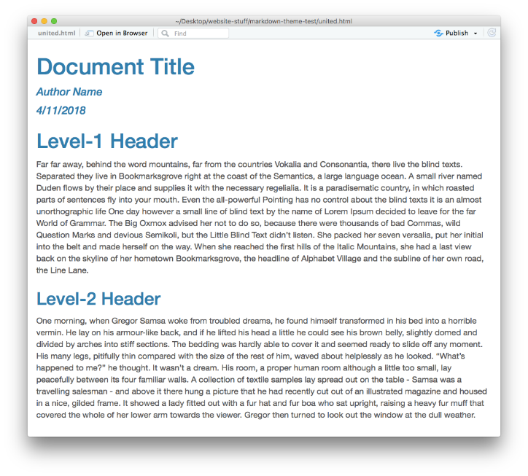
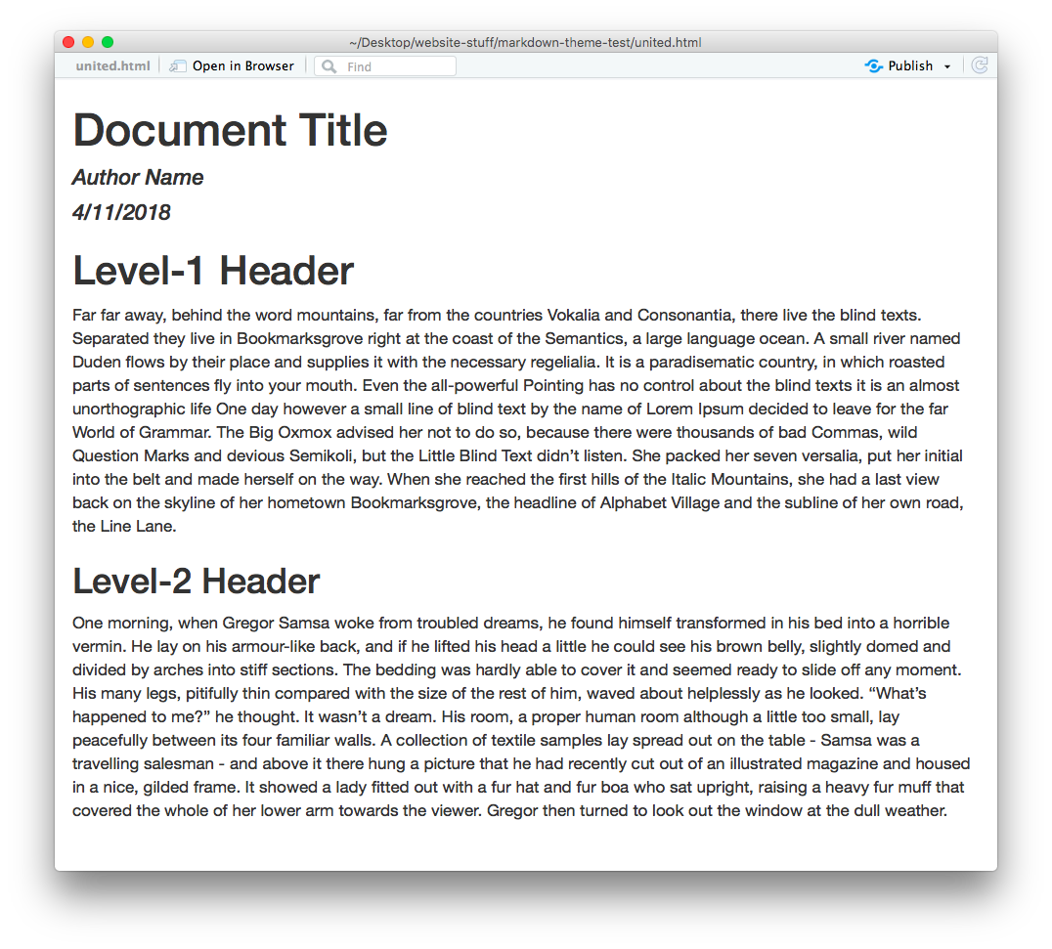
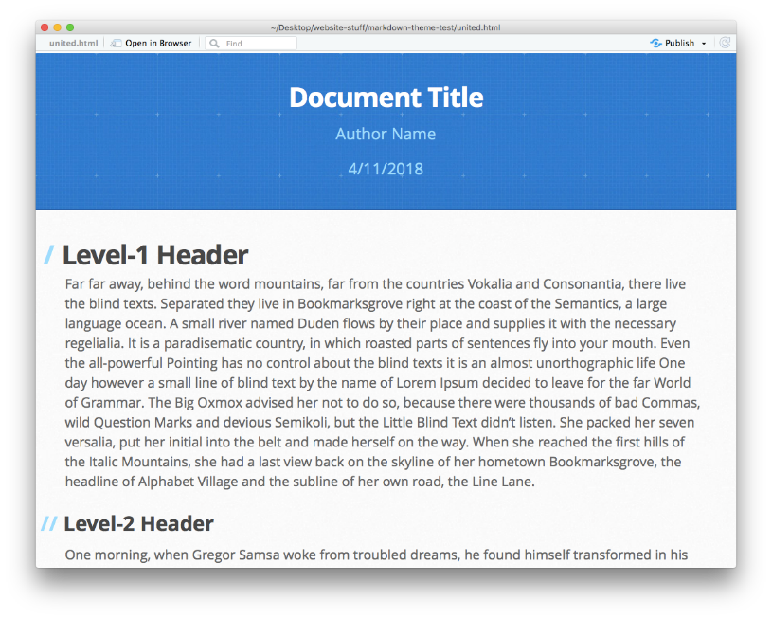
Why use CSS?
Separates the task of creating content from packaging content.
cerulean theme
readable theme
architect theme
---
output:
html_document:
theme: readable
---
You’ve been using this in RMD documents already !

Slide 5

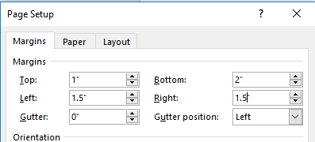
What is a STYLE?
Graphical User Interface Version of Style
body p {
font-type: arial narrow;
font-decoration: bold;
font-size: 18pt;
color: red;
}
(text style)
body {
margin-top: 1;
margin-left: 1.5;
margin-right: 1.5;
margin-bottom: 2;
}
(page style)

Slide 6
github pages

Slide 7
liquid tags

