Slide 1

The Increasing Dominance of Teams in Production of Knowledge
by Stefan Wuchty, Benjamin F. Jones, and Brian Uzzi
Science
Volume 316(5827):1036-1039
May 18, 2007
American Association for the Advancement of Science

Slide 2
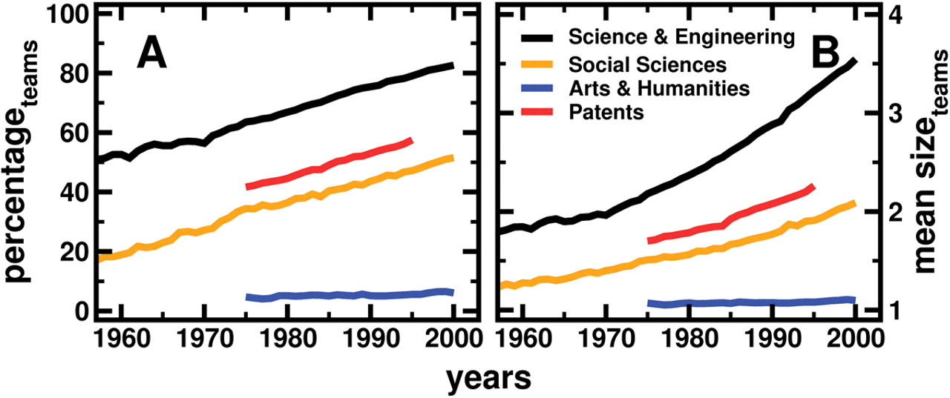
Fig. 1. The growth of teams.
Stefan Wuchty et al. Science 2007;316:1036-1039
American Association for the Advancement of Science
Notes:
The growth of teams. These plots present changes over time in the fraction of papers and patents written in teams (A) and in mean team size (B). Each line represents the arithmetic average taken over all subfields in each year.

Slide 3
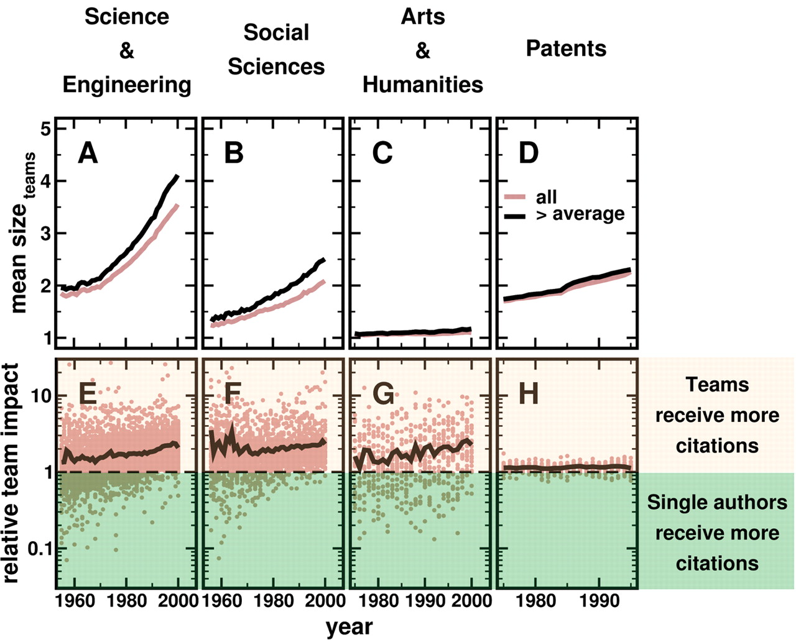
Fig. 2. The relative impact of teams.
Stefan Wuchty et al. Science 2007;316:1036-1039
American Association for the Advancement of Science
Notes:
The relative impact of teams. (A to D) Mean team size comparing all papers and patents with those that received more citations than average in the relevant subfield. (E to H) The RTI, which is the mean number of citations received by team-authored work divided by the mean number of citations received by solo-authored work. A ratio of 1 indicates that team- and solo-authored work have equivalent impact on average. Each point represents the RTI for a given subfield and year, whereas the black lines present the arithmetic average in a given year.

Slide 4
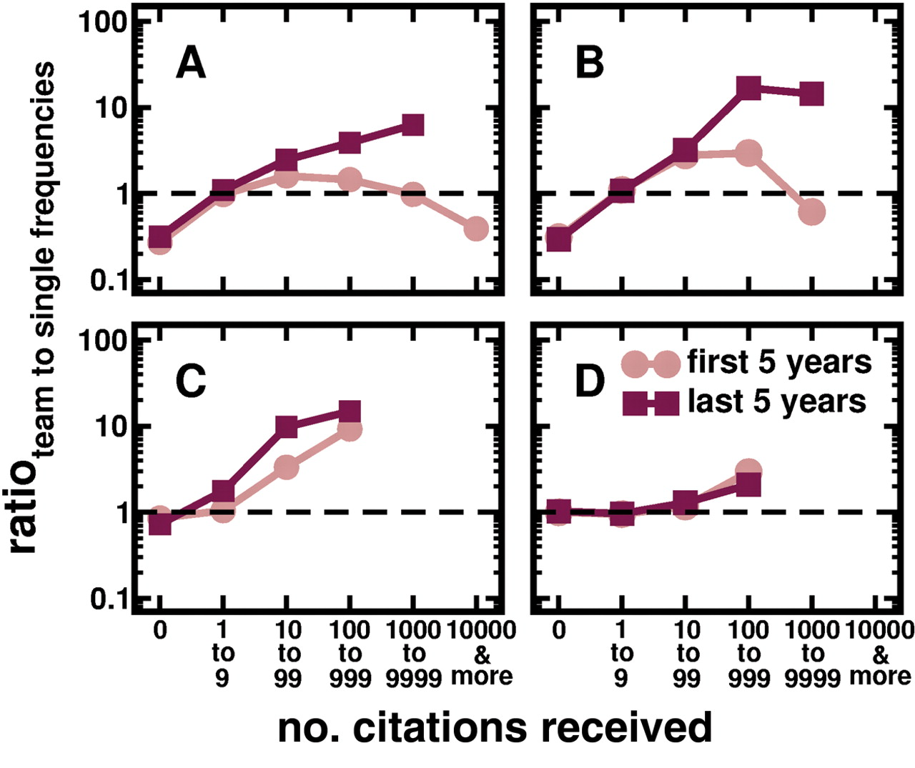
Fig. 3. Exceptional research.
Stefan Wuchty et al. Science 2007;316:1036-1039
American Association for the Advancement of Science
Notes:
Exceptional research. Pooling all publications and patents within the four research categories, we calculated frequency distributions of citations received. Separate distributions are calculated for single authors and for teams, and the ratio is plotted. A ratio greater than 1 indicates that a team-authored paper had a higher probability of producing the given range of citations than a solo-authored paper. Ratios are compared for the early period (first 5 years of available data) and late period (last 5 years of available data) for each research category, sciences and engineering (A), social sciences (B), arts and humanities (C), and patents (D).

