Slide 2
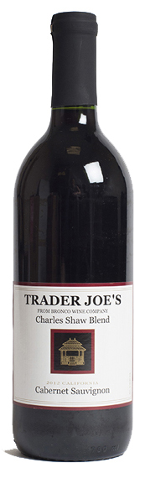

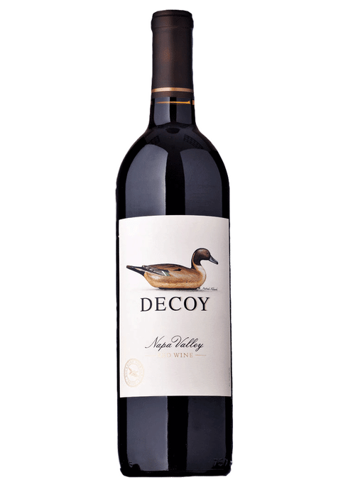
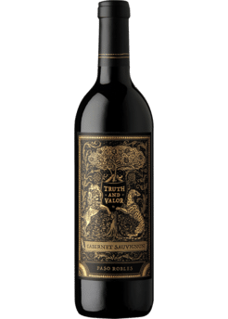
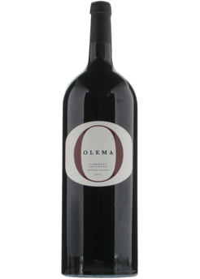
0
1
2
3
4
5
Quality
$0
$3
$6
$12
$25
$50
Price

Slide 3
0
1
2
3
4
5
Quality
$0
$3
$6
$12
$25
$50
Price
1.10 1.79 2.48 3.22 3.91

Slide 4
0
1
2
3
4
5
Quality
0
1.58
2.58
3.58
4.58
5.58
Price (logged_{base2})

