Slide 2
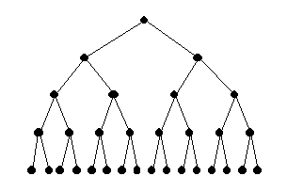
decision made during model selection
models that challenge our view of the world
models that confirm our theory
(all possible models)

Slide 3
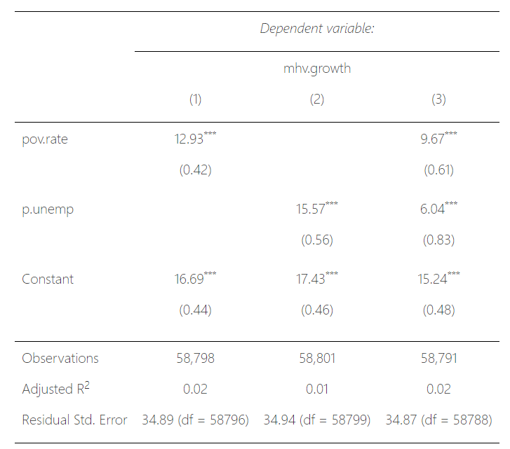
Model
does not “improve”
Coefficients get smaller
Standard errors increase
No increase to R²
No decrease to SER

Slide 4
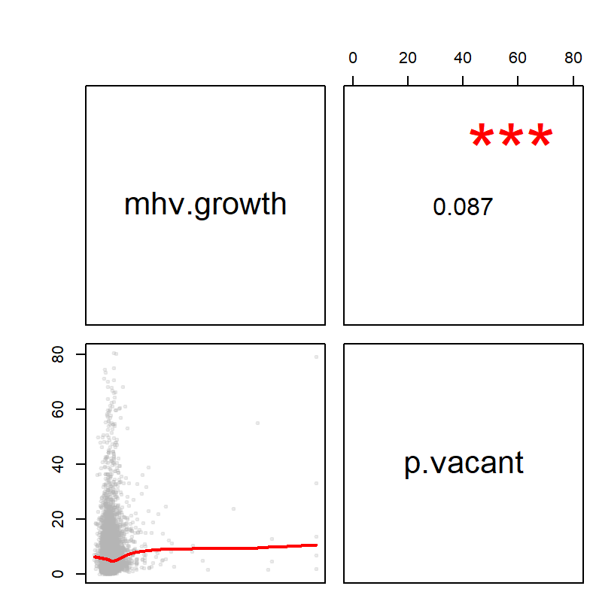
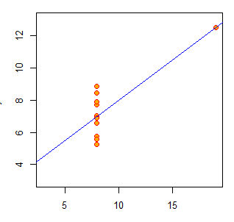
Spurious Correlations

Slide 5
Y
The slope can increase or decrease depending on ratios and the sign of the correlation between X and the control.
The standard error becomes larger when X is highly correlated with the control because very little extra residual (A) is explained, but the variance of X (B+C) is reduced.
a
b
c
X
control

