Slide 1
Spatial Analysis

Slide 2
geographic units

Slide 3
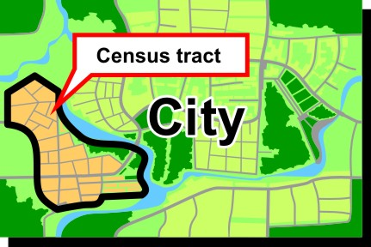
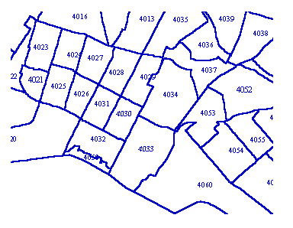
In the U.S., Census tracts are "Designed to be relatively homogeneous units with respect to population characteristics, economic status, and living conditions, census tracts average about 4,000 inhabitants."
Why are the tracts different sizes?

Slide 4
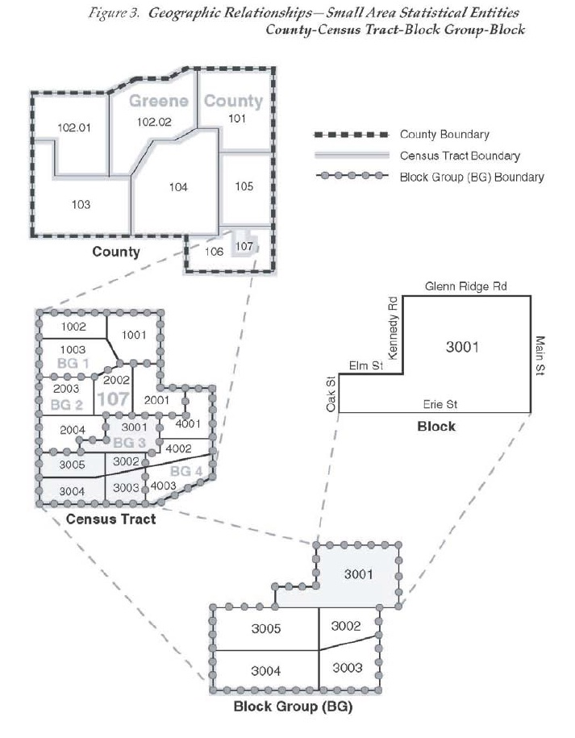
Nested Administrative Units
States
Counties
Census Tracts
Census Blocks
Census Tract is usually the most granular level of data provided by census
County
Census Tract
Block
Block Group

Slide 5
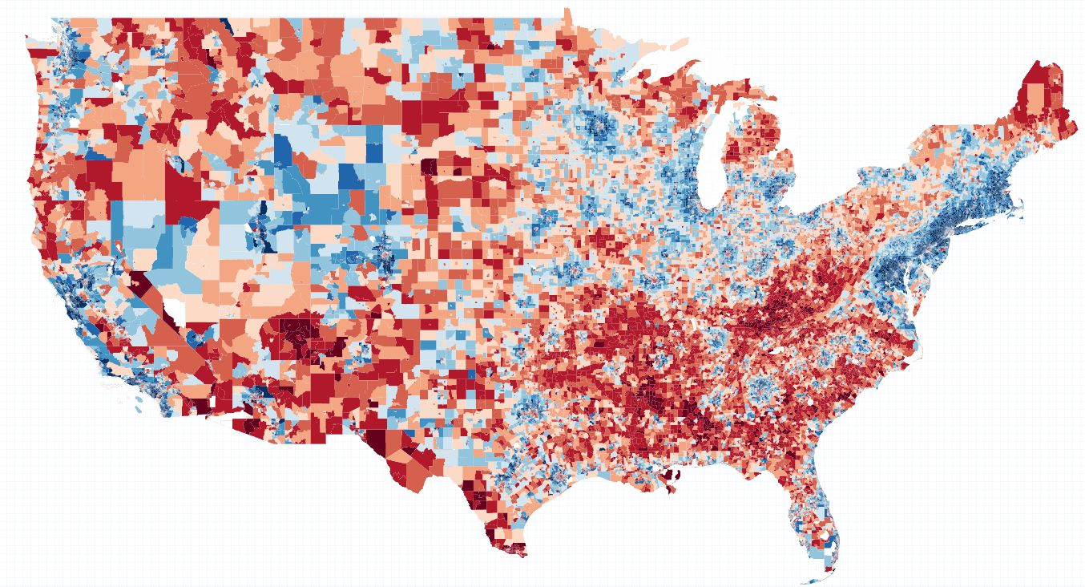
Example: Household Income by Census Tract

Slide 6
FIPS Code Structure
11-digit Geo ID Code
42003000102
42-003-0001.02
State
County
Census Tract

Slide 7
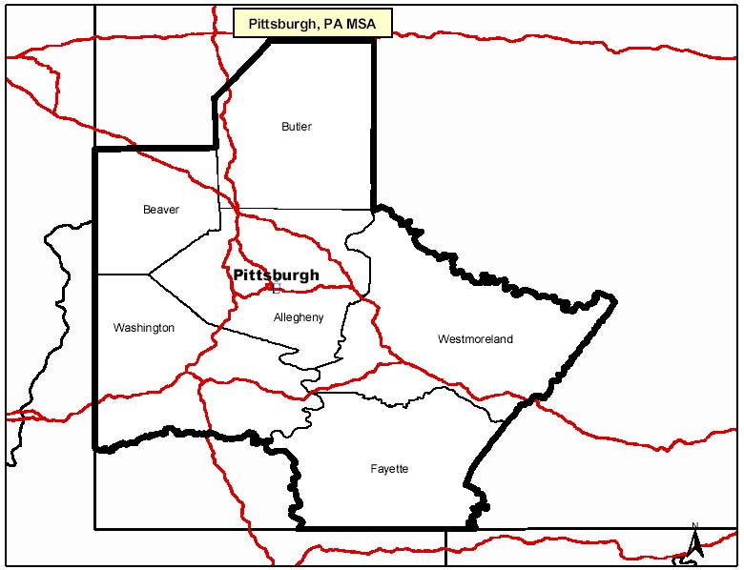
Which counties are in my MSA?
http://www.bea.gov/faq/index.cfm?faq_id=470
Pittsburgh, PA (Metropolitan Statistical Area)
Allegheny, PA [42003]
Beaver, PA [42007]
Butler, PA [42019]
Fayette, PA [42051]
Washington, PA [42125]
Westmoreland, PA [42129]
FIPS Code for Allegheny County (42003)
42 = Pennsylvania
003 = Allegheny County

Slide 8
census data

Slide 9
Topics
Decennial
ACS
Other government “cesus-like” data sources
PUMS
Department of Labor
Sample frameworks (decennial vs ACS)
Topics
Tables

Slide 10
Main Categories
People
Housing
Employment
Etc.

Slide 11
Structure of Census Files
Construct (poverty, race)
Estimates vs Sampling Error
Why 60,000 variables?
Facets (poverty by gender, age, race, etc.)
age x gender x race: 15 x 2 x 8 = 240 combinations

Slide 12
shapefiles

Slide 13
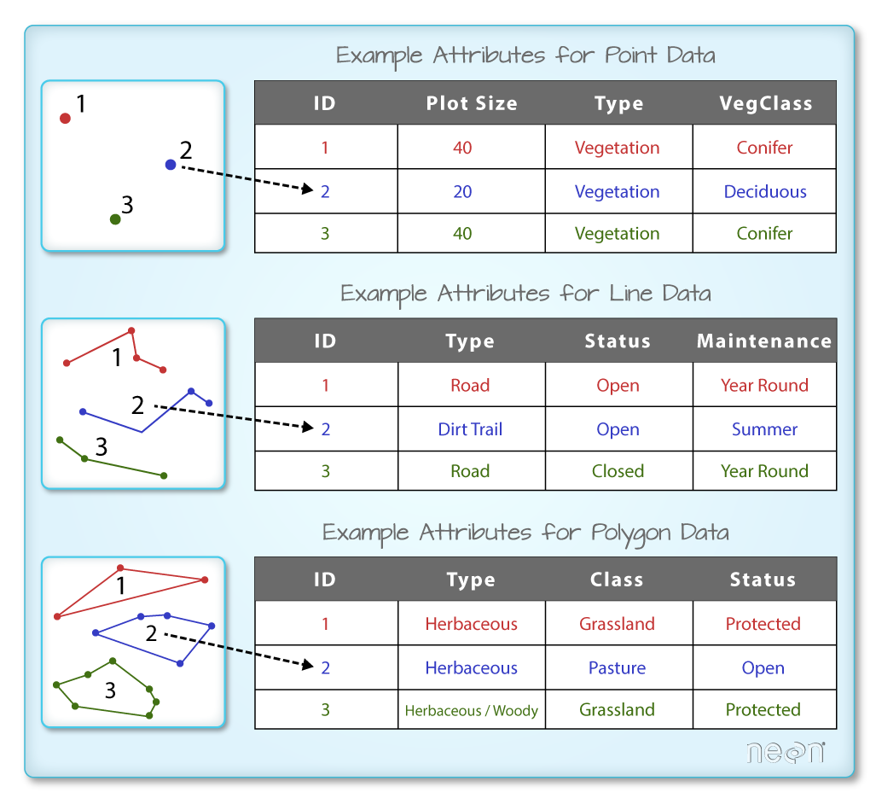
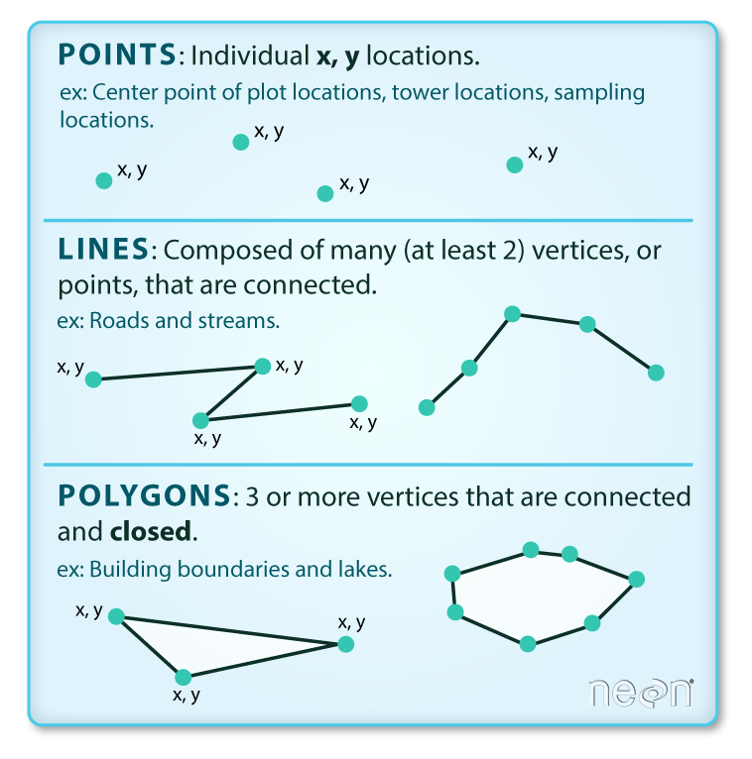
SOURCE: https://www.neonscience.org/dc-open-shapefiles-r

Slide 14
Structure of a shapefile
Geometric elements (e.g. collection of county polygons)
ID
Set of points that draws the object
Data (one row per polygon – attributes of counties)
ID
Area
Population
Meta-data (map attributes)
Layer type (points, lines, polygons)
Map projection
Bounding box

Slide 15
library(sf)
fname <- system.file("shape/nc.shp", package="sf")
fname
nc <- st_read(fname)
plot( nc )
head( nc )
class( nc )
class( nc$AREA )
class( nc$geometry )
nc$geometry[[1]]
st_write( nc, "nc.GeoJSON" )
file.show( "nc.GeoJSON" )
st_write( nc, "nc.csv" )
file.show( "nc.csv" )
# geometries have been dropped

Slide 16
> summary( ncs )
Object of class SpatialPolygonsDataFrame
Coordinates:
min max
x -84.32385 -75.45698
y 33.88199 36.58965
Is projected: FALSE
proj4string :
[+proj=longlat +datum=NAD27 +no_defs +ellps=clrk66 +nadgrids=@conus,@alaska,@ntv2_0.gsb,@ntv1_can.dat]
Data attributes:
AREA PERIMETER CNTY_ CNTY_ID NAME FIPS FIPSNO CRESS_ID
Min. :0.0420 Min. :0.999 Min. :1825 Min. :1825 Alamance : 1 37001 : 1 Min. :37001 Min. : 1.00
1st Qu.:0.0910 1st Qu.:1.324 1st Qu.:1902 1st Qu.:1902 Alexander: 1 37003 : 1 1st Qu.:37051 1st Qu.: 25.75
Median :0.1205 Median :1.609 Median :1982 Median :1982 Alleghany: 1 37005 : 1 Median :37100 Median : 50.50
Mean :0.1263 Mean :1.673 Mean :1986 Mean :1986 Anson : 1 37007 : 1 Mean :37100 Mean : 50.50
3rd Qu.:0.1542 3rd Qu.:1.859 3rd Qu.:2067 3rd Qu.:2067 Ashe : 1 37009 : 1 3rd Qu.:37150 3rd Qu.: 75.25
Max. :0.2410 Max. :3.640 Max. :2241 Max. :2241 Avery : 1 37011 : 1 Max. :37199 Max. :100.00
(Other) :94 (Other):94
BIR74 SID74 NWBIR74 BIR79 SID79 NWBIR79
Min. : 248 Min. : 0.00 Min. : 1.0 Min. : 319 Min. : 0.00 Min. : 3.0
1st Qu.: 1077 1st Qu.: 2.00 1st Qu.: 190.0 1st Qu.: 1336 1st Qu.: 2.00 1st Qu.: 250.5
Median : 2180 Median : 4.00 Median : 697.5 Median : 2636 Median : 5.00 Median : 874.5
Mean : 3300 Mean : 6.67 Mean :1050.8 Mean : 4224 Mean : 8.36 Mean : 1352.8
3rd Qu.: 3936 3rd Qu.: 8.25 3rd Qu.:1168.5 3rd Qu.: 4889 3rd Qu.:10.25 3rd Qu.: 1406.8
Max. :21588 Max. :44.00 Max. :8027.0 Max. :30757 Max. :57.00 Max. :11631.0
Meta-Data
Data

Slide 17
> ncs@polygons[[2]]@Polygons[[1]]@coords
[,1] [,2]
[1,] -81.23989 36.36536
[2,] -81.24069 36.37942
[3,] -81.26284 36.40504
[4,] -81.26624 36.43721
[5,] -81.31332 36.48070
[6,] -81.32478 36.51368
[7,] -81.34754 36.53791
[8,] -81.34530 36.57286
[9,] -80.90344 36.56521
[10,] -80.93355 36.49831
[11,] -80.96577 36.46722
[12,] -80.94967 36.41473
[13,] -80.95639 36.40380
[14,] -80.97795 36.39138
[15,] -80.98284 36.37183
[16,] -81.00278 36.36668
[17,] -81.02464 36.37783
[18,] -81.04280 36.41034
[19,] -81.08425 36.42992
[20,] -81.09856 36.43115
[21,] -81.11331 36.42285
[22,] -81.12938 36.42633
[23,] -81.13840 36.41763
[24,] -81.15337 36.42474
[25,] -81.17667 36.41544
[26,] -81.23989 36.36536
Bounding Box
bbox( ncs )
min max
x -84.32385 -75.45698
y 33.88199 36.58965
Polygon
First and last point is the same to create a closed polygon

Slide 18
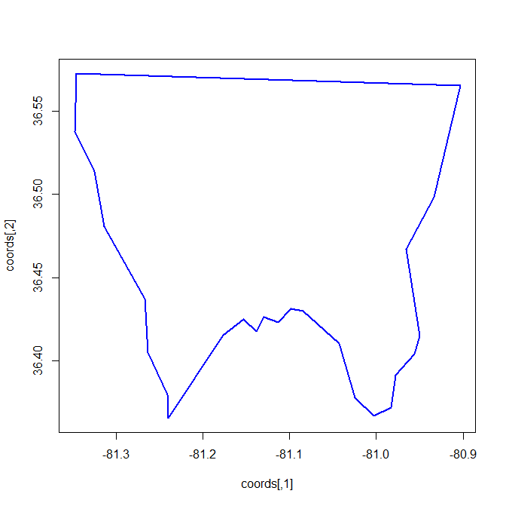
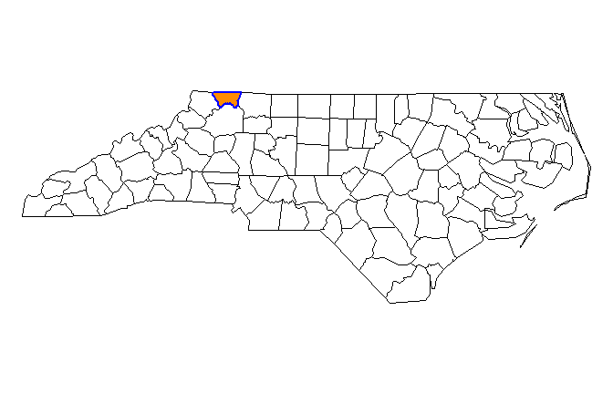
library( sp )
library( rgdal )
ncs <- readOGR( dsn="C:/Users/Documents", layer="nc" )
class( sp )
plot( ncs )
coords <- ncs@polygons[[2]]@Polygons[[1]]@coords
plot( coords, type="l", col="blue", lwd=2 )
plot( ncs )
polygon( coords, col="darkorange",
border="blue", lwd=2 )

Slide 19
shapefile wars

Slide 20
History of the shapefile file format
Generation 1: ESRI Shapefiles (.shp)
One of first serious commercial platforms (ArcGIS)
5 separate files, all compressed and not readable with text editors
Generation 2: Spatial files in R package sp
List with separate data, meta-data, and polygons
Generation 3: “Simple Files” (sf) format
Collapses polygon coordinates into a string that is stored in as a column in the shapefile dataframe
Meta-data is stored as data frame attributes
Follows “tidy” data conventions
Generation 3.5: GeoJSON format is a portable sf file
Widely used by open source GIS tools
Bonus – GitHub will automatically visualize these files for you

Slide 21
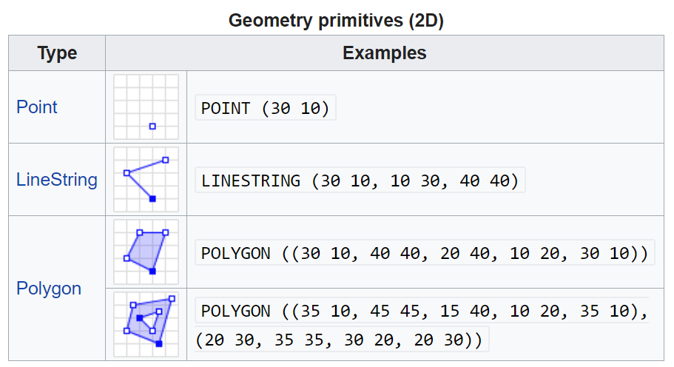
sf package: geometric “primitives” for spatial objects

Slide 22
> head(nc)
Simple feature collection with 6 features and 14 fields
geometry type: MULTIPOLYGON
dimension: XY
bbox: xmin: -81.74107 ymin: 36.07282 xmax: -75.77316 ymax: 36.58965
epsg (SRID): 4267
proj4string: +proj=longlat +datum=NAD27 +no_defs
AREA PERIMETER CNTY_ CNTY_ID NAME FIPS FIPSNO CRESS_ID BIR74
1 0.114 1.442 1825 1825 Ashe 37009 37009 5 1091
2 0.061 1.231 1827 1827 Alleghany 37005 37005 3 487
3 0.143 1.630 1828 1828 Surry 37171 37171 86 3188
4 0.070 2.968 1831 1831 Currituck 37053 37053 27 508
5 0.153 2.206 1832 1832 Northampton 37131 37131 66 1421
6 0.097 1.670 1833 1833 Hertford 37091 37091 46 1452
SID74 NWBIR74 BIR79 SID79 NWBIR79 geometry
1 1 10 1364 0 19 MULTIPOLYGON (((-81.47276 3...
2 0 10 542 3 12 MULTIPOLYGON (((-81.23989 3...
3 5 208 3616 6 260 MULTIPOLYGON (((-80.45634 3...
4 1 123 830 2 145 MULTIPOLYGON (((-76.00897 3...
5 9 1066 1606 3 1197 MULTIPOLYGON (((-77.21767 3...
6 7 954 1838 5 1237 MULTIPOLYGON (((-76.74506 3...
library(sf)
fname <- system.file("shape/nc.shp", package="sf")
fname
nc <- st_read(fname)
plot( nc )
head( nc )
class( nc )
class( nc$AREA )
class( nc$geometry )
nc$geometry[[1]]
st_write( nc, "nc.GeoJSON" )
file.show( "nc.GeoJSON" )
st_write( nc, "nc.csv" )
file.show( "nc.csv" )
# geometries have been dropped
> head( nc$geometry )
Geometry set for 6 features
geometry type: MULTIPOLYGON
dimension: XY
bbox: xmin: -81.74107 ymin: 36.07282
xmax: -75.77316 ymax: 36.58965
epsg (SRID): 4267
proj4string: +proj=longlat +datum=NAD27 +no_defs
First 5 geometries:
MULTIPOLYGON (((-81.47276 36.23436, -81.54084 3...
MULTIPOLYGON (((-81.23989 36.36536, -81.24069 3...
MULTIPOLYGON (((-80.45634 36.24256, -80.47639 3...
MULTIPOLYGON (((-76.00897 36.3196, -76.01735 36...
MULTIPOLYGON (((-77.21767 36.24098, -77.23461 3...

Slide 23
> head(nc)
Simple feature collection with 6 features and 14 fields
geometry type: MULTIPOLYGON
dimension: XY
bbox: xmin: -81.74107 ymin: 36.07282 xmax: -75.77316 ymax: 36.58965
epsg (SRID): 4267
proj4string: +proj=longlat +datum=NAD27 +no_defs
AREA PERIMETER CNTY_ CNTY_ID NAME FIPS FIPSNO CRESS_ID BIR74
1 0.114 1.442 1825 1825 Ashe 37009 37009 5 1091
2 0.061 1.231 1827 1827 Alleghany 37005 37005 3 487
3 0.143 1.630 1828 1828 Surry 37171 37171 86 3188
4 0.070 2.968 1831 1831 Currituck 37053 37053 27 508
5 0.153 2.206 1832 1832 Northampton 37131 37131 66 1421
6 0.097 1.670 1833 1833 Hertford 37091 37091 46 1452
SID74 NWBIR74 BIR79 SID79 NWBIR79 geometry
1 1 10 1364 0 19 MULTIPOLYGON (((-81.47276 3...
2 0 10 542 3 12 MULTIPOLYGON (((-81.23989 3...
3 5 208 3616 6 260 MULTIPOLYGON (((-80.45634 3...
4 1 123 830 2 145 MULTIPOLYGON (((-76.00897 3...
5 9 1066 1606 3 1197 MULTIPOLYGON (((-77.21767 3...
6 7 954 1838 5 1237 MULTIPOLYGON (((-76.74506 3...
Meta-Data
(type of spatial data, type of projection, etc.)
Regular
Data Frame
(e.g. census data)
sf Spatial
Objects
Component
(just another column in a spreadsheet)

Slide 24
sf data format in tidycensus
library( tidycensus )
acs <- get_acs( geography="tract", variables="B19013_001",
state="AZ", county="Maricopa", geometry=TRUE )
> head( acs )
Simple feature collection with 6 features and 5 fields
geometry type: MULTIPOLYGON
dimension: XY
bbox: xmin: -112.772 ymin: 33.46573 xmax: -111.04 ymax: 34.03733
epsg (SRID): 4269
proj4string: +proj=longlat +datum=NAD83 +no_defs
GEOID NAME variable estimate moe geometry
1 04013010101 Census Tract 101.01, Maricopa County, Arizona B19013_001 87167 21599 MULTIPOLYGON (((-111.7869 3...
2 04013010102 Census Tract 101.02, Maricopa County, Arizona B19013_001 115725 23564 MULTIPOLYGON (((-112.0654 3...
3 04013030401 Census Tract 304.01, Maricopa County, Arizona B19013_001 113889 12613 MULTIPOLYGON (((-111.9648 3...
4 04013030402 Census Tract 304.02, Maricopa County, Arizona B19013_001 81994 8271 MULTIPOLYGON (((-111.9958 3...
5 04013040502 Census Tract 405.02, Maricopa County, Arizona B19013_001 40434 6011 MULTIPOLYGON (((-112.772 33...
6 04013040506 Census Tract 405.06, Maricopa County, Arizona B19013_001 40978 7396 MULTIPOLYGON (((-112.3586 3...
sf geometry
https://cran.r-project.org/web/packages/sf/vignettes/sf2.html

Slide 25
GeoJSON format
library(sf)
fname <- system.file("shape/nc.shp", package="sf")
fname
library( sp )
library( rgdal )
ncs <- readOGR( dsn="C:/Users/jdlecy/Documents/R/win-library/3.6/sf/shape", layer="nc" )
st_write( nc, "nc.GeoJSON" )
file.show( "nc.GeoJSON" )

Slide 26
GeoJSON format
{
"type": "FeatureCollection",
"name": "nc",
"crs": { "type": "name", "properties": { "name": "urn:ogc:def:crs:EPSG::4267" } },
"features": [
{ "type": "Feature", "properties": { "AREA": 0.114, "PERIMETER": 1.442, "CNTY_": 1825.0, "CNTY_ID": 1825.0, "NAME": "Ashe", "FIPS": "37009", "FIPSNO": 37009.0, "CRESS_ID": 5, "BIR74": 1091.0, "SID74": 1.0, "NWBIR74": 10.0, "BIR79": 1364.0, "SID79": 0.0, "NWBIR79": 19.0 }, "geometry": { "type": "MultiPolygon", "coordinates": [ [ [ [ -81.472755432128906, 36.234355926513672 ], [ -81.540840148925781, 36.272506713867188 ], [ -81.561981201171875, 36.273593902587891 ], [ -81.633064270019531, 36.340686798095703 ], [ -81.741073608398438, 36.39178466796875 ], [ -81.698280334472656, 36.471778869628906 ], [ -81.702796936035156, 36.519340515136719 ], [ -81.669998168945312, 36.589649200439453 ], [ -81.345298767089844, 36.572864532470703 ], [ -81.347541809082031, 36.537914276123047 ], [ -81.324775695800781, 36.513679504394531 ], [ -81.313323974609375, 36.480697631835938 ], [ -81.2662353515625, 36.437206268310547 ], [ -81.262840270996094, 36.405040740966797 ], [ -81.240692138671875, 36.379417419433594 ], [ -81.239891052246094, 36.365364074707031 ], [ -81.264244079589844, 36.352413177490234 ], [ -81.328994750976562, 36.363502502441406 ], [ -81.361373901367188, 36.353160858154297 ], [ -81.365692138671875, 36.33905029296875 ], [ -81.354133605957031, 36.299716949462891 ], [ -81.367454528808594, 36.278697967529297 ], [ -81.406387329101562, 36.285053253173828 ], [ -81.412330627441406, 36.267292022705078 ], [ -81.431037902832031, 36.260719299316406 ], [ -81.452888488769531, 36.239585876464844 ], [ -81.472755432128906, 36.234355926513672 ] ] ] ] } },
{ "type": "Feature", "properties": { "AREA": 0.061, "PERIMETER": 1.231, "CNTY_": 1827.0, "CNTY_ID": 1827.0, "NAME": "Alleghany", "FIPS": "37005", "FIPSNO": 37005.0, "CRESS_ID": 3, "BIR74": 487.0, "SID74": 0.0, "NWBIR74": 10.0, "BIR79": 542.0, "SID79": 3.0, "NWBIR79
META-DATA
DATA
POLYGON

Slide 27
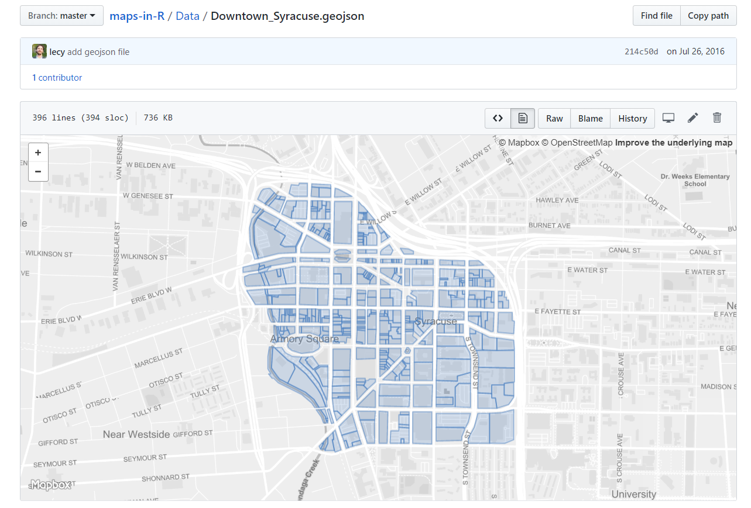
GeoJSON on GitHub
https://github.com/lecy/maps-in-R/blob/master/Data/Downtown_Syracuse.geojson

Slide 28
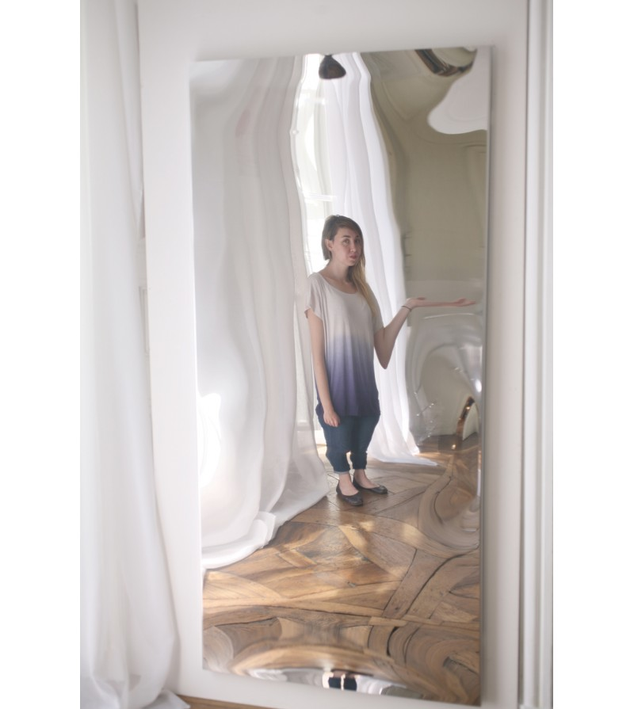
PROJECTING Objects in the mirror may be less awkward than they appear

Slide 29
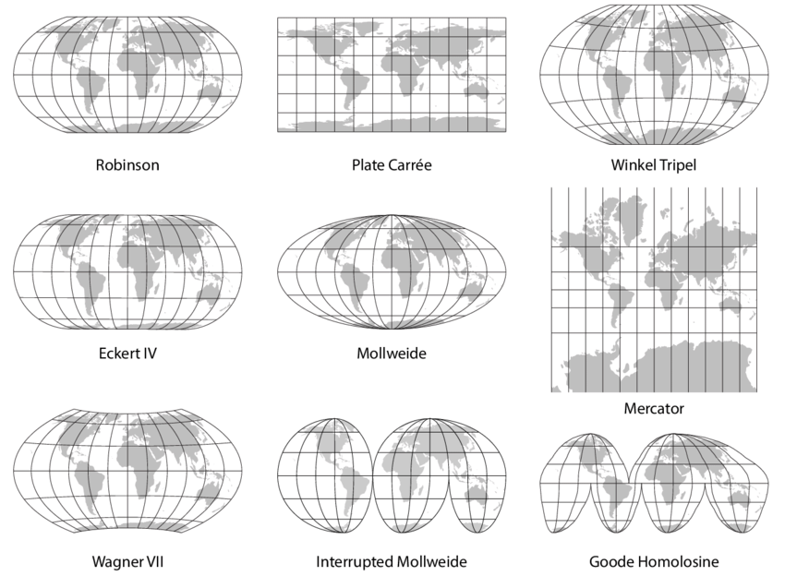
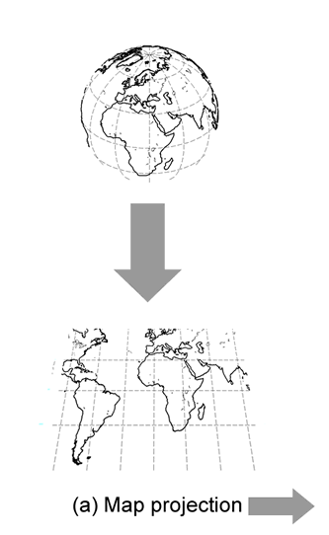

Slide 30
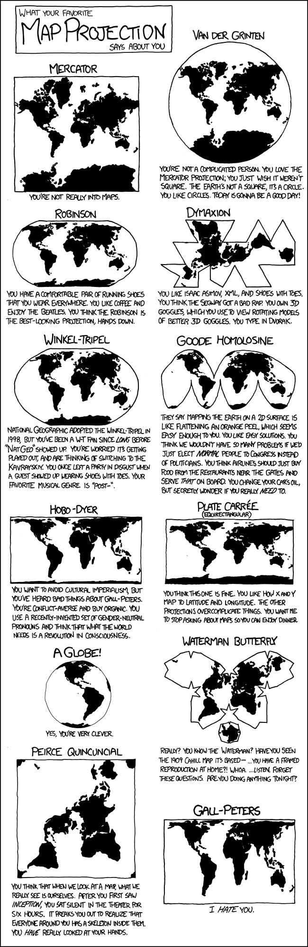
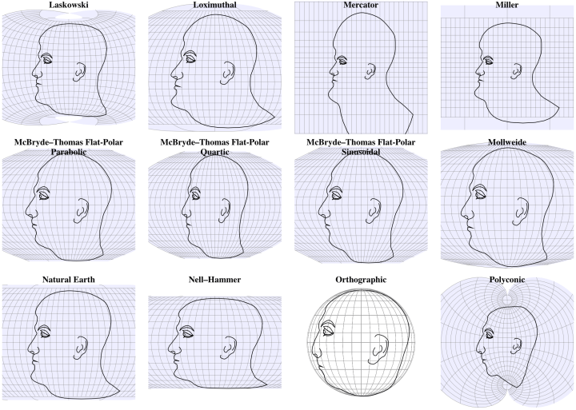
What your map projection says about you

Slide 33
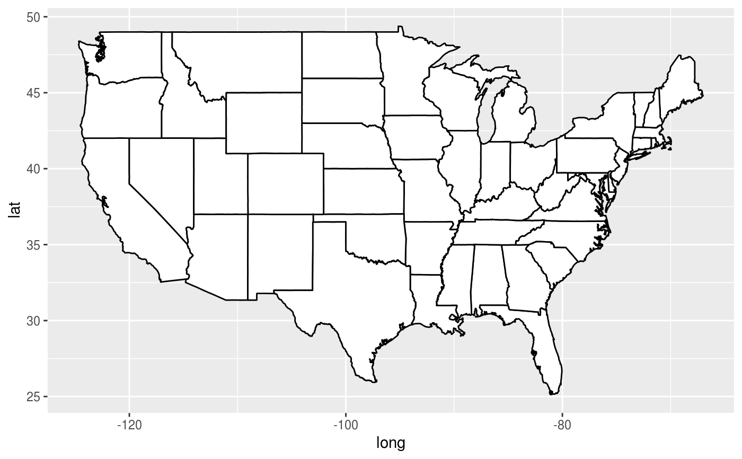
states <- map_data("state") usamap <- ggplot(states, aes(long, lat, group = group)) + geom_polygon(fill = "white", colour = "black")
# Use cartesian coordinates
usamap
https://ggplot2.tidyverse.org/reference/coord_map.html

Slide 34
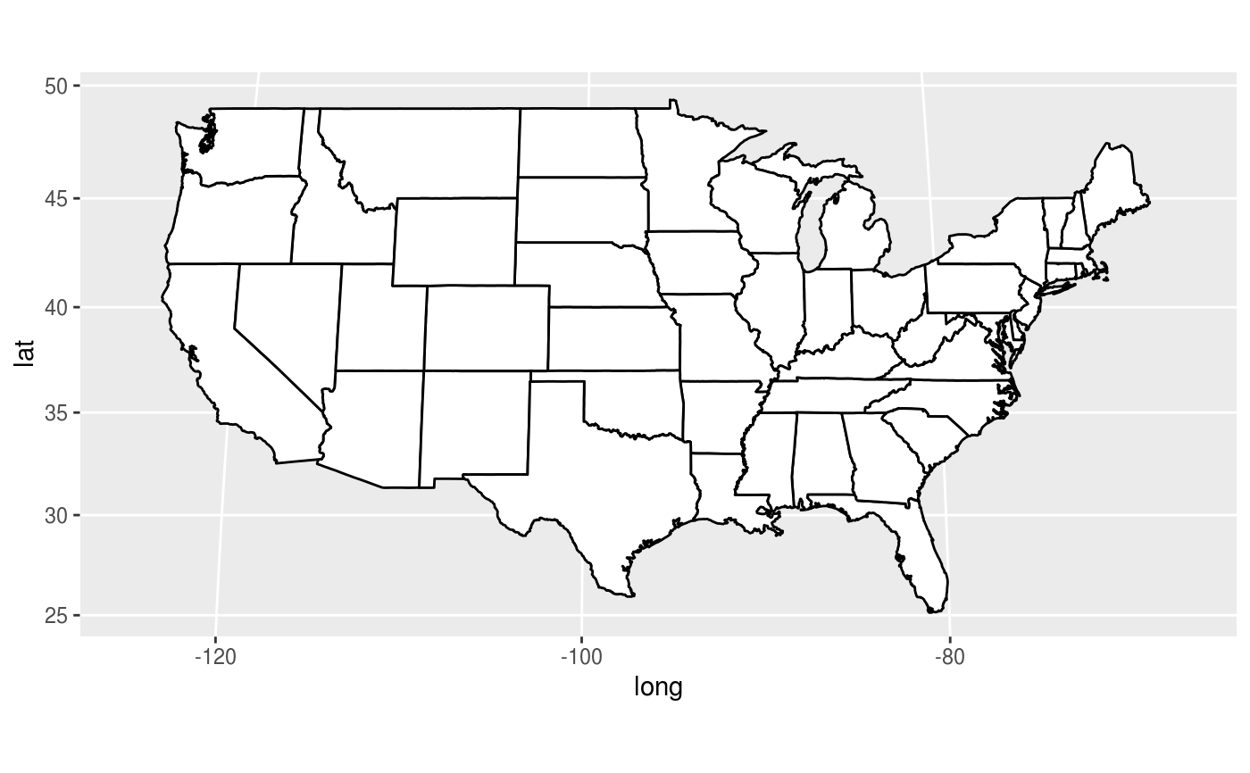
# Use gilbert projection
usamap + coord_map("gilbert")
https://ggplot2.tidyverse.org/reference/coord_map.html

Slide 35
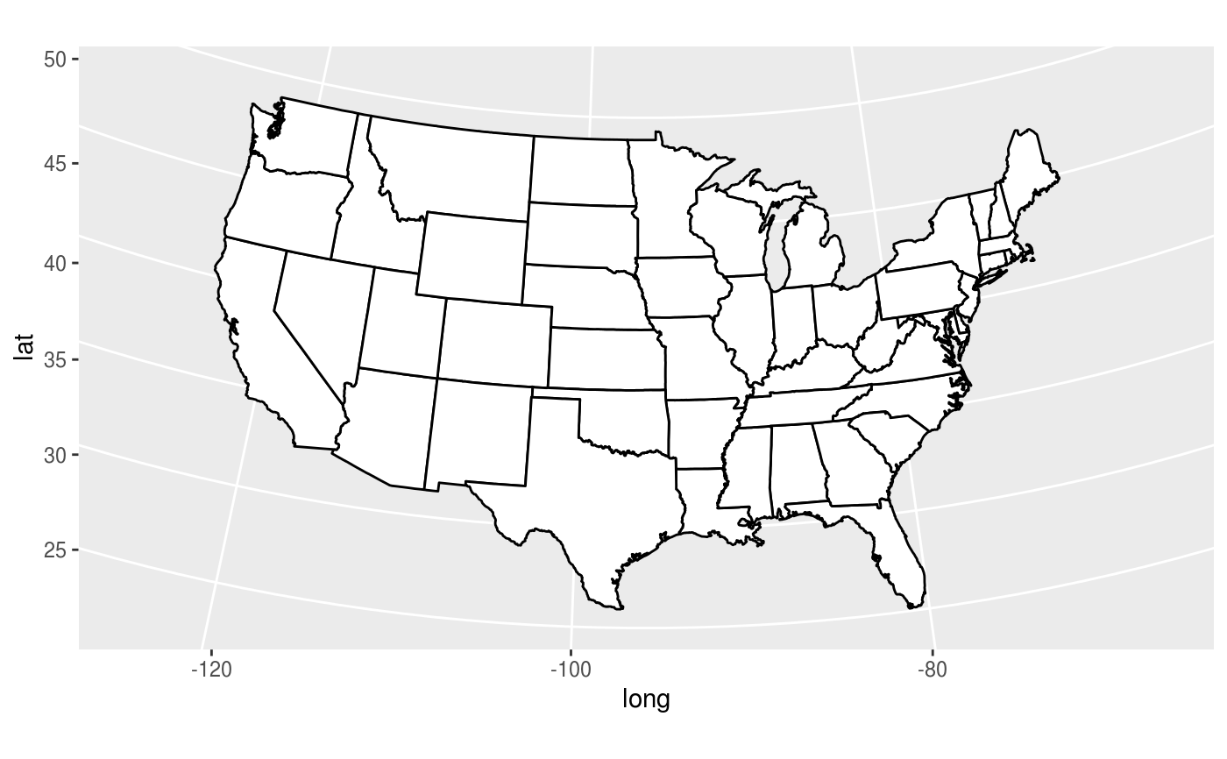
# Use conic projection
usamap + coord_map("conic", lat0 = 30)
https://ggplot2.tidyverse.org/reference/coord_map.html

