Slide 1
Spatial Analysis
in R

Slide 2
Useful vocab: open-source GIS community
OGC - Open Geospatial Consortium, umbrella organization that supports development of open-source GIS tools and standards
GDAL - Geospatial Data Abstraction Library: open source library of tools for converting maps from one format to another (raster versus vector, various transformations)
OGR – OpenGIS Simple Features Reference

Slide 3
R packages for spatial analysis
sp – Core spatial analysis package for working with spatial objects (points, lines, polygons)
rgdal –package for reading shapefiles (and other formats) into R
geojsonio – package for reading and writing GeoJSON file formats
sf – Simple features package that provides a modernization of the sp package by simplifying data structures

Slide 4
census data

Slide 5
R packages: Census data APIs
tigris – downloading tiger shapefiles from the census
censusapi – downloading census data
tidycensus – downloading census data

Slide 6
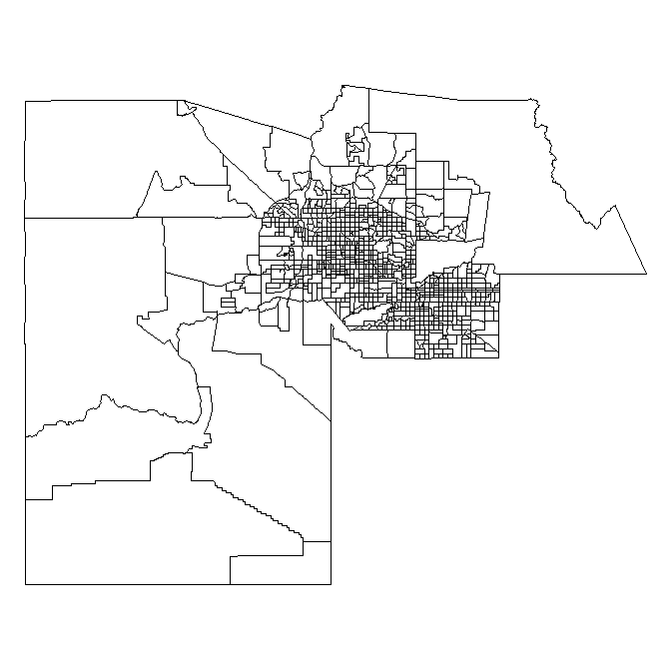
Download Shapefiles
library( tigris )
phx <- tracts( state="AZ", county="Maricopa", cb=TRUE, year=2015 )
plot( phx )

Slide 7
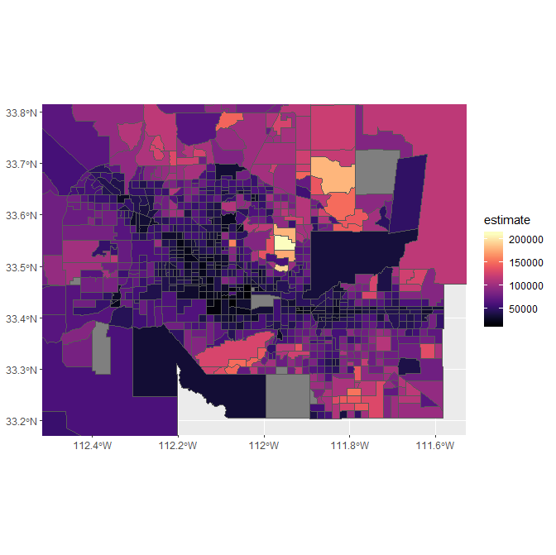
Download Census Data
library( tidycensus )
census_api_key( "YOUR KEY GOES HERE" )
phx <- get_acs( geography = "tract", variables = "B19013_001",
state = "AZ", county = "Maricopa", geometry = TRUE )
ggplot( phx, aes(fill = estimate)) +
geom_sf() +
coord_sf( xlim=xlim, ylim=ylim ) +
scale_fill_viridis( option = "magma" )

Slide 8
# SEARCH FOR VARIABLES
v17 <- load_variables( 2017, "acs5", cache=TRUE )
# convert all letters to upper case
v17$label <- toupper(v17$label)
poverty <-
v17 %>%
mutate( contains.poverty = grepl( "POVERTY", label ) ) %>%
filter( contains.poverty )
head( poverty )
# A tibble: 6 x 4
name label concept contains.poverty
<chr> <chr> <chr> <lgl>
1 B06012_0~ ESTIMATE!!TOTAL!!BELOW 100 PERCENT OF THE POVERTY LEVEL PLACE OF BIRTH BY POVERTY STATUS IN THE PAST 12 MONTH~ TRUE
2 B06012_0~ ESTIMATE!!TOTAL!!100 TO 149 PERCENT OF THE POVERTY LEVEL PLACE OF BIRTH BY POVERTY STATUS IN THE PAST 12 MONTH~ TRUE
3 B06012_0~ ESTIMATE!!TOTAL!!AT OR ABOVE 150 PERCENT OF THE POVERTY LEVEL PLACE OF BIRTH BY POVERTY STATUS IN THE PAST 12 MONTH~ TRUE
4 B06012_0~ ESTIMATE!!TOTAL!!BORN IN STATE OF RESIDENCE!!BELOW 100 PERCENT~ PLACE OF BIRTH BY POVERTY STATUS IN THE PAST 12 MONTH~ TRUE
5 B06012_0~ ESTIMATE!!TOTAL!!BORN IN STATE OF RESIDENCE!!100 TO 149 PERCEN~ PLACE OF BIRTH BY POVERTY STATUS IN THE PAST 12 MONTH~ TRUE
6 B06012_0~ ESTIMATE!!TOTAL!!BORN IN STATE OF RESIDENCE!!AT OR ABOVE 150 P~ PLACE OF BIRTH BY POVERTY STATUS IN THE PAST 12 MONTH~ TRUE

Slide 9


Slide 10
geographic units

Slide 11
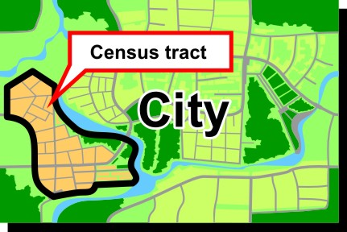
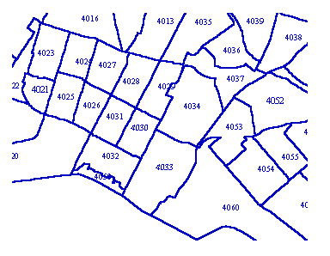
In the U.S., Census tracts are "Designed to be relatively homogeneous units with respect to population characteristics, economic status, and living conditions, census tracts average about 4,000 inhabitants."
Why are the tracts different sizes?

Slide 12
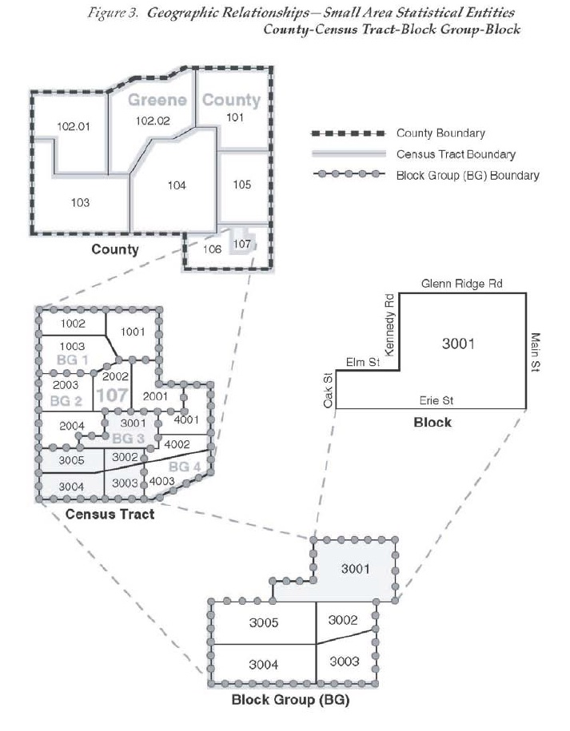
Nested Administrative Units
States
Counties
Census Tracts
Census Blocks
Census Tract is usually the most granular level of data provided by census
County
Census Tract
Block
Block Group

Slide 13
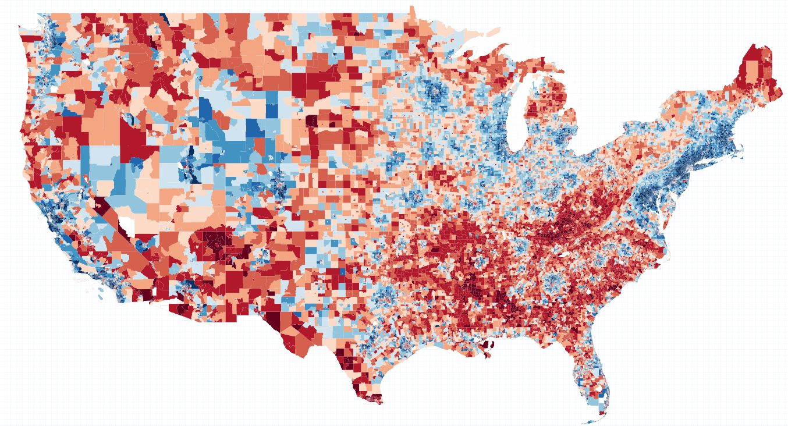
Example: Household Income by Census Tract

Slide 14
FIPS Code Structure
11-digit Geo ID Code
42003000102
42-003-0001.02
State
County
Census Tract

Slide 15
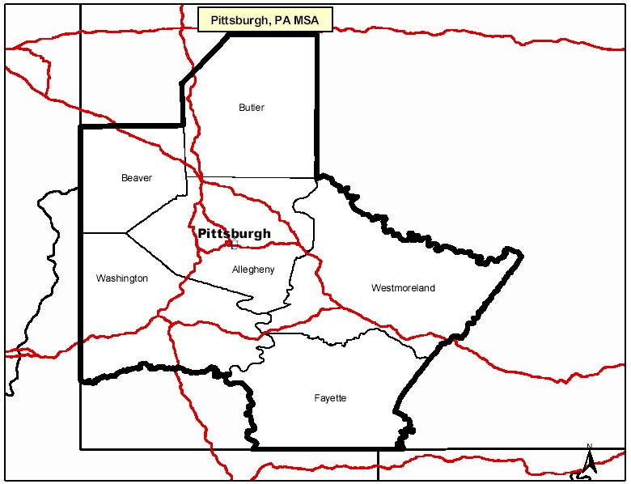
Which counties are in my MSA?
http://www.bea.gov/faq/index.cfm?faq_id=470
Pittsburgh, PA (Metropolitan Statistical Area)
Allegheny, PA [42003]
Beaver, PA [42007]
Butler, PA [42019]
Fayette, PA [42051]
Washington, PA [42125]
Westmoreland, PA [42129]
FIPS Code for Allegheny County (42003)
42 = Pennsylvania
003 = Allegheny County

Slide 16
shapefiles

Slide 17
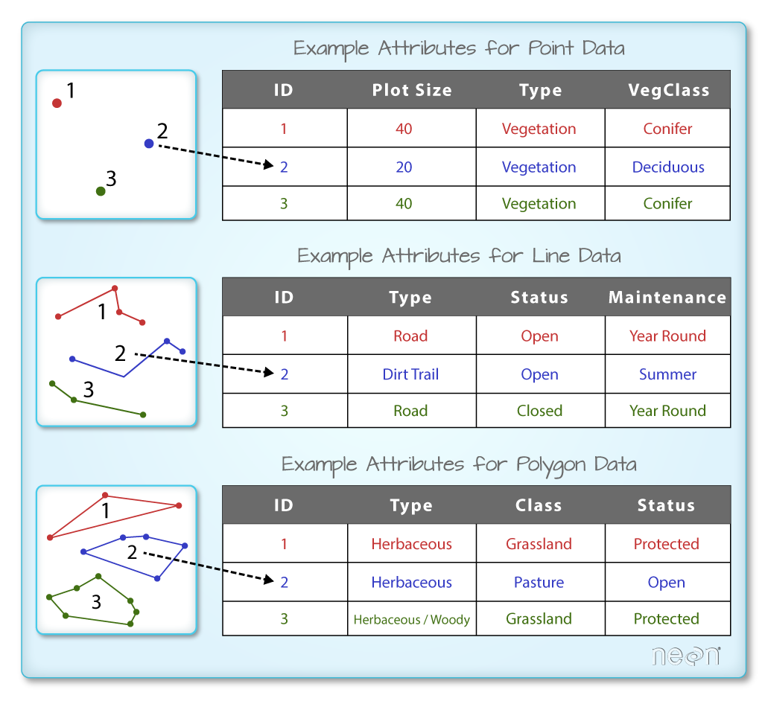
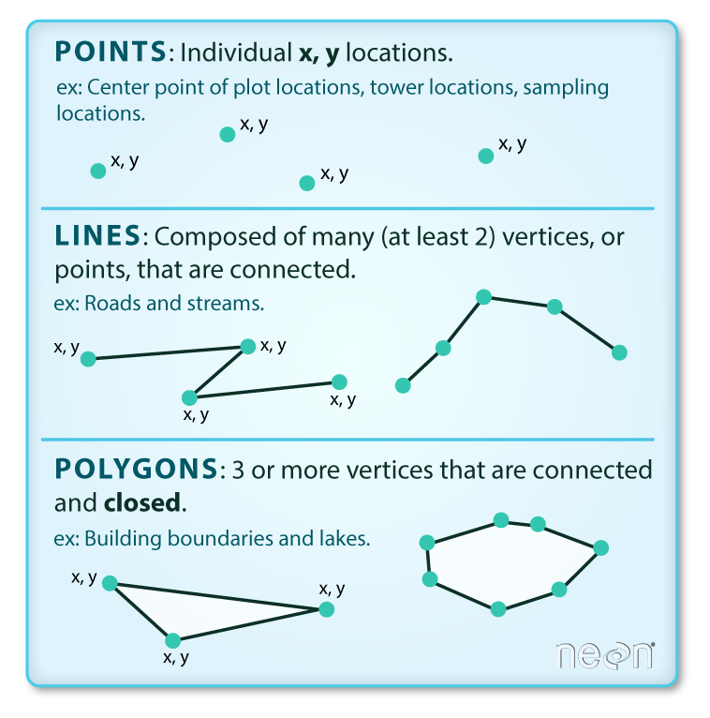
SOURCE: https://www.neonscience.org/dc-open-shapefiles-r

Slide 18
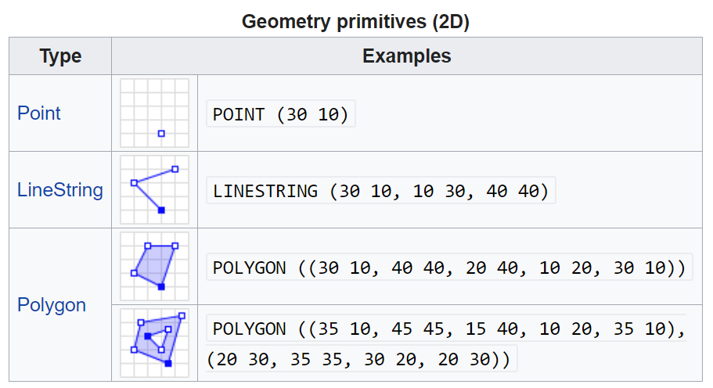
sf package: geometric “primitives” for spatial objects

Slide 19
> head(nc)
Simple feature collection with 6 features and 14 fields
geometry type: MULTIPOLYGON
dimension: XY
bbox: xmin: -81.74107 ymin: 36.07282 xmax: -75.77316 ymax: 36.58965
epsg (SRID): 4267
proj4string: +proj=longlat +datum=NAD27 +no_defs
AREA PERIMETER CNTY_ CNTY_ID NAME FIPS FIPSNO CRESS_ID BIR74
1 0.114 1.442 1825 1825 Ashe 37009 37009 5 1091
2 0.061 1.231 1827 1827 Alleghany 37005 37005 3 487
3 0.143 1.630 1828 1828 Surry 37171 37171 86 3188
4 0.070 2.968 1831 1831 Currituck 37053 37053 27 508
5 0.153 2.206 1832 1832 Northampton 37131 37131 66 1421
6 0.097 1.670 1833 1833 Hertford 37091 37091 46 1452
SID74 NWBIR74 BIR79 SID79 NWBIR79 geometry
1 1 10 1364 0 19 MULTIPOLYGON (((-81.47276 3...
2 0 10 542 3 12 MULTIPOLYGON (((-81.23989 3...
3 5 208 3616 6 260 MULTIPOLYGON (((-80.45634 3...
4 1 123 830 2 145 MULTIPOLYGON (((-76.00897 3...
5 9 1066 1606 3 1197 MULTIPOLYGON (((-77.21767 3...
6 7 954 1838 5 1237 MULTIPOLYGON (((-76.74506 3...
library(sf)
fname <- system.file("shape/nc.shp", package="sf")
fname
nc <- st_read(fname)
plot( nc )
head( nc )
class( nc )
class( nc$AREA )
class( nc$geometry )
nc$geometry[[1]]
st_write( nc, "nc.GeoJSON" )
file.show( "nc.GeoJSON" )
st_write( nc, "nc.csv" )
file.show( "nc.csv" )
# geometries have been dropped
> head( nc$geometry )
Geometry set for 6 features
geometry type: MULTIPOLYGON
dimension: XY
bbox: xmin: -81.74107 ymin: 36.07282
xmax: -75.77316 ymax: 36.58965
epsg (SRID): 4267
proj4string: +proj=longlat +datum=NAD27 +no_defs
First 5 geometries:
MULTIPOLYGON (((-81.47276 36.23436, -81.54084 3...
MULTIPOLYGON (((-81.23989 36.36536, -81.24069 3...
MULTIPOLYGON (((-80.45634 36.24256, -80.47639 3...
MULTIPOLYGON (((-76.00897 36.3196, -76.01735 36...
MULTIPOLYGON (((-77.21767 36.24098, -77.23461 3...

Slide 20
> head(nc)
Simple feature collection with 6 features and 14 fields
geometry type: MULTIPOLYGON
dimension: XY
bbox: xmin: -81.74107 ymin: 36.07282 xmax: -75.77316 ymax: 36.58965
epsg (SRID): 4267
proj4string: +proj=longlat +datum=NAD27 +no_defs
AREA PERIMETER CNTY_ CNTY_ID NAME FIPS FIPSNO CRESS_ID BIR74
1 0.114 1.442 1825 1825 Ashe 37009 37009 5 1091
2 0.061 1.231 1827 1827 Alleghany 37005 37005 3 487
3 0.143 1.630 1828 1828 Surry 37171 37171 86 3188
4 0.070 2.968 1831 1831 Currituck 37053 37053 27 508
5 0.153 2.206 1832 1832 Northampton 37131 37131 66 1421
6 0.097 1.670 1833 1833 Hertford 37091 37091 46 1452
SID74 NWBIR74 BIR79 SID79 NWBIR79 geometry
1 1 10 1364 0 19 MULTIPOLYGON (((-81.47276 3...
2 0 10 542 3 12 MULTIPOLYGON (((-81.23989 3...
3 5 208 3616 6 260 MULTIPOLYGON (((-80.45634 3...
4 1 123 830 2 145 MULTIPOLYGON (((-76.00897 3...
5 9 1066 1606 3 1197 MULTIPOLYGON (((-77.21767 3...
6 7 954 1838 5 1237 MULTIPOLYGON (((-76.74506 3...
Meta-Data
(type of spatial data, type of projection, etc.)
Regular
Data Frame
(e.g. census data)
sf Spatial
Objects
Component
(just another column in a spreadsheet)

Slide 21
Useful Conversions
https://cran.r-project.org/web/packages/sf/vignettes/sf2.html

Slide 22

PROJECTING Objects in the mirror may be less awkward than they appear

Slide 23
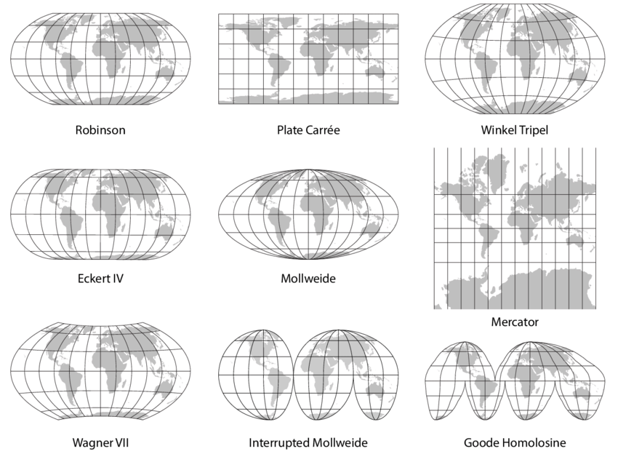
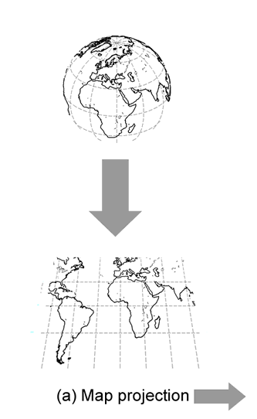

Slide 24
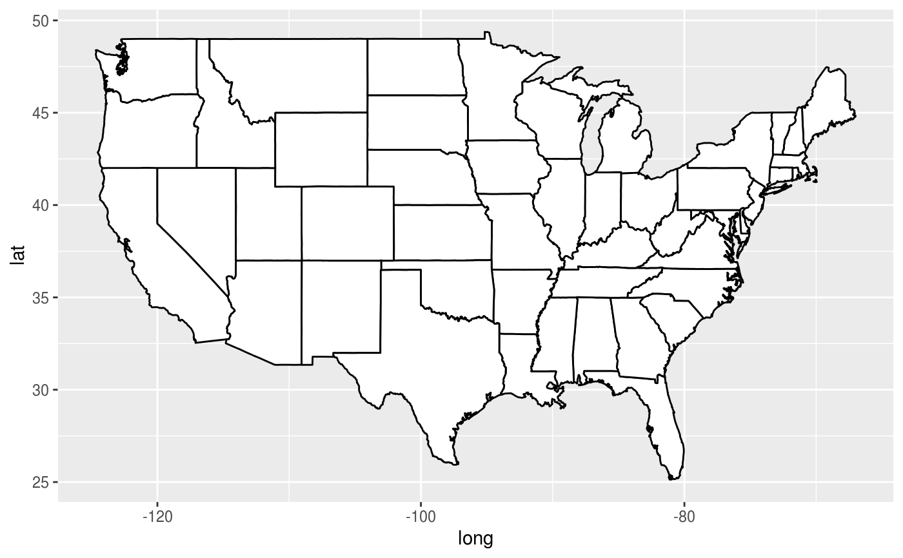
states <- map_data("state") usamap <- ggplot(states, aes(long, lat, group = group)) + geom_polygon(fill = "white", colour = "black")
# Use cartesian coordinates
usamap
https://ggplot2.tidyverse.org/reference/coord_map.html

Slide 25
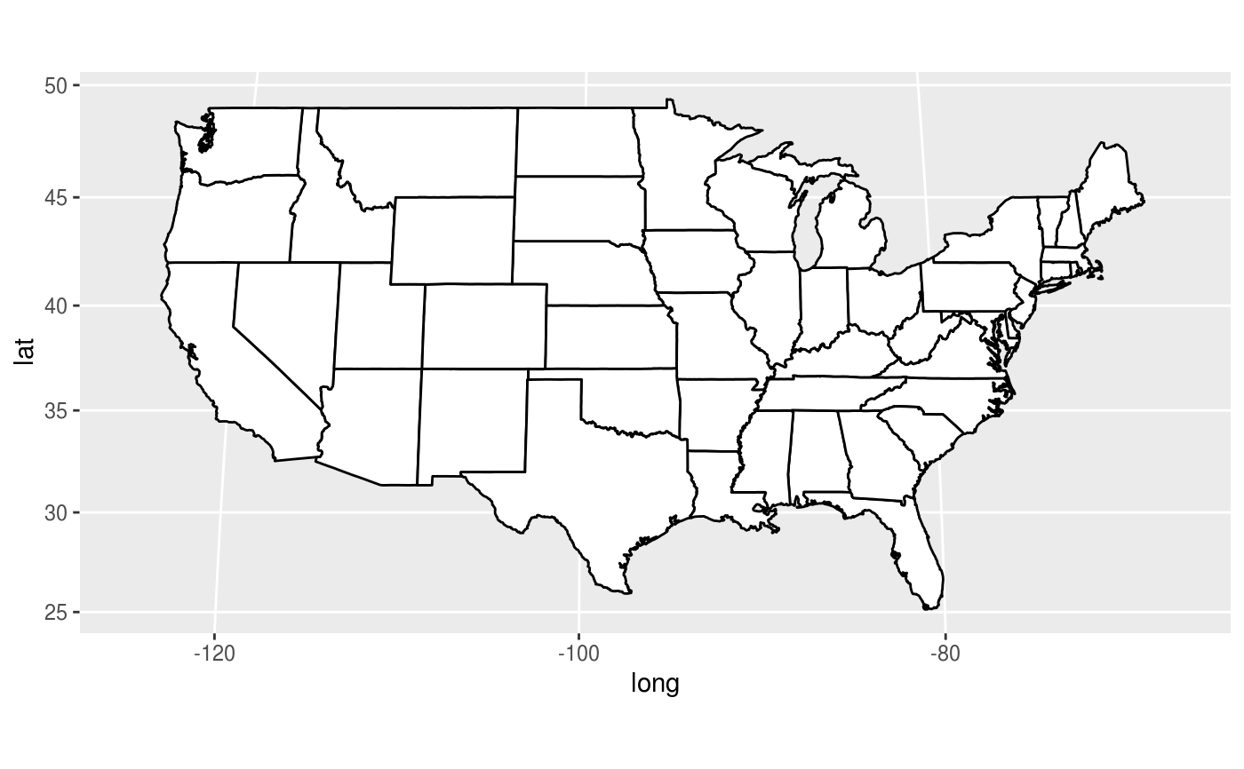
# Use gilbert projection
usamap + coord_map("gilbert")
https://ggplot2.tidyverse.org/reference/coord_map.html

Slide 26
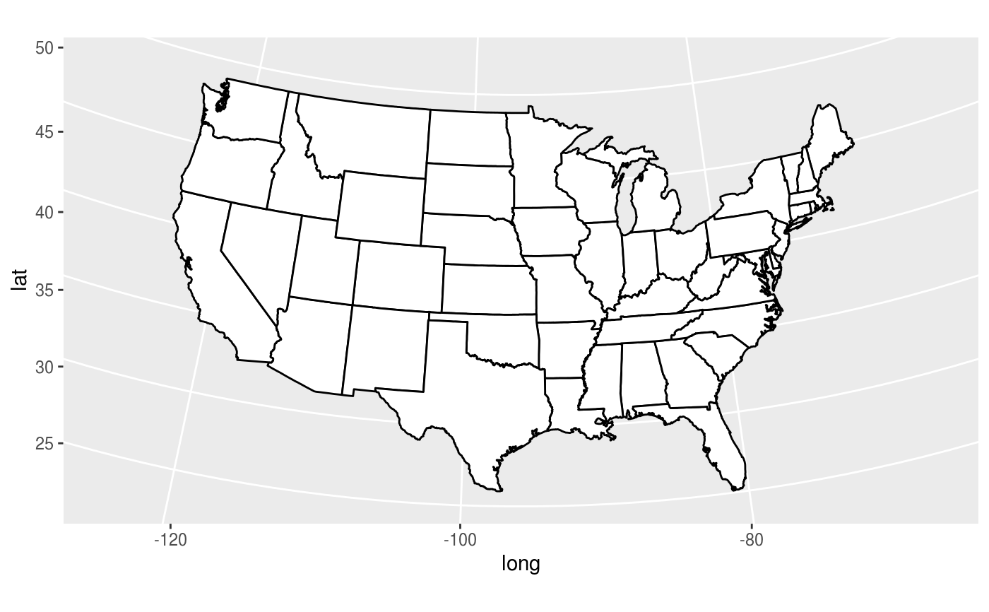
# Use conic projection
usamap + coord_map("conic", lat0 = 30)
https://ggplot2.tidyverse.org/reference/coord_map.html

Slide 27
longitudinal data

Slide 28
Longitudinal Files
Census tracts have between 2000 and 8000 households, 4000 is optimal from sampling frame perspective
New tracts created or old tracts merged if they grow or shrink
Some small changes made to boundaries each census
Tract FIPS: XXXX.XX 6-digit code for each tracts
Last two digits are 00 unless the tracts has been changed
For example, if tract 1234.00 is split it becomes 1234.01 and 1234.02
Longitudinal analysis uses apportionment to standardize data by a given year

Slide 29
Longitudinal Files: Apportionment
Longitudinal analysis uses apportionment to standardize data by a given year
Between 2000 and 2010 Tract 1234.00 is split 1234.01 is assigned 40% of old tract area 1234.02 is assigned 60% of old tract area
The two new tracts did not exist in 2000, so we have a hole in our dataset: We estimate the 2000 pop for 1234.01 as ( POP_{1234.00(year=2000)} )( 0.40 ) We estimate the 2000 pop for 1234.02 as ( POP_{1234.00(year=2000)} )( 0.60 )

