Slide 1
MEASURMENT
Theory

Slide 2
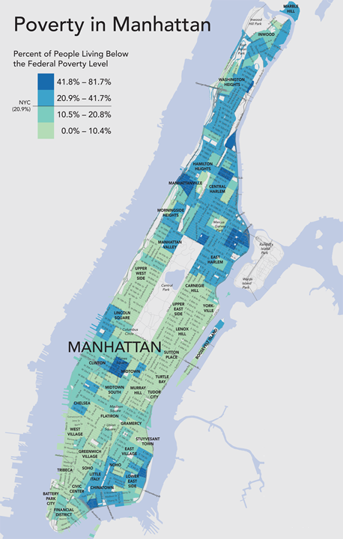
What does the poverty rate measure?
HARLEM ( 40% – 80% poverty )
CHINATOWN ( 40% – 80% poverty )

Slide 3
WHAT DOES THE POVERTY RATE TELL US ABOUT THE COMMUNITY? WHAT ARE WE MEASURING?
HARLEM ( 40% – 80% poverty )
CHINATOWN ( 40% – 80% poverty )

Slide 4
The Poverty Rate Hides a Lot:
Community A
Community B
1%
20%
25%
25%
25% 20%
1%

Slide 5
The Poverty Rate Hides a Lot:
Community A
Community B
20%
1%
25% 1%
25% 20%
24% Chronic Poverty
5% Chronic Poverty

Slide 6
NEIGHBORHOODS WITH SIMILAR RATES CAN BE VERY DIFFERENT
Mostly people born in the US. High rates of inter-generational poverty.
Many new immigrants that have few financial assets but strong social capital. Children have high mobility.

Slide 7
What does the poverty rate ACTUALLY measure?
Lack of money?
Lack of character, morals?
Lack of economic opportunity?
Limited access to healthcare?
Lack of education?
Lack of mobility?
Position in a caste?
Is a college student on a fixed budget poor?

Slide 8
If you could define a federal measure of poverty, HOW WOULD YOU CREATE A MEANINGFUL SCORE? WHAT TYPE OF POVERTY WOULD YOUR INDEX MEASURE?

Slide 9
If you could define a new federal measure of poverty, how would you improve it?
Dimensions:
Financial capital
Human capital
Social capital
Physical health
Public goods (if you have good parks, free libraries, public art do you need money?)

Slide 10
Theory of
Measurement

Slide 11
Types of Measures:
Direct Measures: # of Windshields Installed by a Factory Worker
Markers/Predictors: Direct measures that serve as proxies for correlates that are harder to measure
Latent Constructs: Intelligence (IQ test), Depression (Survey), Health (Survey)

Slide 12
Valid and reliable instruments:
What do we mean by an “instrument”?
What is measurement validity?
What is measurement reliability?

Slide 13
Instruments:
Direct Measures ← instruments are microscopes, spectrometers, and scales
Latent Constructs ← instruments are survey questions, observational protocols for coding data, standardized exams

Slide 14
Instrument
reliability

Slide 15
Valid and reliable instruments:
Latent Construct: Happiness
Instrument: Oxford Happiness Questionnaire:
1. I don’t feel particularly pleased with the way I am. (R) _____
2. I am intensely interested in other people. _____
3. I feel that life is very rewarding. _____
4. I have very warm feelings towards almost everyone. _____
5. I rarely wake up feeling rested. (R) _____
1 = strongly disagree
2 = moderately disagree
3 = slightly disagree
4 = slightly agree
5 = moderately agree
6 = strongly agree

Slide 16
Valid and reliable instruments:
Latent Construct: Good Dancer
Four-Item Survey Instrument:
Other people would say I am a good dancer.
I am athletic.
I am the first one on the dance floor.
My dance moves have been compared to Drake.

Slide 17
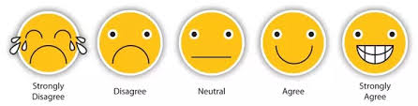
Valid and reliable instruments:
Latent Construct: Good Dancer
Other people would say I am a good dancer [0-4].
I am athletic [0-4].
I am the first one on the dance floor [0-4].
My dance moves have been compared to Drake [0-4].
Good Dancer Measure:
Scale of 0 to 16
Higher is Better
Scale = Instrument
0
1
2
3
4

Slide 18
Is the scale valid?
Latent Construct: Good Dancer
Four-Item Survey Instrument:
Other people would say I am a good dancer.
I am athletic.
I am the first one on the dance floor.
My dance moves have been compared to Drake.
Do we think these items will all measure the same latent construct?

Slide 19
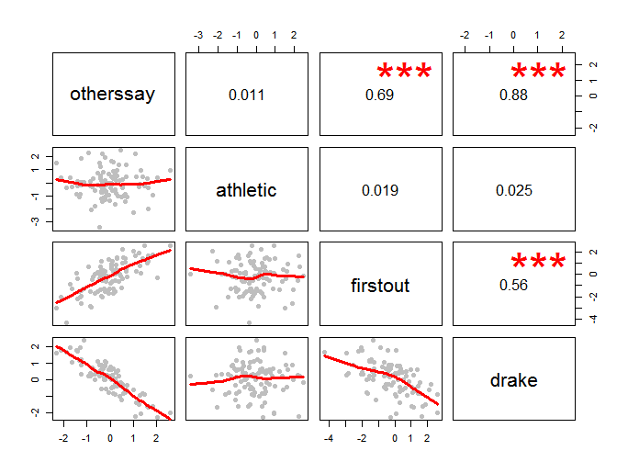
Correlation structure
Which of these are measuring the same thing?

Slide 20
Is the scale reliable?
Latent Construct: Good Dancer
Four-Item Survey Instrument:
Other people would say I am a good dancer.
I am athletic.
I am the first one on the dance floor.
My dance moves have been compared to Drake.
How consistently do these questions measure the same latent construct?

Slide 21
Cronbach's alpha is a measure of internal consistency, that is, how closely related a set of items are as a group.
It is considered to be a measure of scale reliability.

Slide 22

CRONBACH’S ALPHA SCORE MEASURE OF RELIABILITY [ 0, 1 ]
1.0
Excellent
0.9
Good
0.8
Acceptable
N = number of items
c-bar = average inter-item covariance
v-var = average variance per item
0.7
Questionable
0.6
Poor / Inadequate

Slide 23
reliable instruments:
α
1.0
Other people would say I am a good dancer.
I am athletic.
I am the first one on the dance floor.
My dance moves have been compared to Drake.
Excellent
0.9
α = 0.68
Good
0.8
Acceptable
0.7
Questionable
0.6
Poor / Inadequate

Slide 24
Correlation structure
Which of these are measuring the same thing?

Slide 25
reliable instruments:
α
1.0
Other people would say I am a good dancer.
I am athletic.
I am the first one on the dance floor.
My dance moves have been compared to Drake.
Excellent
0.9
α = 0.68
Good
0.8
Acceptable
0.7
Other people would say I am a good dancer.
I am athletic.
I am the first one on the dance floor.
My dance moves have been compared to Drake.
Questionable
α = 0.86
0.6
Poor / Inadequate

Slide 26
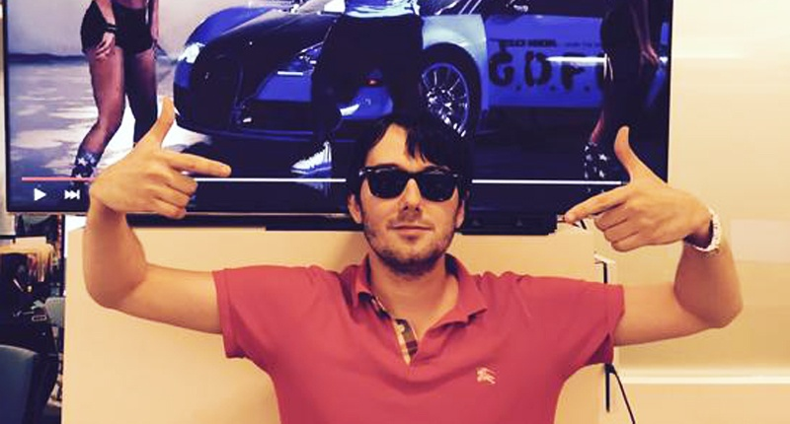
Bro Culture
Characterized by:
Entitlement
Disregard for others
Self-destructive behaviors
Closed-mindedness
Strong group cohesion
https://www.youtube.com/watch?v=VU3zuK7Zmrk

Slide 27
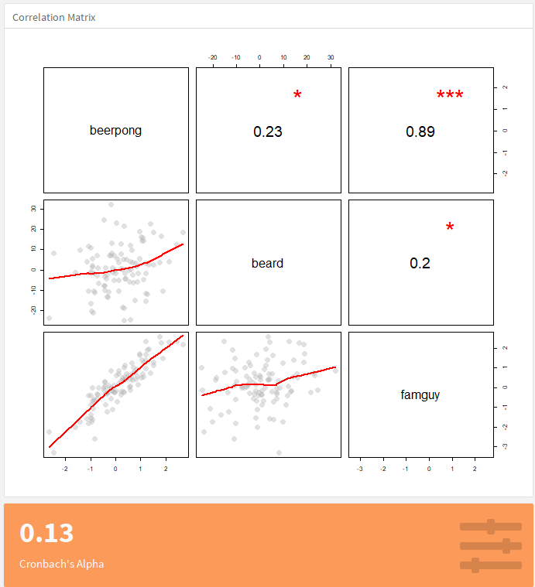
Correlation between Q1 and Q2 (1 star=low)
Q1
Correlation between Q1 and Q3 (3 stars=high)
Q2
Correlation between Q2 and Q3 (1 star=low)
People that like beer pong
also like The Family Guy
(responses are
highly-correlated)
Q3
Must be above 0.6 to be reliable

Slide 28
Survey items to identify bro culture:
Beer pong is a fun game to play at parties.
Salmon is a fine color for shorts.
Beards are repulsive.
Family Guy is a funny television show.
Michael Jackson is one of the best musicians ever.
Santacon is a great idea for a festival.
Strongly Disagree ← 1 2 3 4 5 → Strongly Agree

Slide 29
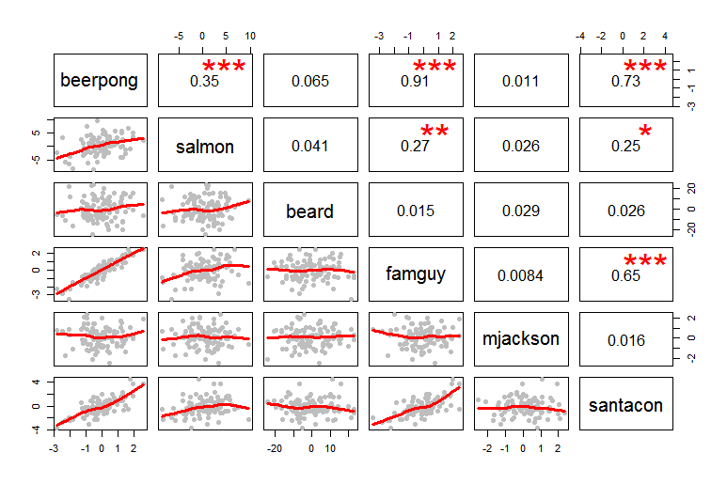
CORRELATION STRUCTURE OF SURVEY ITEMS

Slide 30
Cronbach’s alpha score:
α
1.0
Excellent
Beer pong is a fun game to play at parties.
Salmon is a fine color for shorts.
Beards are repulsive.
Family Guy is a funny television show.
Michael Jackson is one of the best musicians ever.
Santacon is a great idea for a festival.
0.9
Good
0.8
Acceptable
0.7
Questionable
0.6
α = 0.16
Poor / Inadequate

Slide 31
CORRELATION STRUCTURE OF SURVEY ITEMS

Slide 32
Cronbach’s alpha score:
Beer pong is a fun game to play at parties.
Salmon is a fine color for shorts.
Beards are repulsive.
Family Guy is a funny television show.
Michael Jackson is one of the best musicians ever.
Santacon is a great idea for a festival.
α = 0.61

Slide 33
CRONBACH’S ALPHA SCORE MEASURE OF RELIABILITY [ 0, 1 ]
1.0
Excellent
0.9
Good
0.8
Acceptable
N = number of items
c-bar = average inter-item covariance
v-var = average variance per item
0.7
Questionable
0.6
Poor / Inadequate

Slide 34
CORRELATION STRUCTURE OF SURVEY ITEMS

Slide 35
Cronbach’s alpha score:
Beer pong is a fun game to play at parties.
Salmon is a fine color for shorts.
Beards are repulsive.
Family Guy is a funny television show.
Michael Jackson is one of the best musicians ever.
Santacon is a great idea for a festival.
α = 0.89

Slide 36
examples

Slide 37
Progress out of poverty index
Grameen Bank: How does the Progress out of Poverty Index (PPI) work?
Unlike other poverty measurement methods, the PPI was designed with the budgets and operations of real organizations in mind; its simplicity means that it requires fewer resources to use.
The PPI is a set of 10 easy-to-answer questions that a household member can answer in 5 to 10 minutes. The questions are simple – “What material is your roof made out of? How many of your children are in school?”
The scored answers provide the likelihood that the survey respondent’s household is living below the national poverty line and other internationally-recognized poverty lines. The PPI is country-specific. There are PPIs for 45 countries
http://www.progressoutofpoverty.org/about-ppi

Slide 38
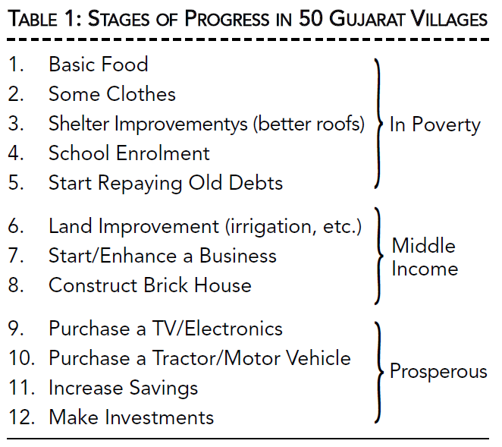
Krishna: stages of progress

Slide 39
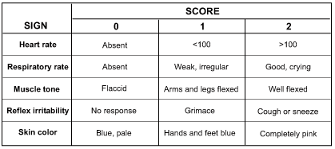
The apgar score
Scale of 0 to 10, measured right after birth, and 5 minutes later.

Slide 40
The politics of
Measurement
(aside)

Slide 41
Measurement is inherently political
Challenges:
What if we can’t measure what we care about?
Time and money spent on data collection.
Perverse Incentives “Multi-tasking” – what get’s measured gets done, but at a price of other activities. Creaming – not providing services to the poorest / hardest cases.
Poor Counterfactuals (evaluation capacity)
Fatigue from Multiple Stakeholders

Slide 42

HUMANS OF NEW YORK
“I decided to become a teacher because I knew what it was like to grow up poor, and I wanted to help kids in similar circumstances. I didn’t expect it to be easy. But I guess I thought there’d be only one or two kids acting up in class, and everyone else would be paying attention. Instead it’s only one or two kids who actually behave. I’m drained every day. I’ve been teaching for thirteen years. And if it wasn’t for summer break, I’d have quit already.
Forty percent of my job rating is based on standardized testing. It’s the only job I know where your performance is based on how other people behave. I can’t control what’s going on outside my classroom. I can’t control if my kids are from abusive households, or don’t eat breakfast, or can’t get to school on time. But those things affect my rating when they show up in test scores. I need to find a new career where my performance is based on me.”

Slide 43
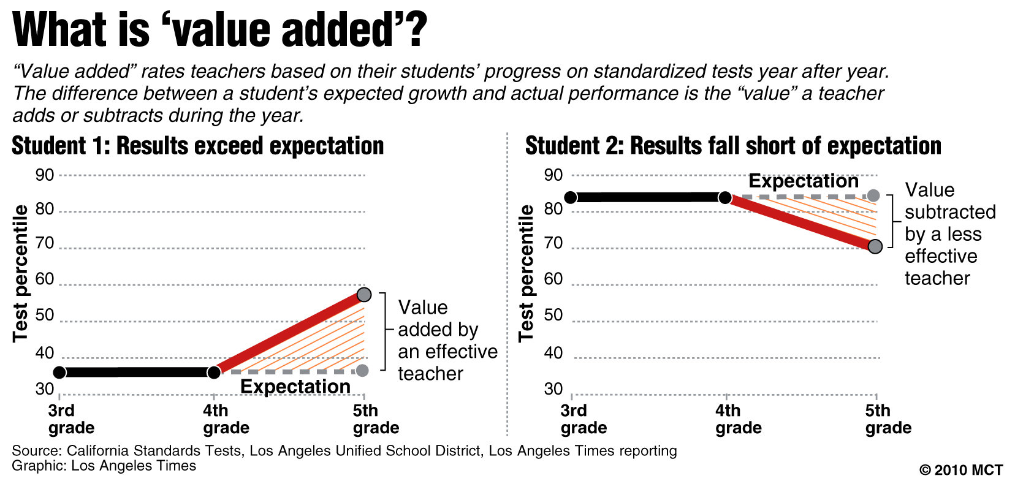
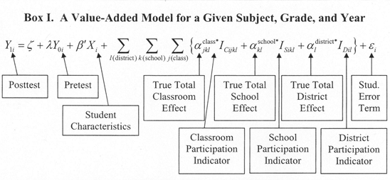
See Weapons of Math Destruction for examples of how metrics have been weaponized in public agencies

Slide 44
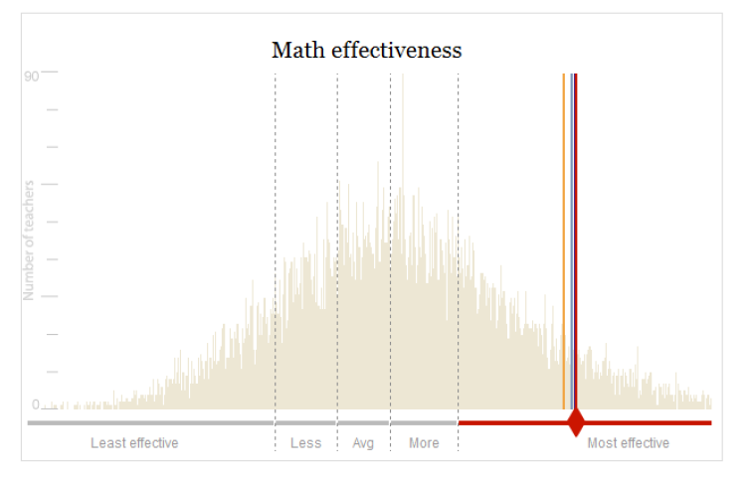
Comparing teacher “effects”

Slide 45
Performance or punishment?
The focusing effects of outcome benchmarks, the pressures of competition, the prospects of incurring a reward or penalty, the awareness that one is being closely monitored: these features of performance management do more than just make agents accountable; they reshape agency itself.
Indeed, performance management is disciplinary, not just in the sense that it involves the allocation of penalties, but also in the deeper sense suggested by Michel Foucault: the use of organized techniques to produce self-regulating subjects (i.e., service providers) who, under conditions of apparent autonomy, conduct themselves in ways that are consonant with prevailing institutions, values, and interests.
~The Organization of Discipline, p2

Slide 46
Performance or punishment?
The beginning of the twenty first century finds us in an era of governance by performance management and nowhere is this more the case than in welfare programs for the poor. By establishing outcome benchmarks focused on work participation and placement, federal and state officials define the goals of service provision and the terms of its evaluation. Choice sets for local actors consist primarily of alternative means toward mandated ends. With these benchmarks in place, sophisticated information systems are used to monitor frontline activities and measure priority outcomes. And based on the outcomes of performance competition, financial rewards and penalties are distributed to incent preferred behaviors and bring lagging service providers to heel. In welfare-to-work programs, performance systems now serve as the core technology for monitoring contract compliance; they guide decisions about when to renew or terminate contracts with local providers; they provide state officials with a yardstick and a prod for the achievement of program goals; and they constitute the major way in which state TANF programs are evaluated by federal officials.
~The Organization of Discipline, p2

Slide 47
Performance or punishment?
Proponents rarely conceptualize performance management as a system of discipline. In celebratory rhetoric, it is presented as a way to harness the dynamic energies of markets, improve the evidentiary basis for policy choices, and reconcile policy experimentation with public accountability. The implicit promise is that local actors will be “freed” to go their own ways and then, later, will be judged by their performance and given the information they need to improve. The reality, however, entails a more complex interplay of structure and agency.
~The Organization of Discipline, p2

