Slide 1
Cluster Analysis: Basic Concepts and Methods

Slide 2
Agenda
Cluster Analysis: Basic Concepts
Partitioning Methods
Hierarchical Methods
Model-Based Methods

Slide 3
What is Cluster Analysis?
Cluster analysis (or clustering, data segmentation, …)
  Groups similar data objects into clusters
  Reveal hidden patterns in the data
Cluster:
  similar (or related) to one another within the same group
  dissimilar (or unrelated) to the objects in other groups
Unsupervised learning: no predefined classes (i.e., learning by observations vs. learning by examples: supervised)

Slide 4
Clustering for Data Understanding and Applications
Biology: taxonomy of living things
Information retrieval: document clustering
Land use: Identification of areas of similar land use
Marketing: Help marketers discover distinct groups in their customer bases, and then use this knowledge to develop targeted marketing programs
City-planning: Identifying groups of houses according to their house type, value, and geographical location
Climate: understanding earth climate, find patterns of atmospheric and ocean
Economic Science: market research

Slide 5
Simple Example of Clustering
Cluster to define market segments
  Small Dataset on Costco Customers
Two Variables
  customer satisfaction (CSAT)
    Likert Scale (1 = very dissatisfied; 9 = very satisfied)
  “loyalty” metric
    Likert Scale (1 = low loyalty; 9 = high loyalty)

Slide 6
Simple Example of Clustering
Scatterplot of customer database.
  Red squares: scores of the individual customers
  Large red circle is the average score
    CSAT (average = 5.05)
    loyalty (average = 5.85)

Slide 7
Simple Example of Clustering
How many clusters do we see?
  3 clusters (segments) of consumers suggested by the data.
How do we interpret clusters?
  Black circle: loyal customers, with a high level of CSAT.
  Blue circle: less loyal customers, with a lower level of CSAT.
  Red circle: largely unsatisfied, yet loyal customers.

Slide 8
Quality: What Is Good Clustering?
The quality of a clustering method depends on
  Its ability to discover some or all of the hidden patterns
  There is usually a separate “quality” function that measures the “goodness” of a cluster.
  It is hard to define “similar enough” or “good enough”
    The answer is typically highly subjective

Slide 9
Major Clustering Approaches (I)
Partitioning approach:
  Construct various partitions and then evaluate them by some criterion, e.g., minimizing the sum of square errors
  Typical methods: k-means, k-medoids, CLARANS
Hierarchical approach:
  Create a hierarchical decomposition of the set of data (or objects) using some criterion
  Typical methods: Diana, Agnes, BIRCH, CAMELEON
Density-based approach:
  Based on connectivity and density functions
  Typical methods: DBSACN, OPTICS, DenClue
Grid-based approach:
  based on a multiple-level granularity structure
  Typical methods: STING, WaveCluster, CLIQUE

Slide 10
Major Clustering Approaches (II)
Model-based:
  A model is hypothesized for each of the clusters and tries to find the best fit of that model to each other
  Typical methods: EM, SOM, COBWEB
Frequent pattern-based:
  Based on the analysis of frequent patterns
  Typical methods: p-Cluster
User-guided or constraint-based:
  Clustering by considering user-specified or application-specific constraints
  Typical methods: COD (obstacles), constrained clustering
Link-based clustering:
  Objects are often linked together in various ways
  Massive links can be used to cluster objects: SimRank, LinkClus

Slide 11
Agenda
Cluster Analysis: Basic Concepts
Partitioning Methods
Hierarchical Methods
Model-Based Methods

Slide 12

Partitioning Algorithms: Basic Concept
Partitioning method: Partitioning a database D of n objects into a set of k clusters, such that the sum of squared distances is minimized (where c_{i} is the centroid or medoid of cluster C_{i})
Given k, find a partition of k clusters that optimizes the chosen partitioning criterion
  Global optimal: exhaustively enumerate all partitions
  Heuristic methods: k-means and k-medoids algorithms
  k-means (MacQueen’67, Lloyd’57/’82): Each cluster is represented by the center of the cluster
  k-medoids or PAM (Partition around medoids) (Kaufman & Rousseeuw’87): Each cluster is represented by one of the objects in the cluster

Slide 13
The K-Means Clustering Method
Given k, the k-means algorithm is implemented in four steps:
  Partition objects into k nonempty subsets
  Compute seed points as the centroids of the clusters of the current partitioning (the centroid is the center, i.e., mean point, of the cluster)
  Assign each object to the cluster with the nearest seed point
  Iterate, and stop when the assignment does not change

Slide 14





An Example of K-Means Clustering
K=2
Arbitrarily partition objects into k groups
Update the cluster centroids
The initial data set
Loop if needed
Reassign objects
Partition objects into k nonempty subsets
Repeat
  Compute centroid (i.e., mean point) for each partition
  Assign each object to the cluster of its nearest centroid
Until no change
Update the cluster centroids

Slide 15
Comments on the K-Means Method
Strength: Efficient: O(tkn), where n is # objects, k is # clusters, and t is # iterations. Normally, k, t << n.
Comment: Often terminates at a local optimal.
Weakness
  Need to specify k, the number of clusters, in advance (there are ways to automatically determine the best k (see Hastie et al., 2009)
  Sensitive to noisy data and outliers

Slide 16
Agenda
Cluster Analysis: Basic Concepts
Partitioning Methods
Hierarchical Methods
Model-Based Methods

Slide 17
Hierarchical Structures
Hierarchical structures often exist naturally among objects (e.g., taxonomy of animals)
A hierarchical structure of products in Walmart
All
grocery
electronics
apparel
TV
DVD
camera

Slide 18
Dendrogram: Shows How Clusters are Merged
  Decompose data objects into a several levels of nested partitioning (tree of clusters), called a dendrogram. Cluster data objects by cutting the dendrogram at the desired level

Slide 19
Distance between Clusters
X
X
Single link: smallest distance between an element in one cluster and an element in the other, i.e., dist(K_{i}, K_{j}) = min(t_{ip}, t_{jq})
Complete link: largest distance between an element in one cluster and an element in the other, i.e., dist(K_{i}, K_{j}) = max(t_{ip}, t_{jq})
Average: avg distance between an element in one cluster and an element in the other, i.e., dist(K_{i}, K_{j}) = avg(t_{ip}, t_{jq})
Centroid: distance between the centroids of two clusters, i.e., dist(K_{i}, K_{j}) = dist(C_{i}, C_{j})
Medoid: distance between the medoids of two clusters, i.e., dist(K_{i}, K_{j}) = dist(M_{i}, M_{j})
  Medoid: a chosen, centrally located object in the cluster

Slide 20

AGNES (Agglomerative Nesting)
Introduced in Kaufmann and Rousseeuw (1990)
Implemented in statistical packages, e.g., Splus
Use the single-link method and the dissimilarity matrix
Merge nodes that have the least dissimilarity
Go on in a non-descending fashion
Eventually all nodes belong to the same cluster

Slide 21
Agenda
Cluster Analysis: Basic Concepts
Partitioning Methods
Hierarchical Methods
Model-Based Methods

Slide 22
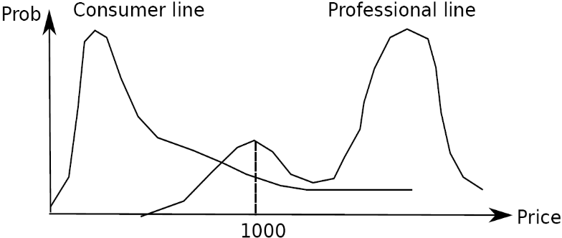
Model-Based Clustering
Cluster analysis is to find hidden categories.
A hidden category (i.e., probabilistic cluster) is a distribution over the data space, which can be mathematically represented using a probability density function (or distribution function).
Ex. categories for digital cameras sold
  consumer line vs. professional line
  density functions f₁, f₂ for C₁, C₂
  obtained by probabilistic clustering
A mixture model assumes that a set of observed objects is a mixture of instances from multiple probabilistic clusters, and conceptually each observed object is generated independently
Our task: infer a set of k probabilistic clusters that is mostly likely to generate D using the same data generation process

Slide 23

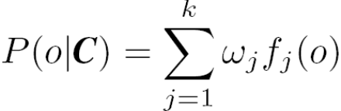
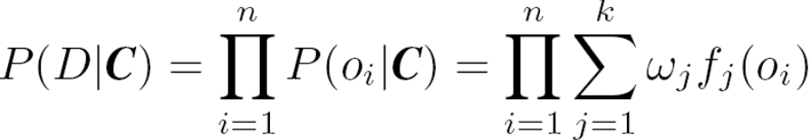
Model Setup
A set C of k probabilistic clusters C₁, …,C_{k} with probability density functions f₁, …, f_{k}, respectively, and their probabilities ω₁, …, ω_{k}.
Probability of an object o generated by cluster C_{j} is
Probability of o generated by the set of cluster C is
Since objects are assumed to be generated independently, for a data set D = {o₁, …, o_{n}}, we have,
Task: Find a set C of k probabilistic clusters s.t. P(D|C) is maximized
To make it computationally feasible (as a compromise), assume the probability density functions being some parameterized distributions

Slide 24
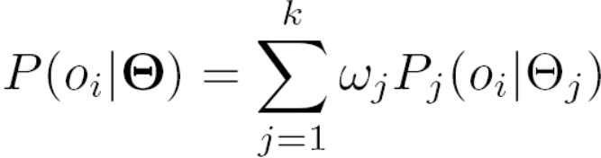
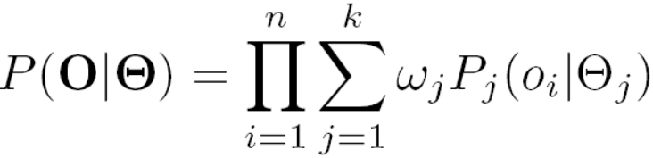
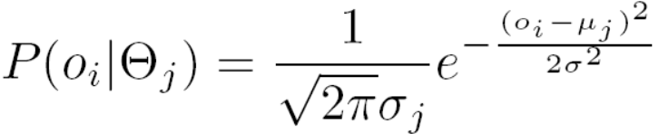
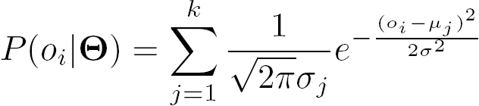
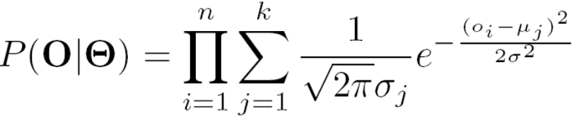
Univariate Gaussian Mixture Model
O = {o₁, …, o_{n}} (n observed objects), Θ = {θ₁, …, θ_{k}} (parameters of the k distributions), and P_{j}(o_{i}| θ_{j}) is the probability that o_{i} is generated from the j-th distribution using parameter θ_{j}, we have
Univariate Gaussian mixture model
  Assume the probability density function of each cluster follows a 1-d Gaussian distribution. Suppose that there are k clusters.
  The probability density function of each cluster are centered at μ_{j} with standard deviation σ_{j}, θ_{j}, = (μ_{j}, σ_{j}), we have

Slide 25
The EM (Expectation Maximization) Algorithm
The (EM) algorithm: A framework to approach maximum likelihood or maximum a posteriori estimates of parameters in statistical models.
  E-step assigns objects to clusters according to the current fuzzy clustering or parameters of probabilistic clusters
  M-step finds the new clustering or parameters that maximize the sum of squared error (SSE) or the expected likelihood

Slide 26
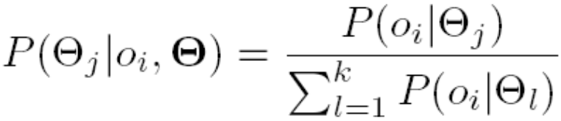
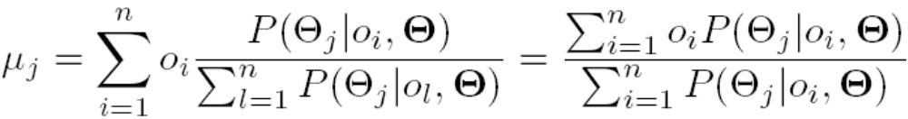
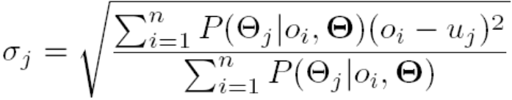
Computing Mixture Models with EM
Given n objects O = {o₁, …, o_{n}}, we want to mine a set of parameters Θ = {θ₁, …, θ_{k}} s.t.,P(O|Θ) is maximized, where θ_{j} = (μ_{j}, σ_{j}) are the mean and standard deviation of the j-th univariate Gaussian distribution
We initially assign random values to parameters θ_{j}, then iteratively conduct the E- and M- steps until converge or sufficiently small change
At the E-step, for each object o_{i}, calculate the probability that o_{i} belongs to each distribution,
At the M-step, adjust the parameters θ_{j} = (μ_{j}, σ_{j}) so that the expected likelihood P(O|Θ) is maximized

Slide 27
Summary
A good clustering method will produce high quality clusters
  high intra-class similarity: cohesive within clusters
  low inter-class similarity: distinctive between clusters
Clustering algorithms can be categorized into partitioning methods, hierarchical methods, density-based methods, grid-based methods, and model-based methods

