Slide 1
visual narrative

Slide 2
Your data tells a story

Slide 3
Does your visual narrative match your actual narrative?

Slide 4
Issue 01:
Geographic Units
and Proportionality

Slide 5
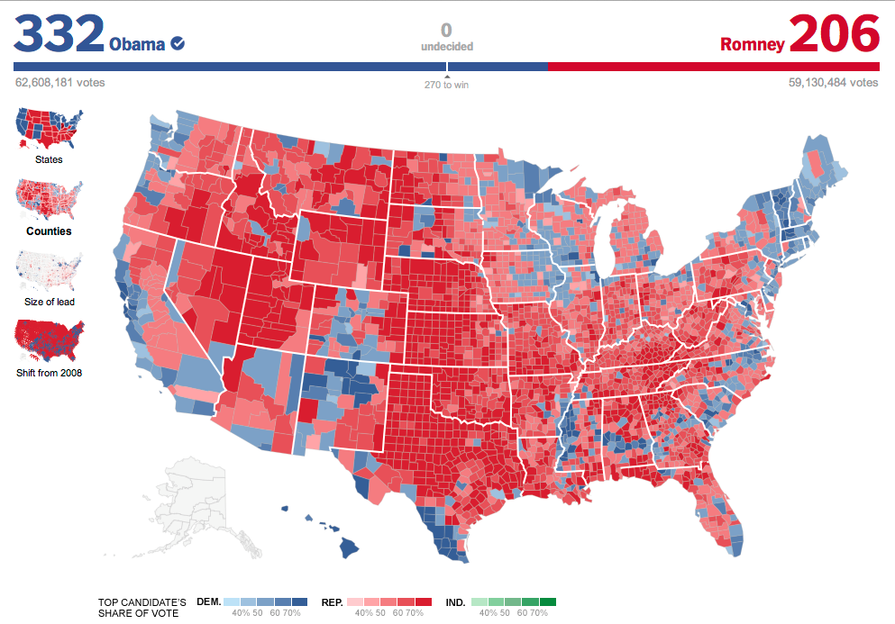
Intended narrative: one party won the election with more votes.
According to your map who won the election? RED is dominant

Slide 6
Land does vote, people vote. PROBLEM: you are visualizing land.

Slide 7
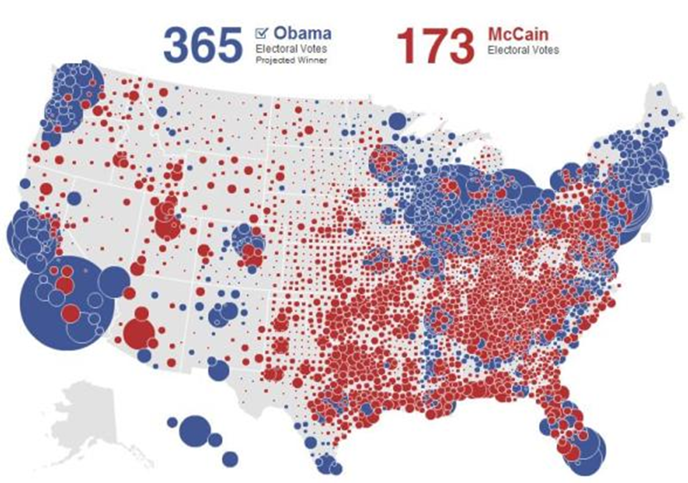
This is what a visualization of people looks like.

Slide 8
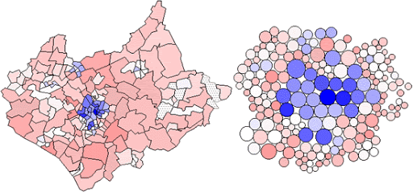
The problem with choropleth maps:
When population density varies spatially then simply coloring geographic units like census tracts is extremely misleading. They will over-emphasize people in rural areas and hide people in dense urban areas.
Census tracts are designed to contain approximately 2 to 4 thousand people. Thus the denser the neighborhood the smaller they are. The brain associates size with importance. The choropleth map on the left makes the blue group look like a small minority of all people and thus unimportant. Dorling Cartograms present a more accurate narrative by scaling geographies by population to correctly represent group proportionality.

Slide 9
RESOLUTION: If you are presenting data about populations, make sure your data viz tells the story of the people and not the land. Most choropleth maps using Census data are presenting a narrative about people, so make sure your visual narrative is not misleading!

Slide 10
Issue 02:
Grouping Data

Slide 11
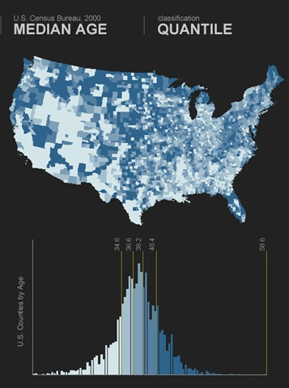
Binning data
Binning data is the process of converting a continuous variable into a factor by selecting the number of groupings you would like displayed and then identifying corresponding cut points for the bins.

Slide 12
BIN
Cut points defined by quantile rule: each bin contains 20% of the data
# identify cut points
bin.vals <- quantile( x, prob=c( 0,0.2,0.4,0.6,0.8,1 ) )
cut( x, breaks=bin.vals )
(these are percentiles)

Slide 13
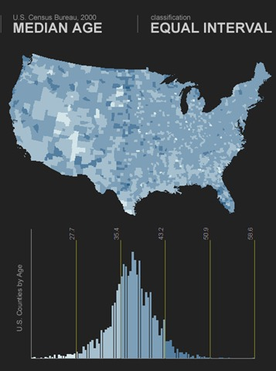
BIN
Cut points with equal interval rule: each bin is equal size
# cut() determines cut points by
cut( x, breaks=5 )

Slide 14
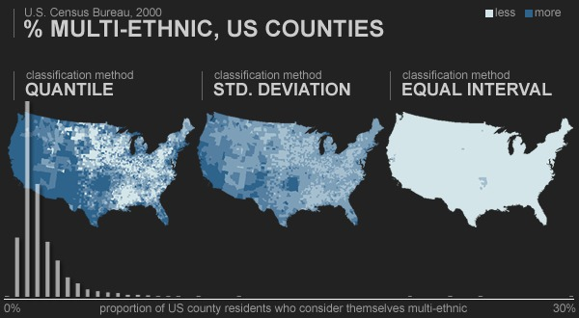
Hiding data with poor binning
No variation on the map – visual narrative is that everyone is the same across all geographies
All of the data
None of the data
Outliers in
skewed data

Slide 15
Hiding data with poor binning
MODE
In skewed data think about the “average” case as the modal case
Emphasize this variance
minimize this variance

Slide 16
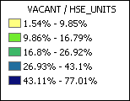
BINNING data
Process of placing data into groups (classes or bins) that have a similar characteristics or values
Break points
Breaks the total attribute range up into these intervals
Keep the number of intervals as small as possible (5-7)
Use a mathematical progression or formula instead of picking arbitrary values
Break
points

Slide 17
SELECTING MEANINGFUL BREAK POINTS
Quantiles
Places the same number of data values in each class
Will never have empty classes or classes with too few or too many values
Attractive in that this method produces distinct map patterns
Analysts use because they provide information about the shape of the distribution.
Example: 0–25%, 25%–50%, 50%–75%,75%–100%
Notes:
http://en.wikipedia.org/wiki/Data_classification

Slide 18
SELECTING MEANINGFUL BREAK POINTS
Equal intervals
Divides a set of attribute values into groups that contain an equal range of values
Best communicates with continuous set of data
Easy to accomplish and read
Not good for clustered data
Produces map with many features in one or two classes and some classes with no features

Slide 19
SELECTING MEANINGFUL BREAK POINTS
Increasing interval widths
Long-tailed distributions
Data distributions deviate from a bell-shaped curve and most often are skewed to the right with the right tail elongated
Example: Keep doubling the interval of each category, 0–5, 5–15, 15–35, 35–75 have interval widths of 5, 10, 20, and 40.

Slide 20
SELECTING MEANINGFUL BREAK POINTS
Exponential scales
Popular method of increasing intervals
Use break values that are powers such as 2^{n} or 3^{n}
Generally start out with zero as an additional class if that value appears in your data
Example: 0, 1–2, 3–4, 5–8, 9–16, and so forth

Slide 21
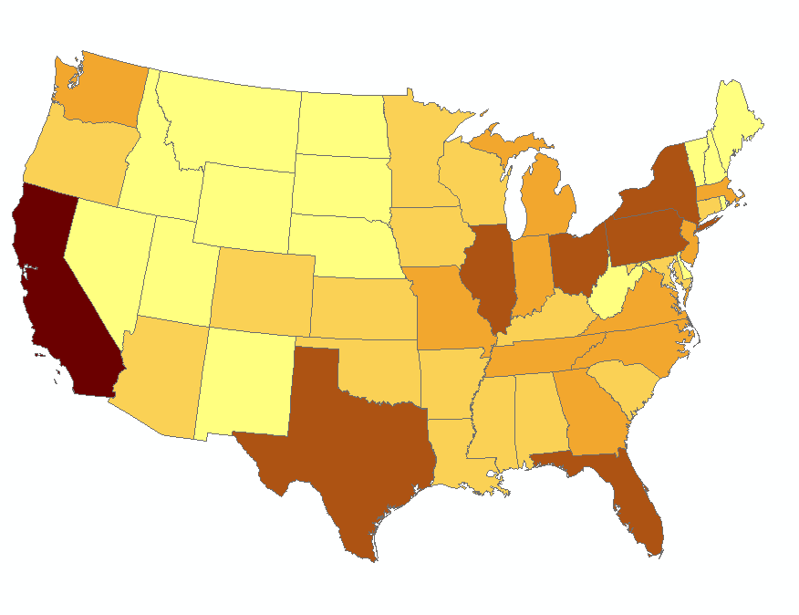
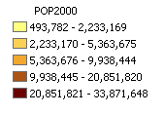
Original map (natural breaks)
U.S. population by state, 2000

Slide 22
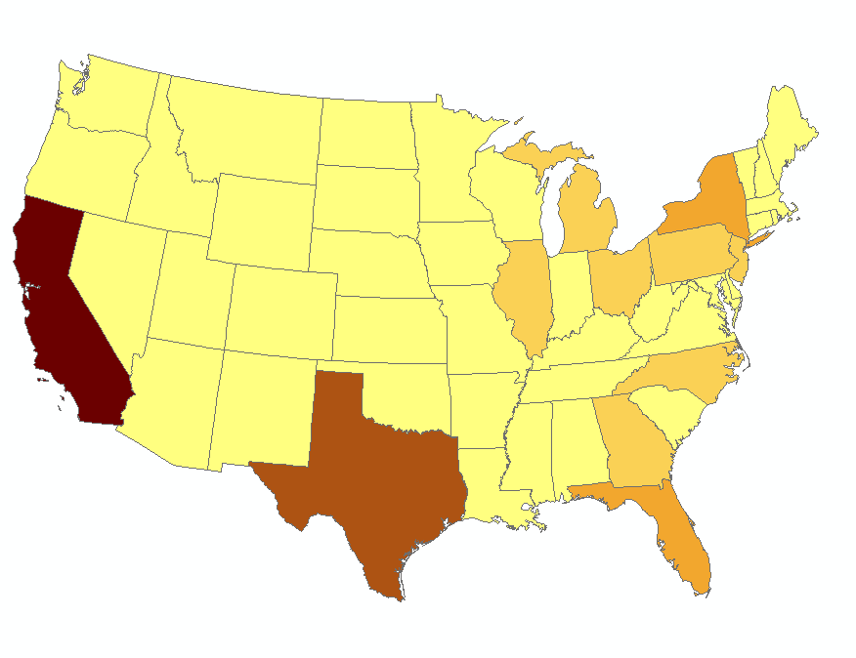
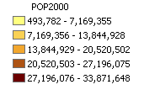
Equal interval scale
Not good because too many values fall into low classes

Slide 23
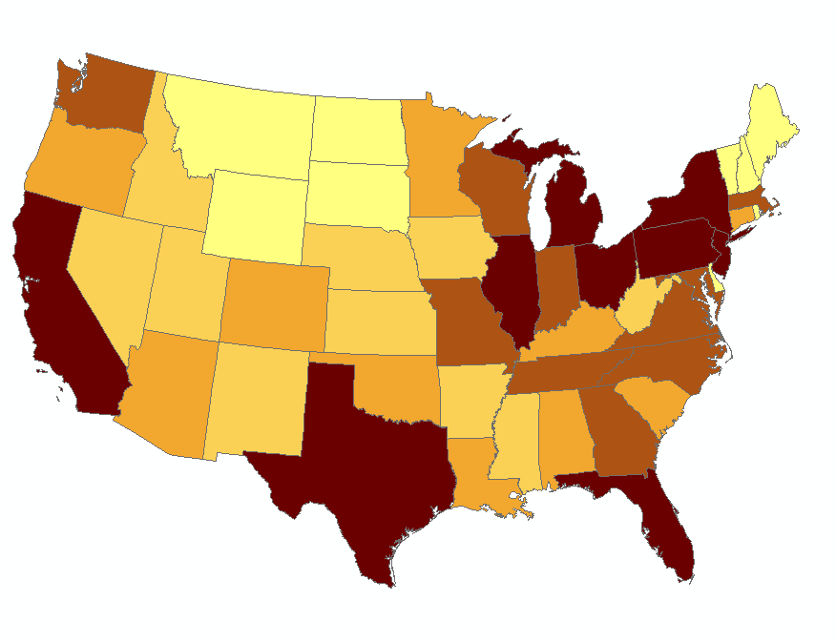
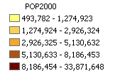
Quantile scale
Shows that an increasing width (geometric) scale is needed

Slide 24
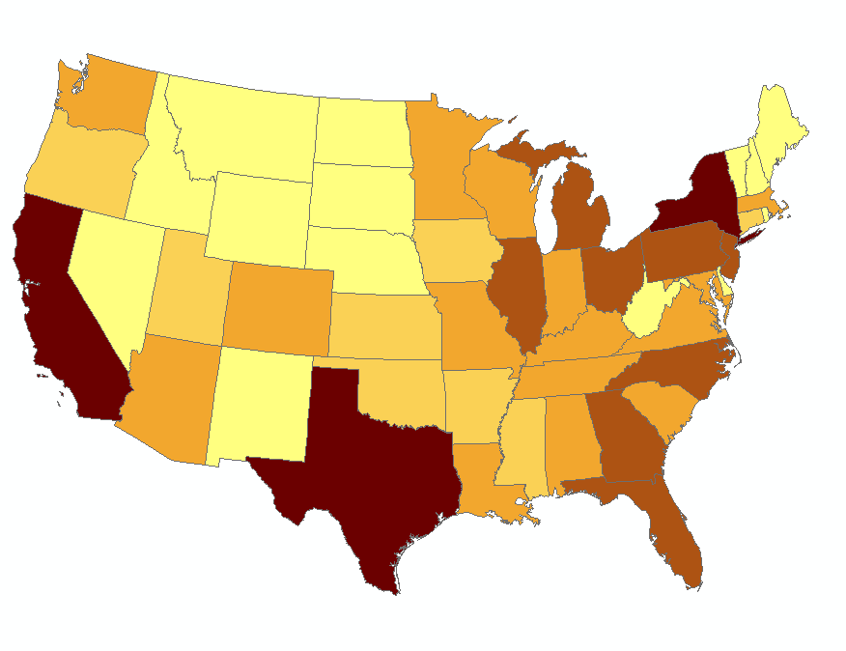
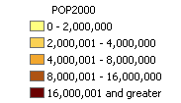
Custom geometric scale
Experiment with exponential scales with powers of 2 or 3.

Slide 25
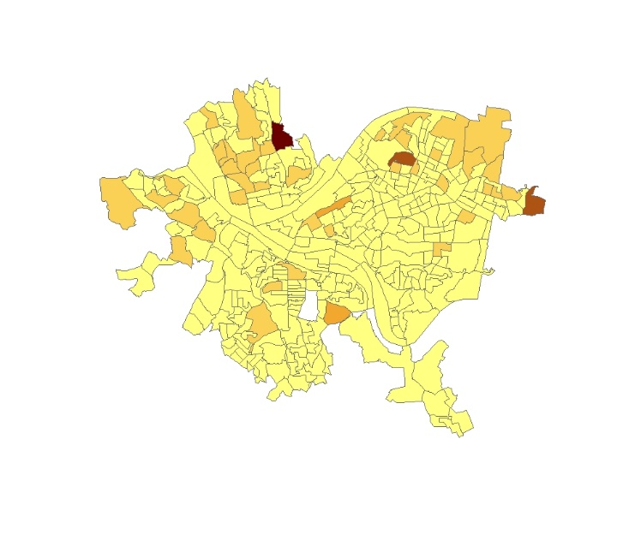
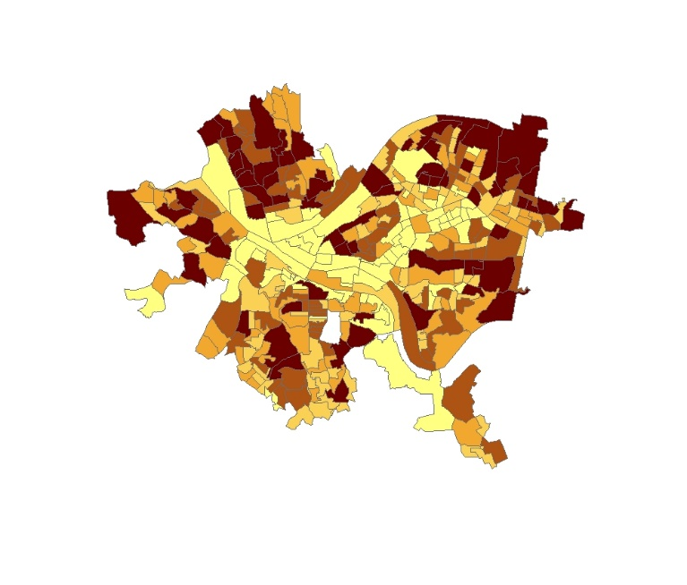
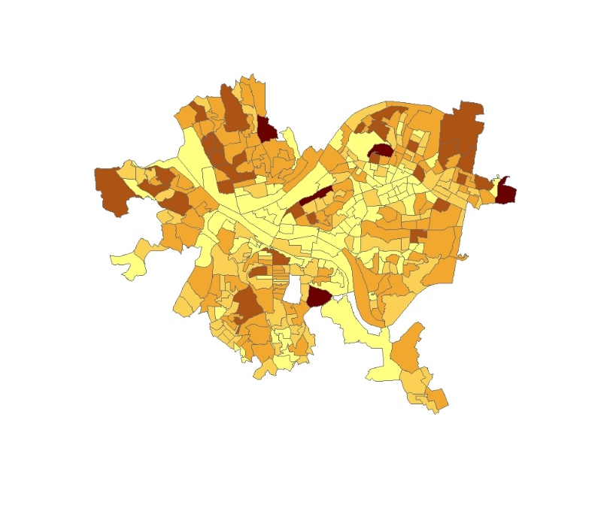
Implications of bin selection
Equal Intervals
Quantiles
These maps are all made with the same data using different intervals for the break points.
Geometric

Slide 26
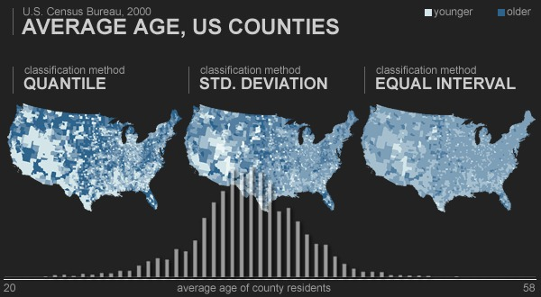
Break points for normal distributions
http://uxblog.idvsolutions.com/2010/03/crazy-world-of-range-breaks.html

Slide 27
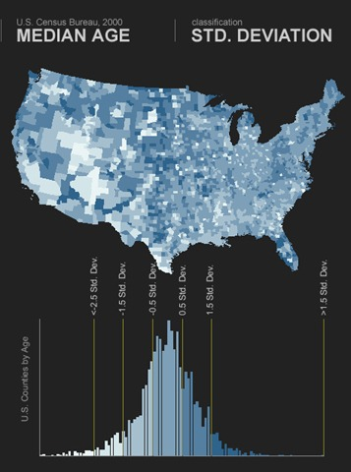

Slide 28
Break points for skewed distributions

Slide 29
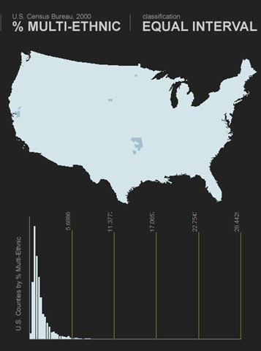
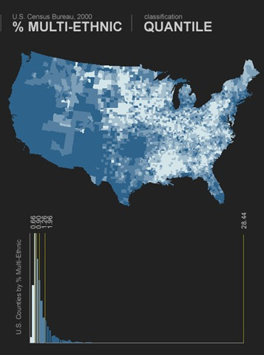
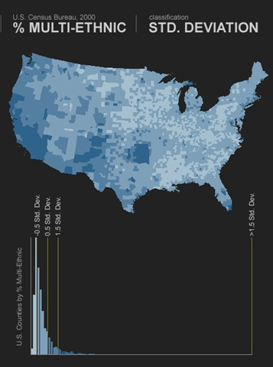

Slide 30
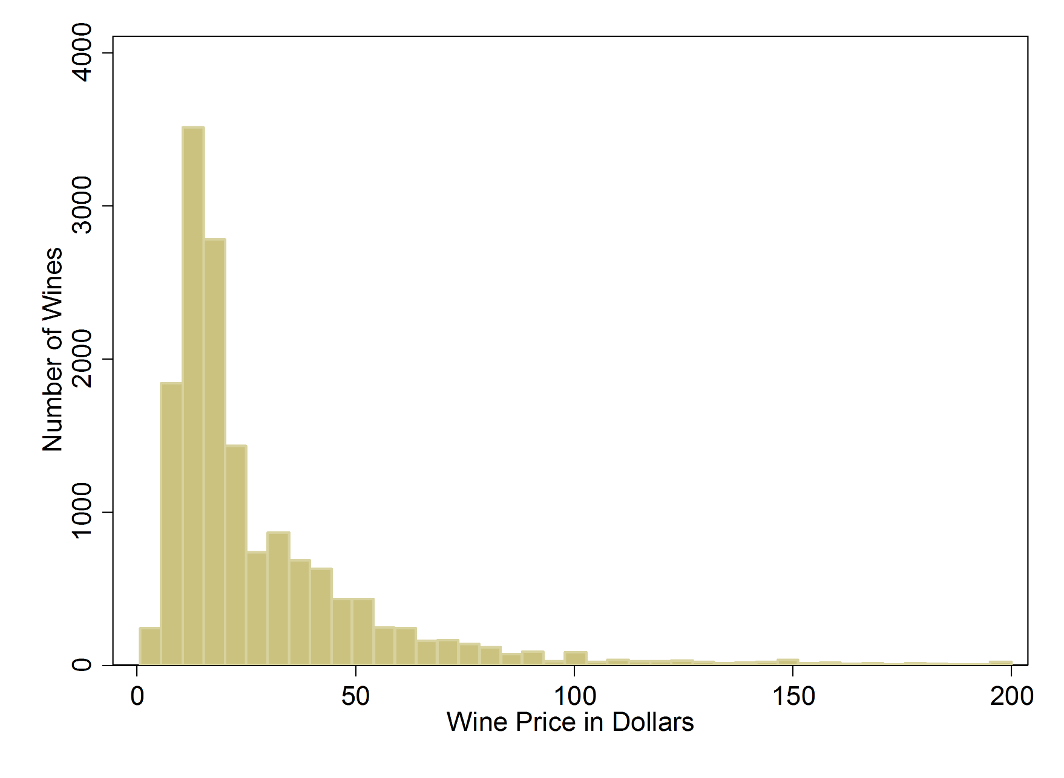
Highly-skewed Distributions:
http://www.medpagetoday.com/PublicHealthPolicy/GeneralProfessionalIssues/50497

Slide 31
Highly-skewed Distributions:
Think about skewed distributions like you think about classes of wine.
The first level of quality is a bottle for $3, the next level is a bottle at $6, the next level is at $10-12, the next level at $25, the next level at $50, then $100.
To move up one class, you basically double the price.
If you want a scale that translates wine prices into class, it would look something like:
$0 - $4 Cheap wine
$4 - $8 Low quality
$8 - $20 Medium quality
$20 - $80 High quality
$80 + Excellent quality

Slide 32
Rules of Thumb for selecting bins:
First Rule: use common sense! What do your groups represent, and are they meaningful? Are you misleading your audience with unreasonable breaks?
Binning by quantiles is typically a safe way to create breaks to show low, medium, and high values.
If a lot of your data is bunched together (for example, half of your values are close to zero), quantiles will not be meaningful because it will imply differences that do not exist.
If your distribution is skewed, consider increasing-interval or exponential scales. For example, define the first group as 0-2, second as 2-6, third as 6-14, next as 14-30 (your interval size doubles each break).

Slide 33
Issue 03:
COUNTS of things
versus RATES of things

Slide 34
Normalizing data

Slide 35
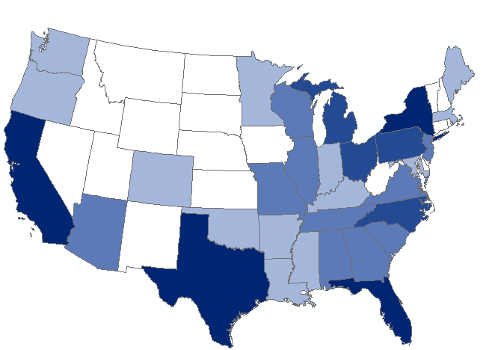
New
Mexico:
100 crimes
Texas
1,000 crimes
I want to compare crime rates in Texas and New Mexico.
If they are 10 times higher in Texas, does that mean its 10 times more violent / crime-ridden?

Slide 36
New
Mexico:
100 crimes
Texas
1,000 crimes
New Mexico
Population: 2 million
Crime: 5 per 100k
TEXAS
Population: 29 million
Crime: 3.5 per 100k
Normalized to Population Size: Crime RATE
(better apples to apples comparison)

Slide 37
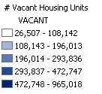
RAW data
NUMBER of vacant housing units by state, 2000
States with large populations will have most vacant units

Slide 38
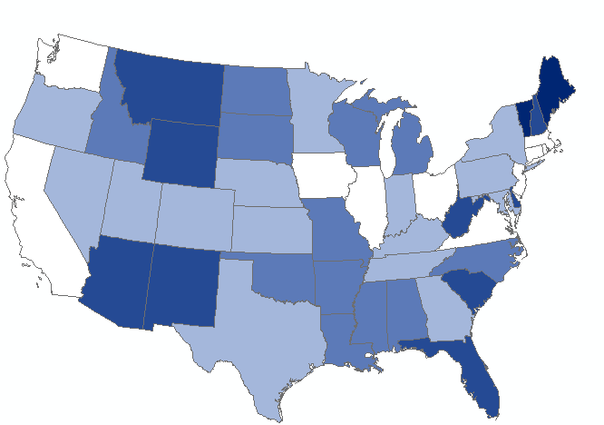
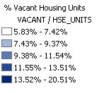
Normalized data
Percentage vacant housing units by state, 2000
Now we can see RATES OF VACANCY independent of population size

Slide 39
Normalizing data
Divides one numeric attribute by another in order to
minimize differences in values based on the size of
areas or number of features in each area
Examples:
Dividing the number of vacant housing units by the total number of housing units yields the percentage of vacant units
Dividing the population by area of the feature yields a population density
Notes:
For example, dividing the 18- to 30-year-old population by the total population yields the percentage of people aged 18–30. Similarly, dividing a value by the area of the feature yields a value per unit area, or density.

Slide 40
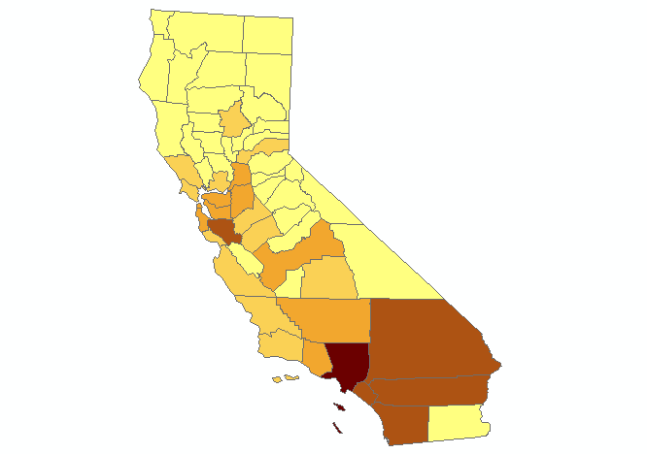
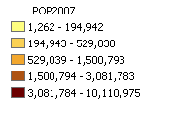
Non-Normalized data
California POPULATION BY COUNTY

Slide 41
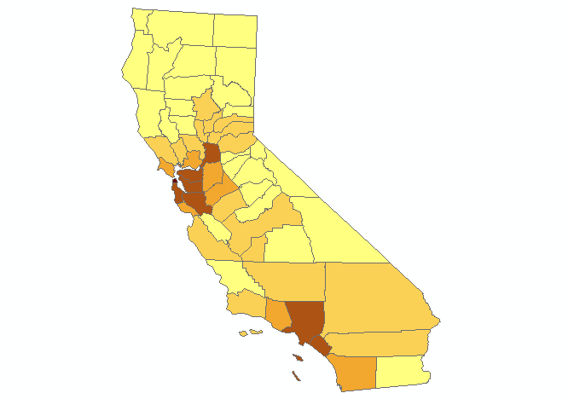
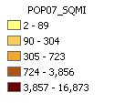
Normalized BY GEOGRAPHY
California POPULATION DENSITY

Slide 42
Issue 04:
Low to High Scale
versus
Average / Not Average

Slide 43
Selecting colors
If you have naturally categorical data you select colors to maximize contrast between categories so membership is clear.
If you have numeric data you need to decide:
Is my narrative about the low or high performers? Select a sequential (light to dark) scale.
Or is my narrative about the non-average cases (both low and high groups)? Select a DIVERGENT scale (dark-light-dark).
Comparison group is always light

Slide 44
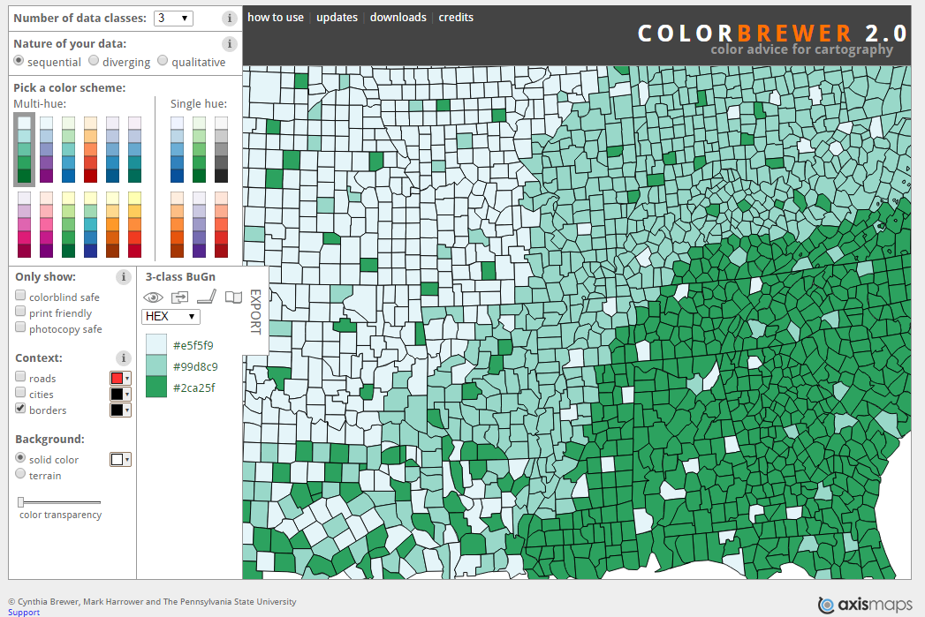
Sequential scale
http://colorbrewer2.org/

Slide 45
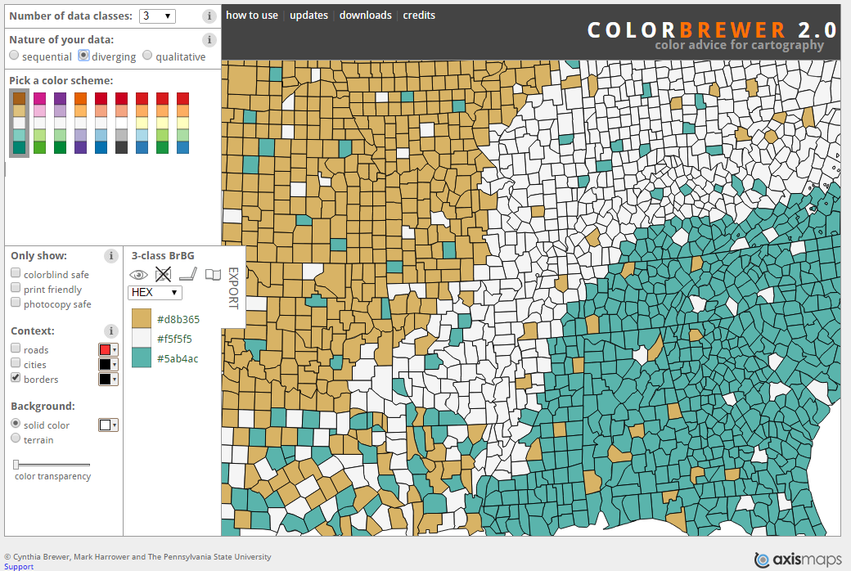
Divergent scale

Slide 46
Rules of Thumb:
If you are highlighting a class of individuals, like those in poverty, a single color might be sufficient (FE red for in poverty, gray for not).
When you are highlighting performance along a single dimension, use a sequential scale with white or gray at the bottom of your color scale and a dark color at the top.
If your comparison is relative to the average put white or gray in the middle to represent “average.” Consider red for low, blue or green for high (depending on the context if high is good, low is bad).
Five to seven categories is typical.

Slide 47
Color functions

Slide 48
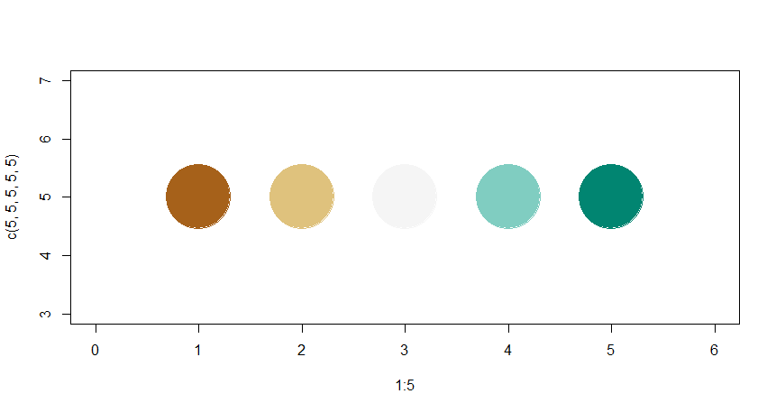
http://colorbrewer2.org/
MANUALLY:
color.vals <- c("#a6611a", "#dfc27d", "#f5f5f5", "#80cdc1", "#018571" )
plot( 1:5, c(5,5,5,5,5), col=color.vals, pch=19, cex=10, xlim=c(0,6) )

Slide 49
library( RColorBrewer )
display.brewer.pal( 7, "BrBG" )
display.brewer.pal( 5, "BrBG" )
display.brewer.pal( 7, "BuGn" )
brewer.pal( 5, "BrBG" ) # identical to previous slide
color.vals <- brewer.pal( 5, "BrBG" )

Slide 50
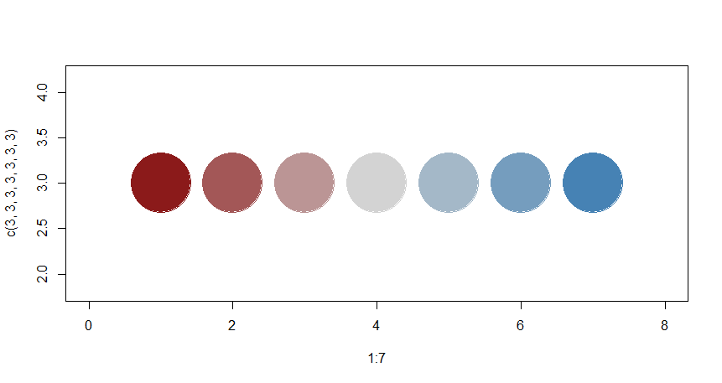
Set center and end colors
CREATE YOUR OWN COLOR RAMP:
color.function <- colorRampPalette( c("firebrick4","light gray","steel blue" ) )
color.function(5) # number of classes you desire
col.vals <- color.function(7)
plot( 1:7, c(3,3,3,3,3,3,3), pch=19, cex=10, col=col.vals, xlim=c(0,8) )

Slide 51
IDENTIFY BREAK POINTS FOR QUANTILES:
norm.vec <- rnorm(10000) + 10
# Five groups, 20% of the data in each
quantile( norm.vec, probs=c(0, 0.20, 0.40, 0.60, 0.80, 1 ), na.rm=T )
# Seven groups
quantile( norm.vec, probs=seq( from=0, to=1, by=1/7 ), na.rm=T )
bin.values <- quantile( norm.vec, probs=seq( from=0, to=1, by=1/7 ) )
cut( norm.vec, breaks=bin.values ) # assigns data to bins
col.vals <- color.function(7)
cut( norm.vec, breaks=bin.values, labels=col.vals ) # adds color labels

Slide 52
Issue 05:
Don’t hide your subject

Slide 53
Graphical hierarchy

Slide 54
Ground and figure
Assign bright colors (red, orange, yellow, green, blue) to important graphic elements
Features are known as figure, or the subject of the map.
Assign drab colors to the graphic elements that provide orientation or context, especially shades of gray
Features known as ground, or the context for the subject.

Slide 55
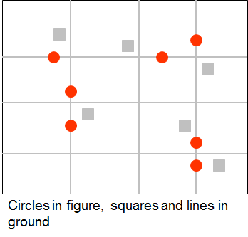
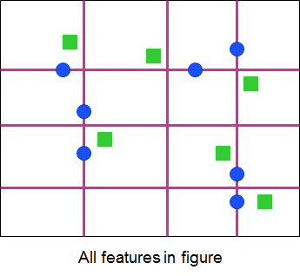
GOOD
BAD

