Slide 1
Introduction

Slide 2




Data programming language
User interface (IDE)
Document formatting rules
R + Markdown = data-driven docs

Slide 3
Functions

Slide 4
object
function()
cookies <- bake( batter, temp=400 )
assignment

Slide 5
arguments (function input)
makeCookies <- function( flour, eggs, sugar )
{
batter <- mix( flour, eggs, sugar )
cookies <- bake( batter, temp=400 )
return( cookies )
}
“recipe”
return value (function output)

Slide 6
argument
function( x1 )
{
x2 <- step1( x1 )
x3 <- step2( x2 )
x4 <- step3( x3 )
return( x4 )
}
assignment
object
“recipe”
return

Slide 7
Data Structures

Slide 8
vector
V1 = [ 3, 7, 2, 9, ]
element
value=2

Slide 9
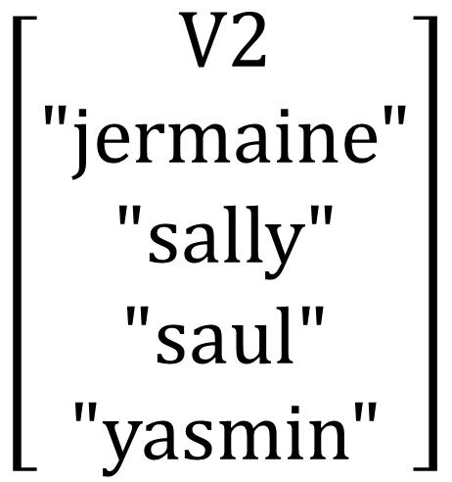
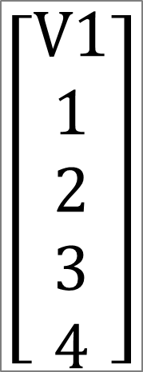


data frame
$$\left[\begin{aligned}V1 \\ 1 \\ 2 \\ 3 \\ 4\end{aligned}\right]$$
$$\left[\begin{aligned}V2 \\ "jermaine" \\ "sally" \\ "saul" \\ "yasmin"\end{aligned}\right]$$
$$\left[\begin{aligned}V3 \\ male \\ female \\ male \\ female \end{aligned}\right]$$
$$\left[\begin{aligned}V4 \\ TRUE \\ TRUE \\ FALSE \\ FALSE \end{aligned}\right]$$
numeric
character
factor
logical

Slide 10
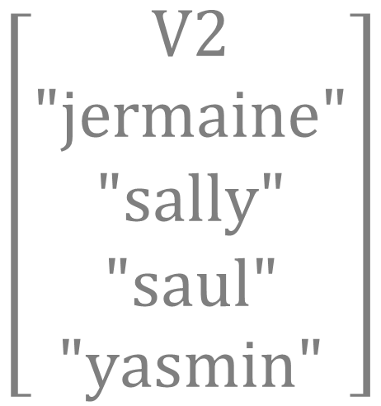

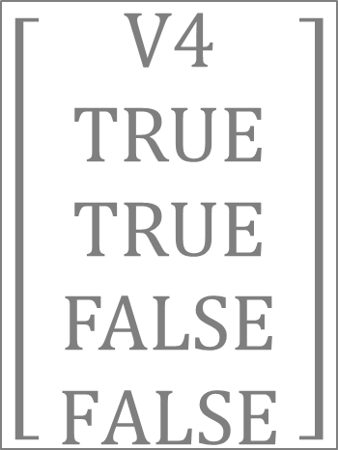

data frame
$$\left[\begin{aligned} V1 \\ 1 \\ 2 \\ 3 \\ 4\end{aligned}\right]$$
$$\left[\begin{aligned}V2 \\ "jermaine" \\ "sally" \\ "saul" \\ "yasmin"\end{aligned}\right]$$
$$\left[\begin{aligned}V3 \\ male \\ female \\ male \\ female \end{aligned}\right]$$
$$\left[\begin{aligned}V4 \\ TRUE \\ TRUE \\ FALSE \\ FALSE \end{aligned}\right]$$
numeric
character
factor
logical

Slide 11
R Markdown Settings

Slide 12
---
title: “Lab 07"
output: html_document:
---
# Setup
Global options
Load packages
Load data
# Your Work Here
```{r my_plot}
plot( x, y )
```
yaml header
always include these in document setup

Slide 13
---
title: "Markdown Document Overview"
output: html_document:
---
# Setup
Set global options
Load packages
Load data
# Your Work Here
```{css, echo=F}
table
{
margin-top:60px;
margin-bottom:60px;
}
```

Slide 14
Logical Statements

Slide 15
these.female <- gender == “female”
Male
TRUE
Study
Sample
FALSE

Slide 16
gender == “female” & study == “control”
gender
study
male
control
female
treatment
female
Female
control
Selected Group
Study
Sample
female
Female
control
control
male
control
female
treatment
male
treatment

Slide 17
1.
2.
3.
gender == “male” & beard == TRUE
!( gender == “male” & beard == TRUE )
gender == “male” & beard == FALSE
gender
beard
1. Bearded Men
male
TRUE
male
TRUE
female
FALSE
female
FALSE
2. Not (!) Bearded Men
3. Men Without Beards
male
FALSE
male
FALSE
female
TRUE

Slide 18
gender == “male” & beard == TRUE
!( gender == “male” & beard == TRUE )
gender == “male” & beard == FALSE
gender
beard
Bearded Men
male
TRUE
male
TRUE
female
FALSE
female
FALSE
Not (!) Bearded Men
Men Without Beards
male
FALSE
male
FALSE
female
TRUE

Slide 19
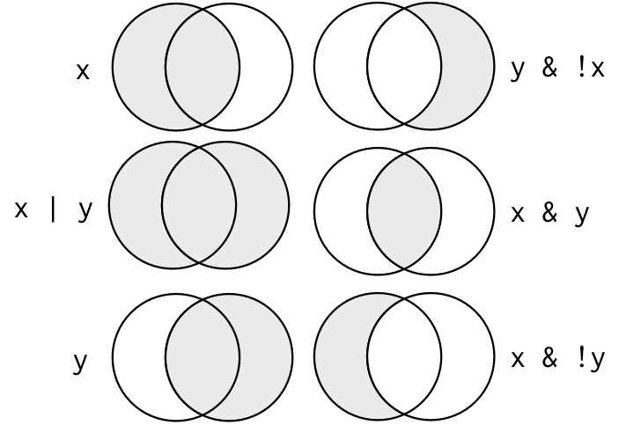
Women in the control group
x == “control”
y == “female”
Men and women in the control group
Women not in the control group
Men in the control group and all women
Women in the control group
Men in the control group
All women

Slide 20
x
y

Slide 21
X <- c(“A”,”B”)
Y <- c(“B”,”C”)
X
Y
A
B
C

Slide 22
Dataset Verbs

Slide 23
Data Verbs
function( )

Slide 24
function( )

Slide 25
Data Verbs
function( )

Slide 26
Data Verbs
function( )

Slide 27
Data Verbs
function( )

Slide 28
1
2
3
4
2
4
filter()
A | B | C
A | C
select()
1
3
4
2
1
2
3
4
arrange()

Slide 29
1
2
3
4
2
4
filter()
A | B | C
A | C
select()
1
3
4
2
1
2
3
4
arrange()

Slide 30
Data Recipes

Slide 31
Data Frame Input
Data Verbs
function( , arguments )
Data Frame Output
Piped Data Frame
Chaining Data Verbs
dat %>% filter( study.group == “control” ) %>% summarize( n=n() )
Pipe
Operator
Piped Data Frame

Slide 32
Data Frame Input
Data Verbs
function( , arguments )
Data Frame Output
dat %>% filter( study.group == “control” ) %>% summarize( n=n() )
Pipe
Operator

Slide 33
Data Recipe
Ingredients:
Step 1.
Step 2.
Step 3.
Step 4.
dat %>%
select( ... ) %>%
filter( ... ) %>%
group_by( ... ) %>%
summarize( ... ) %>%
Data verbs manipulate the input data and return a new dataset
Pipe operators pass the new dataset to the next verb

Slide 34
Data Recipes
Ingredients:
Step 1.
Step 2.
Step 3.
Step 4.
dat %>%
select( ... ) %>%
filter( ... ) %>%
group_by( ... ) %>%
summarize( ... ) %>%
Data verbs can be chained since they return a data frame
Pipe operators pass the new dataset to the next verb

Slide 35
Ingredients:
Step 1.
Step 2.
Step 3.
Step 4.
dat %>%
select( ... ) %>%
filter( ... ) %>%
group_by( ... ) %>%
summarize( ... ) %>%
Data verbs can be chained since they return a data frame
Pipe operators pass the new dataset to the next line

Slide 36
visualization

Slide 37
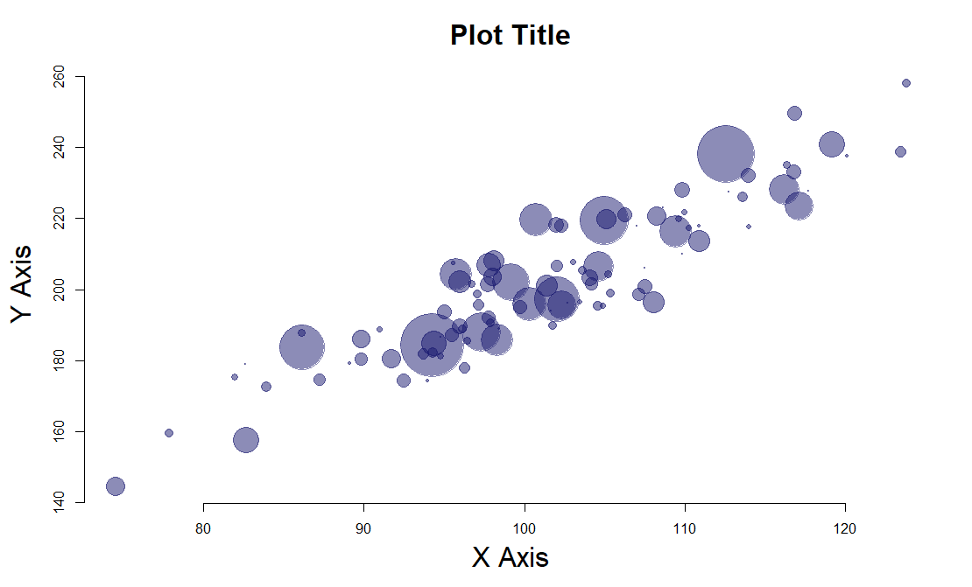
Chicago

Slide 38
text()
title()
plot.window()
Chicago
points()
axis()
title()

Slide 39
plot.window( xlim=c(70,130), ylim=c(140,260) )
text( x=100, y=220, “Chicago”, col=“orange” )
Chicago
title( main=“Plot Title” )
points( x, y, cex=z)
mar
title( xlab=“X Axis” )
axis( side=1, from=min(x), to=max(x), by=10 )

Slide 40
title( main=“Plot Title” )
text( x=100, y=220, “Chicago”)
Chicago
points( x, y, cex=z)
mar
plot.window(
xlim=c(70,130),
ylim=c(140,260) )
axis( side=1, from=min(x), to=max(x), by=10 )

Slide 41
Data Joins

Slide 42
dat1
dat2
id | x1
A | 1
B | 2
C | 3
id | x2
B | T
C | F
D | T
dat1
dat2
A
B, C
D
Shared and Distinct Observations

Slide 43
Inner Join
Keep all shared cases
dat1
dat2
dat3
id | x1
A | 1
B | 2
C | 3
id | x2
B | T
C | F
D | T
id | x1 | x2
B | 2 | T
C | 3 | F
dat3 <- merge( dat1, dat2, by=“id”, all=FALSE )

Slide 44
Outer Join
Keep all cases
dat1
dat2
dat3
id | x1
A | 1
B | 2
C | 3
id | x2
B | T
C | F
D | T
id | x1 | x2
A | 1 | NA
B | 2 | T
C | 3 | F
D | NA | T
dat3 <- merge( dat1, dat2, by=“id”, all=TRUE )

Slide 45
Left Join
Keep all of dat1
dat1
dat2
dat3
id | x1
A | 1
B | 2
C | 3
id | x2
B | T
C | F
D | T
id | x1 | x2
A | 1 | NA
B | 2 | T
C | 3 | F
dat3 <- merge( dat1, dat2, by=“id”, all.x=TRUE )

Slide 46
Right Join
Keep all of dat2
dat1
dat2
dat3
id | x1
A | 1
B | 2
C | 3
id | x2
B | T
C | F
D | T
id | x1 | x2
B | 2 | T
C | 3 | F
D | NA | T
dat3 <- merge( dat1, dat2, by=“id”, all.y=TRUE )

Slide 47
Left Join
Right Join
dat1
dat2
dat1
dat2
id | x1
A | 1
B | 2
C | 3
id | x2
B | T
C | F
D | T
id | x1
A | 1
B | 2
C | 3
id | x2
B | T
C | F
D | T
Inner Join
Outer Join
dat1
dat2
dat1
dat2
id | x1
A | 1
B | 2
C | 3
id | x2
B | T
C | F
D | T
id | x1
A | 1
B | 2
C | 3
id | x2
B | T
C | F
D | T

Slide 48
Compound IDs
dat1
dat2
id | year | x1
A | 2001 | 1
A | 2002 | 2
B | 2001 | 3
B | 2002 | 4
C | 2001 | 5
C | 2002 | 6
id | year | x2
A | 2001 | T
A | 2002 | T
B | 2001 | T
B | 2002 | F
C | 2001 | T
C | 2002 | F
merge( dat1, dat2, by=c("id","year") )

