Slide 1
Introduction

Slide 2




Data programming language
User interface (IDE)
Document formatting rules
R + Markdown = data-driven docs

Slide 3
Data Science Skill Level
The Learning Curve
ask a
clear question
that is easy to answer
( part 1: learning how to learn )
read
Stack-
Overflow
read
R help
files
google
error
messages
break
your code
End of
Semester 1
copy
and
adapt code

Slide 4
Data Science Skill Level
develop
own
applications
The Learning Curve
( part 2: the empire strikes back )
develop
own
functions
develop
own
scripts
start
writing
own
code
successfully
adapt code
for own
nefarious
purposes
get stuck
and
problem-
solve
steal
code
from
others
End of
Second Course

Slide 5
Data Science Skill Level
spend seven years in Tibet
The Learning Curve
create
own
R
package
( part 3: peak robert pattinson hair )
platinum
airline
status
gainful
employ-
ment
develop
own
applications
develop
own
functions
start
writing
own
code
develop
own
scripts
End of the
Program

Slide 7
Functions

Slide 8
object
function()
cookies <- bake( batter, temp=400 )
assignment

Slide 9
arguments (function input)
makeCookies <- function( flour, eggs, sugar )
{
batter <- mix( flour, eggs, sugar )
cookies <- bake( batter, temp=400 )
return( cookies )
}
“recipe”
return value (function output)

Slide 10
argument
function( x1 )
{
x2 <- step1( x1 )
x3 <- step2( x2 )
x4 <- step3( x3 )
return( x4 )
}
assignment
object
“recipe”
return

Slide 11
Data Structures

Slide 12
vector
V1 = [ 3, 7, 2, 9, ]
element
value=2

Slide 13
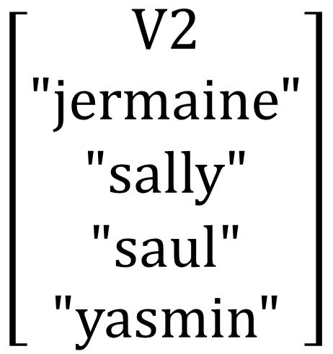



data frame
$$\left[\begin{aligned}V1 \\ 1 \\ 2 \\ 3 \\ 4\end{aligned}\right]$$
$$\left[\begin{aligned}V2 \\ "jermaine" \\ "sally" \\ "saul" \\ "yasmin"\end{aligned}\right]$$
$$\left[\begin{aligned}V3 \\ male \\ female \\ male \\ female \end{aligned}\right]$$
$$\left[\begin{aligned}V4 \\ TRUE \\ TRUE \\ FALSE \\ FALSE \end{aligned}\right]$$
numeric
character
factor
logical

Slide 14
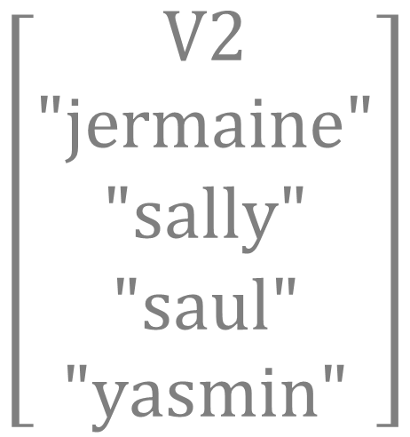

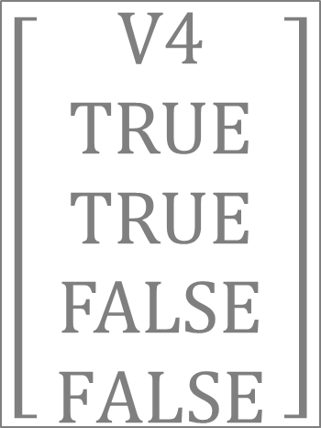

data frame
$$\left[\begin{aligned} V1 \\ 1 \\ 2 \\ 3 \\ 4\end{aligned}\right]$$
$$\left[\begin{aligned}V2 \\ "jermaine" \\ "sally" \\ "saul" \\ "yasmin"\end{aligned}\right]$$
$$\left[\begin{aligned}V3 \\ male \\ female \\ male \\ female \end{aligned}\right]$$
$$\left[\begin{aligned}V4 \\ TRUE \\ TRUE \\ FALSE \\ FALSE \end{aligned}\right]$$
numeric
character
factor
logical

Slide 15
R Markdown Settings

Slide 16
---
title: “Lab 07"
output: html_document:
---
# Setup
Global options
Load packages
Load data
# Your Work Here
```{r my_plot}
plot( x, y )
```
yaml header
always include these in document setup

Slide 17
---
title: "Markdown Document Overview"
output: html_document:
---
# Setup
Set global options
Load packages
Load data
# Your Work Here
```{css, echo=F}
table
{
margin-top:60px;
margin-bottom:60px;
}
```

Slide 18
Logical Statements

Slide 19
these.female <- gender == “female”
Male
TRUE
Study
Sample
FALSE

Slide 20
gender == “female” & study == “control”
gender
study
male
control
female
treatment
female
Female
control
Selected Group
Study
Sample
female
Female
control
control
male
control
female
treatment
male
treatment

Slide 21
1.
2.
3.
gender == “male” & beard == TRUE
!( gender == “male” & beard == TRUE )
gender == “male” & beard == FALSE
gender
beard
1. Bearded Men
male
TRUE
male
TRUE
female
FALSE
female
FALSE
2. Not (!) Bearded Men
3. Men Without Beards
male
FALSE
male
FALSE
female
TRUE

Slide 22
gender == “male” & beard == TRUE
!( gender == “male” & beard == TRUE )
gender == “male” & beard == FALSE
gender
beard
Bearded Men
male
TRUE
male
TRUE
female
FALSE
female
FALSE
Not (!) Bearded Men
Men Without Beards
male
FALSE
male
FALSE
female
TRUE

Slide 23
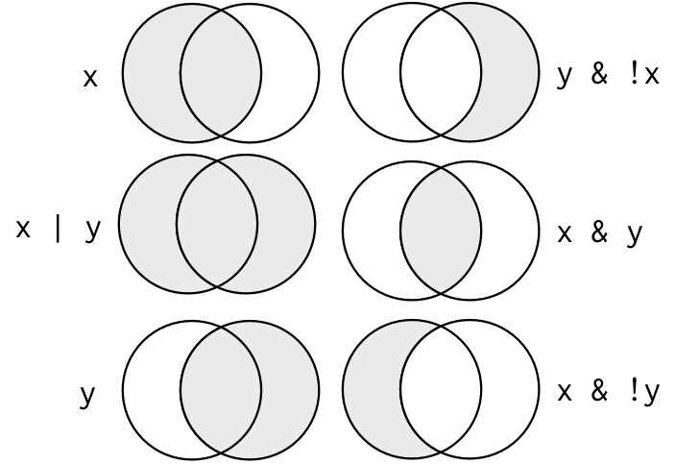
Women in the control group
x == “control”
y == “female”
Men and women in the control group
Women not in the control group
Men in the control group and all women
Women in the control group
Men in the control group
All women

Slide 24
x
y

Slide 25
X <- c(“A”,”B”)
Y <- c(“B”,”C”)
X
Y
A
B
C

Slide 26
Dataset Verbs

Slide 27
Data Verbs
function( )

Slide 28
function( )

Slide 29
Data Verbs
function( )

Slide 30
Data Verbs
function( )

Slide 31
Data Verbs
function( )

Slide 32
1
2
3
4
2
4
filter()
A | B | C
A | C
select()
1
3
4
2
1
2
3
4
arrange()

Slide 33
1
2
3
4
2
4
filter()
A | B | C
A | C
select()
1
3
4
2
1
2
3
4
arrange()

Slide 34
Data Recipes

Slide 35
Data Frame Input
Data Verbs
function( , arguments )
Data Frame Output
Piped Data Frame
Chaining Data Verbs
dat %>% filter( study.group == “control” ) %>% summarize( n=n() )
Pipe
Operator
Piped Data Frame

Slide 36
Data Frame Input
Data Verbs
function( , arguments )
Data Frame Output
dat %>% filter( study.group == “control” ) %>% summarize( n=n() )
Pipe
Operator

Slide 37
Data Recipe
Ingredients:
Step 1.
Step 2.
Step 3.
Step 4.
dat %>%
select( ... ) %>%
filter( ... ) %>%
group_by( ... ) %>%
summarize( ... ) %>%
Data verbs manipulate the input data and return a new dataset
Pipe operators pass the new dataset to the next verb

Slide 38
Data Recipes
Ingredients:
Step 1.
Step 2.
Step 3.
Step 4.
dat %>%
select( ... ) %>%
filter( ... ) %>%
group_by( ... ) %>%
summarize( ... ) %>%
Data verbs can be chained since they return a data frame
Pipe operators pass the new dataset to the next verb

Slide 39
Ingredients:
Step 1.
Step 2.
Step 3.
Step 4.
dat %>%
select( ... ) %>%
filter( ... ) %>%
group_by( ... ) %>%
summarize( ... ) %>%
Data verbs can be chained since they return a data frame
Pipe operators pass the new dataset to the next line

Slide 40
visualization

Slide 41
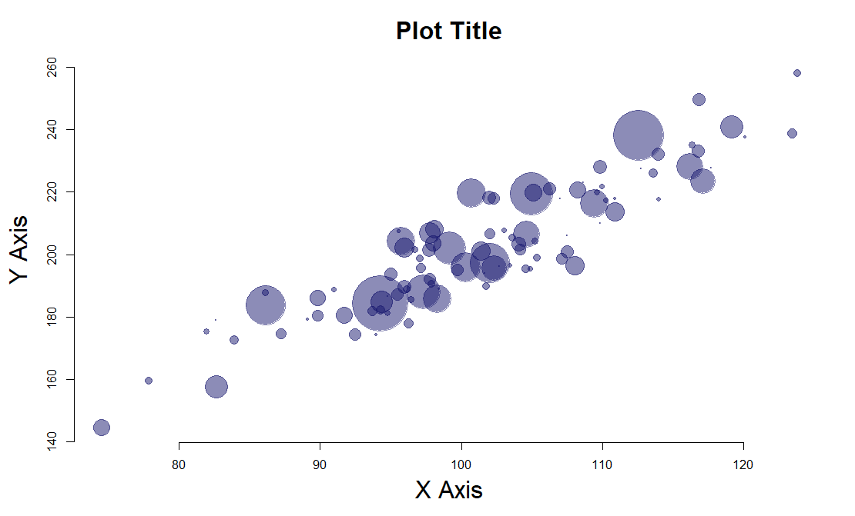
Chicago

Slide 42
text()
title()
plot.window()
Chicago
points()
axis()
title()

Slide 43
plot.window( xlim=c(70,130), ylim=c(140,260) )
text( x=100, y=220, “Chicago”, col=“orange” )
Chicago
title( main=“Plot Title” )
points( x, y, cex=z)
mar
title( xlab=“X Axis” )
axis( side=1, from=min(x), to=max(x), by=10 )

Slide 44
title( main=“Plot Title” )
text( x=100, y=220, “Chicago”)
Chicago
points( x, y, cex=z)
mar
plot.window(
xlim=c(70,130),
ylim=c(140,260) )
axis( side=1, from=min(x), to=max(x), by=10 )

Slide 45
Data Joins

Slide 46
dat1
dat2
id | x1
A | 1
B | 2
C | 3
id | x2
B | T
C | F
D | T
dat1
dat2
A
B, C
D
Shared and Distinct Observations

Slide 47
Inner Join
Keep all shared cases
dat1
dat2
dat3
id | x1
A | 1
B | 2
C | 3
id | x2
B | T
C | F
D | T
id | x1 | x2
B | 2 | T
C | 3 | F
dat3 <- merge( dat1, dat2, by=“id”, all=FALSE )

Slide 48
Outer Join
Keep all cases
dat1
dat2
dat3
id | x1
A | 1
B | 2
C | 3
id | x2
B | T
C | F
D | T
id | x1 | x2
A | 1 | NA
B | 2 | T
C | 3 | F
D | NA | T
dat3 <- merge( dat1, dat2, by=“id”, all=TRUE )

Slide 49
Left Join
Keep all of dat1
dat1
dat2
dat3
id | x1
A | 1
B | 2
C | 3
id | x2
B | T
C | F
D | T
id | x1 | x2
A | 1 | NA
B | 2 | T
C | 3 | F
dat3 <- merge( dat1, dat2, by=“id”, all.x=TRUE )

Slide 50
Right Join
Keep all of dat2
dat1
dat2
dat3
id | x1
A | 1
B | 2
C | 3
id | x2
B | T
C | F
D | T
id | x1 | x2
B | 2 | T
C | 3 | F
D | NA | T
dat3 <- merge( dat1, dat2, by=“id”, all.y=TRUE )

Slide 51
Left Join
Right Join
dat1
dat2
dat1
dat2
id | x1
A | 1
B | 2
C | 3
id | x2
B | T
C | F
D | T
id | x1
A | 1
B | 2
C | 3
id | x2
B | T
C | F
D | T
Inner Join
Outer Join
dat1
dat2
dat1
dat2
id | x1
A | 1
B | 2
C | 3
id | x2
B | T
C | F
D | T
id | x1
A | 1
B | 2
C | 3
id | x2
B | T
C | F
D | T

Slide 52
Compound IDs
dat1
dat2
id | year | x1
A | 2001 | 1
A | 2002 | 2
B | 2001 | 3
B | 2002 | 4
C | 2001 | 5
C | 2002 | 6
id | year | x2
A | 2001 | T
A | 2002 | T
B | 2001 | T
B | 2002 | F
C | 2001 | T
C | 2002 | F
merge( dat1, dat2, by=c("id","year") )

