Slide 1
selector vectors

Slide 2


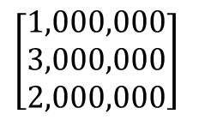
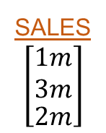

data frame: hiphop
artist
$$\left[\begin{aligned}\begin{aligned}cardi b \\ drake\end{aligned} \\ migos\end{aligned}\right]$$
album
$$\left[\begin{aligned}\begin{aligned}album1 \\ album2\end{aligned} \\ album3\end{aligned}\right]$$
sales
$$\left[\begin{aligned}\begin{aligned}1m \\ 3m\end{aligned} \\ 2m\end{aligned}\right]$$
vector: hiphop$sales
$$\left[\begin{aligned}1,000,000 \\ 3,000,000 \\ 2,000,000\end{aligned}\right]$$

Slide 3

data frame: hiphop
selector vector: hiphop$sales > 2000000
artist
$$\left[\begin{aligned}\begin{aligned}cardi b \\ drake\end{aligned} \\ migos\end{aligned}\right]$$
album
$$\left[\begin{aligned}\begin{aligned}album1 \\ album2\end{aligned} \\ album3\end{aligned}\right]$$
sales
$$\left[\begin{aligned}\begin{aligned}1m \\ 3m\end{aligned} \\ 2m\end{aligned}\right]$$
$$\left[\begin{matrix}1m>2m & 3m>2m & 2m>2m \\ FALSE & TRUE & FALSE\end{matrix}\right]$$
vector: hiphop$sales
$$\left[\begin{aligned}1,000,000 \\ 3,000,000 \\ 2,000,000\end{aligned}\right]$$

Slide 4

data frame: hiphop
selector vector: hiphop$sales > 2000000
artist
$$\left[\begin{aligned}\begin{aligned}cardi b \\ drake\end{aligned} \\ migos\end{aligned}\right]$$
album
$$\left[\begin{aligned}\begin{aligned}album1 \\ album2\end{aligned} \\ album3\end{aligned}\right]$$
sales
$$\left[\begin{aligned}\begin{aligned}1m \\ 3m\end{aligned} \\ 2m\end{aligned}\right]$$
$$\left[\begin{matrix}1m>2m & 3m>2m & 2m>2m \\ FALSE & TRUE & FALSE\end{matrix}\right]$$
how many? sum( hiphop$sales > 2000000 )
sum( F, T, F ) = [ 1 ]
vector: hiphop$sales
$$\left[\begin{aligned}1,000,000 \\ 3,000,000 \\ 2,000,000\end{aligned}\right]$$
what prop.? mean( hiphop$sales > 2000000 )
mean( 0, 1, 0 ) = [ 0.33 ]

Slide 5



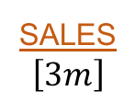
data frame: hiphop
subset: hiphop[ hiphop$sales > 2000000 , ]
artist
$$\left[\begin{aligned}\begin{aligned}cardi b \\ drake\end{aligned} \\ migos\end{aligned}\right]$$
album
$$\left[\begin{aligned}\begin{aligned}album1 \\ album2\end{aligned} \\ album3\end{aligned}\right]$$
sales
$$\left[\begin{aligned}\begin{aligned}1m \\ 3m\end{aligned} \\ 2m\end{aligned}\right]$$
artist
$$\left[drake\right]$$
album
$$\left[album2\right]$$
sales
$$\left[3m\right]$$
vector: hiphop$sales
$$\left[\begin{aligned}1,000,000 \\ 3,000,000 \\ 2,000,000\end{aligned}\right]$$

Slide 6



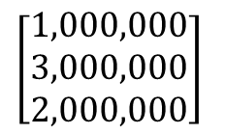
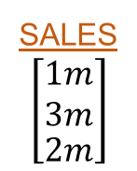
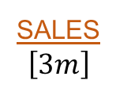


subset: hiphop[ hiphop$sales > 2000000 ]
data frame: hiphop
artist
$$\left[drake\right]$$
album
$$\left[album2\right]$$
sales
$$\left[3m\right]$$
artist
$$\left[\begin{aligned}\begin{aligned}cardi b \\ drake\end{aligned} \\ migos\end{aligned}\right]$$
album
$$\left[\begin{aligned}\begin{aligned}cardi b \\ drake\end{aligned} \\ migos\end{aligned}\right]$$
sales
$$\left[\begin{aligned}\begin{aligned}1m \\ 3m\end{aligned} \\ 2m\end{aligned}\right]$$
what prop.? mean( hiphop$sales > 2000000 )
how many? sum( hiphop$sales > 2000000 )
vector: hiphop$sales
selector vector: hiphop$sales > 2000000
$$\left[\begin{aligned}1,000,000 \\ 3,000,000 \\ 2,000,000\end{aligned}\right]$$
$$\left[\begin{matrix}1,000,000 & 3,000,000 & 2,000,000 \\ FALSE & TRUE & FALSE\end{matrix}\right]$$

