Slide 1
Image formats
Lecy ∙ Data Driven M.

Slide 2
Image format

Slide 3
Image file formats:
Raster – A raster graphic is an image made of hundreds (or thousands or millions) of tiny squares of color information, referred to as either pixels or dots. Pro: file size Con: blurry when scaled
Vector – A vector graphic uses math to draw shapes using points, lines and curves. So whereas a raster image of a 1” x 1” square at 300 dpi will have 300 individuals pieces of information, a vector image will only contain four points, one for each corner; the computer will uses math to “connect the dots” and fill in all of the missing information. Pro: infinitely scalable Con: hard to embed in documents, file size may be large
Metafile – Flexible format that can include elements of raster and vector images. Pro: you can edit Con: large file size

Slide 4
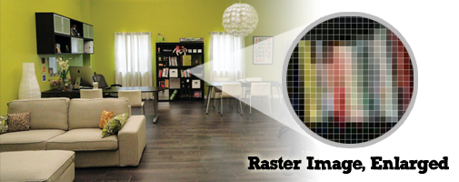
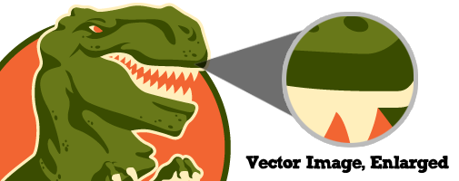

Slide 5
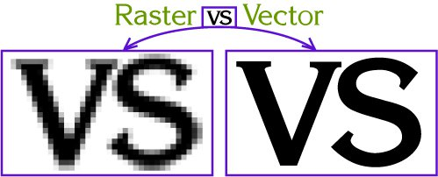
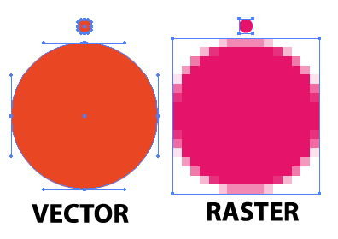

Slide 6
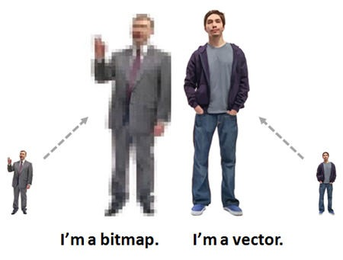

Slide 7
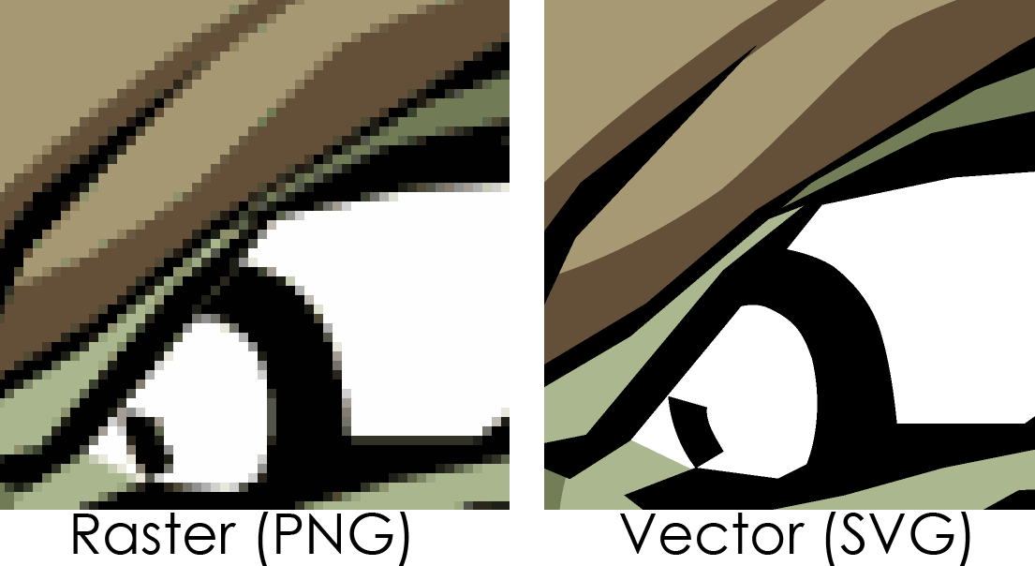

Slide 8
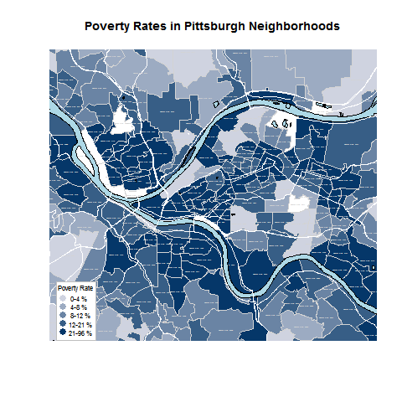
PNG file format
Default image size

Slide 9
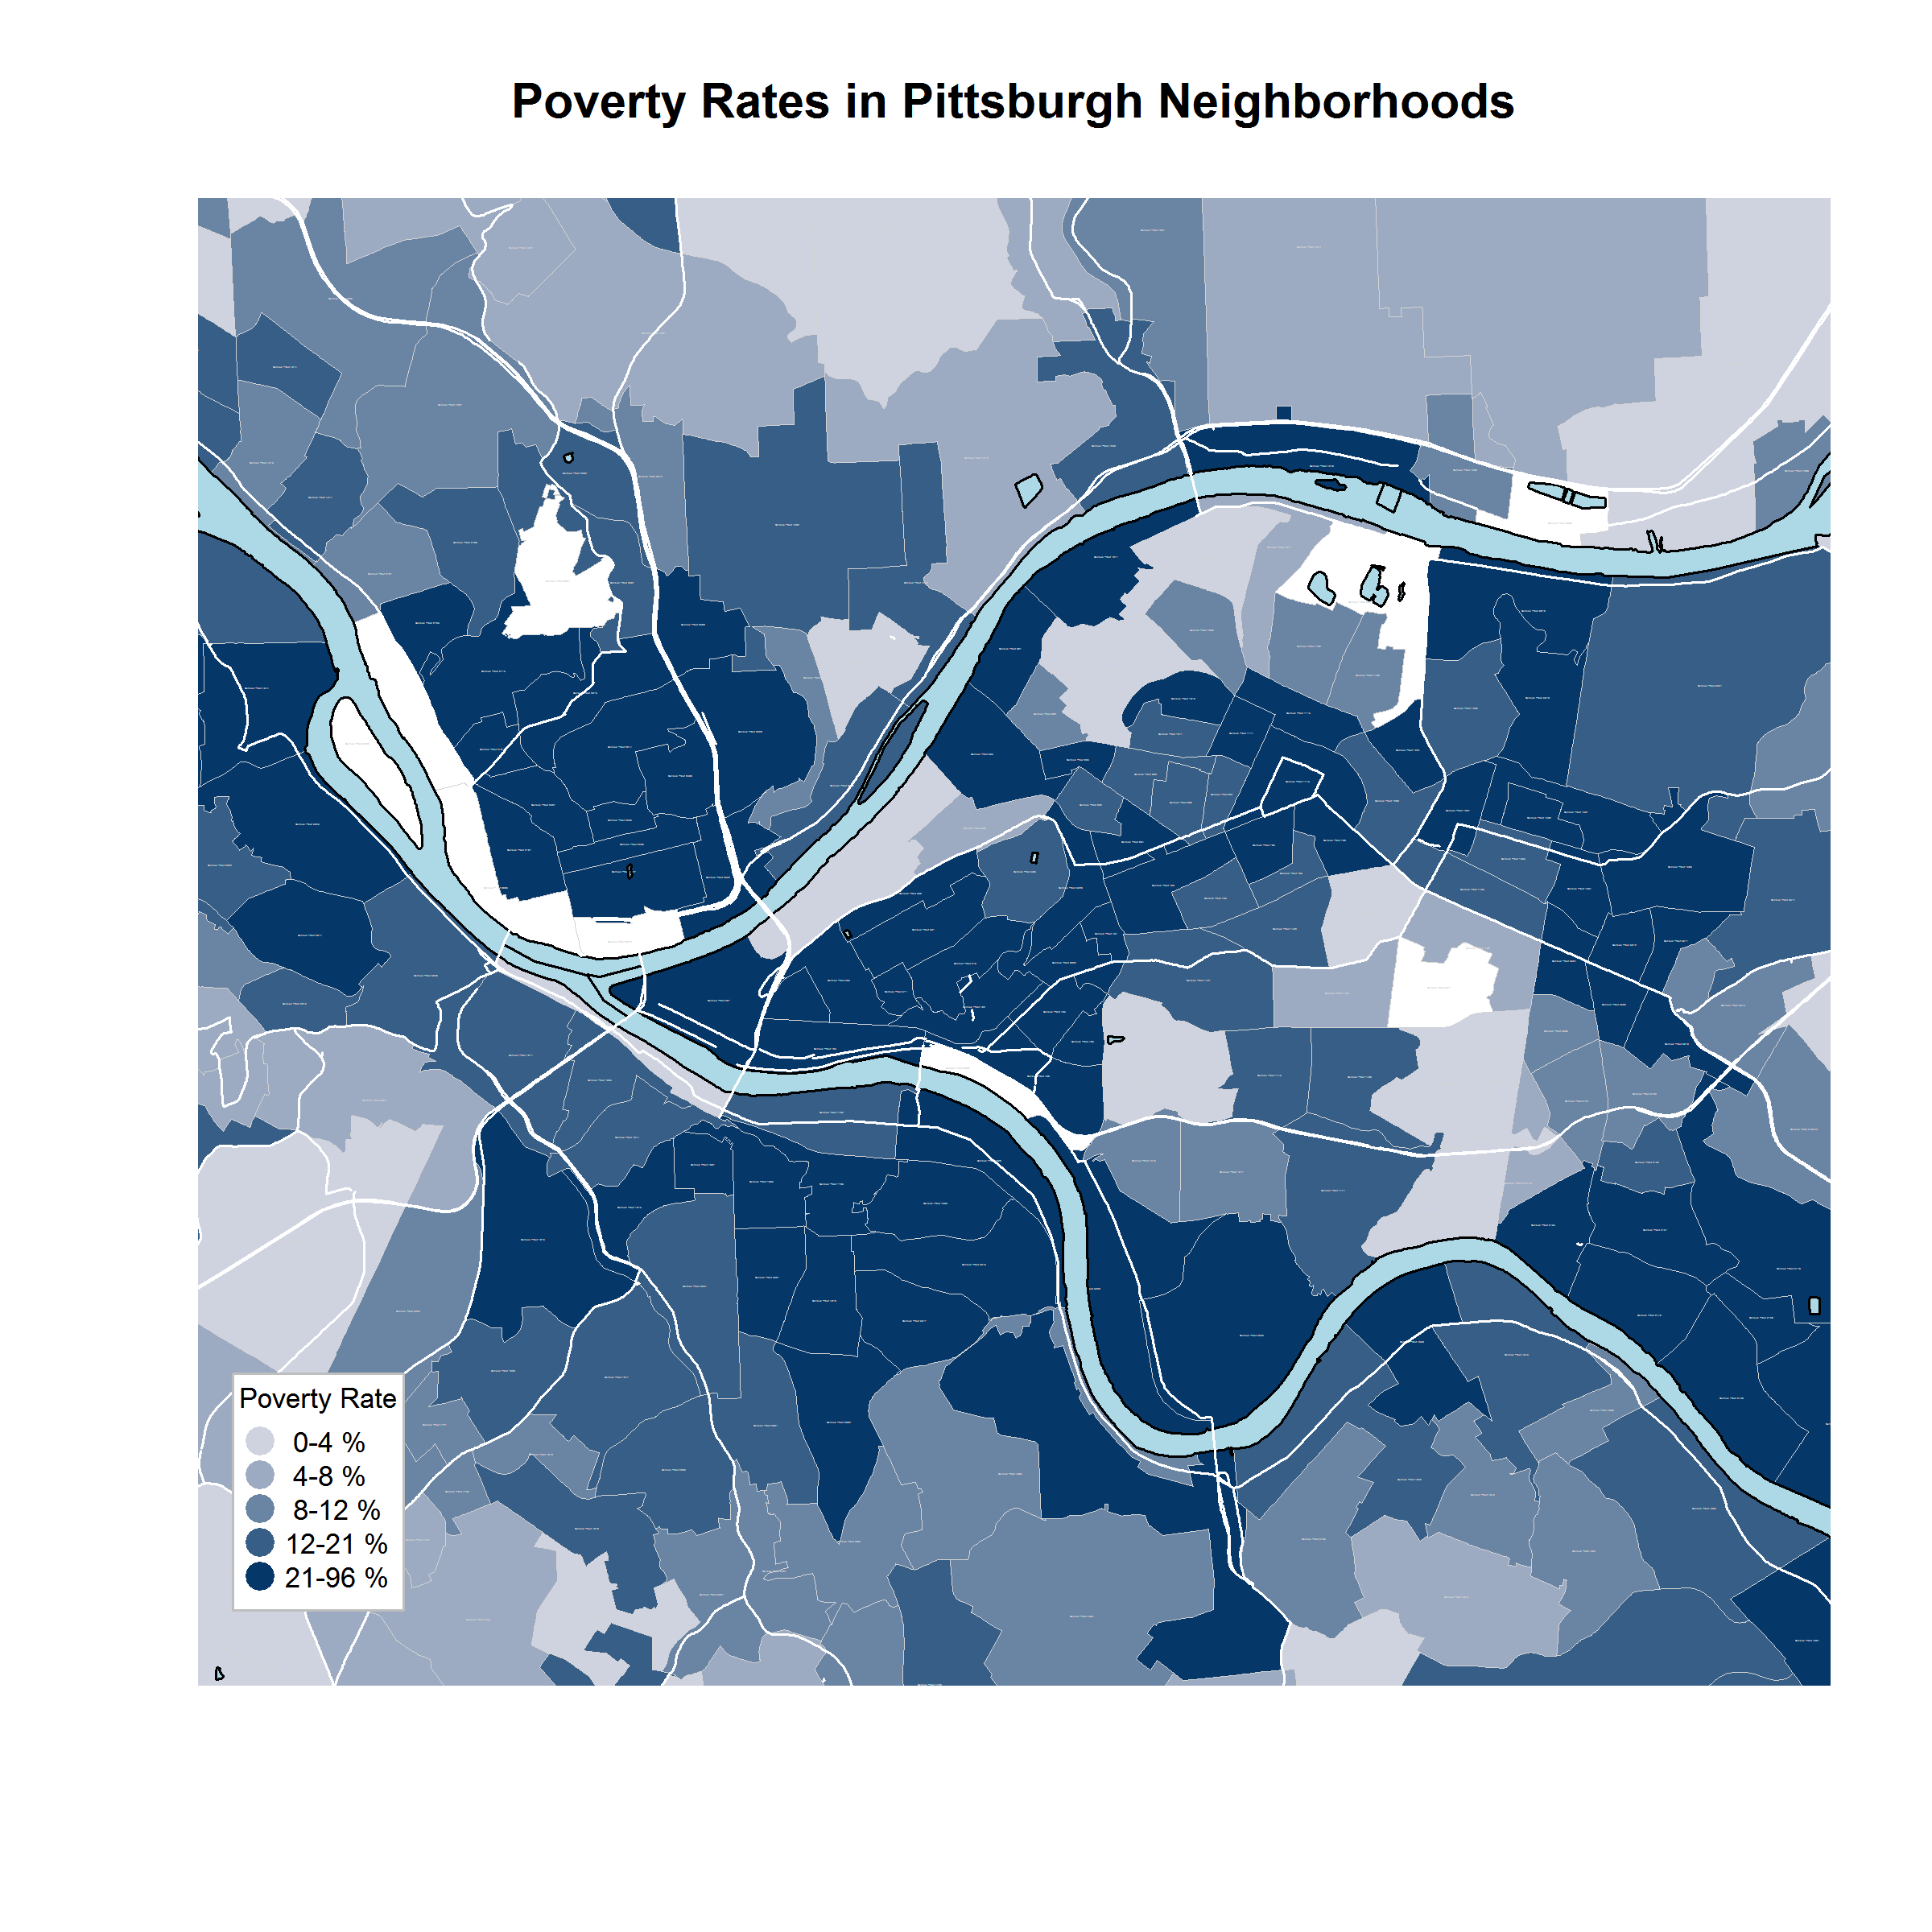
PNG file format
Large image size

Slide 10
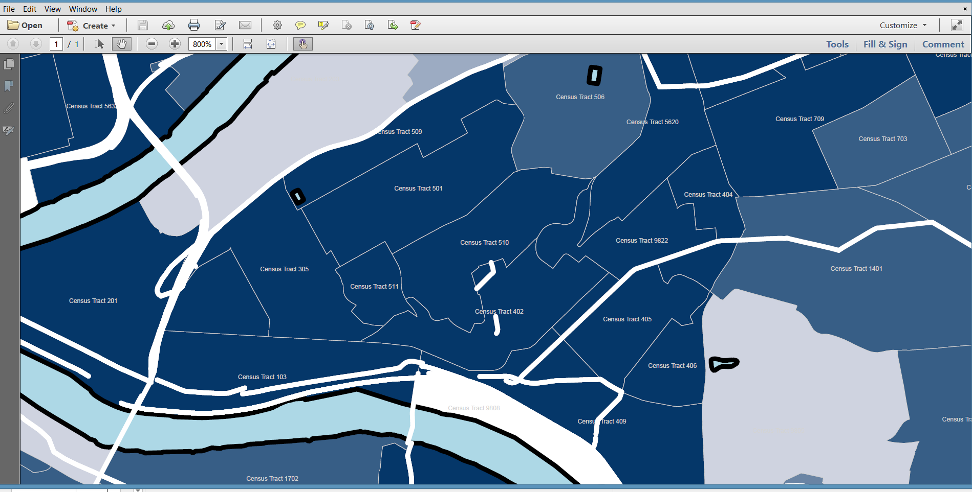
PDF file format
Zoomed to 800%

Slide 11
Metafile example:
plot( 1:5, 1:5, pch=19, col="gray",
cex=5, xlab="My X", ylab="My Y",
main="Metafile")
points( 1:5, 1:5, pch=21, col="orange",
cex=5 )

