Slide 1
Threshold
College GPA
Honors Courses
Ave Y
Ave Y
9th Grade Standardized Test

Slide 2
Threshold
College GPA
Summer
School
Ave Y
Ave Y
9th Grade Standardized Test

Slide 3
College enrollment
Income

Slide 4
Cutoff
College enrollment
Control group
Treatment group
Income
c

Slide 5
Cutoff
College enrollment
Treatment group
Control group
Treatment effect
Income
c

Slide 6
Individual | Outcome | Score | Treatment | Score_c
1 | 74 | 20 | 1 | 0 | (20-20)
2 | 46 | 10 | 0 | -10 | (10-20)
3 | 96 | 30 | 1 | 10 | (30-20)
4 | 54 | 25 | 1 | 5 | (25-20)
5 | 50 | 22 | 1 | 2 | (22-20)
6 | 30 | 18 | 0 | -2 | (18-20)
7 | 60 | 12 | 0 | -8 | (12-20)
8 | 40 | 27 | 1 | 7 | (27-20)

Slide 7
Cutoff
College enrollment
Treatment group
Control group
Counterfactual
Income
c

Slide 8
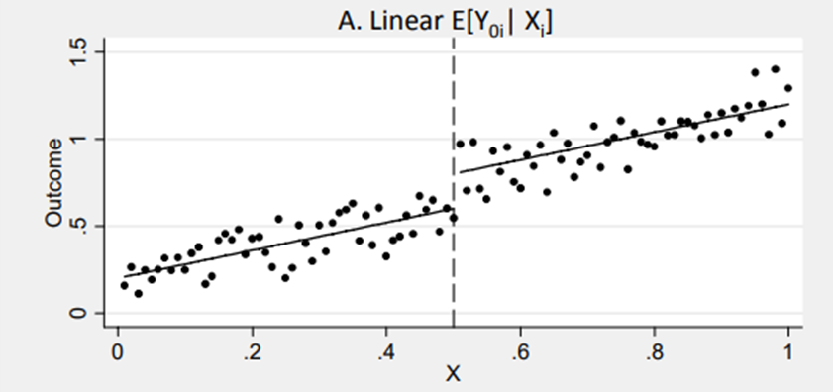

Slide 9
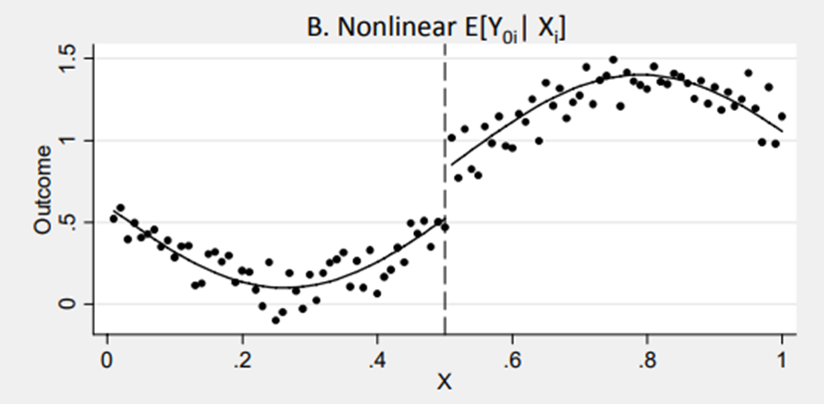

Slide 10
