Slide 1
Threshold
College GPA
Honors Courses
Ave Y
Ave Y
9th Grade Standardized Test

Slide 2
Threshold
College GPA
Honors Courses
Ave Y
Ave Y
9th Grade Standardized Test

Slide 3
Threshold
College GPA
Summer
School
Ave Y
Ave Y
9th Grade Standardized Test

Slide 4
College enrollment
Income

Slide 5
Cutoff
College enrollment
Control group
Treatment group
Income
c

Slide 6
Cutoff
College enrollment
Treatment group
Control group
Treatment effect
Income
c

Slide 7
Individual | Outcome | Score | Treatment | Score_c
1 | 74 | 20 | 1 | 0 | (20-20)
2 | 46 | 10 | 0 | -10 | (10-20)
3 | 96 | 30 | 1 | 10 | (30-20)
4 | 54 | 25 | 1 | 5 | (25-20)
5 | 50 | 22 | 1 | 2 | (22-20)
6 | 30 | 18 | 0 | -2 | (18-20)
7 | 60 | 12 | 0 | -8 | (12-20)
8 | 40 | 27 | 1 | 7 | (27-20)

Slide 8
Cutoff
College enrollment
Treatment group
Control group
Counterfactual
Income
c

Slide 9
Cutoff
Summer School
Program Impact
Math GPA Following Year
Treatment group
Control group
Counterfactual
GPA without summer school
Score on End of Year State Math Exam

Slide 10
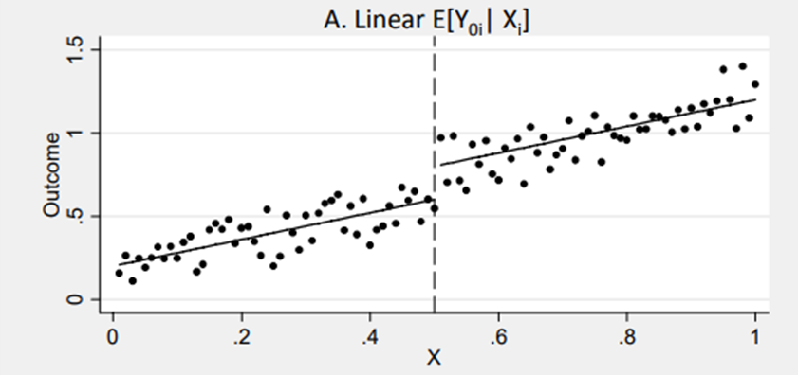

Slide 11
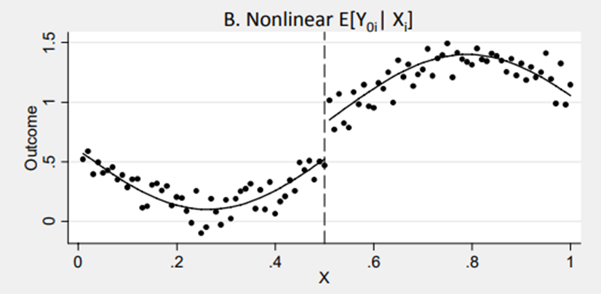

Slide 12
