Slide 2
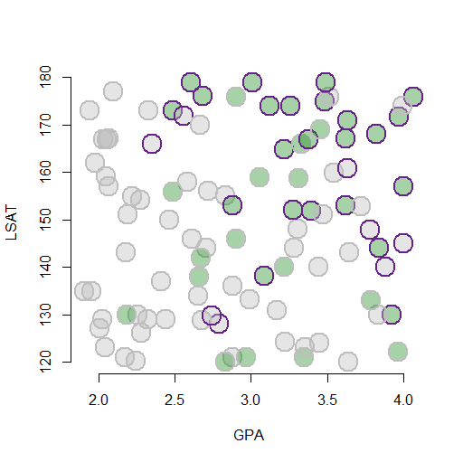
Received admissions coaching
Admitted to Law School
Both

Slide 3
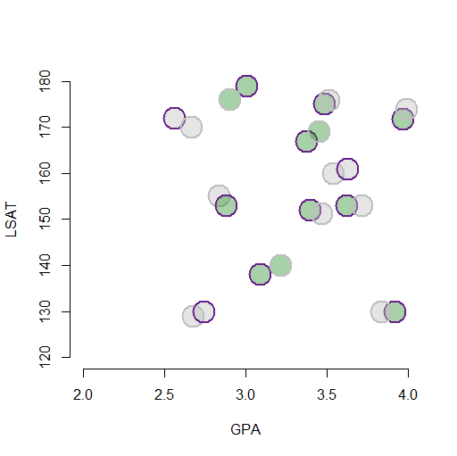
Received Admissions Coaching
Admitted to Law School
Both

Slide 4
Would have succeeded without coaching
Failed despite coaching

Slide 5
Succeeded because
of coaching

Slide 6
Succeeded because
of coaching
Would have succeeded without coaching
Failed despite coaching

Slide 7
College GPA
Commitment to Becoming a Lawyer
LSAT Score
Admissions
spurious correlation
?
?
Admissions Coaching
improved chance of success

Slide 8
Selection Problem
After Randomization
X4
X4
X3
Y
Y
X3
X2
X2
X1
X1
policy variable
policy variable

