Slide 1
Time series

Slide 2
Tobacco consumption
T₀
T₁₀
T₂₀
Time

Slide 3
Policy intervention
Tobacco consumption
T₀
T₁₀
T₂₀
Time

Slide 4
Policy intervention
Tobacco consumption
T₀
T₁₀
T₂₀
Time

Slide 5
Policy intervention
Tobacco consumption
T₀
T₁₀
T₂₀
Time

Slide 6
Policy intervention
Tobacco consumption
T₀
T₁₀
T₂₀
Time

Slide 7
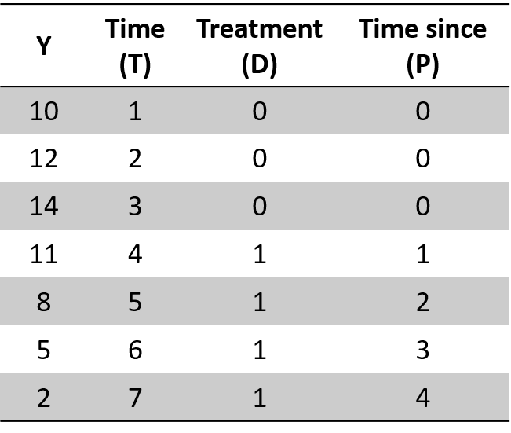
Policy intervention

Slide 8
Policy intervention
b₁= pre-intervention
slope
Tobacco consumption
b₀
T₀
T₁₀
T₂₀
Time

Slide 9
Policy intervention
b₁= pre-intervention
slope
Tobacco consumption
b₂ = immediate effect
b₀
T₀
T₁₀
T₂₀
Time

Slide 10
Policy intervention
b₁= pre-intervention
slope
Tobacco consumption
b₃= difference between pre and post slope
b₀
T₀
T₁₀
T₂₀
Time

Slide 11
Policy intervention
b₁= pre-intervention
slope
Tobacco consumption
b₃= difference between pre and post slope
b₂ = immediate effect
b₀
T₀
T₁₀
T₂₀
Time

Slide 12
Policy intervention
Intervention has not occurred:
Y = b₀ + b₁*T + b₂*0 + b₃*0
Tobacco consumption
Intervention has occurred: Y = b₀ + b₁*T + b₂*D + b₃*P
b₀
T₀
T₁₀
T₂₀
Time

Slide 13
Policy intervention
Tobacco consumption
Counterfactual
Predicted Y
b₀
T₀
T₁₀
T₁₂
T₂₀
Time

Slide 14
Policy intervention
Counterfactual
Tobacco consumption
b₀
Predicted Y
T₁₀
T₁₈
T₀
T₂₀
Time

Slide 15
Policy intervention
Income
b₀
T₀
T₁₀
T₂₀
Time

Slide 16
Policy intervention
10 months later
Income
b₀
T₀
T₁₀
T₂₀
Time

Slide 17
Policy intervention
Wellbeing
b₀
T₀
T₁₀
T₂₀
Time

Slide 18
Policy intervention
Control group
Outcome
Intervention group
T₀
T₁₀
T₂₀
Time

Slide 19
Policy intervention
Policy intervention
Outcome
T₀
T₁₀
T₁₄
T₂₀
Time

