Slide 1
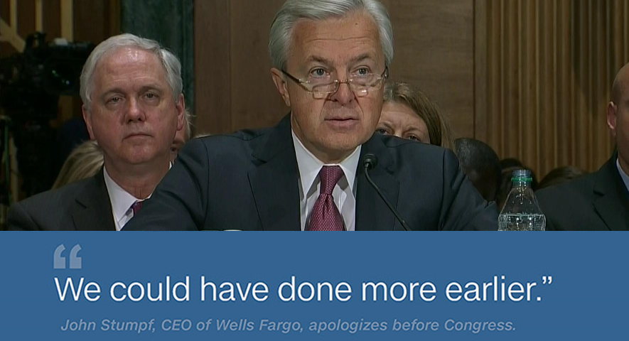
Wells Fargo's September from hell
-CNN
Wells Fargo CEO John Stumpf GRILLED by Congress - House Financial Services Committee Hearing
-Fox News
Elizabeth Warren to Wells Fargo CEO: 'You should be fired‘
-CNN
Learn from his mistakes…
Don’t be like John
Notes:
Ask Audience: Does anyone know the back-story for this image?
Answer: In September 2016, Wells Fargo was fined $185 million by various regulators for opening customer accounts without the customers' permission
*click* bring in news headlines
Wells Fargo CEO John Stumpf was summoned to testify before U.S. Congress to share what he knew and when he knew it regarding this fraudulent activity.
How could a CEO be so unaware that 5,300 Wells Fargo employees were opening accounts without customer’s permission?
Low level managers would enforce unattainable sales quotas while simultaneously hounding, berating, demeaning and threatening employees to meet the quotas.
Customer complaints related to this fraudulent activity were clearly not being report up the chain of command.
*click* bring in floating text, “Learn from his mistakes”
Team-14 has developed a product to help C-level executives in the Financial Sector review unfiltered customer complaint data and reconcile that data against internal reporting metrics to reveal potential discrepancies.
*click* bring in NO symbol

Slide 2
C-level Executives
Mid-level Managers
Low-level Managers
Customers
Broken model:
Complaint data stopped at lower levels of management
C-level Executives “flying blind”
COMPLAINTS IN NORMAL RANGE
STOP
COMPLAINTS
Notes:
The model for analyzing customer complaints at Wells Fargo was clearly broken.
Complaint data was not making it to senior decision makers.
C-level Executives are left with the impression that complaint metrics are in normal range.

Slide 3
C-level Executives
Mid-level Managers
Low-level Managers
Customers
TEAM 14’s value proposition:
Descriptive Analytics
Predictive Analytics
Competitive Intelligence
Enhanced datasets for identifying potential Predatory Lending Practices
“Unfiltered Consumer Complaint analytics customized for your Company”
COMPLAINTS
Notes:
Team 14 can short-circuit the communication process and provide unfiltered complaint data directly to C-level Executives
We can provide:
Descriptive analytics to demonstrate how a company is performing
Predictive analytics to forecast future performance
Competitive Intelligence; how to you compare to your peers?
Enhanced datasets to identify potential Predatory Lending Practices.

